Slide 1
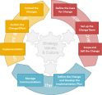
Define the Change
4. Define the Change and Develop the Implementation Plan
Engage with Staff
Agree the baseline ‘As Is’
Define the detailed ‘To Be’
Consider the Impact on People, Processes, Infrastructure, Structure and Culture
Plan the Transition and identify the Actions and Support required
Prepare a detailed Change Plan with Timescales and Milestones (Toolkit 5)
Define the Change
and Develop the
Implementation Plan

