Slide 1
R&IS - HESA Training
Andrea Donnelly, Thomas Crompton and Tom Sharp

Slide 2
What is HESA?
HESA (Higher Education Statistics Agency) is responsible for collecting, analysing, publishing HE data
HE providers have a statutory requirement to report data to HE funding and regulatory bodies
Research income - should conform to the conventions of the Frascati definition of research
Notes:
HESA collect, assure and disseminate HE data – includes research income.
It is Important that this is correct as is part of the University’s statutory returns – the data is used widely in terms of government reporting
This is reported upon annually through finance. However, the data comes from Ideate initially and is checked by research finance upon award.
We can only include in our return what is classified as ‘research’

Slide 3
Frascati definition of research
https://warwick.ac.uk/services/ris/systems/dataquality/frascati
Research and experimental development (R&D) comprise creative work undertaken on a systematic basis in order to increase the stock of knowledge, including knowledge of man, culture and society, and the use of this stock of knowledge to devise new applications.
Includes: Basic research, Applied research, Experimental development
Should have ‘an element of novelty and the resolution of scientific and/or technological uncertainty’
Does not include: routine testing and analysis of materials, components, products, processes, etc; feasibility studies; routine software development; general purpose data collection
Most reporting based on ‘Research’ only (as recorded under ‘Activity Type’ in Ideate). If projects are wrongly tagged, there’s a risk they’ll be missed or wrongly attributed in management information reports. If in doubt, please speak to the Research Operations team.
Notes:
Frascati definition – more information and links to guidance on the R&IS web pages
The term R&D covers 3 activities these are basic Research, applied research and experimental development
Exclusions - Activities that should normally be excluded include: scientific and technical information services; testing and standardisation; feasibility studies; specialised health care; policy-related studies; programmatic evaluations; purely R&D financing activities; and indirect supporting activities.
This definition is important for our HESA return and also for much of the reporting we do – the research dashboards are based on Research only and key applications and awards reports and these are presented at research committee.
Email evidence is required by the PI to show how the project sits in the Frascati definition.
If in doubt, speak to your RSM or the Research Systems team for guidance.

Slide 4
Sources of Income
Source of Income (as defined by HESA) | HESA Category (category options in Ideate)
Research Councils (incl Royal Society, British Academy) | Research Councils 9E
UK-based charities (open competitive process/peer review process) | UK Charities Competitive 9X
UK-based charities (other) | UK Charities Other
UK central government bodies/local, health and hospital authorities | UK Government Bodies 9D
UK industry, commerce and public corporations | UK Industry and Commerce 9C
UK Other sources | UK Other 9H
EU government bodies | EU Government 9T
European Union Funding (ie ERC, EU, EC) | Contracts EC 9I
EU-based charities (open competitive process) | EU Charities Competitive 92
EU industry, commerce and public corporations | EU Industry and Commerce 9B
EU (excluding UK) other | EU Other 93
Non-EU-based charities (open competitive process) | Overseas Charities Competitive 9Y
Non-EU industry, commerce and public corporations | Overseas Commercial 9G
Non-EU other | Overseas Other 94

Slide 5
Competitive Charities
The correct recording of Competitive Charities is key:
  The University receives a top up from the Government for eligible charity research income via QR funding
HESA definition
There should be evidence that a particular income stream or grant was available to more than one HEP through direct competition. This should be within a process where no credible candidate was excluded, and the income awarded to the HEP which demonstrated the highest quality research proposal according to external peer review.
To be eligible the funding must be from a registered charity, delivered through an openly competitive process and subject to external peer review in the award process.
Notes:
For audit purposes, the classification of a competitive charity must be supported by evidence of open competition and peer review (usually from a website – review panel of external experts etc.). The Research Systems team will upload this to the Ideate funder record, this also need uploading to the documentation page on the ideate record with the proposal.
In order to claim QR we need prove, Evidence needs uploading for each application you do.
If you struggle come and speak to us to decide it together.
Every time we receive a request for this we will contact you for further detail if none have been provided ????

Slide 6
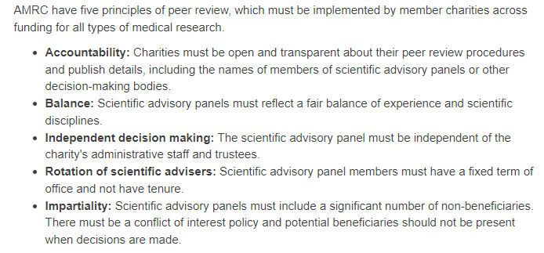
Evidence of Competitive Processes
Proof of a competitive process can often be found on funders’ websites. The example below is from Oracle Cancer Trust, which is governed by the AMRC;
Notes:
If evidence is needed, the funders’ website is often useful.

Slide 7
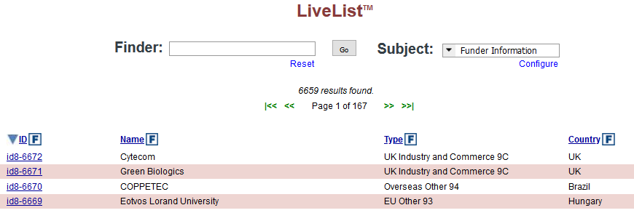
Funder Records Are Available For Officers
Notes:
This is the Funder interface of Ideate. All Research & Impact Services staff have access to this section. We currently have over 8.5k funders and counting,

Slide 8
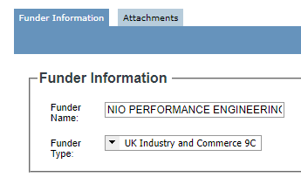

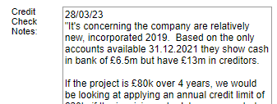
Funder Information on Ideate
HESA categories are ‘hard-coded’ to each funder.
Cannot be changed at proposal level.
The date of the latest credit check is recorded
to identify if a new report is needed.
The Notes field is used to record finance
guidance from Credit Control, changes in
HESA categorisation, and competitive process
information
Notes:
HESA categories can be changed at source by Research Ops, but once a funder is selected for a proposal the HESA category cannot be changed without editing the original funder record.

Slide 9
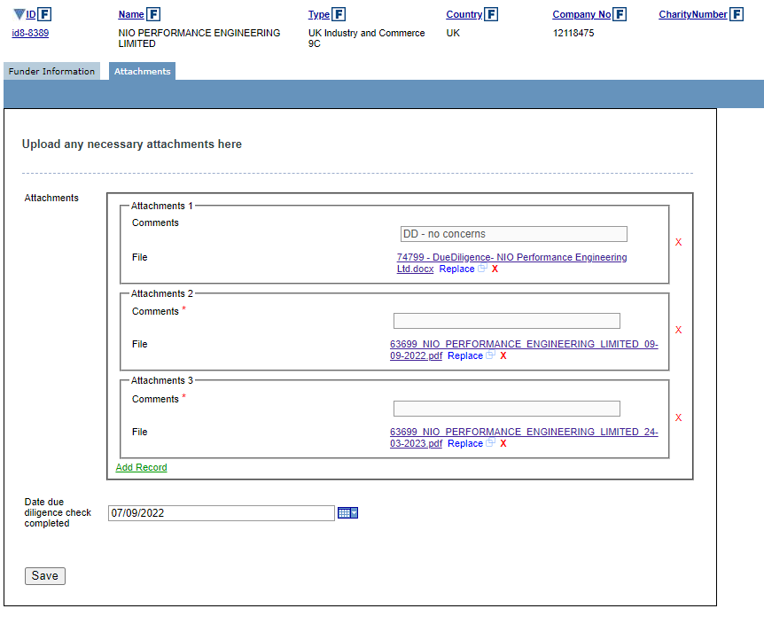
Funder Attachments
Officers can view and upload documents relating to
due diligence, credit checks, and evidence of
competitive processes.
Any changes to HESA category will be recorded
here.
Notes:
This is where staff can view and upload documents, particularly for evidence of competitive processes for charities, credit checks and due diligence work. It’s important to check this part of Ideate as DD and credit checks might need to be redone if they are over a year old or the value of the new project is far higher than the original checks.

Slide 10
Frequently seen issues
Competitive Charities – if you submit a Competitive Charities funder request, you may be asked for evidence
Industry – UK / EU / Overseas - income received from a multinational company should be coded depending on the location of the office making the award, e.g. a multinational with a French subsidiary making the award would be coded as EU.
EU / Overseas – Switzerland, Norway and Liechtenstein are Overseas.
Research Ops often change funder requests that have EU countries but have an ‘Overseas’ HESA designation in the web form. EU and Overseas funding data is frequently requested, and the HESA category is key to this.
Missing company numbers and charity numbers – these are used to identify organisations and help Credit Control obtain credit checks.
Notes:
The frequently seen issues regarding Funders are things like;
Competitive Charities – Is this really a competitive process? The Ops team ask for evidence when adding the funder to Ideate, so it’s good if that can be provided at source.
Industry Funding – the HESA category will differ depending on where funding is coming from. For example, Lubrizol’s HQ is in the US, but if the UK arm of the company is funding the research, you’d have to select the UK funder, which would make the HESA category of the project UK Industry & Commerce. If you get this wrong, Research Finance will come after you!
EU & Overseas categorisation – when requesting a funder, make sure the HESA category suits the location. Switzerland, Norway and Liechtenstein are non-EU, so would go down as Overseas. I’m not sure we have funders from Liechtenstein, but you get the idea.

Slide 11
Collaborators / Sub-contractors / Partners
It is the nature of the relationship that determines whether the research income can be counted:
Collaborator – the University is in collaboration with a party at application and assuming a share of academic, legal and financial responsibility – this can NOT be included in research income in the University’s accounts. e.g. collaboration on an UKRI grant.
Sub-Contactor - if a party is acting in the capacity of a subcontractor, where the University would hold the balance of control, risk and responsibility – this CAN be included in research income in the University’s accounts. e.g. buying in a survey/service on a project.
Partner – the University is working in partnership with a party who supply some input to the research, often in terms of an in-kind contribution e.g. industrial company providing some equipment for use – example FLF
Notes:
Collaborators / Sub-contractors / Partners

Slide 12
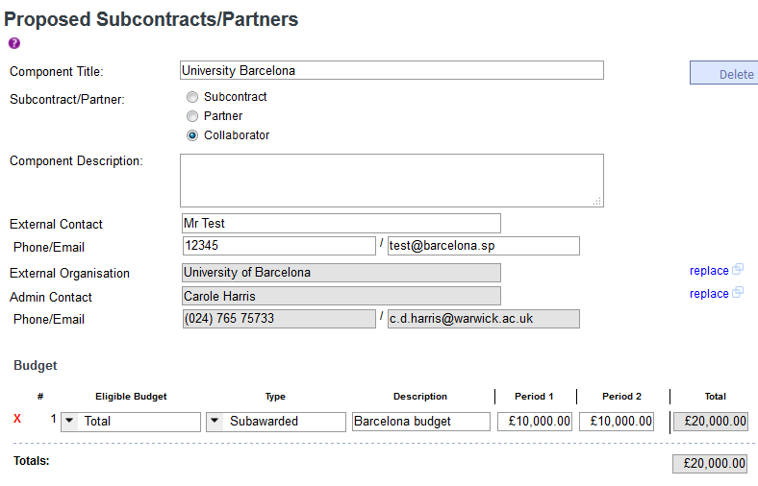
Collaborators / Sub-contractors / Partners
The nature of the relationship affects whether the research income can be counted, which affects how we record the budget in Ideate:
Sub-Contractors – Ideate DOES include sub-contractors’ budget in fEC / Price, which is pulled through automatically to the costing.
Don’t use dots or dashes in mandatory fields for contact details – Research Finance often refer to these for contacts.
Important to record any external parties and the nature of the relationship for HESA and other reporting (e.g. international relationships, industrial partnerships)
Notes:
The Collaborators / Sub-contractors / Partners data is added in the External Components section of Ideate.
It’s important to record any external partners and their relationships for HESA reporting and MI reporting.
Research Ops use this section of Ideate to report on the University’s work with overseas organisations, industrial partnerships, ODA data, FoI requests, and checking that we are not working with Sanctioned Countries. The more data recorded here, the better.

Slide 13
R&IS – HESA Training
Thanks for listening. Any questions?

