Slide 1
Riley Court Building User Guide

Slide 2
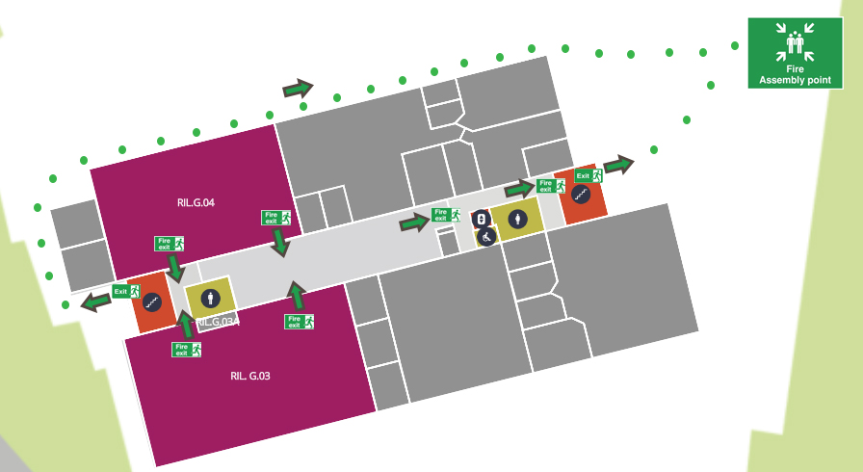
Fire Alarm and fire exits
The weekly fire alarm is tested each Wednesday between 08:00 – 10:00.
The final exits are marked on the plan below.

Slide 3
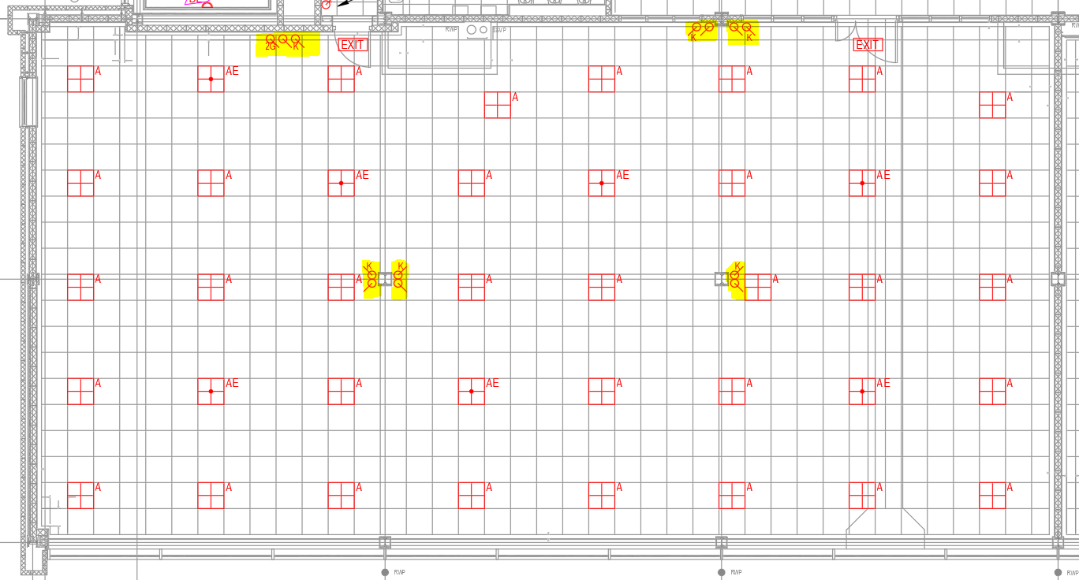
Riley Court Lighting – RIL.G.03
Lighting within this room is manually switched on and off. Please switch off lighting upon leaving the room. Switch locations are located as indicated in yellow below.

Slide 4
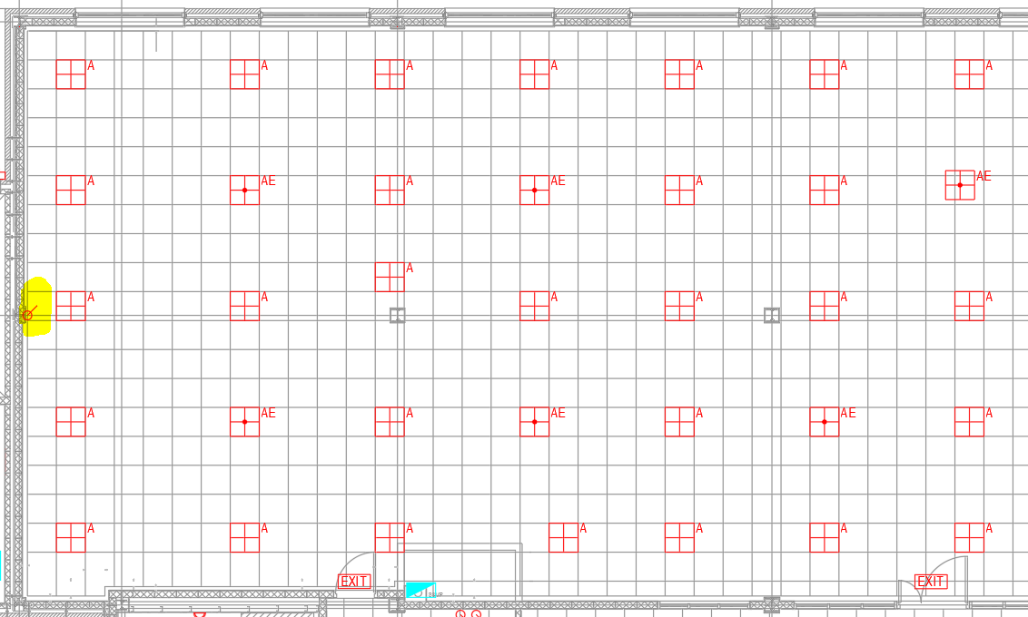

Riley Court Lighting – RIL.G.04
Lighting within this room is switched Auto on and Auto off. Lighting can be adjusted by the scene setting switch as located adjacent the lectern as indicated in yellow below.
Scene Setting controls as follows

Slide 5
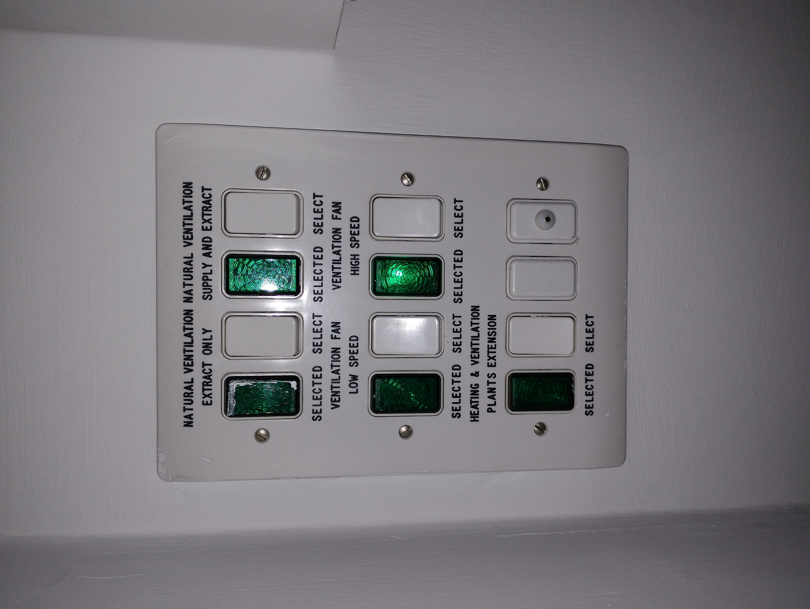
Riley Court Ventilation
Operational instructions
If the CO₂ monitor activates / sounds:
Open the windows
Press and hold the right-hand white “Ventilation Fan High Speed” button down for 3 seconds.
A green light will light up on the left-hand side to indicate it is active.
To turn the system off; Press and hold the same right-hand white “Ventilation Fan High Speed” button down for 3 seconds until green light turns off.

Slide 6
Toilets
Accessible, Female and Male toilets are provided on the ground floor. See plan below.
There are additional female toilet provision available on the first floor, via the main entrance stairs.

Slide 7
Cleaning
Cleaning of RIL.G.03 and RIL.G.04, common ground floor areas and toilets will take place each day during Term time.
The cleaning team will turn on the lights in RIL.G.03 each morning.

Slide 8
Community Safety
There is no central reception area at Riley Court.
In the event of an emergency please contact the Community Safety Team on:
•(General) - 024 7652 2083
•(Emergency) - 024 7652 2222
Building reference: 01.296_Riley Court
The Community Safety team will undertake a daily evening visit as part of their rounds to ensure the building is secure and lights are turned off.
All keys are currently located within the Zone 2 Hub, which Community Safety have access to.

Slide 9
Term time access
The building will be on open access:
Monday, Tuesday, Thursday 08:30 – 19:30
Wednesday 08:30 – 13:30
Friday 08:30 – 18:30
At all other times, including weekends, access will be restricted to approved individuals only.

