Slide 1


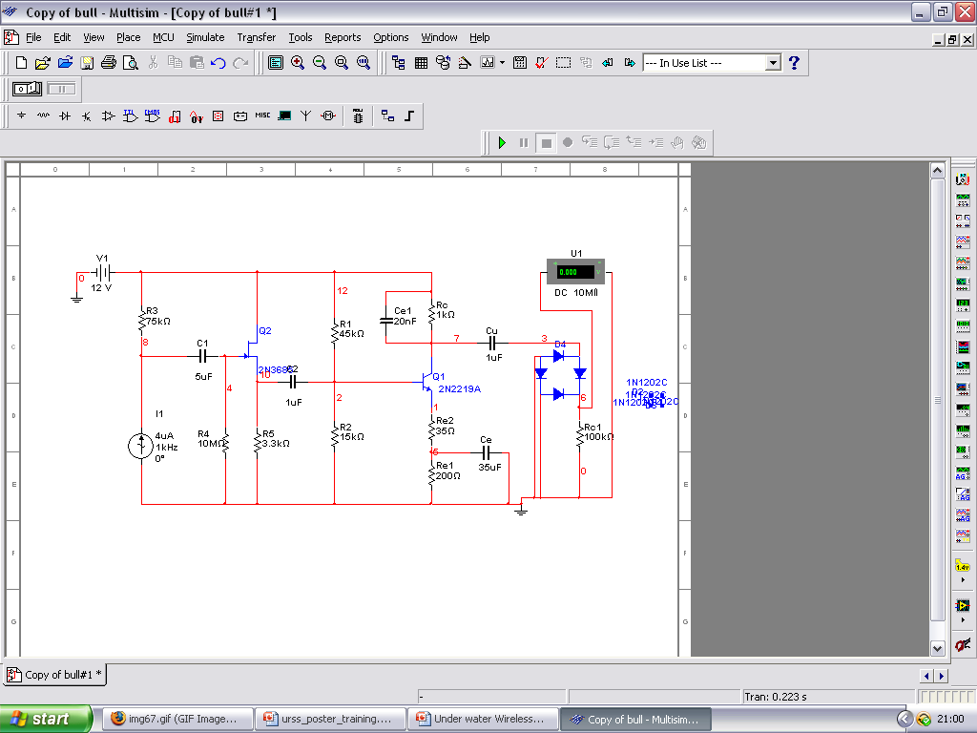
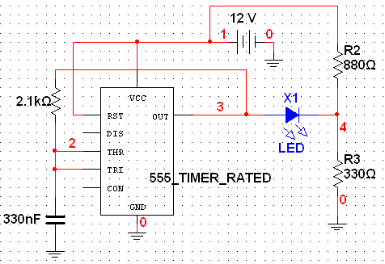
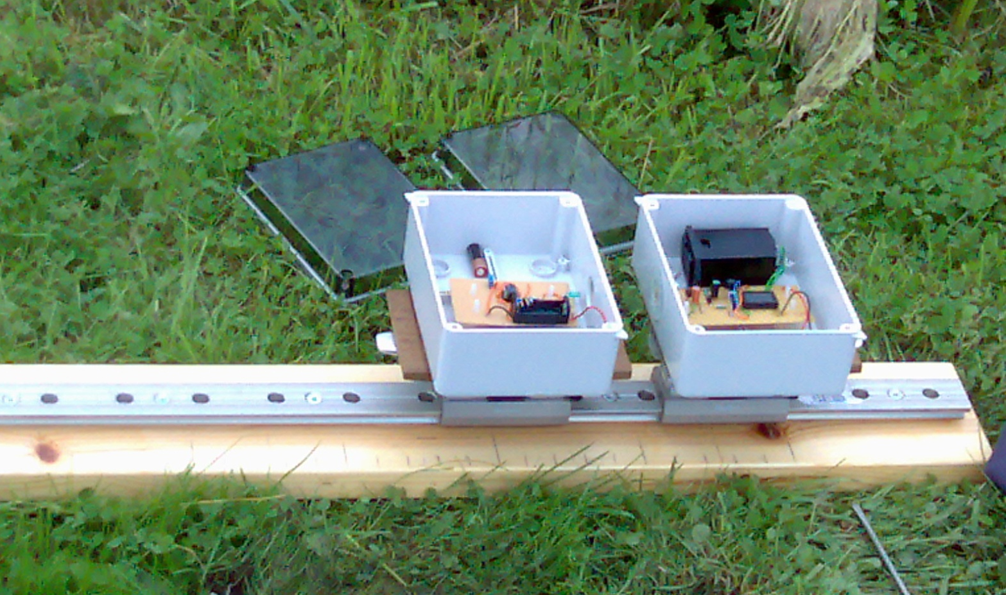
MOWL – Marine Optical Wireless Link
Kavninder Singh (Third year Electronic Engineering)
Supervisor – Dr Roger Green
Introduction-
The project was part of the preliminary study of a bigger project undertaken by engineering department, and my aim was to examine the behaviour of electromagnetic signal transmission between transmitter and receiver in sea water. The preliminary study showed that the least absorbed electromagnetic frequency by water is that of green light (532nm wavelength). The signal properties will be observed by varying the distance between the transmitter and receiver and notice the change in the voltage induced in the receiver circuit.
Results-
The measurements were taken for the output voltage while varying the distance between transmitter and receiver. The output voltage slowly decreased with increase in distance, and the signal completely died away after 300mm. As shown on the graph, the power transmitted is logarithmically related to the distance. The trend from graph can be used to predict strength of signal received by photodiode, and hence data transfer rate at a given displacement.
The receiver circuit consisted of a photodiode followed by two stage signal amplification in order to get a notable output voltage. The circuit was designed with a very narrow bandwidth with the centre at 1 kHz, in order to avoid background noise and other unwanted wavelengths to be amplified. Since the output signal is square wave, a full wave rectifier is used to convert the signal to DC which can be read from the digital voltmeter. To allow portability, the circuits were powered by 12V batteries.
After initial testing of the circuit on bread board, the components were soldered onto circuit board and mounted inside the water proof boxes (as shown in picture below). The waterproof boxes were mounted onto a T rail which enabled the linear movement of the transmitter and receiver in order to take measurements. The measurements were taken in a canal which gives a close approximation for sea water in terms of impurities.
Design-
Before constructing the apparatus in order to take measurements, I had to design the transmitter and receiver circuits to work with 532nm light beam modulated at 1 kHz.
The transmitter circuit was designed using the software package Multisim. The circuit consisted of CMOS timer and the correct combination of resistors and capacitors (as shown in figure below) to drive the green LED used as a signal transmitter for square wave. The choice of square wave over sine wave is justified by the fact that square wave has higher RMS value which means stronger signal, and hence will travel further.
Conclusion-
The logarithmic relationship between voltage output and displacement can be used to predict data transfer rate. The data will also help the project team to calculate the attenuation coefficient which can be used for constructing laser transmitter for long distance underwater communication.
Acknowledgement - Many thanks to URSS for providing the funding for project and I also appreciate all the support from my supervisor Dr Roger Green.
Experience – URSS provided me the platform to gain in depth understanding of the way wireless communication operates, how to design such circuits by giving me an opportunity to get involved in a professional research project. This project will prove invaluable in making a decision for PhD after my final year, and in long term also provided me knowledge and skills involved in undertaking projects.

