Slide 1
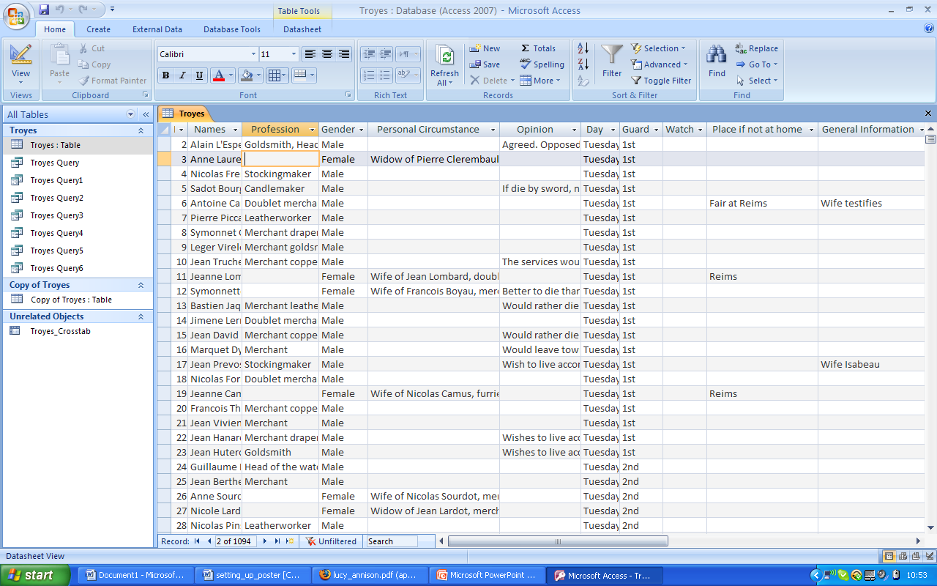
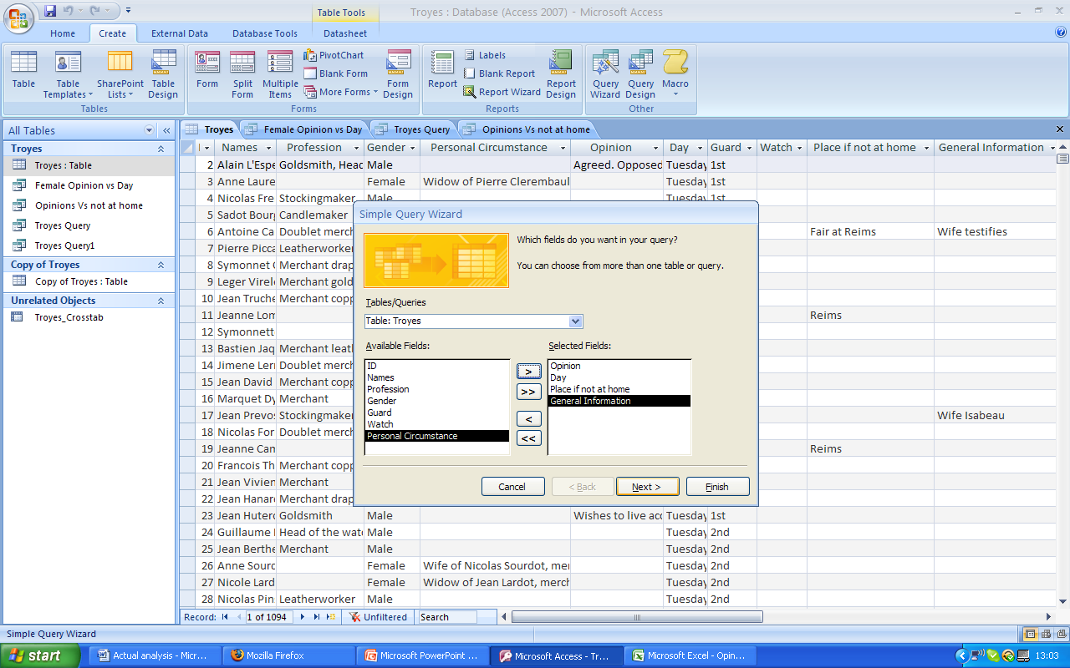
Database of a unique public opinion poll in sixteenth-century France
Student: Sheena Amin sheena.amin@warwick.ac.uk
Supervisor: Penny Roberts penny.roberts@warwick.ac.uk
AIM OF THE RESEARCH
The purpose of the project was to analyse the findings of a survey which took place over five days in April 1563 in the French town of Troyes. The goal of the census was to determine whether the people of Troyes wished to uphold the existing religion of Catholicism or whether they wished to permit new Protestant services at a time when France was engulfed in intense religious wars. The town was divided into four quarters of which the records for only one of the quarter remains, Comporté, thus any assumptions and conclusions that I made will be for Comporté only. Heads for the quarter were designated to visit each household, recording their name, response and signature.
METHODOLOGY
A total of 1087 records exist for the quarter of Comporté. The most practical way to view and analyse the data was to sort it in the form of a database. Headings were assigned to appropriate categories which were made as strict and relevant as possible to ensure efficient assessment of the information. When all the data had been entered into the database, I began to produce simple queries which allowed me to customise information relevant to my search. After I collated all the statistics and facts necessary to evaluate the data and make a credible conclusion, I began to produce graphs making the data more digestible than in bare figures.
FINDINGS
A striking discovery of this survey is what the opinions divulge about the type of society that lived in the quarter of Comporté. No direct denunciations of particular members of the other religious community were recorded, revealing some degree of tolerance between the two
opposed faiths. Even when aggressive declarations were expressed such as ‘if her five children became Huguenots she would break all their necks’ and ‘they would prefer to be disembowelled’, those who made them derived from a wide stratum of society, leaving no real connection between social category and religious opinion. Another significant finding that I made concerns gender. Although men were the dominant gender in the survey, 2/5s of women who were involved in the census expressed an opinion about the services. This not only highlights their importance within the household, but provides us with a rare opportunity to hear their voices when few documents from the period record female opinion. Moreover, widows who made a declaration comprised just fewer than 25 per cent of all the women who made a comment, emphasising their role as heads of household.
CONCLUSION
The survey discloses more about Catholic attitudes toward their fellow Huguenot community than vice versa. One would have presumed it to have been the other way round as the main objective of the consensus was to determine whether the community in Troyes wished to hold Protestant services or not. The study is made all the more interesting as we have rare first hand accounts expressing peoples' views and attitudes concerning a highly controversial topic during a very volatile period in French history. Thus despite hostile declarations being made, the poll reveals some coexistence of catholic and protestant communities.
ACKNOWLEDGEMENTS
I would like to express my gratitude to Penny Roberts for giving me this opportunity to further my research skills which has proved invaluable. I would also like to thank her for helping me on this project and for providing me with essential materials without which I would not have been able to commence my research.
Step 1 – Inserting all data in the database according to the appropriate category
Step 2 & 3 –
Producing simple queries to collate relevant information for specialised searches
Step 4 –
Producing graphs from the query reports allowing me to clearly analyse the data

