Slide 1


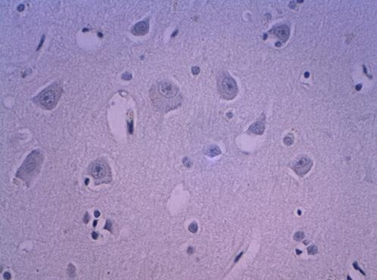
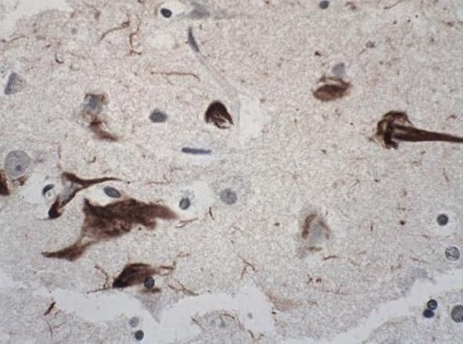
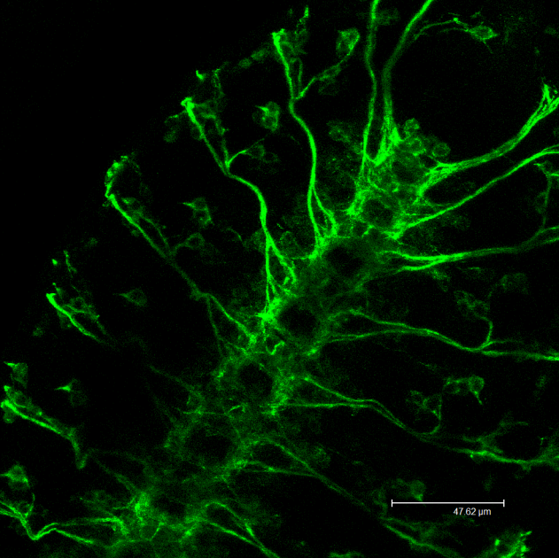
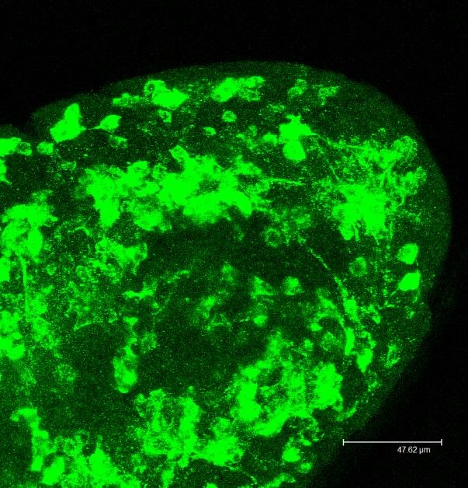
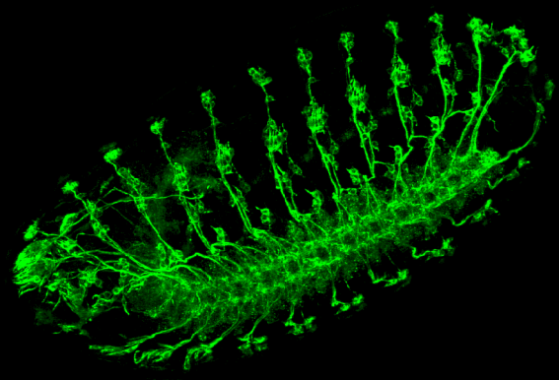
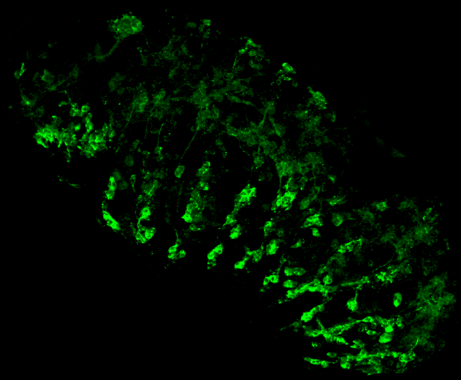
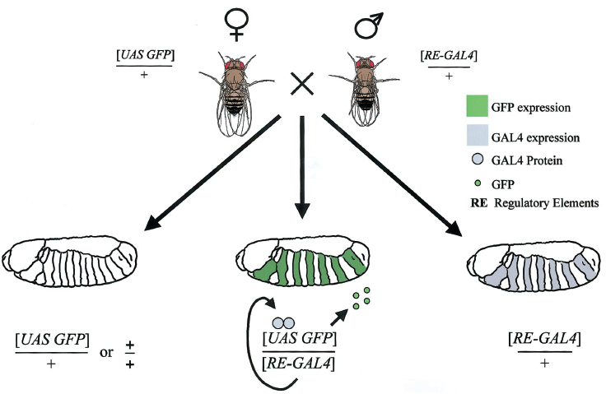
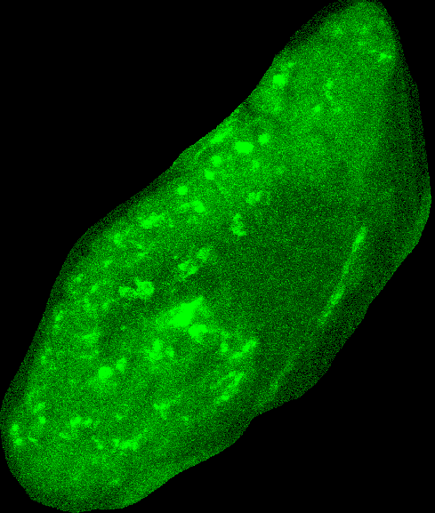
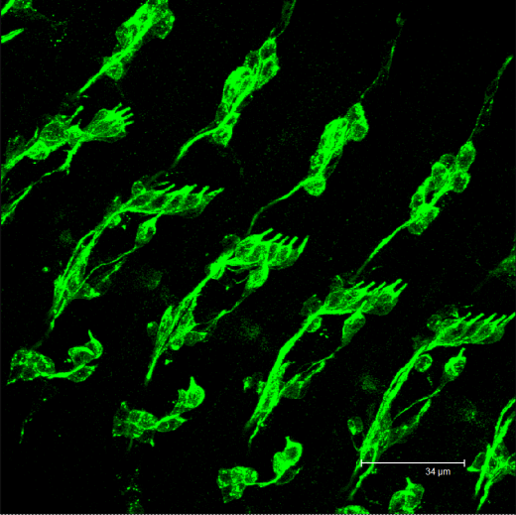
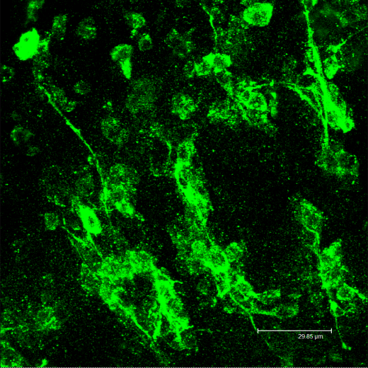
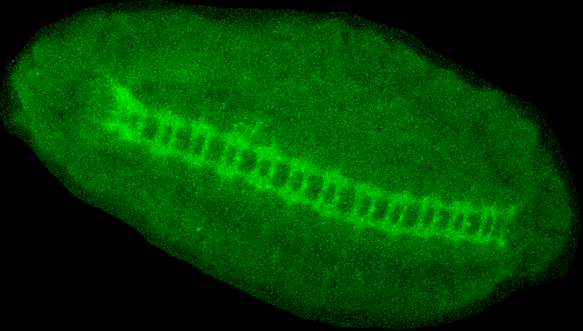
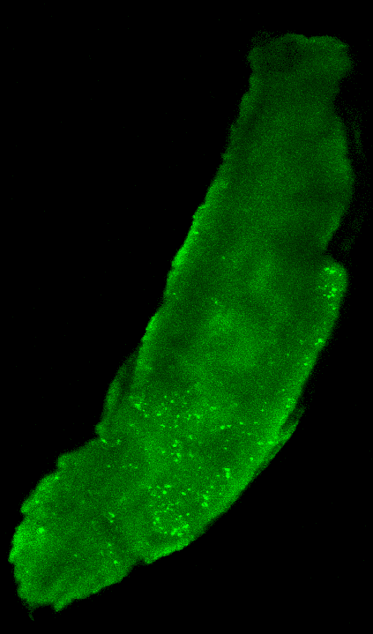
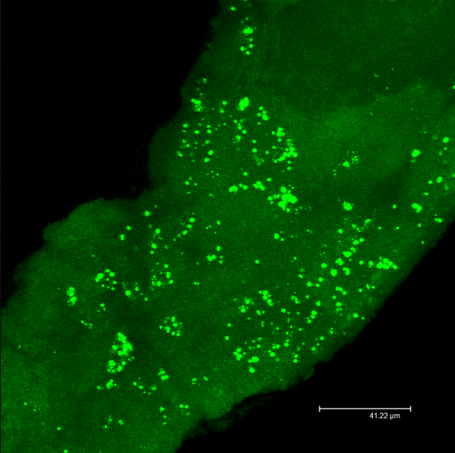
The role of the BRSK gene in neural development
Marija Navickaite and Kevin Moffat, Biological Sciences Department, University of Warwick, Coventry CV4 7AL United Kingdom
M.Navickaite@warwick.ac.uk
1.
Alzheimer’s disease
2.
Neurofibrillary tangles and protein Tau
Alzheimer (AD) disease is a chronic neurodegenerative disease that is characterized clinically by a progressive decline of cognitive function, leading to dementia.
One of the major neuropathological hallmarks of AD are intracellular neurofibrillary tangles (NFTs).
A kinase transfers phosphate groups from high energy donor donor molecules, such as ATP, to specific substrates. This process is referred to as phosphorylation.
Kinases that target tau are important candidates for intervention in AD
Brain specific kinases (BRSKs) which hyperphosphorylate Tau causes its accumulation and lead to neurodegeneration
To learn more about the normal role of the BRSK kinases we have initiated a study of a fly homologue of the human
BRSK. This will allow future interpretations of the use of model animals to study AD.
Neurofibrillary tangles of Non-damaged brain
Affected neurofibrillary tangles
Causes of neurofibrillary tangles
NFTs are composed of Tau protein, which plays an important role in neuron structure.
Overactive enzymes (kinases) causes accumulation of Tau and formation of NFT.
It is hoped that investigations into this pathway will lead to the development of drugs that will reduce or even prevent the accumulation of pathalogical Tau in AD.
3.
UAS- GAL4 System
4.
Removal of BRSK affects the nervous system
This system allows selective activation of any cloned gene. GAL4 is a yeast transcription factor which is incorporated into Drosophila genome to drive the GAL4 expression. To activate the target gene, flies carrying the target (UAS-GeneX) are crossed to flies expressing GAL4.
RNAi was used to reduce BRSK gene expression from the fly. In short, RNAi cleaves the mRNA of the gene of interest leading to inactivation.
Pictures below show defects in both CNS and PNS development in late stage embryos when BRSK gene expression is reduced.
Wild type CNS
Defective CNS
Wild type CNS and PNS
Defective CNS and PNS
Wild type CNS
Defective CNS
Wild type PNS neurons
Defective PNS neurons
5.
BRSK expression
6.
Conclusions
BRSK gene is expressed in the nervous system. To see the pattern of BRSK expression, we used an in-situ hybridization technique. A fluorescent probe binds to the mRNA of the gene in the whole embryo so it is possible to see the places of the expression. Early expression has been hard to detect because this gene is expressed in the late stage of development.
The fly BRSK homologue is expressed in the nervous system
Reduction of BRSK expression in embryos results in defects in neural development.
BRSK gene homologues are also found in human brains.
While the fly is a good model to investigate AD this work shows that if BRSK is to be a therapeutic target then care must taken to ensure potential neurodevelopmental defects are not a side-effect
Brain
Brain
References:
GAL4 System in Drosophila:A Fly Geneticist’s Swiss Army Knife
(Joseph B. Duffy 2002)
Targeted gene expression as a means of altering cell fates and generating
dominant phenotypes (Andrea H. Brand and Norbert Perrimon 1993)
http://www.nature.com/nrd/journal/v6/n6/images/nrd2111-f1.jpg
http://www.sciencedaily.com/releases/2007/09/070905224343.htm
Nerve cord
Nerve cord
Pictures shows the mRNA expression pattern of BRSK gene in early Drosophila larva .

