Slide 1
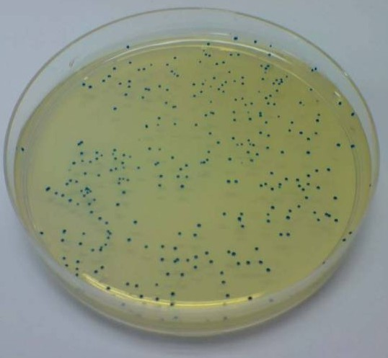
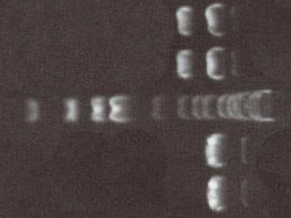
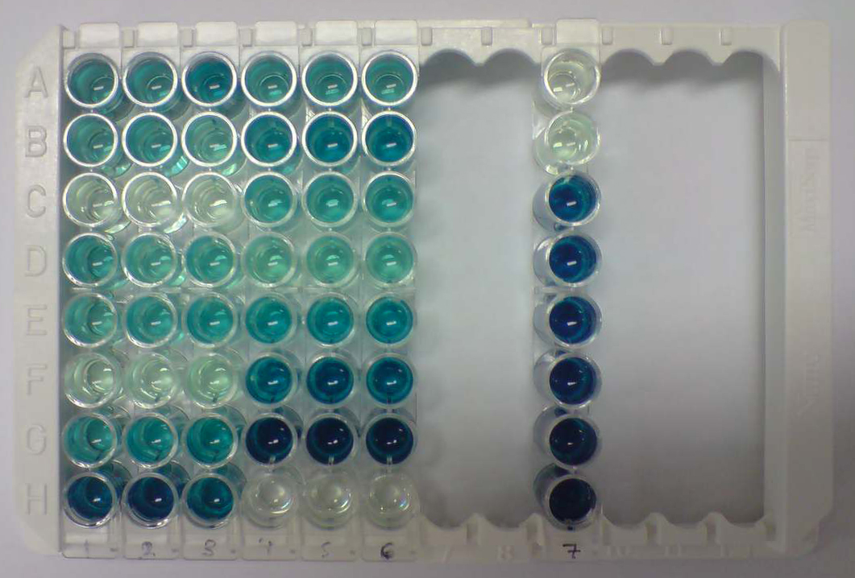

Coupled translation in the mouse genome
By Carl-Fredrik Hartelius with Dr. Phillip Gould and Prof. Andrew Easton
C-F.Hartelius@warwick.ac.uk
Introduction
Translation is the process by which ribosomes read mRNA and use it in triple nucleotides, or codons, to produce proteins. Coupled translation is where the ribosome, upon encountering a stop codon, shuffles back on the mRNA to a second start codon to initiate the translation of a second open reading frame (ORF), overlapping with the first. This process has been observed in the M2 gene of respiratory syncytial virus, but this project explored such processes in the mouse genome.
Fig 1: coupled translation
5’ ATGCAGTTACG...GTTGGCCGCATGTCGGCGGTAGCT...CGGTAG 3’
ORF 1
5’ ATGCAGTTACG...GTTGGCCGCATGTCGGCGGTAGCT...CGGTAG 3’
ORF 2
Fig 2: constructs
Step 1: creating constructs
The mouse genes, UBTF, RSH, and CASQ2, were ordered and primers for them were designed, in which the first stop codon was mutated. By using polymerase chain reactions (PCR), one copy with the mutation in the first stop codon, and a normal copy were produced. Restriction enzymes acted on the genes to create ‘sticky ends’ which could be ligated to a CAT gene, and that new structure was simultaneously ligated into PBS, a plasmid vector.
Step 2: transformations and transfections
The different plasmids were transformed into E. coli, which was plated out on ampicillin, IPTG and X-galactose (AIX) agar plates. Because PBS contains an ampicillin resistance gene, only transformed bacteria could grow, and since IPTG induced the lac operon causing cells to take up X-galactose, which is blue. This meant that only colonies which were not blue would be correct because if transformation had occurred properly, the lac operon would be disrupted. Therefore white colonies were chosen and grown overnight during which the E. coli would recognise the CAT gene, as it comes from bacteria originally, and replicate the plasmids as bacteria divided. After the plasmids were isolated from the bacteria, some were deconstructed and sequenced to ensure accuracy. The plasmids were then transfected, injected into tissue cultures via a virus, alongside lacZ (coding for β-galactosidease) as a positive control.
Fig 3: AIX plate
Fig 4: gel electrophoresis
Fig 5: CAT-ELISA
Step 3: assaying protein expression
After allowing the tissues to express proteins, which were then isolated, ONPG was added to a part of each sample, turning yellow in the presence of β-galactosidease. The next step was an enzyme linked immunoabsorbent assay (ELISA), during which samples with CAT protein stick to well due to CAT antibodies, which then bind free CAT antibodies bound with another protein, DIG, which was in turn covered with a third antibody carrying HRP. HRP is an enzyme which changes ABTS, turning it dark green, which was also assayed by photospectrometry.
Data analysis and conclusions
Normalized values were created using a combination of β-galactosidease and ELISA readings, used to compare the expression of CAT in the true gene copy and the mutated copy (containing a disrupted stop codon) in order to determine if coupled translation had occurred. It was predicted that the expression of CAT should be much lower in the stop mutants since that stop codon is, in theory, essential to the ribosomal shuffling which allows for the expression of ORF 2. In practice we found that stop mutations in RSH can vastly increased ORF 2 expression levels, and only minor levels of coupled translation was observed in UBTF. The CASQ2 construct was shown to be ultimately incorrect, and it would seem that the nature of the protein makes successful constructs kill the bacteria.
Fig 6: change in ORF 2 expression

