Slide 1
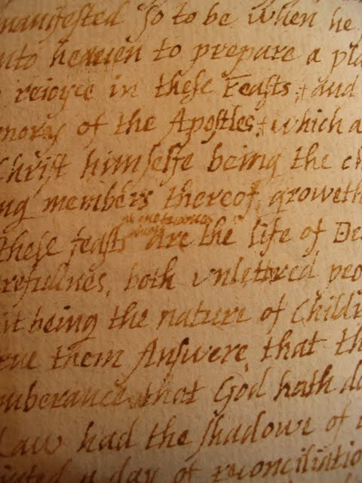


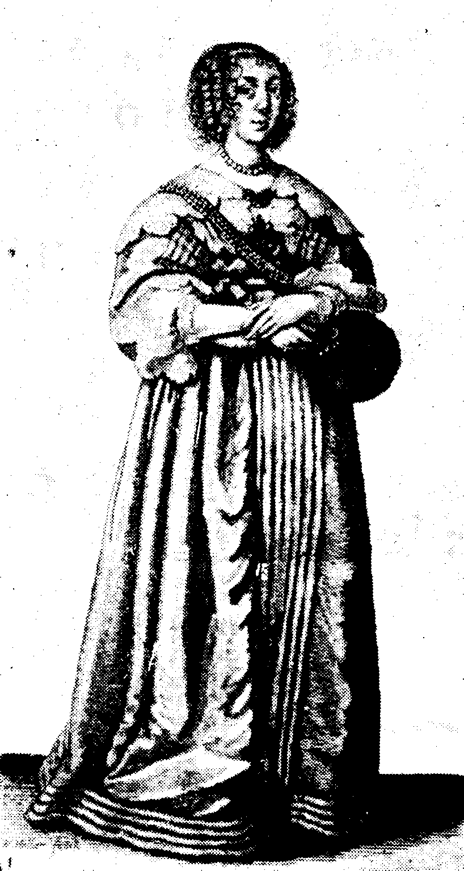
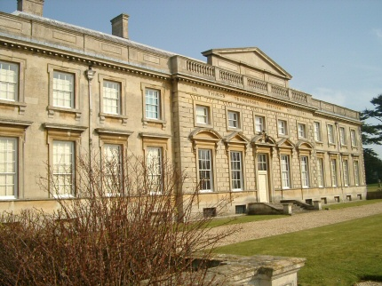
Constructing Elizabeth Isham
Launching the first autobiography in English- Elizabeth Isham's 'Remembrances', 1638
Research Student: Celeste Mottahedin-Fardo
Project Supervisor: Elizabeth Clarke
Who was Elizabeth Isham?
Born in 1609, Isham was the eldest daughter and household manager in a prominent and literary Northamptonshire family.
In 1638, she started working on a form of literature which had never been attempted before – an autobiography. The document, which exceeds 50,000 words, is a chronological narrative which not only gives details of the day-to-day activities of Lamport Hall (pictured below), but also an insight into the inner workings of the mind of a 17th century lady.
How has she been constructed?
The survival of the manuscript which, among other papers, has only recently been discovered, is of great importance as it is very rare that a document of the period should survive, especially one with such unusual content as this.
The manuscript was typed with the Web edition being launched in 2008. Soon after, the University of Toronto commissioned to have an edition of the autobiography which would be suitable for undergraduate students.
Working closely with Elizabeth Clarke who id director of the project, my work for the URSS scheme has involved modernising Isham’s language and providing footnotes and annotations to the text. Examples of the editing I have done include investigating Biblical references and modernising words which have become obsolete or would be difficult to understand by an undergraduate readership.
Fig. 1 (below) shows the original manuscript and fig. 2 shows how it has now been revised, refined and edited to make it suitable for publication.
Fig. 1
Commit thy workes unto the lord, and thy thoughts shall be directed.* Thou* deepest searcher of each secret thought,
finding these verses in a Booke to be fit I have heare placed them Infuse in me thy all affecting grace; So shall my work\e/s to good effectes be brought,
While I pe\r/use my ugly sinnes a space,
Which (I co\n/fesse) in me hath tane deepe place,
Whose staining filth so spotted hath my soule,
As nought will wash but teares of inward dole,
O Lord. Which do\e/st put into our minds good desires: give us grace to bring the same to good effect; through Jesus Christ our Lord, Amen.
Beholde now I have begun to speake unto my Lord, and I am but dust and ashes
Fig. 2
Commit thy works unto the Lord, and thy thoughts shall be directed¹.
Thou deepest searcher of each secret thought,
Infuse in me thy all affecting grace;
So shall my works to good effects be brought,
(Finding these verses in a book to be fit I have here placed them),
While I peruse my ugly sins a space,
Which (I confess) in me hath ta’en deep place,
Whose staining filth so spotted hath my soul,
As nought will wash but tears of inward dole².
O Lord, which doest put into our minds good desires,
give us grace to bring the same to good effect; through
Jesus Christ our Lord,
Amen³.
Behold now I have begun to speak unto
my Lord, and I am but dust and ashes⁴.
------------------------------------------------------------------------------------------------------------------------------------------------
¹ This is likely to be a paraphrase of Proverbs 3:6 (“In all thy ways acknowledge him, and he shall direct thy paths”) or 16:3 (“Commit thy works unto the LORD, and thy thoughts shall be established.”)
² This poem is stanza 19 in G. Ellis's 'The lamentation of the lost sheepe' (1605) . Ellis has added a fifth line but has copied it almost completely from Nicholas Breton's The Passion of a discontented minde (1601) , stanza 4.
³ This opening prayer is drawn from the Book of Common Prayer, the collect for Holy Communion for Easter Day.
⁴ Genesis 18:27 – “Then Abraham spoke up again: ‘Now that I have been so bold as to speak to the Lord, though I am nothing but dust and ashes’ ”
Project Evaluation
Despite the process being slow at times due to Isham’s complex use of grammar and language, the process as a whole has been a fascinating experience for me.
Being involved with a project which has allowed me to embark on cutting-edge research with world-class academics has inspired me to apply to do a Master’s course next year in early women’s writing.
The URSS scheme has been extremely rewarding and I am hoping to secure funding in order to complete the project in the coming year.
The future of Elizabeth Isham
Due to the project becoming more widely known, interest has been shown in turning Elizabeth Isham’s fascinating story into a novel.
I am hoping to secure funding in order to continue and complete the work I have already begun. I also am interested in exploring the possibilities of serialising ‘Remembrances’ and adapting it for the radio, as her narrative style lends itself well to this form of media.
I have also discussed with my tutor the possibilities of writing a screenplay for a short film about the life of Elizabeth Isham.

