Slide 1



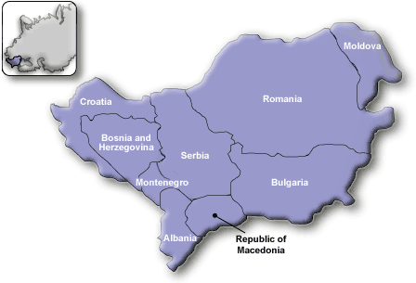
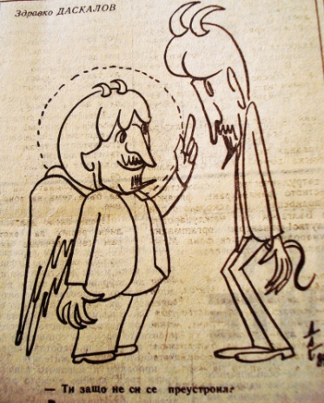
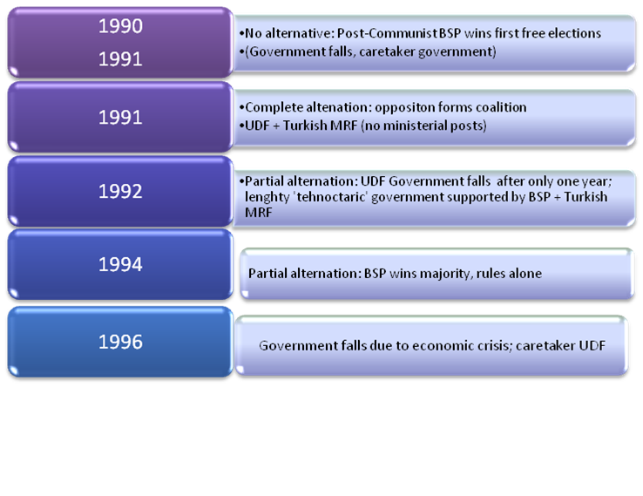
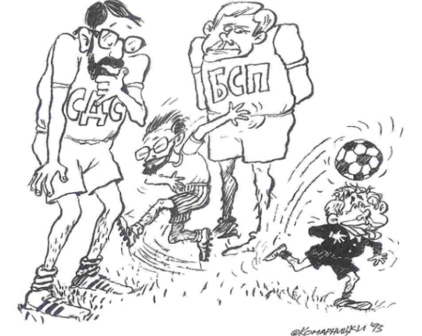
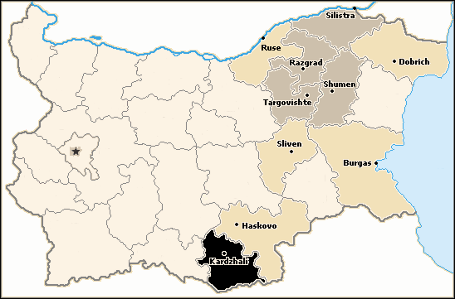
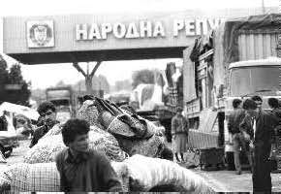
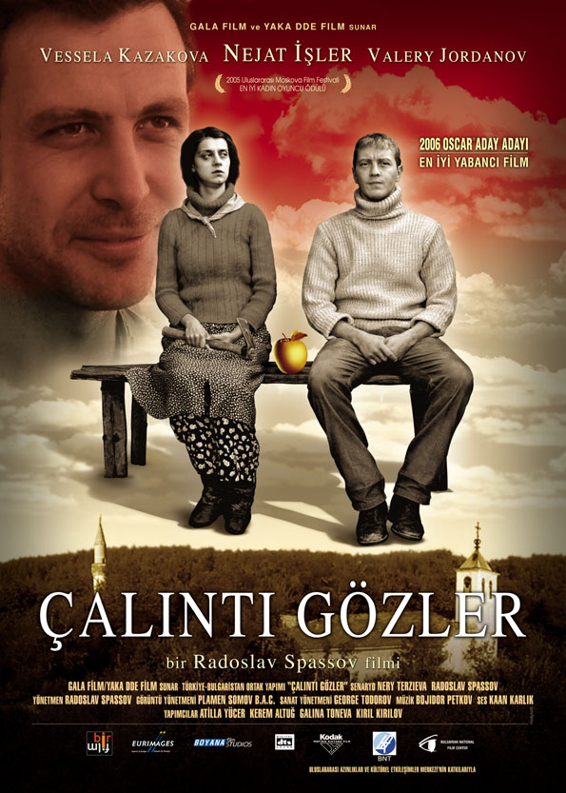
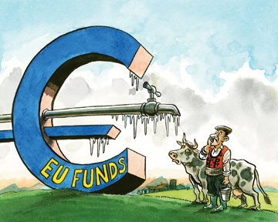
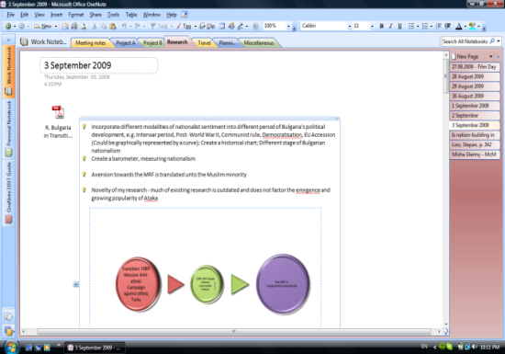

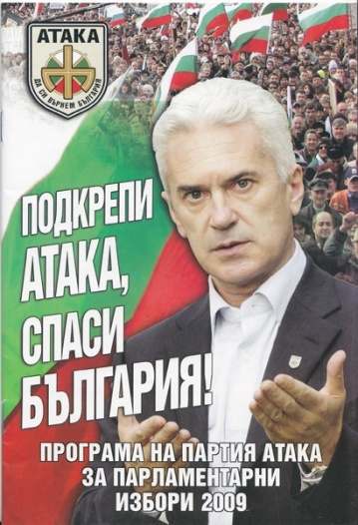
Project by Ivana Dimitrova, I.G.Dimitrova@warwick.ac.uk
Supervisor Dr. Peter Ferdinand
Democracy and the Revival of Nationalism in Bulgaria
1. Introduction. Methodology
The investigation operates at two levels of analysis – micro- (elite decisions, intra-ethnic coexistence, fieldwork research) and macro- ( the role of the international environment, institutional engineering and democratic diffusion).
The case of Bulgaria’s transition to democracy challenges the dominant portrayal of the Balkans as an ethnic melting pot, trapped in a historical legacy of exclusive ethnic nationalism and violent redrawing of borders. Its success story – the ‘Bulgarian ethnic model’ was highly praised by foreign commentators. However, Bulgaria’s path to democratic consolidation seems less amicable, bringing to the fore deeply engrained ethnic enmities and dangerous nationalist sentiments. Therefore, this research attempts to investigate the curious relationship between democratisation and nationalism and ascertain to what extent they are correlated.
In order to achieve this goal it employs qualitative and quantitative approaches.
Quantitative Methods
Using Freedomhouse and Polity IV data
Qualitative Methods
Documentary analysis and literature review (Letters, Diaries, Official Documents, Mass-media outputs, Academic Journals, Information Agencies, Websites)
Unstructured Interviews
Game thery
Ethnography and Participant Observation
Case Study
Statistical Analysis
Content Analysis of History Textbooks and Party Manifestos
2. Conclusions: Main Topics
1. Bulgaria’s Elite-Dominated Transition- The Illiberal Path (1989-1994)
1. Bulgarian Nationalism and the Image of ‘ the Other’
Free, but Not Fair Elections
The Bulgarian Socialist Party won the first free elections due to its structural advantage over the opposition, its successful propaganda apparatus and populist election platform
The opening of the regime was initiated and guided by an unreconstructed, self-serving communist elite. The ruling party managed to personalise the dictatorship, abandon Marxist ideology and reinvent itself as the left alternative towards ‘gradual’ , i.e. façade, liberalisation
(Un)Reformed Communists
The articulation of Bulgarian nationalism touches upon two main points: the Macedonian question and the Turkish/Muslim problem. However, the first issue remains marginalised in the public discourse on ‘the national question’. It occupies only several peripheral organisations with negligible support base.
‘Reformed Communists’, Duma Newspaper, 1990
Fig. 4
Minority Inclusion and Nationalism
Fragmented Opposition
The ‘Turkish question’, on the other hand, is a divisive issue and the Muslim minority is an object of frequent ethnic scapegoating. ‘Otherness’ is constructed on the basis of exclusive cultural and ethnic primordial criteria – ironically, a product of modernity and post-Enlightenment Western concepts of nationhood. Bulgarian nationalism strives to invoke images of the ‘Turkish yoke’ and the internal danger of the ‘Turkefication’ of society. Externally, it points at Turkey’s irredentist agenda and its aspirations for creating a ‘fifth column’.
The Union of Democratic Forces was an incoherent umbrella organisation, divided between free-marketeers, social liberals of the German type and Western-style social democrats
2. Re-Imagining the Bulgarian Nation. The ‘Revival Process’, ‘The Grand Excursion’ and the End of Communism
The Turkish ethnic party - Movement for Rights and Freedoms - has been constitutionally recognised, thus channelling minority demands into an institutional framework; No violent demonstrations of extreme ethnic nationalism
1990
No alternation: post-communist BSP wins first free elections
1991
Opposition Forms Coalition :Union of Democratic Forces +Turkish MRF
1992
1994
1997
Technocratic government supported by BSP+ MRF
BSP wins majority, rules alone, but in 1996 the government falls due to economic crisis
Centre-right UDF+ small parties
The Leaders of the BSP, MRF and UDF
From 1960 onwards, the parasitic party-state, faced with a profound legitimacy crisis, embarked on a nation-wide assimilation campaign, whose long-term strategic goal was to divert attention from the poor economic management of the country and to eliminate dissident elements by creating a homogenous nation-state.
2. Democratic Consolidation – Beyond Electoral Democracy
Density of the Muslim population in Bulgaria
The corruption of economic reform and BSP Inc.
Economic Indicators of Bulgaria, 1989=100
Termed by Bulgaria’s former president Zhelyui Zhelev ‘a typical case of cultural genocide’, this campaign culminated in 1984-1985 with the forceful change of 700,000 Turkish-Muslim names to Christian-Slavic ones.
Hellman’s ‘partial reform equilibrium’ – after 1994 neocommunist ‘entrepreneurs’ were involved in the theft of national assets, appropriation of loans from state banks and arbitrage opportunities in the foreign export business
(See Ganev, V. , ‘The Dorian Gray Effect’). In 1996, inflation reached the 300 percent mark and GNP contracted by a staggering 9 percent. Bulgaria, an island of stability, sank below the economic level of strife- ravaged Bosnia and Albania.
The Grand Excursion- at the Turkish border
Dependence on External Actors
Fig. 1
This blatant attempt at eradication of the religious and ethnic identity of the largest minority in Bulgaria resulted in the mass exodus of over 350.000 ethnic Turks- the largest movement of people since World War II.
After the 1997 election victory of the UDF, Bulgaria has moved away from the communist quasi-mafia domination. However, the Kostov government grew strategically and financially dependent on IMF stabilisation loans and defined the prosperity of the country within the framework of European integration and Westernisation.
The European Union’s Sticks and Carrots
Ever since Bulgaria’s accession in 2007, the European Union has been considered the only viable path towards overcoming the country’s endemic corruption and organised crime. After the 2009 July elections, the centre-right party Citizens for European Development of Bulgaria (GERB) has dedicated its ruling mandate to fulfilling the European Commission’s reform prescriptions and maintaining close ties with Brussels.
The Bulgarian-Turkish film ‘Stolen Eyes’,
portraying the ‘Renaming Process’
Fig. 5
Fig. 6
Source: The Economist, 9th July 2009
3. The URSS Experience
These two charts represent citizens’ apprehension about the resurgence of ethnic conflict according to political affiliation (Fig.5) and average monthly income per household (Fig. 6).
Being an Undergraduate researcher has enabled me to:
3. Reviving Skeletons in the Cupboard , the Myth of the Ethnic Model and Ataka’s Hybrid Nationalism
Academic
Skills
Apply theoretical models in practice and pursue my interests in greater detail
Develop various research techniques
Learn how to employ effectively the existing literature, search library resources and find alternative sources of information
- Communicate with people of diverse backgrounds and improve my interpersonal skills
Ataka’s
nationalism
Ataka’s economic and political platform
Preaching against European integration and Westernisation
Proposing left-wing economic measures and generous welfare benefits
Religious elements: Orthodox Christianity as a main characteristic of nationhood
Racist elements: emphasis on blood, origin and a unitary nation-state, based on homogenous ethnicity
Threats to national unity and territorial integrity: external(Turkey and the West) and internal (Bulgaria has to be saved from ‘Turkish yoke’ and Islamic fundamentalism)
Introducing legislation banning the existence of MRF and any other sources of minority linguistic, cultural and political expression
A leadership, media party
Transferable
Fig. 3
Ataka can be defined as a media party, running a TV station, a newspaper and a Website
Source: OESCE Annual Reports (2005,2009)

