Slide 1



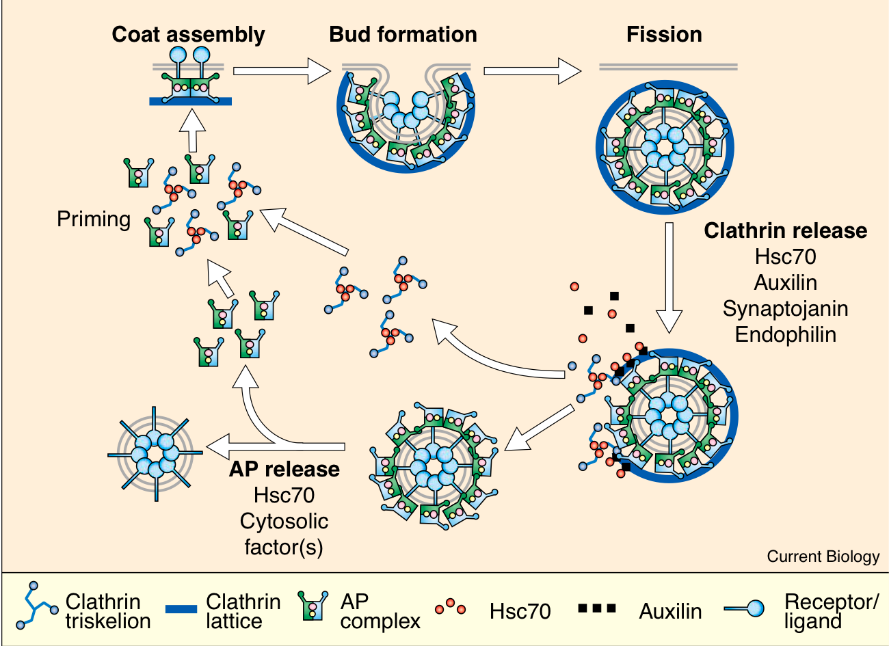
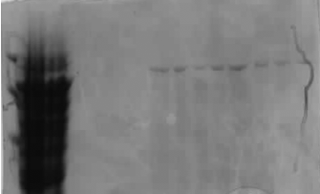
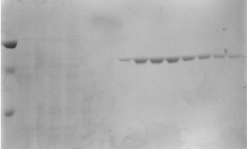
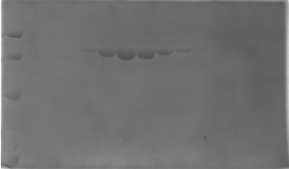
Creating a fluorescent probe tagged Hsc70
Roshani Patel
Supervisor: Corinne Smith and Alice Rothnie, Department of Biological Sciences, University of Warwick
Introduction
Endocytosis is a receptor-mediated process that initiates the invagination of the plasma membrane, forming a budding vesicle for import of specific external proteins and nutrients (fig. 1). The clathrin coat disassembles as the vesicles are transported to the target membrane. The process of disassembly involves a 70 kDa Hsc70 chaperone protein which binds to the clathrin coat with its cofactor auxillin. Hsc70 is an ATPase which becomes stimulates by auxillin.
Aim: The aim of this research project was to create a fluorescent Hsc70 mutant, which can be used for the flourescence assays with Hsc70 bound the clathrin coated vesicles.
1. Hsc70 purification
a. b. c.
Figure 1. shows the cycle of clathrin assembley and disassembley with the factors influencing the processes at vairious stages of the process. (Lemmon, 2001)
kDa
85
70
50
kDa
85
70
50
kDa
85
70
50
40
To construct a tagged Hsc70, a mutant Hsc70 with only one cysteine must be purified. The Hsc70 mutant used for this experiment is called C603, which has a single cysteine at the C terminus of the Hsc70, in comparison to the wild type (WT) Hsc70, which constitutes 4 cysteines at positions C17, C276, C574 and C603.
1. The C603 Hsc70 was expressed by baculovirus infection of Sf9 insect cells. Hsc70 purification involved 3-steps using affinity columns and gel filtration (Fig 2). The purified WT, Cysless and C603 Hsc70 were then used in assays to test if the mutation had affected the structure and the activity of the Hsc70.
Figure 2. The 3-step purification of Wt Ssc70 using hydroxyapitite column (a) ATP-agarose column (b) and gel filtration column(c) with the coomassie stained gel of the fractions collected.
2. Circular dichroism
2. Any structural changes conferred by the mutation in C603 were determined using a CD spectrometer to compare the secondary structure of C603 and WT Hsc70. The circularly polarised light was passed through the active protein allowing the absorbance to be measured. The results have shown both WT and C603 Hsc70 have similar secondary structure before and after heat denaturation and therefore the mutation does not affect the structure (fig. 3).
3. Clathrin disassembly
3. Although the structure remains the same the activity must not be alter ed. This was confirmed by the clathrin disassembly assay showing that the rate of disassembly is the same for both WT and C603 (fig 4). Clathrin disassembly was monitored by light scattering, upon addition of Hsc70, the clathrin cages disassemble and less light is scattered.
4. Fluorescent labeling
Figure 4: shows the decrease in absorbance as the Hsc70 addition causes disassembly of the clathrin coat.
4. The single cysteine in C603 mutant was utilised to tag Hsc70 with Pympo-maleimide fluorescent probe, which binds to cysteines. For this a mutant with no cysteine was used as a negative control (cysless). The fluoresnce of labelled C603 is significantly higher than cysless, showing specific labelling (fig 5).
Conclusion
After the purification of WT and C603 Hsc70 the activity and structure comparison confirmed that there is no significant difference between them. The C603 is an ideal mutant for tagging as the cysteine at position C603 remain at the C-terminus and less likely to alter the function of Hsc70. The fluorescent tagging was also successful and can now be used for further studies on Hsc70 function. Using thr fluorescence
Figure 5: shows the change in fluorescence with Cysless and C603 at two incubation time points.
Future work
Further activity assays on the tagged Hsc70
Labelling with nanogold probe fors tructural imaging
Using fluorescence anisotropy
Acknowledgements
I am grateful to Alice Rothnie and Corinne Smith for the continual support and guidance with the project. Research funded by URSS and MRC

