Slide 1
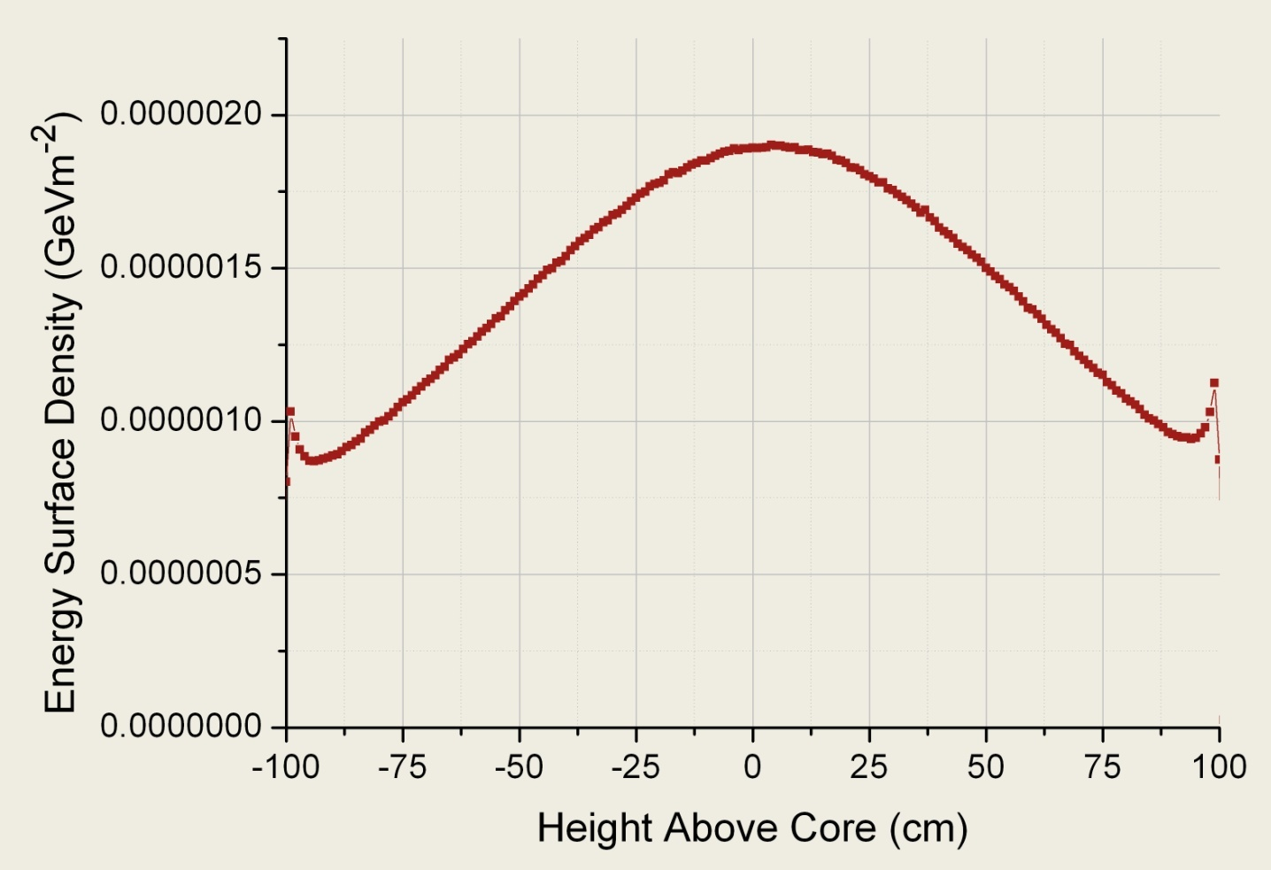
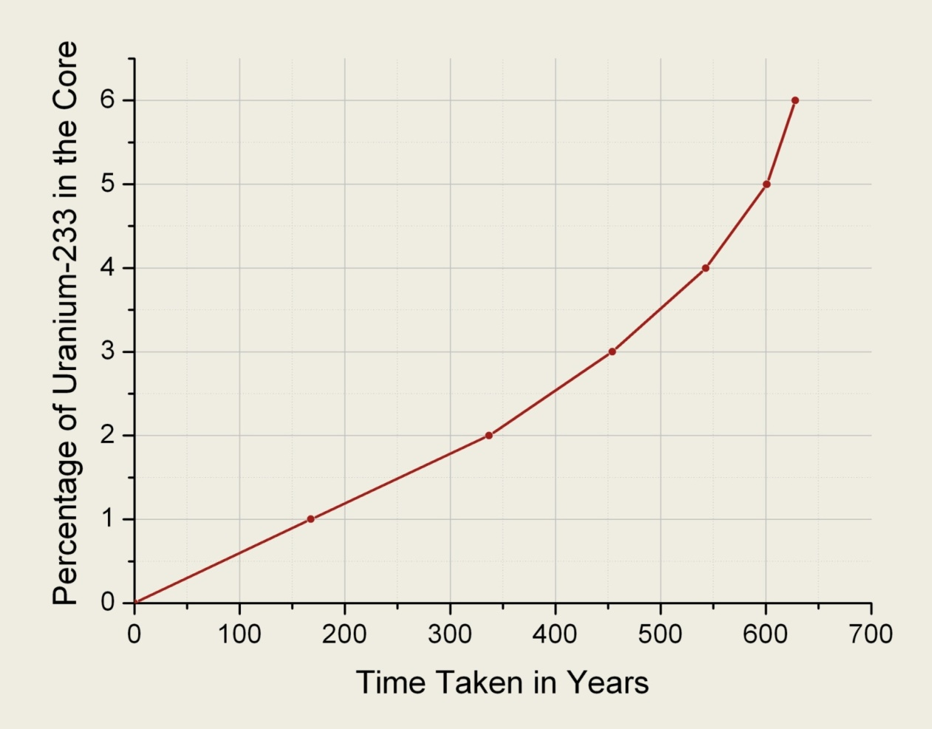
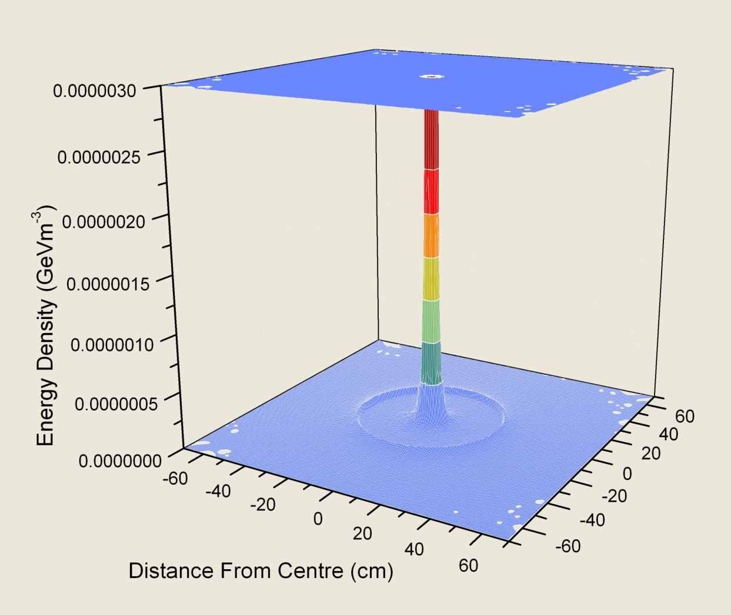
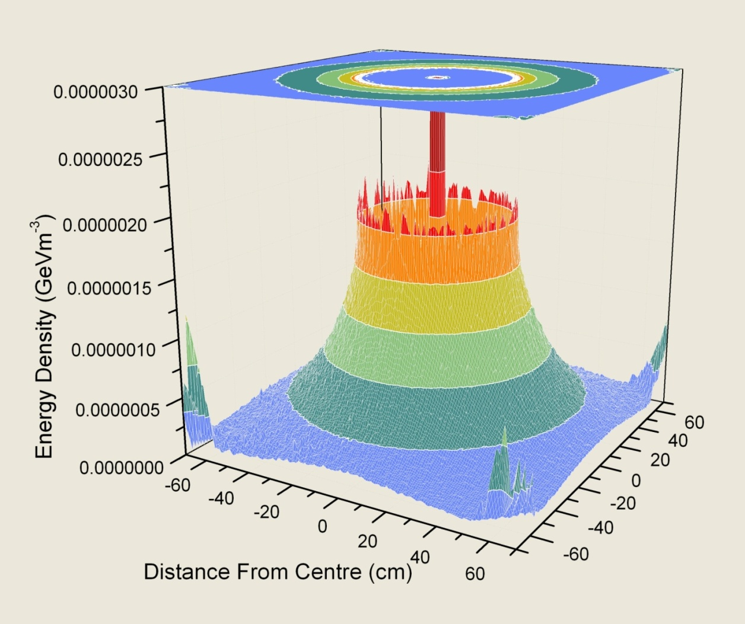


ADSRs: Greener and Safer
Nuclear Power Using Thorium
Jack Benton, supervised by John Back
ADSR stands for Accelerator Driven Sub-Critical Reactor, a type of Nuclear Reactor that’s sustained by a beam of protons from a particle accelerator. This type of Reactor can be run on an alternative to uranium, thorium. Not only is thorium more abundant but it has a decay chain with few long-lived isotopes, reducing radioactive waste. To use thorium, it must first absorb a
neutron in the Reactor and then decay to
uranium-233 which will undergo fission
when struck by another
neutron. This releases
energy.
Th²³²+n Th²³³ Pa²³³+e U²³³+e
¹
⁰
Daughter nuclei, neutrons
and energy.
+n
fission
¹
⁰
Many aspects of the reactor where simulated including the optimum placement of the lead target in the core, which proved to be directly in the centre.
The goal of the project was to use a particle physics code called Fluka to simulate a simplified reactor, as shown here in the centre diagram.
Lead
Reflectors
Thorium Core
7.7m
Bottom left is a graph of energy density in the reactor using a core of pure Thorium. A ring of absorption can be seen
which marks the edge of the core but the energy is
absorbed and dissipates
The remainder of the project examined the rate at which uranium-233 can be produced in the core. The results in the figure were calculated manually from thorium production rates and are shown
Lead Target
quickly. The same simulation is shown on the right but with an added 5% Uranium 233. As you can see there is a lot more energy produced by fission and it takes longer to dissipate in the core, spreading further out.
Importantly. In both graphs the energetic neutrons have been contained within the core, which suggests this design is efficient and safe.
only up to a fraction of 6% due to software limitations. It is clear from the graph above that doping the core with small percentages of uranium-233 will produce more uranium in a nearly exponential feedback and is a likely consideration for future designs.
Undertaking this project has been a great learning experience, providing the motivation to adopt a wealth of new skills. The Demands of the work proved to always be challenging but rarely frustrating.
This project was possible thanks to the support of the Undergraduate Research Scholarship Scheme and the Warwick University Physics Department.
For more information on Fluka please visit www.fluka.org
Department of Physics,
University of Warwick Gibbet Hill Road, Coventry CV4 7AL

