Slide 1
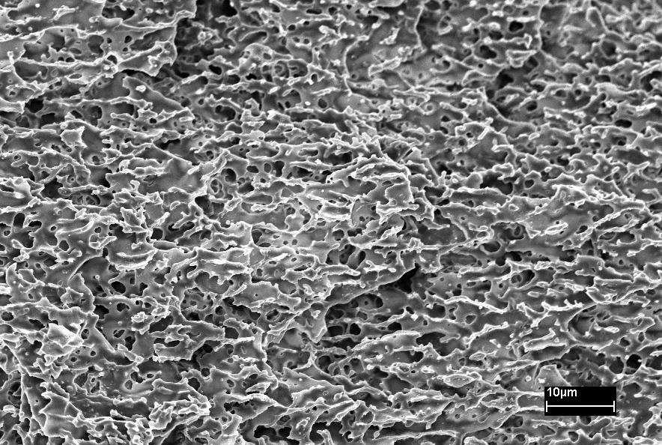
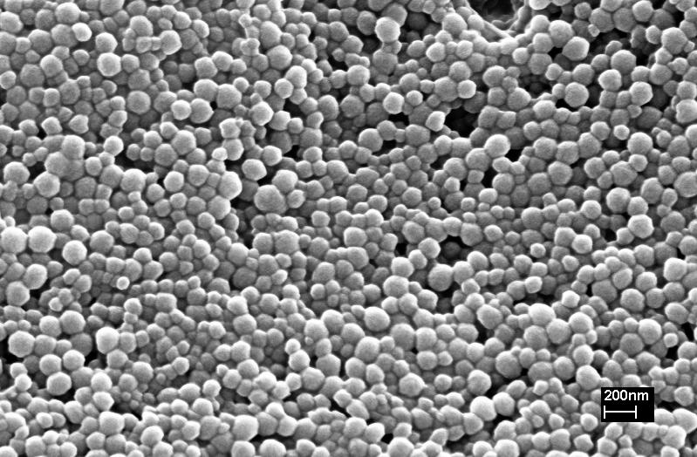
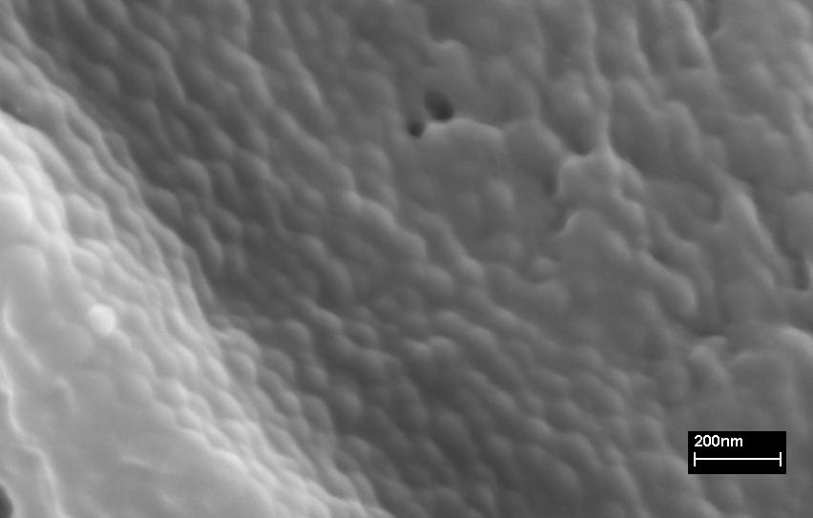
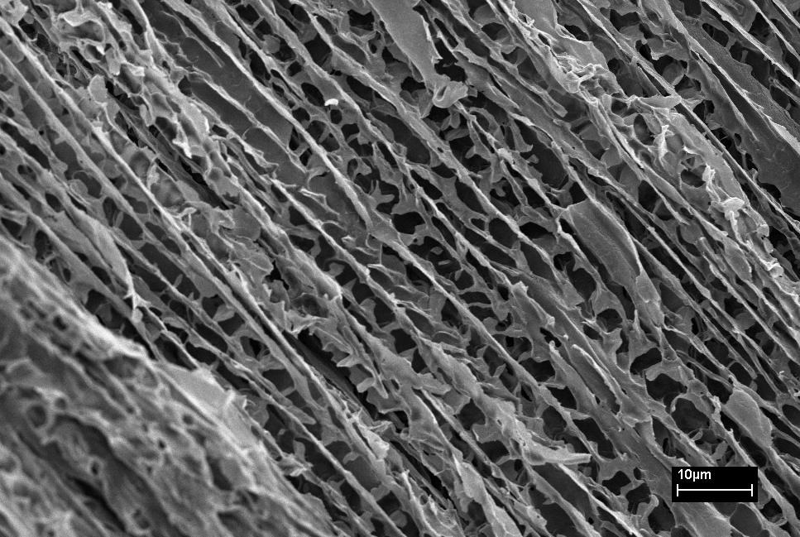

Supracolloidal cellular structures made via ice-crystal templating
Marius Rutkevicius*, Nicholas Ballard, Catheline Colard, Dr. Ir. Stefan A. F. Bon
M.Rutkevicius@warwick.ac.uk
1. Introduction.
Lightweight, solid polymer foams have unique properties. They can be used in various applications such as support for catalysis, 3D batteries, antistatic shields, cheap sensors, etc.
The aim of the project was to design foams that could potentially be used in gas sensors. Two pathways were explored: (mini)emulsion mixing with PS latex and PS latex swelling with monomers.
2. Method.
(Mini)emulsion (see figure 1 for polymerised (mini)emulsion) or various monomers are mixed with polystyrene (PS) latex (see figure 2) in water and then initiator is added.
Solution is frozen into liquid nitrogen (-196 °C).
Mixture is left in freezer (-20 °C) for 24 hours to polymerise.
Ice is sublimated using freeze dryer.
Samples were made using various methods and different monomers.
3. Results.
How are foams formed?
Latex particles are ‘glued’ together (see figure 3)
Water forms ice crystals and monomer particles concentrate in the space between ice crystals.
Porous polymer with a negative replica to ice is obtained after freeze-drying (see figure 4).
What happens in the freezer?
An initiator, ammonium persulfate (APS), is used to polymerise monomers. It works by breaking down in two symmetrical radicals:
This can only happen at high temperatures (T > 100 °C), therefore a co-initiator (TEMED) is added. In this case, polymerisation occurs at T < -25 °C.
TEMED
Figure 1: SEM image of polymerised and dried (mini)emulsion
Figure 2:SEM image of latex particles
Figure 3: SEM image of ‘glued’ latex particles
4. Conclusions.
Several different pathways to construct polymer foams have been explored with promising results. Foams from samples that were not left in freezer present continuous cellular structure
(see figure 4). Also , at this point of research it is clear
that swelling latex with various monomers is more promising than mixing PS latex with (mini)emulsion.
5. Future work.
Methods used to produce continuous porosity foams could be used to make porous conducting composites. Adding conductive component would allow to observe a conductivity change in presence of toxic gas.
Figure 4: SEM image of polyvinyl alcohol with latex total 10wt%. Sample exhibits continuous porosity
6. Acknowledgements.
I would like to express my sincere appreciation towards my supervisor Dr. Ir. Stefan A. F. Bon and the members of his research team, who guided me through such an amazing project. I would also like to thank URSS for the financial support.
7. References.
1. Catheline A. L. Colard, Adv. Mater. 2009, 21, 2894.
2. H. Zhang, A. I. Cooper, Adv. Mater. 2007, 19, 1529.
3. S. Deville, E. Saiz, Science 2006, 311, 515.

