Slide 1


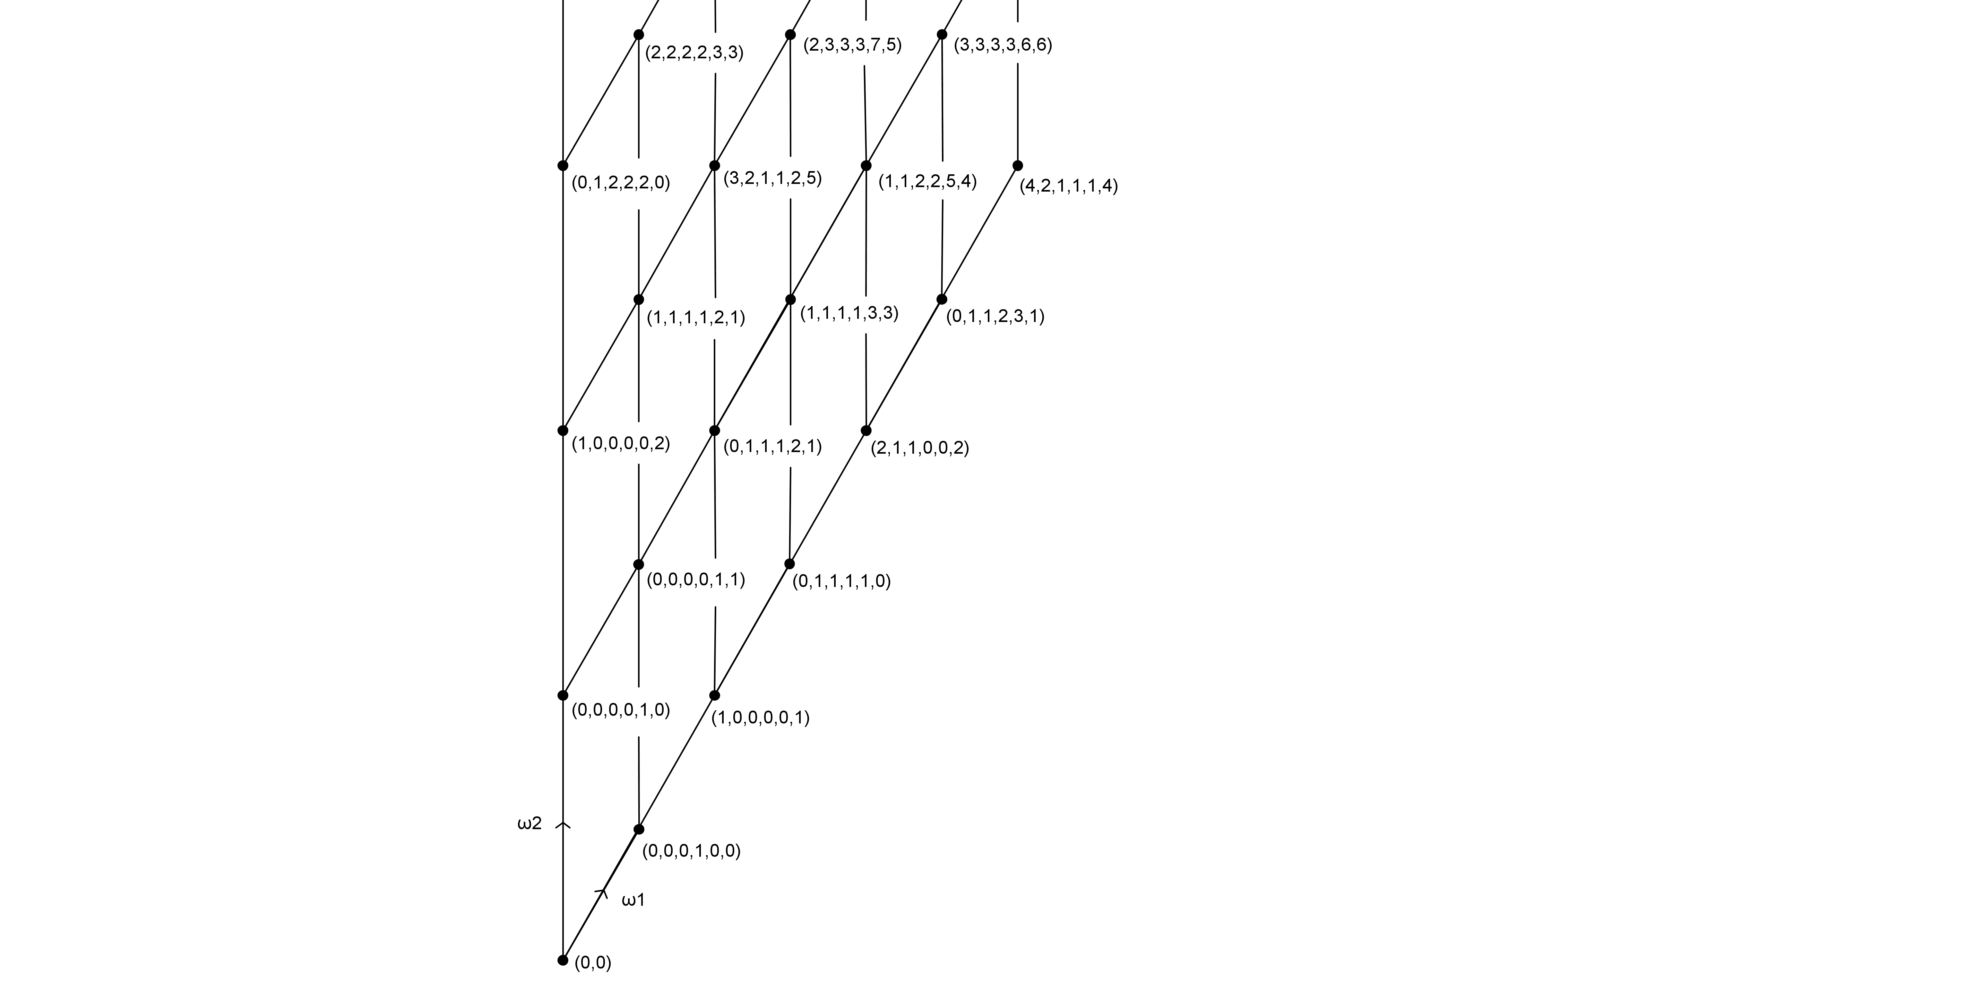


Irreducible representations of G2
The zero weight space case
Lambros Mavrides Supervisor: Dmitriy Rumynin
L.Mavrides@warwick.ac.uk Mathematics Department
Introduction
is one of the five exceptional simple Lie Groups, in particular the smallest one with dimension 14. Letting denote the maximal torus of and the normaliser of , we get the so called Weyl group of which is the quotient . In our case the Weyl group of is isomorphic to the dihedral group of order 12, . For the case of the zero weight space of an irreducible representation of , the Weyl group is acting on it.
Hence our attention is restricted to the action of the Weyl group , which is generated by two reflections; the reflection given by 60 degrees and denoted and the reflection given by 180 degrees and denoted . Hence our Weyl group has a presentation
.This group has six conjugacy classes;
What follows is a description of how one can compute characters for these six conjugacy classes.
The identity element
The trace of the identity element is equal to the dimension of the zero weight space. To calculate this, we have used Kostant’s multiplicity formula;
where is the weight of the irreducible representation , of highest weight , being half the sum of positive roots and , denoting respectively the Weyl group and Kostant’s partition function.
The Weyl chamber of
The chamber is marked with the characters of each fundamental weight, in the basis of irreducible characters of . The results were produced using our GAP implementation.
The elements &
For the representations of the element we have used a restriction to the subalgebra with basis , where is one of the simple roots. Therefore, in finding the trace of the representation of with highest weight L, we need only to consider the multiplicities of the weights along the simple root .
The element
The characters of this element were computed directly using Weyl’s character formula; for an integral weight and denoting half the sum of positive roots, the character of is given by
, where
The element
In this case the first step was to restrict to the subgroup of .
If the representation of is characterised by for two non-negative integers , and if denotes the restriction of to , characterised by two non-negative integers , then
with , , , where p, q, r are integers.
(M. Perroud)
The element
For the last element we restricted the representation to the action of principal triple. For an arbitrary root , , we have that
One can then use the Weyl’s character formula to compute the character.

