Slide 1


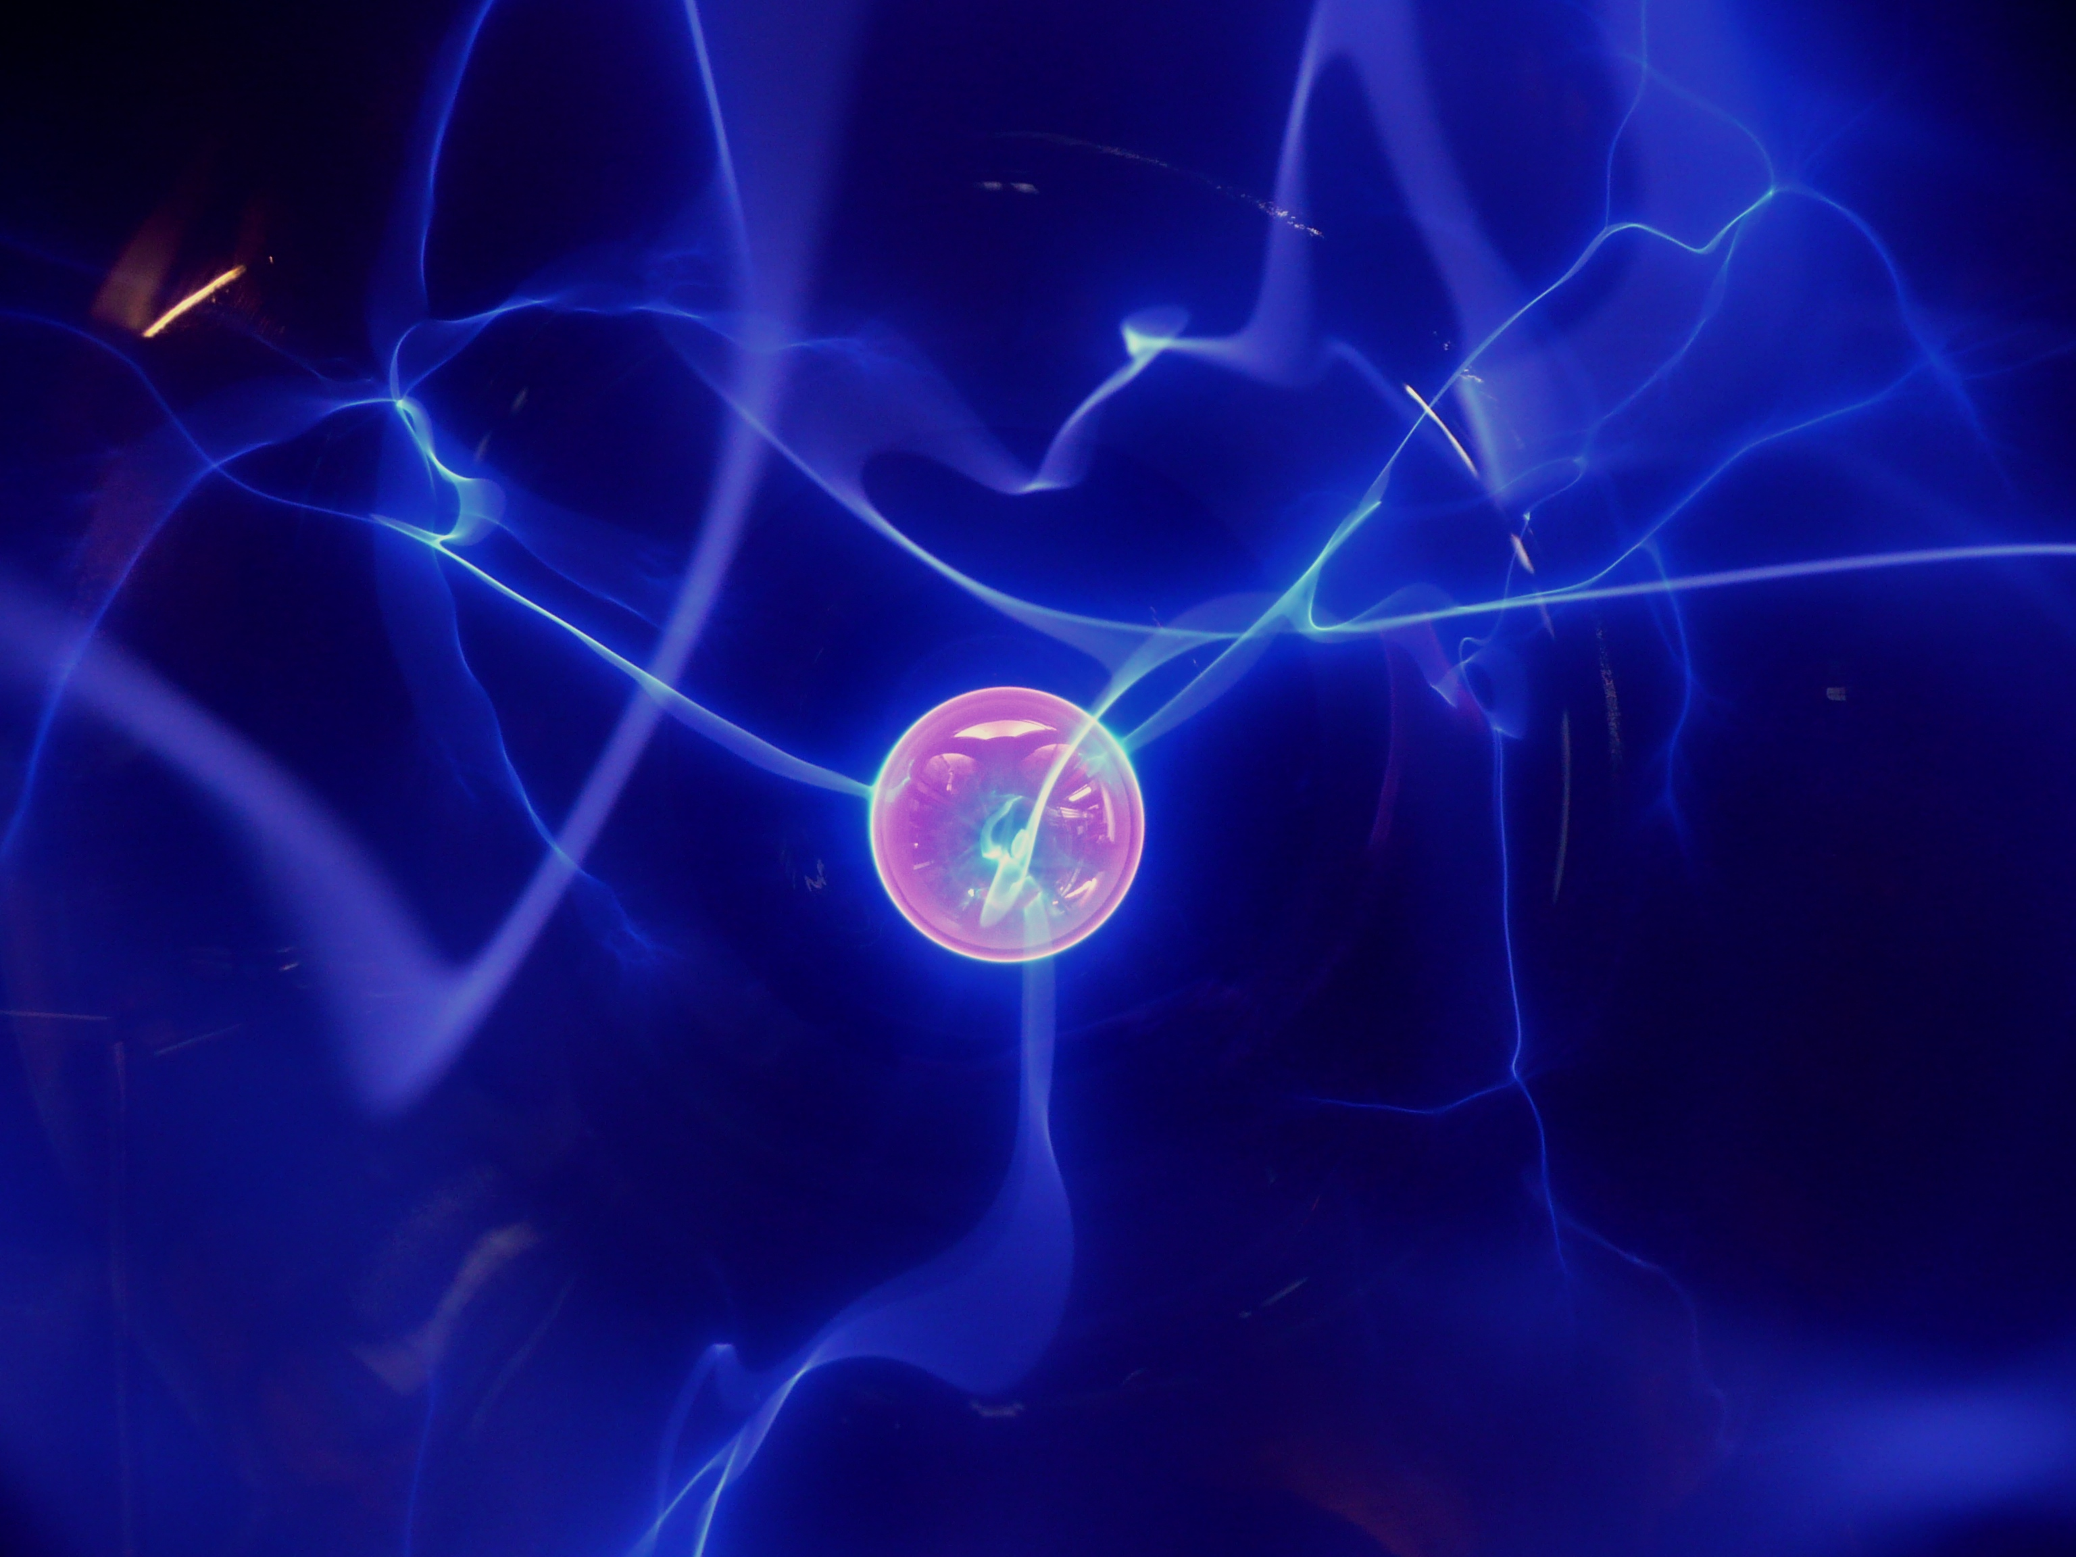
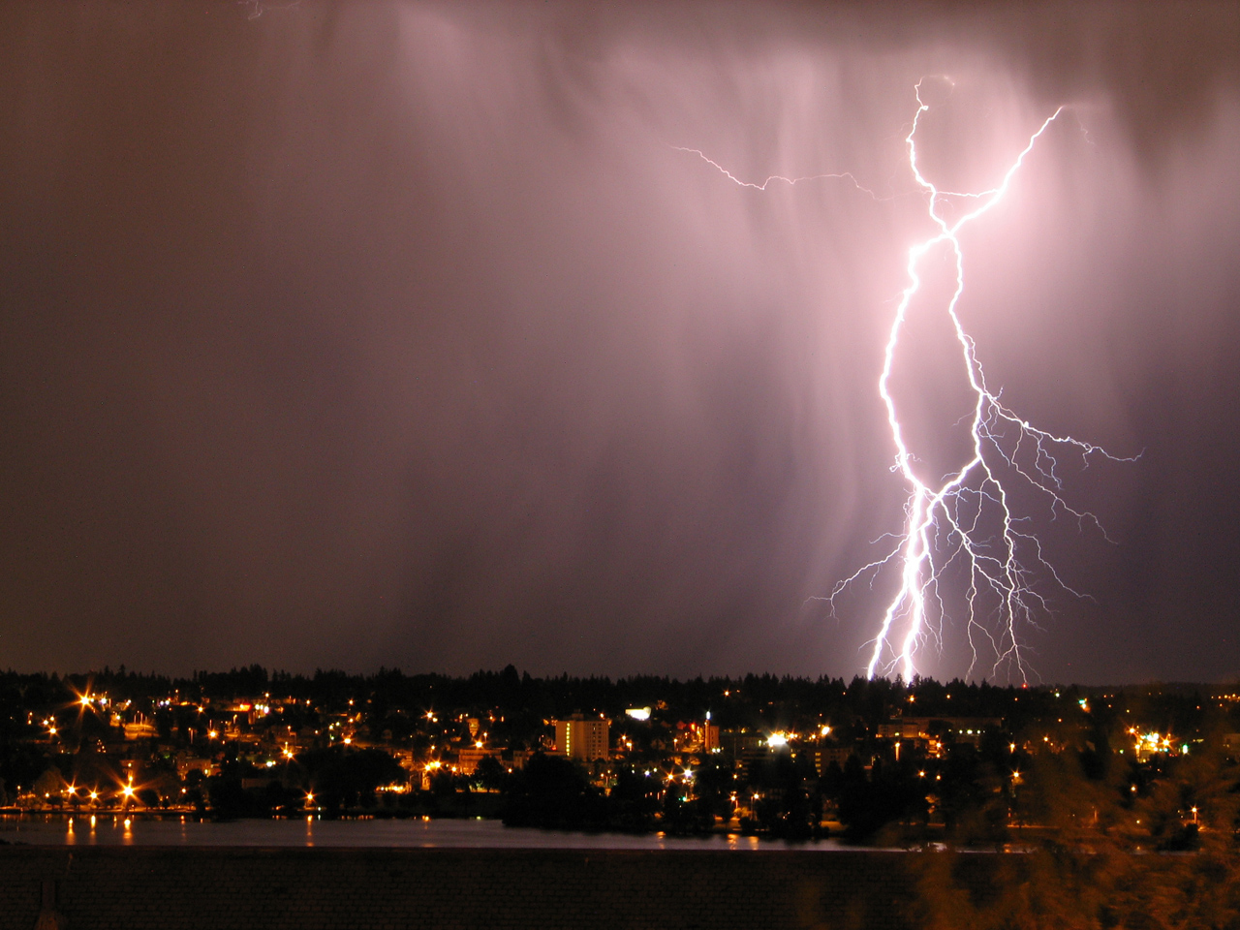
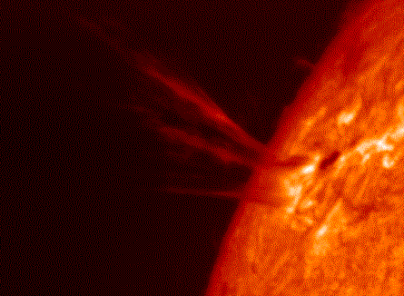
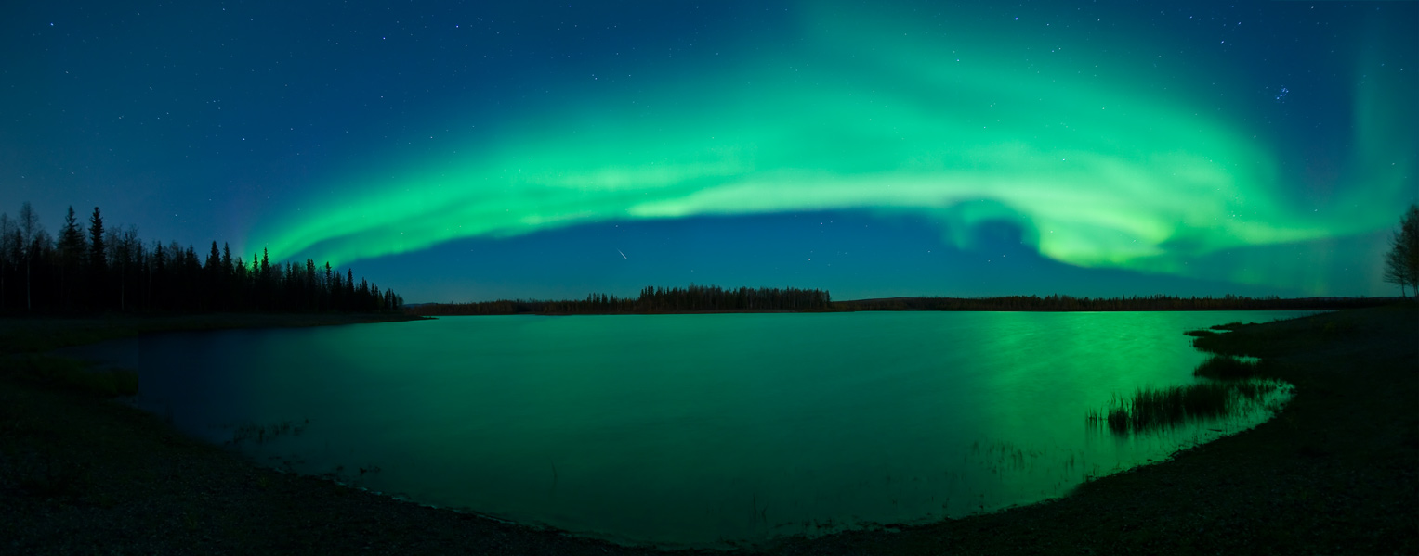
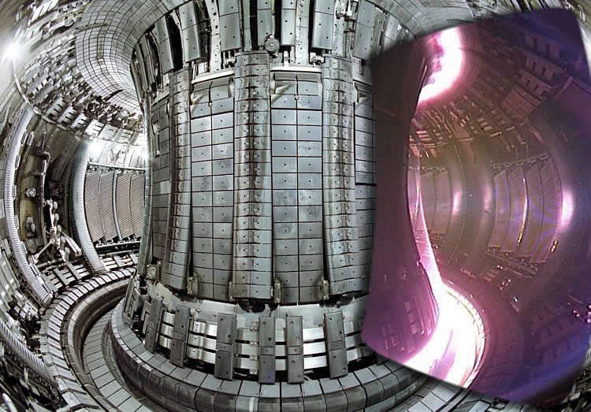
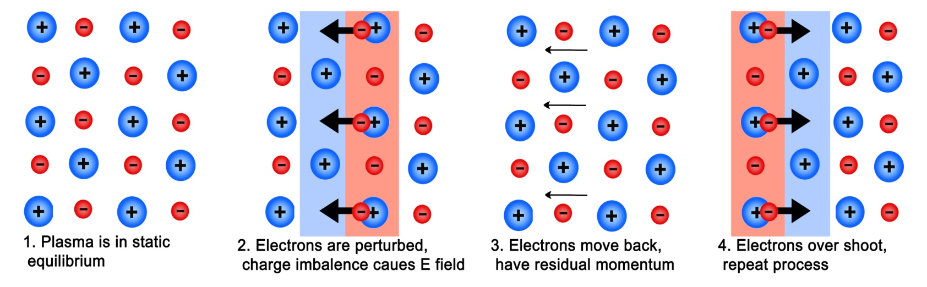
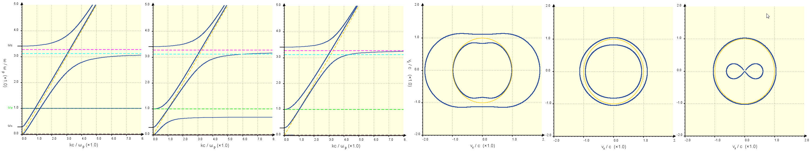
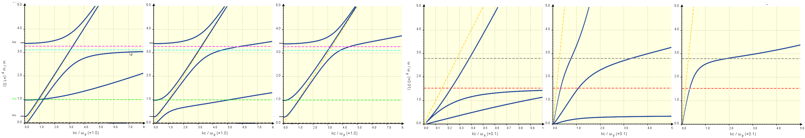
Virtual Plasma Wave Laboratory
fusenet
The European Fusion
Education Network
A java applet was written to display the dispersion curves and phase speeds for waves in a two-species Maxwellian uniform plasma for variable densities, ion masses, ion charges and the strength a magnetic field and its direction relative to the wave propagation. Further, a second applet was written to take account of the case of partial pressures in the plasma, i.e. pressure gradients of variable strengths along the direction of wave propagation. The applet will be made available in the future as part of the Warwick Plasma Calculator, which is sponsored by EU Frame work 7 and EPSRC.
Motivation
Over 90% of the known universe consists of plasma, including the Sun and all other stars, as well as the streams of charged particles they emit into the interstellar medium, known as solar wind. Further, there are plasmas all around us, for example in fires, lightning storms, Auroras and the Ionosphere. Furthermore, there are numerous examples of artificially produced plasmas in both house hold applications as well as in scientific experiments, most notably the fusion experiments in the Tokamak. Thus, the properties of plasmas are of great interest to physicists, as is the nature of wave propagation in plasmas.
The purpose of this project was the production of a java applet to calculate and display the dispersion relation and phase speeds of plasma waves under a number of possible conditions. While most text books on plasma physics only contain very particular cases of dispersion graphs with particular conditions, almost exclusively with the direction of propagation either parallel or perpendicular to the magnetic field, this program provides a comprehensive resource of dispersion plots for a multitude of different conditions. The program is to be viewable on the internet and should serve researchers and students working in plasma physics alike.
Figure 1: From [1], lightning is caused by a charge difference between clouds and the ground, causing air molecules to ionise, creating a plasma through which the current can flow. They produce Whistler waves that travel along the Earth magnetic field to the other hemisphere and heard as a frequency sweeping burst.
Figure 2: From [2], showing a coronal mass ejection from the sun, where hot ionised plasma is thrown out into space. CMEs and flares are often associated with bursts of radio waves caused by the interaction of particles with plasma waves
Figure 3: From [3], Aurora Borealis are caused by magnetic substorms, throwing amounts of plasma of the sun’s solar wind towards the earth. Upon contact with the atmosphere, the particles in the plasma interact with molecules in the air, putting them in a higher energy state, releasing energy as light as they drop back.
Figure 4: From [4], Tokamak device at the ITER project. Here hot plasma is confined in a toroidal magnetic field for the purpose of generating thermo nuclear fusion. Methods of heating this plasma are of vital importance and they include ion cyclotron resonance heating (ICRH) and electron cyclotron resonance heating (ECRH).
The Theory
In physics, a plasma is described as an ionised gas in a state of electrical quasi neutrality. Essentially it can be seen as the fourth state of matter, in which ions and electrons are no longer coupled as atoms. Here the motion of particles are governed by long range electro magnetic interactions.
The approach that is used here to study the wave propagation in plasmas is to find the ‘dispersion relation’ of the different wave modes in the plasma. A given wave mode will have a certain wave frequency ω for a given wave number k, where k = 2π/λ. These relationships are then plotted as ‘dispersion curves’.
If we assumed all the electrons and ions in the plasma to be evenly distributed and stationary (i.e. a ‘cold’ plasma), perturbing an electron would destroy the equilibrium and result in an electric field that would in turn cause the electron to oscillate back and forth at a frequency, which depends on the density, charge and mass of the electrons in the plasma, known as the ‘electron plasma frequency’ ω_{pe}. Applying the same to the ions we find the ‘plasma frequency’ ω_{p} as:
It follows that there exist a wave mode in cold plasmas, namely the electrostatic wave mode (see figure 5) , with oscillations at the plasma frequency. Since this mode is static mode only exists when k = 0. It is essentially the low temperature approximation of the ‘Langmuir wave’; a purely longitudinal wave, propagating only in the absence of a magnetic field or parallel to it.
However, more wave modes are observed in plasmas, especially if they are permeated by a magnetic field. To solve the dispersion relation for a more general case it is necessary to use a dielectric description of a plasma to obtain a linearised generalised Ohm’s law of the form:
Where σ is the conductivity tensor and j the current density of the plasma, induced by an electric field E. To do this, we consider the forces acting on charged particles in electromagnetic field:
Using this, we can determine the current densities and hence the conductivity tensor, which in turns leads us to an equation for the dielectric tensor ε, which contains all information about the macroscopic response of a plasma to applied electric fields.
, where I is the identity matrix. Further, from Maxwell’s equations we can show that M ·E = 0, where
which in matrix form, where N terms are components of the refractive index (N=kc/ω), is equal to
In conclusion, we need to find the components of M for which the determinant of the matrix is equal to zero.
Doing this calculation leads us to a dispersion graph with up to five different branches, amongst which left hand and right hand circularly polarized modes, which tend to ω = ck, and the whistler mode, which tends to become non-dispersive at higher wave numbers, tending either towards the electron cyclotron frequency or the upper hybrid frequency [5]
Figure 5: Illustrating electrostatic plasma oscillations, induced by the displacement of electrons
The Applet
Solving Det(M)=0 for N, an analytical solution for k in terms of ω was obtained. A program was written to calculate values of k for a range of ω values, specifiable by the user, and to connect them with lines. The parameters of the program include the electron density (which determines the ion density as well), ion charge, ion mass, magnetic field strength and propagation angle relative to the magnetic field (see figure 6).
Further, a program was written to plot the phase velocity of a wave of a specifiable frequency, namely (1/N(θ, ω))(cosθ + sinθ), as a function of the propagation angle relative to the magnetic field. These were displayed in polar plots (see figure 7) where v_{Z} represents the velocity parallel to the magnetic field and v_{X} the velocity perpendicular to the magnetic field. On the applet, the polar plot is displayed adjacent to the dispersion graph.
Right hand circularly
Polarized EM wave
A) B) C) A) B) C)
Left hand circularly
Polarized EM wave
Resonance at
upper hybrid
frequency
Direction of
Magnetic field
Whistler wave
ECR
Figure 6: The dispersion plot for a plasma with n_{e}= 10¹⁴m⁻³, ion atomic mass = 1, ion charge state = 1, B = 0.01T, with wave propagation at an angle relative to B of 0° (a), 45° (b) and 90° (c), generated by the applet. The green, cyan and magneta dotted lines represent the plasma, electron cyclotron and the upper hybrid frequency respectively.
Figure 7: Showing the polar plots for the wave speeds of waves in a plasma with n_{e}= 10¹⁴m⁻³, Ion atomic mass = 1, ion charge state = 1, B = 0.01T, at frequencies of 1.2 w_{p} (a), 2.1 w_{p} (b) 3.2 w_{p} (c), generated by the applet. The yellow line is representative of the speed of light in vacuum.
The relationship describing the wave modes becomes more sophisticated when partial pressures are taken into account. Assuming adiabaticity with a specific heat ration γ, an additional pressure force is acting on the particles of the form:
As a consequence of this modification, a new wave mode arises in the plasma, namely the ‘Ion acoustic wave’, which becomes visible at low frequencies (see figure 9). Further the Langmuir wave is no longer non-dispersive (see figure 8), but it’s frequency rises as a function of k according to:
The partial pressures further affect other wave modes, causing there to be no resonance at the upper and lower hybrid frequencies, indicating that heating laboratory plasmas with radiation at these frequencies is not a viable method.
Unfortunately, due to the increased complexity, solutions for k could not be obtained analytically. Hence, a second applet was written to determine the appropriate k values numerically. This method required a program with more calculations and limited precision, but is adequate for the size of the display.
A) B) C) A) B) C)
Langmuir Wave
ICR
Ion-acoustic wave
Figure 8: Dispersion plot for a plasma with n_{e}= 10¹⁴m⁻³, Ion atomic mass = 1, ion charge state = 1, B = 0.01T, T_{e} = 5x10⁸ K, T_{i} = 1x10⁹ K with propagation angle of 0° (a), 45° (b) and 90° (c), generated by the 2nd applet. The green, cyan and magneta lines represent the plasma, electron cyclotron and the upper hybrid frequency respectively.
Figure 9: Low frequency dispersion plot for a plasma with n_{e}= 10¹⁴m⁻³, Ion atomic mass = 1, ion charge state = 1, B = 0.01T, T_{e} = 10¹⁰ K, T_{i} = 10¹¹ K with propagation angle of 0° (a), 75° (b) and 90° (c), generated by the 2nd applet. The grey and red dotted lines represent the lower hybrid and ion cyclotron frequency respectively
Contact
Dr Erwin Verwichte (Supervisor) Erwin-Verwichte@warwick.ac.uk
Jan Graf von der Pahlen J.N.Graf-von-Pahlen@warwick.ac.uk
CFSA www.warwick.ac.uk/go/cfsa
References
[1] http://upload.wikimedia.org/wikipedia/commons/e/e9/L%E2%88%9Esenut_-_Lightning_bolt!_(by-sa).jpg
[2] http://apod.nasa.gov/apod/image/9611/solarcme_soon.gif
[3] http://apod.nasa.gov/apod/ap071009.html
[4] http://www.iter.org/sci/science/jet_tokamak_plasma_overlay_1.jpg
[5] Dendy R. O., Plasma Dynamics, Clarendon Press, Oxford, 2002

