Slide 1
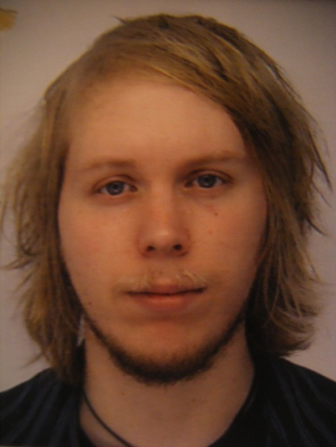




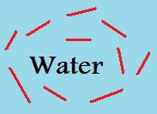
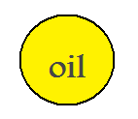
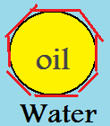
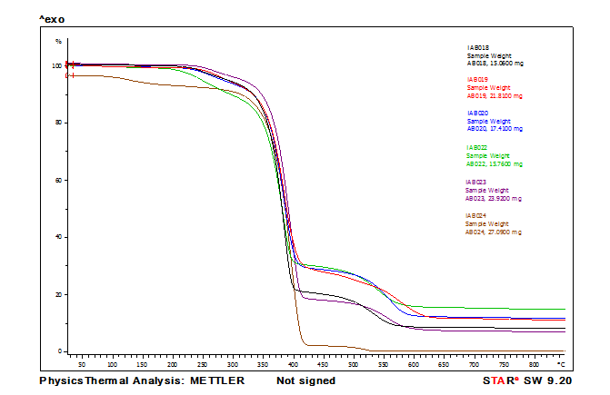
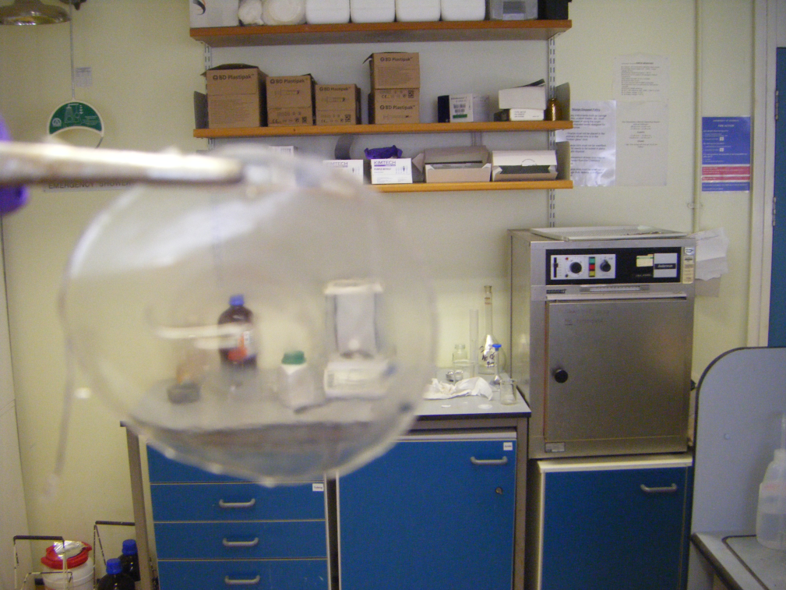
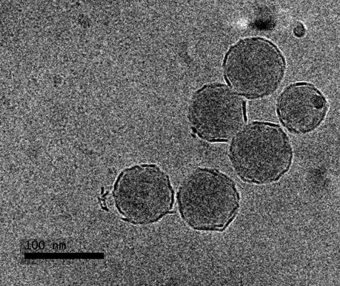
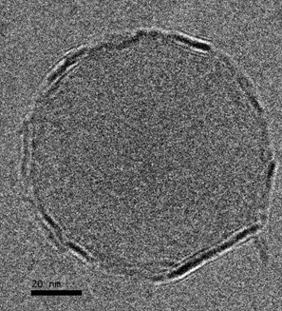
Fire resistant supra-colloidal coatings
by Ashton Boyd and Associate Professor Dr.Ir. Stefan Bon (Supervisor)
Department of Chemistry, University of Warwick, Coventry,CV4 7AL
www.Stefanbon.com Ashton.Boyd@warwick.ac.uk
Introduction
Colloidal chemistry is a very exciting area of chemical research. The technology and the control we have over materials at the present is remarkable. Being able to manipulate and arrange molecules and particles on the nano-scale and being able to creating large complex structures is an amazing achievement. However, what is even more interesting is when you alter a characteristic on the nano-scale and how this change can drastically affect the properties of the bulk material on the macro-scale.
Aims
The aim of the project was to create a flame resistant coating via solids-stabilised or Pickering emulsion polymerization. Pickering stabilisation is the process by which an emulsion droplet is stabilised by solid particles which adhere onto the interface between the oil and water phases. In a standard emulsion, for example oil droplets dispersed in water, droplets will usually coalesce to reduce the energy of the system (depending on the hydrophilicity of the oil droplets) but in Pickering emulsions the oil droplets are protected from coalescing by presence of the solid colloidal particles at the liquid-liquid interface.
We are interested in fabricating a waterborne coating (polymer latex) in which the polymer particles are armoured with nanosized clay discs (Laponite clay). The idea is that upon film formation (watching the paint dry) the presence and positioning of the clay will generate flame retardant features. We want to use Pickering emulsion polymerization using Styrene, Butyl acrylate and Laponite clay disks as a solid stabiliser to prepare such a protective and transparent coating
Methodology
Pickering Miniemulsion Polymerization:
Laponite clay was added to deoxygenated water in a beaker. The solution was stirred, homogenized and sonicated for 6 minutes (70 % amplitude, 30 s on, 30 s
off. NaCl added after 30 s). Next Styrene, Butyl acrylate and Octadecyl acrylate were added to the solution.
The resulting liquid was homogenized and sonicated. Finally the emulsion was place in a round bottomed
flask, degassed for 20 minutes, heated to 60 ^{O}C and initiator was added. The reaction was left overnight.
Solids-Stabilised Emulsion Polymerization:
Laponite clay was added to deoxygenated water in a beaker. The solution was stirred and added to a reactor which was set to stir at 285 rpm. Next Butyl acrylate and Styrene were added to the reactor. The system was closed and degassed for 20 minutes. Finally the reactor was heated to 60 ^{O}C and the initiator was injected. The reaction was left for 6-8 hours.
1.
+
Laponite
2.
+
=
Results
Evidence
of transparent film:
2. Evidence of heat resistance:
Figure 1. shows the TGA data of the solid latex between the temperature range of
20 ^{O}C to 850 ^{O}C. The brown lower line represents the % weight loss of just the polymer on its own with no clay. The other coloured lines represent the % weight loss of clay armoured particles with slightly varying recipes. The bumps show a degree of thermal stabilisation for up to 600 ^{O}C. The retained mass is insulating.
3. Evidence of Solids-Stabilised Emulsion Polymerization:
Image (a) is an SEM image showing the structure of the solid film after being heated to 850 ^{O}C. The polymer at this temperature has been boiled off leaving gaps. Straight edges can be seen where the laponite disks are. You can see that a large honeycomb structure is formed.
Images (b) and (c) are Cryo-TEM images of a latex formed by the above recipe. Dark, straight edges can clearly be seen around the lighter shaded polymer regions of the particles.
The dark edges show the laponite clay disks.
Figure 1. TGA data of several samples.
(a)
(b)
(c)
Conclusion/future work
I conclude that by using the above recipe and the correct ratio of reactants and monomers, it is possible to create clay armoured particles via Pickering emulsion polymerization that can form a film offering a heat resistance of around 200 ^{O}C. It is also possible to form a transparent film when the latex is left to dry. Future work will look at using charring agents to try and retain a greater % mass of the latex when it is heated to high temperatures. Also Controlling particle size by varying the % of clay used in a reaction will be very important in altering thermal properties.
References
Acknowledgements
Pickering Miniemulsion polymerization using Laponite clay as stabilizer Stefan A. F. Bon* and
Patrick J. Colver, Langmuir, 2007, 23(16) pp 8316 – 8322
Patrick J. Colver’s Thesis.
I would like to thank Stefan Bon and the URSS scheme for giving me this
amazing opportunity.
I would also like to thank Nicholas Ballard, Roberto Teixeira, Catheline
Colard and Andrew Edwards for their help and guidance in the lab.

