Slide 1
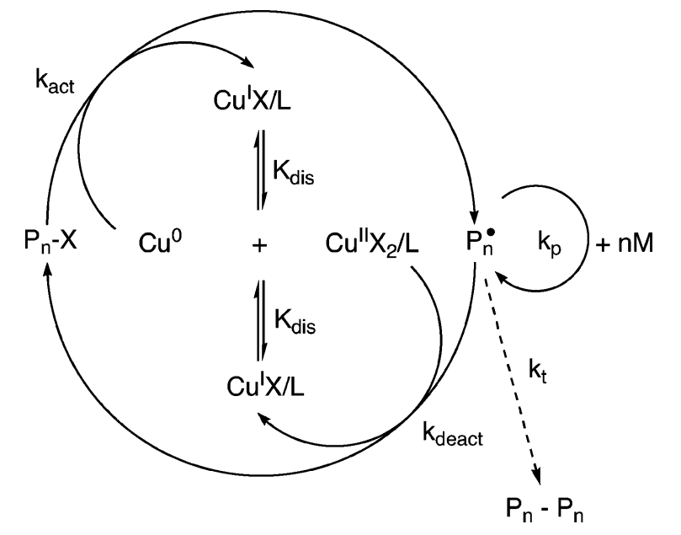


Single electron transfer
‘living’ radical polymerisation
Martin J Wilcockson, Anthony J Grice and David M Haddleton
Department of Chemistry, University of Warwick, Coventry, CV4 7AL
m.wilcockson@warwick.ac.uk
Introduction
Procedure
Single electron transfer ‘living’ radical polymerisation (SET-LRP) is a new controlled radical polymerisation technique which has recently been investigated by Percec et. al.¹
This polymerisation proceeds rapidly at room temperature in polar solvents (such as water, alcohols and ionic liquids) and uses Cu(0) and/or “nascent” Cu(0) generated in situ by disproportionation of various Cu(I) precursors as a catalyst.
Polymers of ultrahigh molecular weight and narrow molecular weight distribution (PDi < 1.2) can be made as a result of radical generation via a lower activation energy ‘outer-sphere’ single electron transfer (SET) mechanism² rather than the inner sphere mechanism of an atom transfer radical polymerisation (ATRP).
It has been suggested³ that the use of Cu(0) wire instead of Cu(0) power can have beneficial effects; Cu(0) wire is a more convenient and cost effective Cu(0) source that allows for greater variability and control of total surface area (rate of propagation, k_{p}^{app}, scales appropriately with total surface area of Cu(0) used).
The general procedure used for the polymerisation of PEGA₄₅₄ initiated by ethyl 2-isobromobutyrate is as follows:
Figure 1 Mechanism of SET-LRP as proposed by Percec¹
Results
A series of polymerisations were carried out targeting a molecular weight of 10000. Regular samples of reaction mixture were analysed by NMR spectroscopy to determine reaction kinetics. Figure 2 shows the ln[M]₀/[M] against time plots for the polymerisation of PEGA₄₅₄ in a series of alcohols. The more polar/less sterically hindered the alcohol, the faster the rate of reaction.
Each polymerisation showed an induction period, i.e. an initial slow rate of between 0.5 and 3 hours before significant monomer consumption begins. A repeat polymerisation was carries out under methanol where the Cu(0) wire catalyst had not been cleaned – appearing to increase the induction period.
The use of Gel Permeation Chromatography to analyse the PEGA₄₅₄ polymers shows the narrow molecular weight distribution typical of SET-LRP, however a high molecular weight species was observed. It was found that:
The more polar/less sterically hindered the alcohol, the larger the high molecular weight peak [figure 3].
Targeting a higher molecular weight of 80000 produced a high molecular weight shoulder roughly 50% the size of the main peak [figure 4].
Replacing the bromine based initiator with a chlorine based initiator, phenyl-2-chloroisobutyrate (stronger R-X bond) resulted in a smaller shoulder [figure 5].
Figure 4 shows an increase in the high molecular weight species when targeting a higher molecular weight
Figure 2 shows the increase in reaction rate with increasing solvent polarity and decreasing steric hindrance
Figure 3 shows the decrease in the high molecular weight species with decreasing solvent polarity and increasing steric hindrance
Figure 5 shows the decrease in the high molecular weight species with use of a chlorine based initiator rather than a bromine based initiator
Conclusions
References
The rate of polymerisation of PEGA₄₅₄ by SET-LRP is dependant on the solvent used in the reaction.
An induction period is observed, and this is varies with the solvent used.
The extent of high molecular weight species dependant on solvent, initiator and targeted molecular weight.
V. Percec, T. Guliashvili, J. S. Ladislaw, A. Wistrand, A. Stjerndahl, M. J. Sienkowska, M. J. Monteiro, S. Sangrama, J. Am. Chem. Soc., 2006, 128 (43), 14156-14165.
V. Percec, T. Guliashvili, J. Polym. Sci., Part A: Polym. Chem., 2007, 45, 1607-1618.
N. H. Nguyen, B. M. Rosen, G. Lligadas, V. Percec, Macromolecules, 2009, 42 (7), 2379-2386.

