Slide 1


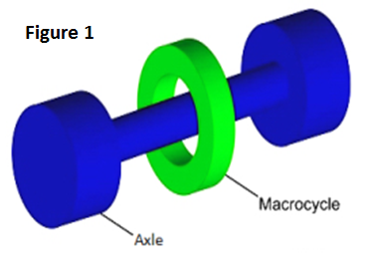
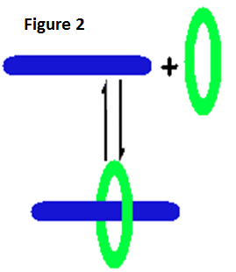
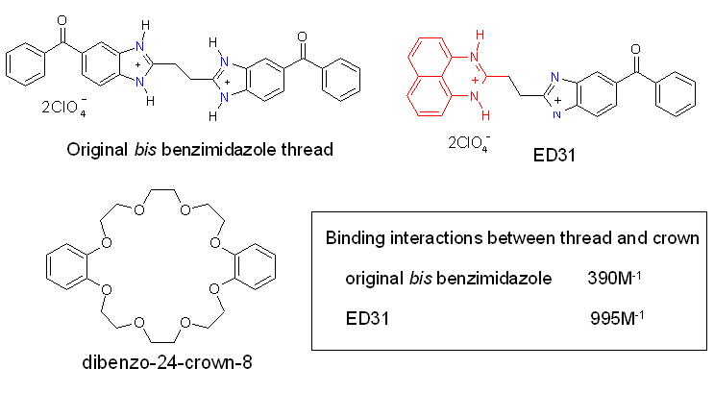
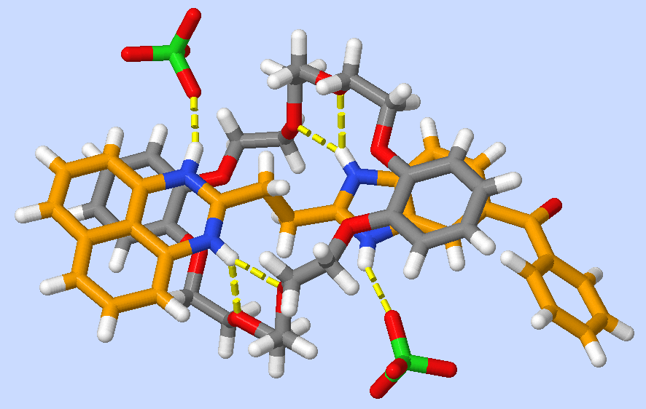
Improved design and synthesis of functional rotaxane template
Efrat Doron and Guy Clarkson
Department of Chemistry, University of Warwick
e.doron@warwick.ac.uk
Introduction
A rotaxane is a molecular interlocked architecture containing an axle which is threaded through a macrocycle, this is prevented
from slipping off the thread due to bulky groups at each end which act as stoppers. (Figure1) Pseudorotaxanes contain no
stoppers, the macrocycle stays in place by non covalent interactions with the axle, (figure 2) such as hydrogen bonds, π stacking,
electrostatic and hydrophobic interactions or metal coordination.
Rotaxanes can be formed in three ways:
1.Capping - the macrocycle is threaded onto the axle to produce a pseudorotaxane then stoppers are added
2. Clipping - a macrocycle precursor is clipped around the axle by ring closing to form the rotaxane
3. Slipping - the axle and macrocycle are pre-formed then they are subjected to high temperatures. This causes the macrocycle to distort so that it can fit over one of the stoppers
Applications
Results
Rotaxanes have been used as molecular machinery in applications such as:
Valves – can be used for controlled drug release.
Insulated molecular wires
Molecular switches and shuttles – due to the control of movement of the components of the rotaxane.
The new thread ED31 was found to have an greatly improved binding interaction with the dibenzo-24-crown macrocycle:
The ED31 interaction can be modified by reducing the carbonyl to an alcohol. The alcohol is less electron withdrawing than the benzoyl group and hence modifies the hydrogen bonding interaction and pi stacking interactions between thread and crown
The perimidine half of ED31 can also be reduced electrochemically also modifying the thread / crown interaction.
These two techniques allow you to tune the binding interaction over a range of values. This makes it an ideal component of a molecular machine (shuttle) where you can modify the interaction between this binding site and the crown by both chemical and electrochemical reduction, so controlling the position of the crown on the thread.
Binding constant of original bisbenzimidazole = 390 M⁻¹
Binding constant of ED31 = 995M⁻¹
Molecules studied in this project
X-ray Crystallography
Conclusions
                New template, ED31, synthesised which shows increased binding interaction with the crown
                ED31 has a carbonyl handle that can be used to both modify the interaction with the crown or capped with a stopper to synthesize rotaxanes
                The solid state structure of the complex from X-ray crystallography highlights the interactions responsible for templating the interlocking of thread and
                crown
Solid state structure showing the interpenetration of the crown (grey) by the thread (orange). The hydrogen bonding interactions that locate the thread in the crown cavity are shown in yellow. Also visible are the pi stacking interactions where there is an overlap of the aromatic rings of crown and thread which also enhance the interaction.
References
Acknowledgements
C. L. M. Goodyer et al., Bioorg. Med. Chem , 2003, 11, 4189–4206
G.J. Clarkson, L. Li., Org. Lett. 2007, 9, 497-500
K.Phoa; J.B.Neaton; V.Subramanian, Nano Lett., 2009, 9, 3225–3229
My sincere gratitude goes to...
Guy Clarkson for providing me with this wonderful experience and for all his help throughout the project.
Jennifer Yates and Lucie Guetzoyan for their constant help and guidance.
URSS and Warwick University department of Chemistry for financial support

