Slide 1

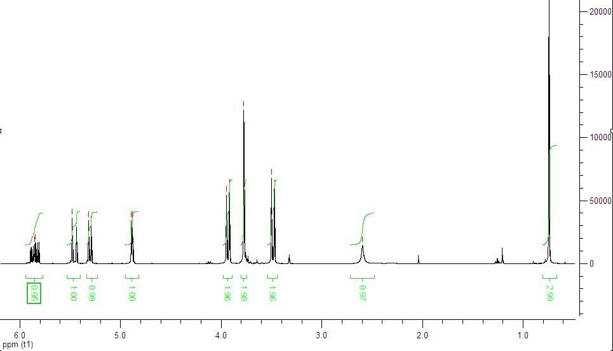
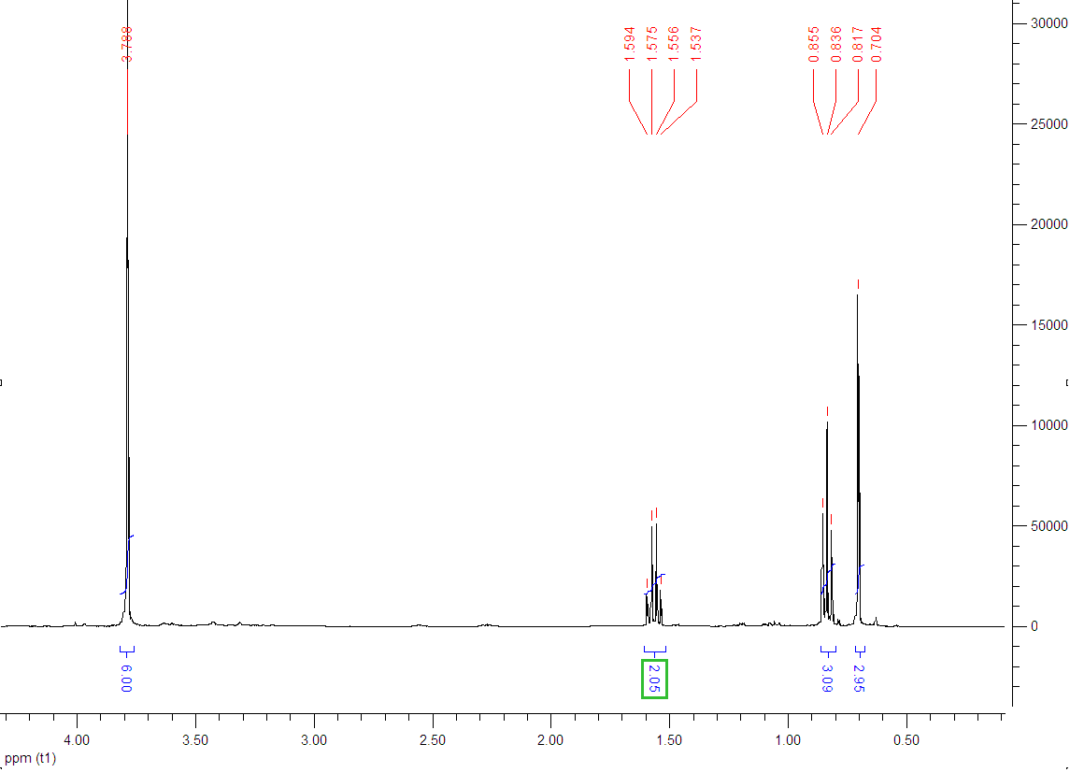
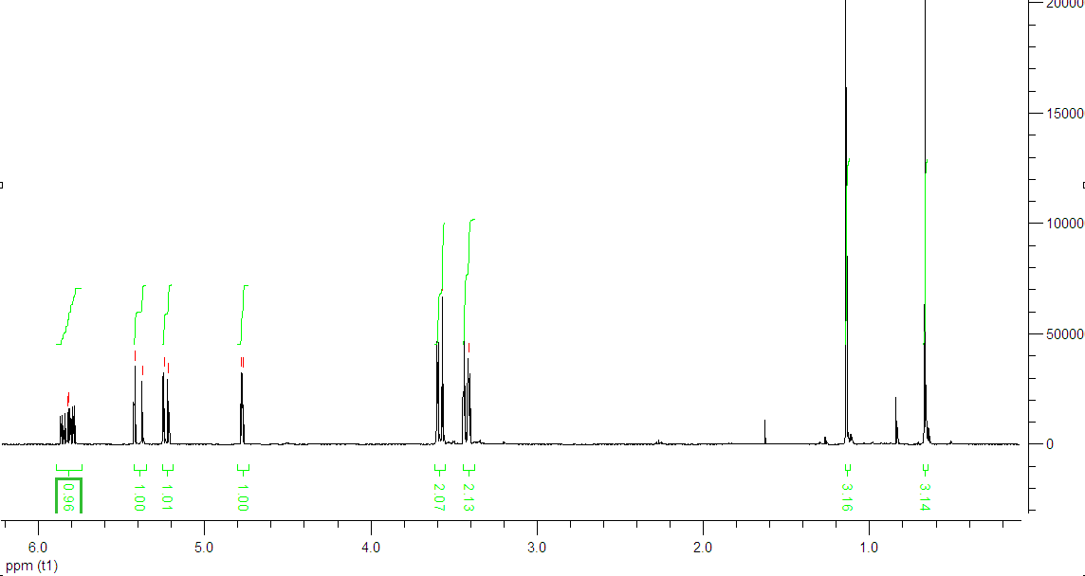

Synthesis, protection and reactivity of cyclic ketene acetals.
Oliver Hutter, Jan Becker and Andrew Dove (Supervisor)
Department of Chemistry, University of Warwick, CV4 7AL, UK.
O.S.Hutter@warwick.ac.uk
Introduction
In this project acrolein (pentanal) was reacted with diols and triols producing six-membered cyclic acetals with terminal double bonds. Protection of these double bonds was then investigated using Diels-Alder chemistry.
The cyclic acetals were also converted into ortho-esters using a one-pot ruthenium catalyst methodology. Cyclic acetals are very water and acid sensitive and can undergo undesirable cross linking reactions. The ortho-ester functional group contains three alkoxyl groups around one carbon atom.
Polyorthoesters are important because they are degradable (bioerodible) polymers that can be used for drug delivery.¹ These polymers are surface erodible which is important for drug delivery and the polymer structure can be tuned to control the rate of drug delivery by varying the rate of degradation.
The approach outlined herein will enable more accessible synthesis of these polymers.
3. Acetal protection
Protection of the terminal double bond (of acetal 1) was investigated using furan, furfuryl acetate and cyclopentadiene. All of these readily undergo Diels-Alder reactions to yeild bicyclic adducts. Freshly cracked cyclopentadiene was used.
For furan, X= O and R1=H, for furfuryl acetate X=O and R1=CH₂OCOCH₃ and for cyclopentadiene X=C and R1=H.
Figure 4. The Diels-Alder reaction with acetal 1 .
2. Acetal synthesis
Cyclic six-membered acetals were synthesised from neopentyl-glycol, 1,1,1-tris(hydroxymethyl)ethane and 2-methyl-1,3-propanediol. The main issue with regard to synthesising these acetals was the reactivity of the acrolein. This was overcome by the very slow addition of 1.1 equivalents of acrolein to the reaction vessel.² Purified acrolein was also used but this did not affect the reaction.
All three were successfully investigated on a small scale. The furan derivative is the ideal candidate, due to its ease of removal in later reactions and hence was synthesised on a larger scale. The furan Diels-Alder adduct was proven to be stable for twelve hours at 120˚C and under a pressure of 2 x10⁻³ Torr at room temperature. ¹³C NMR, ¹H NMR and Mass Spectrometry analysis were carried out on the adduct. The NMR spectra showed that both the endo and exo isomers were produced.
1
4. Production of ortho-esters.
The cyclic acetals produced were then reacted to form ortho-esters. This involves using a ruthenium catalyst for in situ generation of the ketene acetal and subsequent reaction with the alcohol to form the orthoester in one pot.^{4,5} The shifting of the terminal double bond is the rate determining step in these reactions. The sodium carbonate is present to prevent undesired cross linking. This is extremely efficient chemistry, and can be achieved without solvent, in one reaction vessel, with quantitative yields and was carried out with the acetals 1 and 2. Acetal 1 undergoes intra-molecular ring closure in the ketene acetal form resulting in a bicyclic ortho-ester.
2
Figure 1. The synthesis of acetals from alcohols and acrolein.
2
Figure 2. The ¹H NMR spectrum of acetal 1.
3
1
3
4
4
5
1
Figure 5. The reaction of acetal 1.
6
7
5
4
4
2
7
6
Figure 6. The reaction of acetal 2 with benzyl alcohol.
1
1
3
4
Figure 3. The ¹H NMR spectrum of acetal 2.
2
2
3
3
3
5
4
1
1
2
1
4
5
5
3
2
2
2
1
4
Figure 7. The ¹H NMR of the ortho-ester synthesied from acetal 1.
References.
1) J.; Heller, J.; Barr, Biomacromolecules, 2004 , Vol. 5, No. 5, 1625-1632
2) Drauz Karl Heinz et al, Chemiker Zeitung, 1984, 108, 391-397.
3) S.P.; Chavan, P.; Sarma, G.R.; Krishna, M.; Thakkar, Tetrahedron Lett., 2003, 44, 3001-3003.
4) S.; Krompiec, R.; Penczek, N.; Kunznik, J.G.; Malecki, M.; Matlengiewicz, Tetrahedron Lett., 2007, 48, 137-140.
5) J.V.; Crivello, R.; Malik, Y.L.; Lai, Journal of Polymer Science, 1996, 34, 3091-3102.
5. Conclusion
Three six-membered cyclic acetals have been successfully synthesised, protection using furan has been achieved, and this has proven to be relatively stable .Two ortho-esters have also been synthesised from two of the cyclic acetals. Future work will investigate using this ruthenium catalysis method to polymerise the acetals, making polyorthoesters .
Acknowledgements. The Chemistry department and URSS scheme for funding and Jan Becker and Andrew Dove for all of their help.
Stanford, Dove, Macromolecules, 2009, 42, 141.
go.warwick.ac.uk/dovegroup

