Slide 1
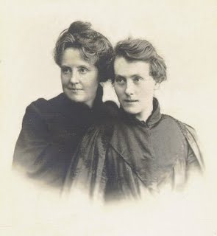
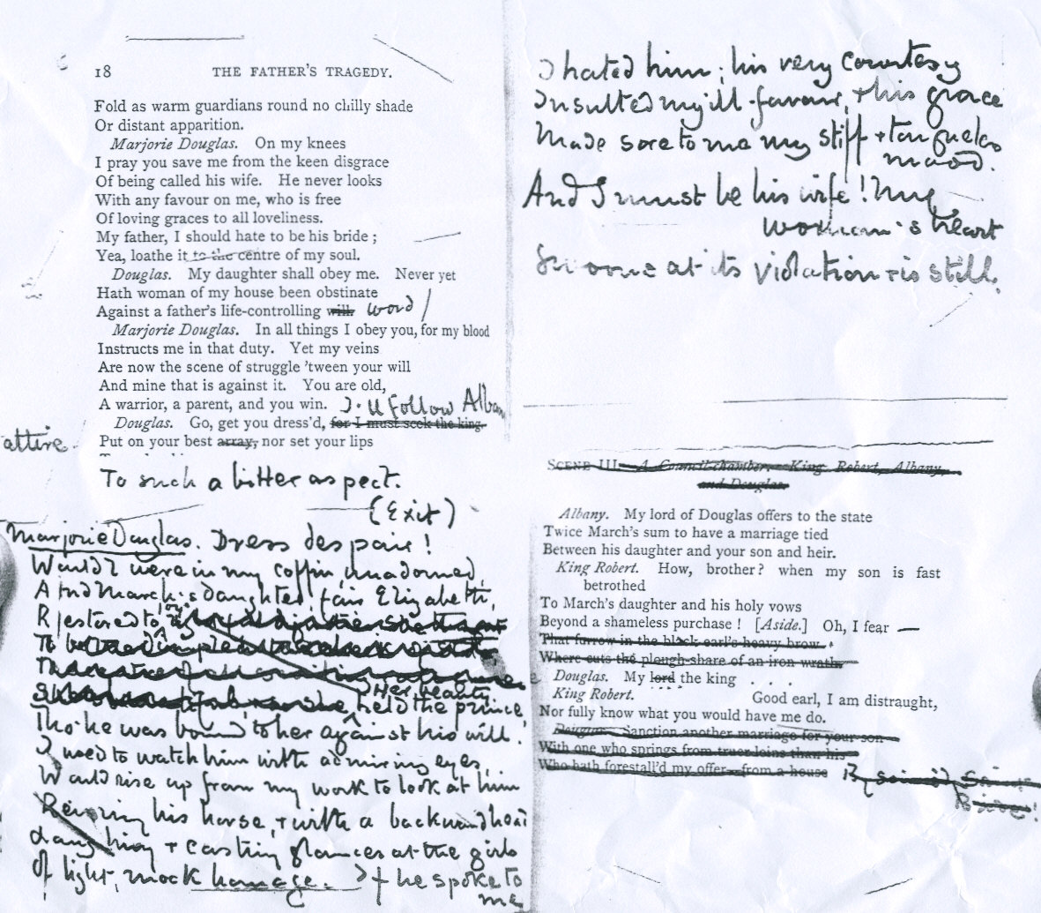
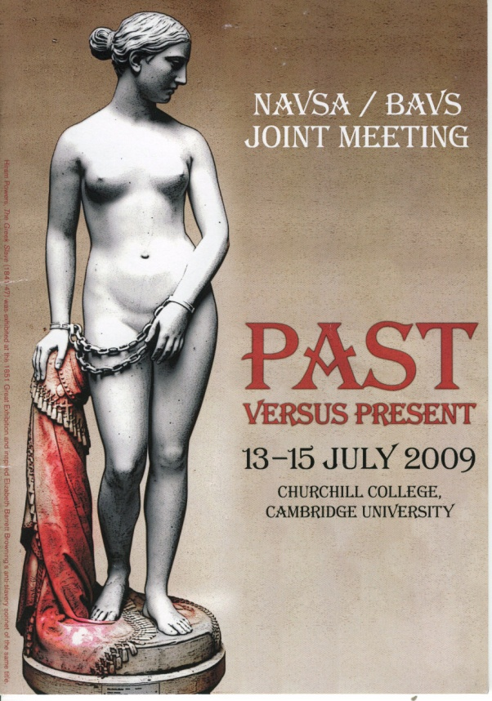
Michael Field’s ‘love that dare not speak its name’
Charlie Cosham: c.cosham@warwick.ac.uk
Supervised by Dr. Emma Mason: emma.mason@warwick.ac.uk
Plan
I was keen to study the original manuscripts of ‘Michael Field’’s work to discover how the two female poets behind this pseudonym reconciled both their individual voices and their unusual relationship through the performance as a male. I accessed their poetry and verse dramas in Oxford’s Bodelian library, and attended a conference in Victorian Studies at Cambridge University to collaborate with leading academics in the field.
Background
’Michael Field’ was the pseudonym of Katherine Bradley and Edith Cooper – two Victorian poets who were aunt and niece, separated by 16 years but living as lovers.
Whilst their male pseudonym opened publishing opportunities unavailable to women, it also represented their revolutionary form of feminism that shrugged off gender altogether. Whilst presenting in feminine attire, they often referred to eachother under nicknames Michael and Henry, and adopted the male pronoun.
Despite the literary merit of their passionate prose and verse, their reputation was scrutinised due to the mystery of the identity of the author(s). However, with the help of figures such as Oscar Wilde, T. Sturge Moore and Mary Robinson, their collaborative voice was heard and they forged a new way of articulating both a female voice and, more specifically, a lesbian one.
‘Michael Field’: Katherine Bradley and Edith Cooper
Findings
Through reading their correspondence and analysing the editing they performed on each-other’s work, I became interested in their strategies for reconciling the two voices speaking behind the single, performed identity of ‘Michael Field’.
I became fascinated by the resurrection of Greek lesbian poet Sappho in their poetry. In the collection entitled ‘Long Ago’ they expanded the remaining fragments of Sappho’s verse into a poetry that articulated a voice specifically known for its associations with the ‘love that dare not speak it’s name’. This led me to research other lesbian poets, and found this Sapphism resurrected in the works of Amy Lowell, Natalie Barney and Renee Vivien.
Edith’s editions to Katherine’s draft of ‘The Father’s Tragedy’
Conference
I attended a week-long conference at Cambridge University – a revolutionary collaboration between the American and British Associations of Victorian Studies that brought leading academics from around the globe together in a series of plenaries, papers and workshops.
Being the only undergraduate in attendance was both a daunting and a privileged position – but the contacts I made that week and the glimpse into life as an academic was an immensely valuable experience, one which shall greatly influence the work and attitude I carry forward into further study.
Evaluation
The URSS scholarship enabled me to push myself into a level of study above what is usually asked of an undergraduate – a challenge which I thoroughly enjoyed and have found immensely useful in directing my Masters applications and thesis preparations. The chance to conduct first-hand research and forge vital academic connections will no doubt bolster my Masters and PhD applications and provided me with a unique field of specialist research. I shall carry my skills and discoveries forward into both my final year dissertation, and my PhD thesis.

