Slide 1
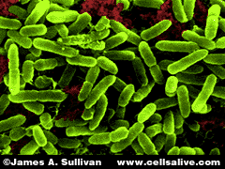
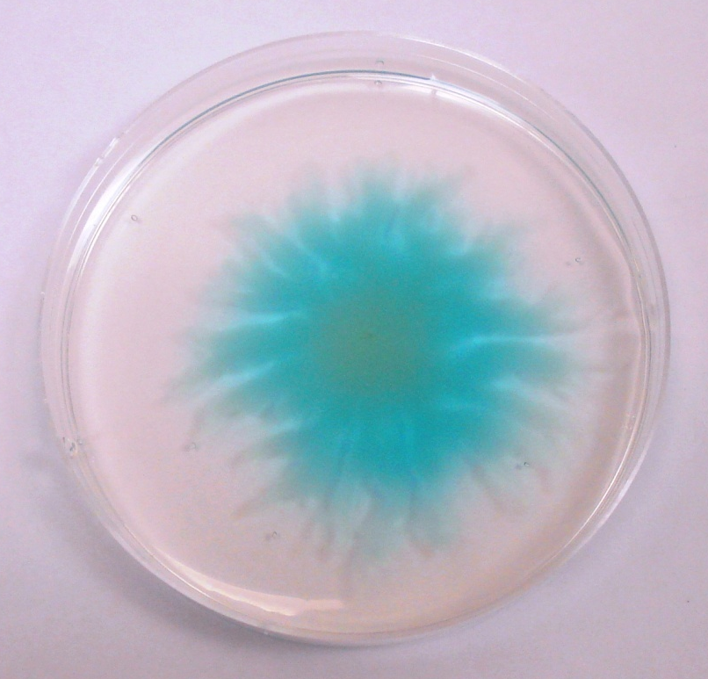
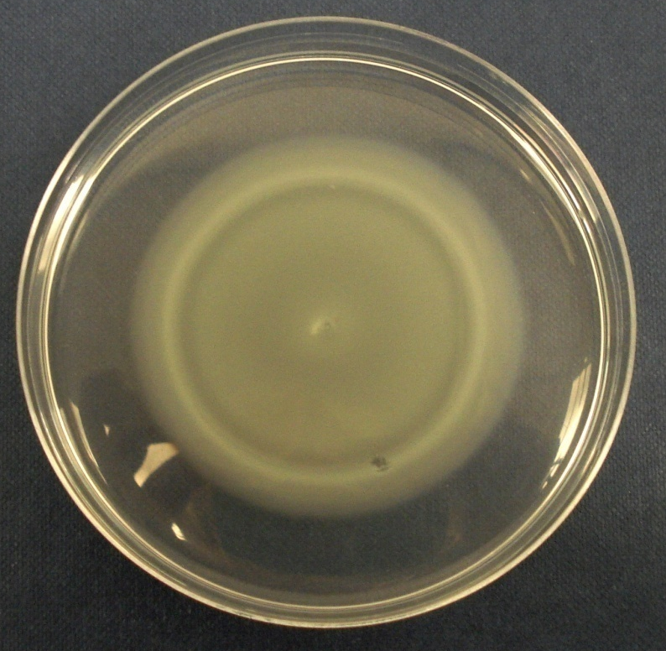
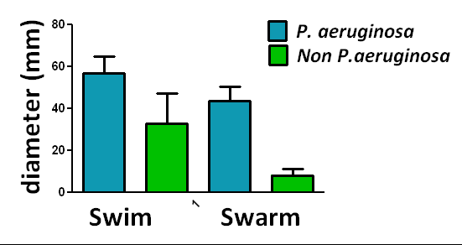


Comparative virulence of isolates of the opportunistic pathogen Pseudomonas aeruginosa
By Emily Reeve: e.l.reeve@warwick.ac.uk, Department of Biological Sciences, University of Warwick
1. Introduction
4. Results
C) Motility Continued...
A) Epidemic strains
The bacterium Pseudomonas
aeruginosa is ubiquitous in the
environment and commonly
causes long term infections in
people with the genetic disease; Cystic Fibrosis (CF). Infection
occurs in the majority on CF adults, resulting in increased lung destruction and decreased life expectancy.
Until recently it was believed that CF patients acquire unique strains of P. aeruginosa from the environment. However, the discovery of highly transmissible epidemic strains changed perceptions. Infection with epidemic strains from other patients is associated with faster deterioration of lung function.
P. aeruginosa virulence is complex and multifactorial. The bacterium exhibits three modes of motility (swimming , swarming and twitching) conferred by pili and flagella, which are thought to be important in biofilm persistence in the CF lung. P. aeruginosa also produces many toxins including ExoS and ExoU, which are mutually exclusive.
It was found that the proportion of positive clinical strains was significantly higher than for the environmental isolates. This supports the view that epidemic strains are spread between CF patients rather than acquired individually from the environment.
I also found that the majority of clinical isolates were positive for ExoS, while environmental were predominantly ExoU as expected.
Manchester
Swarming motility produces finger-like projections from point of inoculation.
Swimming motility creates a circular pattern of growth
B) Phylogeny
The phylogenetic tree opposite shows the identities and relatedness of environmental isolates that were identified as P. aeruginosa by a vet lab. After sequencing the 16S rRNA of these isolates, it was found that 42% were P. aeruginosa and the rest belonged to other related species, suggesting current isolation and identification protocols requires improvement.
The seven MLST loci were sequenced for environmental P. aeruginosa isolates and one of which was found to be a previously unidentified sequence type that was allocated ST824.
5. Conclusions
Epidemic strains were more commonly found amongst clinical isolates compared with plant and canine and feline isolates, thus supporting the hypothesis that these virulent strains are acquired from other humans rather than the environment.
Motility between clinical and environmental strains showed no significant differences suggesting clinical isolates have not adapted to greater motility to aid virulence.
Based on MLST nucleotide sequences, marine Pseudomonas aeruginosa isolates tend to form distinct phylogenetic groupings based on the site of isolation.
2. Objectives
To genetically and phenotypically characterise clinical, veterinary and environmental isolates of Pseudomonas aeruginosa.
Construction of phylogenetic trees to illustrate relatedness between environmental, veterinary and clinical isolates.
Neighbour joining bootstrap phylogenetic tree of 16S sequences from environmental isolates using Mega 4.1 software
Bibliography
Hall, B G. 2008. Phylogenetic trees made easy, a how-to manual. 3rd Edition.
Khan, N H. 2008. Multilocus Sequence Typing and Phylogenetic Analyses of Pseudomonas aeruginosa isolates from the ocean. Applied and Environmental Microbiology Vol 64 no. 20 6194-6205
Rashid, M H and Kornberg, A. 2000. Inorganic polyphosphate is needed for swimming, swarming and twitching motilities of Pseudomonas aeruginosa. PNAS Vol 97 no. 9 4885-4890
Fothergil J L, Upton A, Pitt T, Hart A, Winstanley C. 2008. Diagnostic multiplex PCR assay for the identification of Liverpool, Midlands 1 and Manchester CF Epidemic strains of Pseudomonas aeruginosa. Journal of Cystic Fibrosis. 7 258-261.
C) Motility
3. Methods
P. aeruginosa was more motile than non P. aeruginosa species environmental species and the bacteria swam further than they swarmed. No significant difference was seen between clinical and environmental motility, but larger sample sizes would be needed for confirmation of this finding.
Swimming and Swarming motility of P. aeruginosa versus non P. aeruginosa environmental isolates
Bacterial strains were sourced from the Dowson Group strain collection and cultured at 37°C on LB agar. Motility assays were carried out on low-agar minimal medium as previously described (3). PCR was carried out on colony boilates using the Promega GoTaq kit and previously published conditions (Fothergil). 16S and MLST gene sequencing reactions were carried out by the Molecular Biology Service at the University of Warwick.
Acknowledgements
Professor Christopher Dowson and Elli Pinnock, Biological Sciences, University of Warwick

