Slide 1



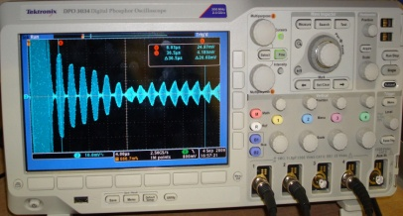
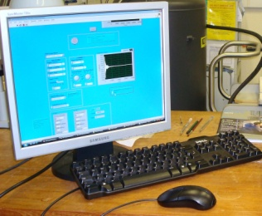
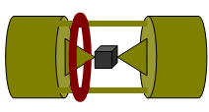
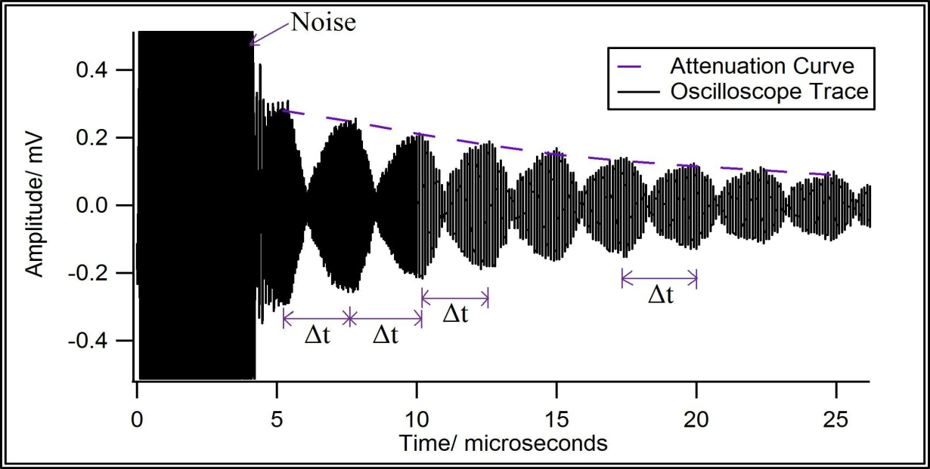
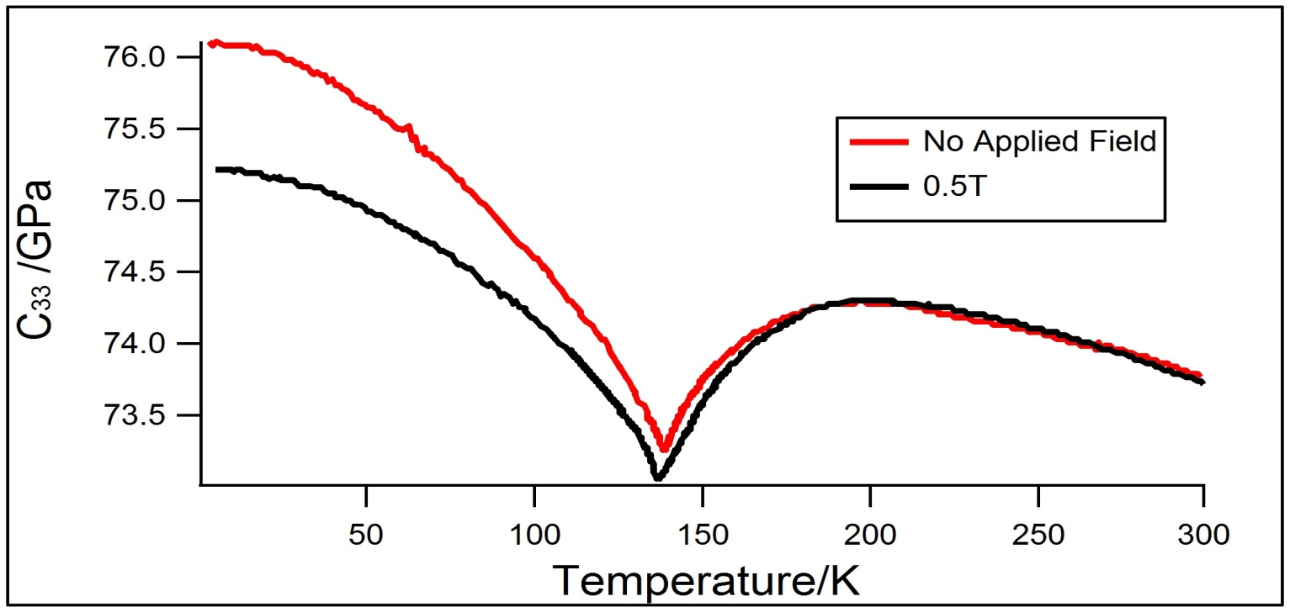
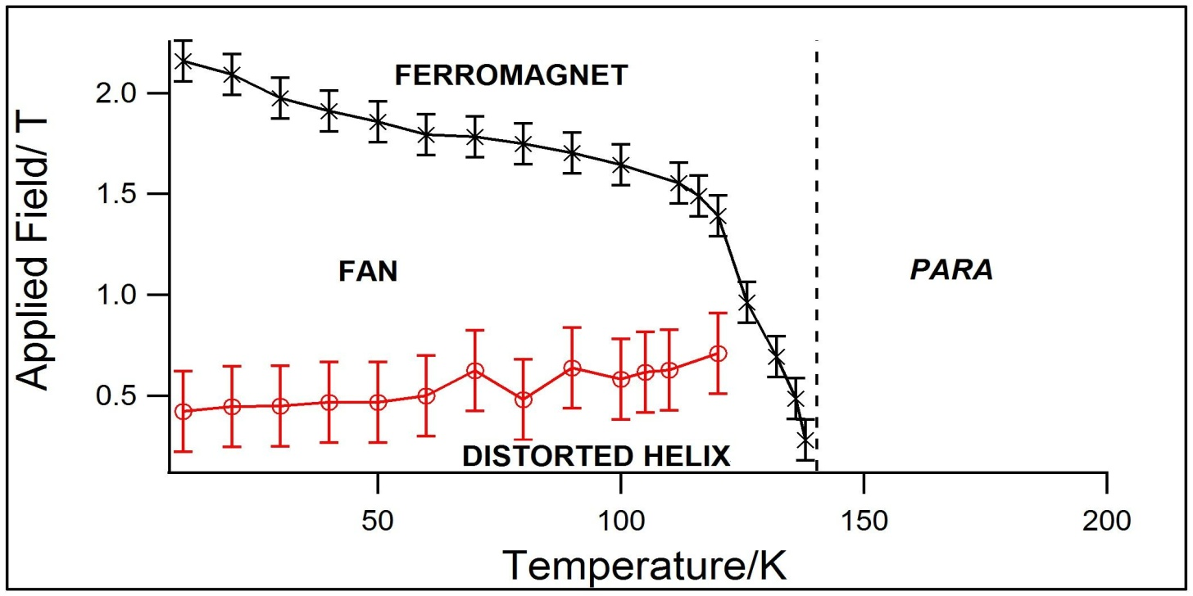
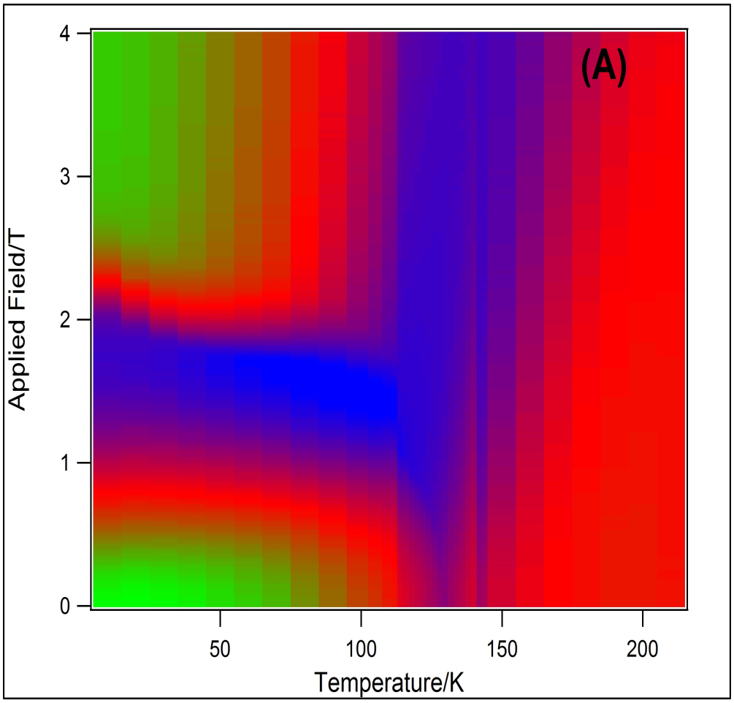
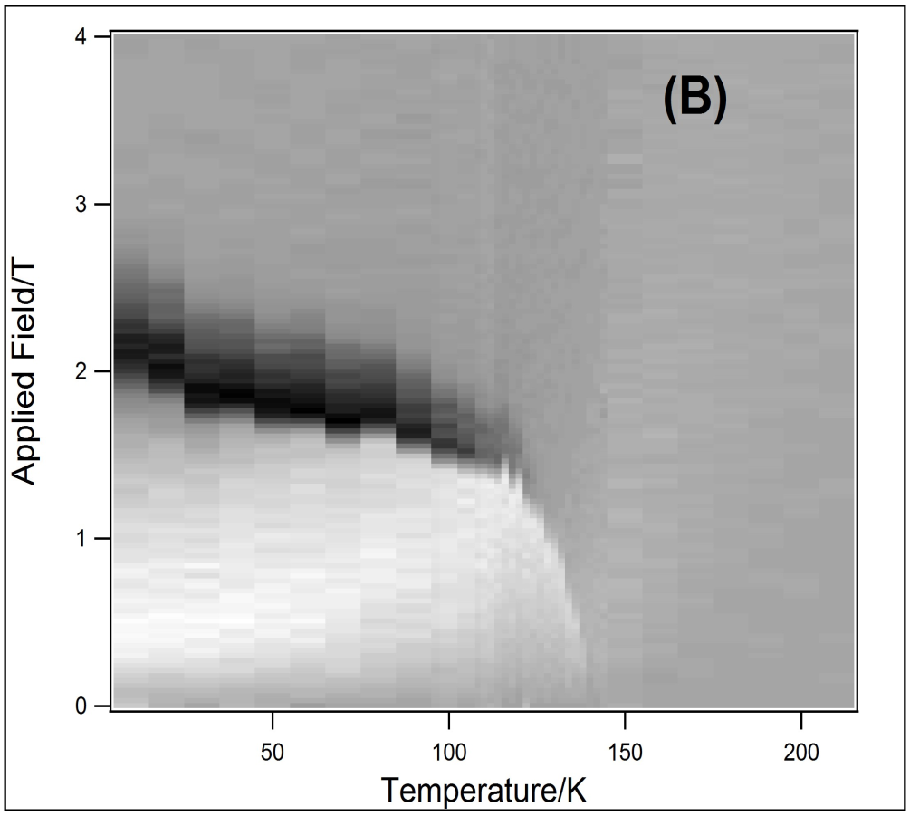
Low Temperature Ultrasonic Measurements of Gd64Sc36 Single Crystal
Demetra Cleanthous, Dr. Rachel Edwards
Introduction
The elastic moduli of a material can be determined by measuring the velocity of ultrasound travelling through it. They are dependent both on temperature and the magnetic field. Thus the behavior of the material can be studied by recording the overall change of its elastic moduli over a range of temperatures and magnetic fields. During this experiment the sample used was Gd64Sc36, a rare-earth single crystal with magnetic properties and a hexagonal close-packed (hcp) structure . A 15MHz x-cut quartz transducer was attached onto the face of the sample which was normal to its c-axis. Since the transducer is piezoelectric, when a small voltage is applied to it, ultrasound propagates through the medium along its c-axis. Due to the symmetry of an hcp crystal propagation of ultrasound along the c-axis using an x-cut transducer (longitudinal wave) enables the determination of C33; one of the five moduli of elasticity that have to be obtained to completely describe the elastic properties of the crystal.
2. Method
3. Measurements
The sample was mounted on the end of a long probe which had a heater and a thermistor attached to its end. The probe was then carefully inserted in the variable temperature insert (VTI) situated in a cryostat inside the superconducting magnet. In this way the magnetic field as well as the temperature could be varied and the sample was placed at the centre of the magnetic field.
The following measurements were performed:
  The magnetic field was set to zero and the temperature was varied from 4.2K to 299K and vice versa.
  The temperature was kept fixed and the magnetic field was varied from 0T to 6T and back to 0T. The range of temperatures covered was from 10K to 210K.
  The field was set to 0.5T and the temperature was varied from 5K to 299K.
In order to obtain the velocity of ultrasound and therefore C33 a technique similar to the pulse-echo overlap method was used. The time delay between the echoes , Δt , as shown in Fig.2 was determined by writing a program in LabVIEW achieving cross correlation of 2 consecutive pulses and finding the time difference between their peaks.
Fig.1 displays the equipment used and a simplification of how it was connected. The Pulse Generator sends a 15MHz signal which is converted to ultrasound propagating through the medium.
Digital
Multimeter
Pulse Generator
(15MHz)
Heater
Magnet
Sample
Probe
Transducer
Rotated Clockwise by 90°
Magnet
Power Supply
The velocity of ultrasound, v, is calculated using equation 1 where x is the sample’s length and Δt is the time delay between the echoes. Finally, the elastic constant C33 is calculated using equation 2 where ρ is the density of the sample.
Fig.1: Schematic Diagram of equipment
The transducer then detects reflected pulses, converts them to an electrical signal which is then amplified and displayed on the oscilloscope. Also, the digital multimeter is connected to the thermistor and records its resistance which varies with temperature.
A program was created using LabVIEW enabling us to record and save the following directly on the computer while carrying out the experiment;
  Data from oscilloscope
  Magnetic field
  Resistance (Converted to temperature using a calibration curve and a set of programs written in LabVIEW.)
v = 2x / Δt (Eq.1)
C33 = ρv² (Eq.2)
Fig.2: Typical Data
4. Analysis & Results
  Fig.5 demonstrates two image plots of C33 against applied field and temperature.
  Initially individual plots of C33 against applied field were created for a range of temperatures. On these plots the fan to ferromagnetic transition was identified at a critical field. This critical field together with the corresponding temperature and C33 were recorded and were then used to plot Fig.5 (A).
  However, Fig.5 (B) was formed after taking the derivatives of these plots and distinguishing where the transition from distorted helix to fan phase also occurred which was not as obvious on the earlier plots. Hence, both transitions are clearly displayed here.
Fig.3: Graph of C33 against Temperature with
No field applied (red) and 0.5T field applied (black).
Fig.4: Magnetic Phase Diagram of Gd64Sc36
as a function of applied field and temperature.
A dramatic change in the ultrasonic velocity and consequently C33 indicates a phase change of the crystal.
  In Fig.3 a phase transition occurs at 139K when no field is applied, and shifts to 136K when the field is increased to 0.5T.
  This characteristic temperature is known as the Neel temperature, below which a paramagnetic to ferromagnetic phase transition occurs.
Fig.4 displays the magnetic phase diagram of Gd64Sc36, indicating a phase transition from a distorted helix to a fan phase at around 0.4T and another more obvious field-induced transition from fan to ferromagnetic [1].
Fig.5 is a modern version of Fig.4 plotted using improved computer software enabling 3D plots.
Fig.5: Image Plots of C33 against applied field and temperature. (C33 is displayed by the colour on each plot.)
5. Conclusion
Automation of the experiment has been achieved. This allows it to be carried out much faster and more accurately than previous experiments. This method can be used to examine the magnetic properties of other samples which may be of need to future work such as development of new magnetoelastic devices.
References:
[1] R.J. Melville et al., Helimagnetism and field-induced phases in random Gd64Sc36 single crystals, J. Phys.: Condens. Matter 11, 7115–7124 (1999).
Email:
D.Cleanthous@warwick.ac.uk

