Slide 1

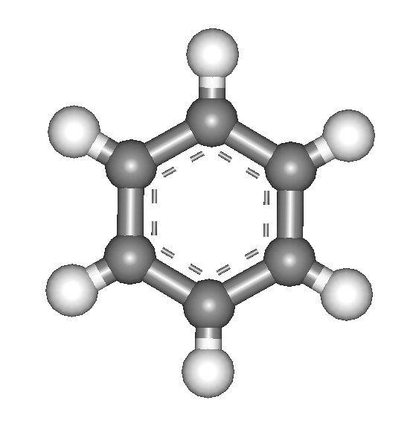
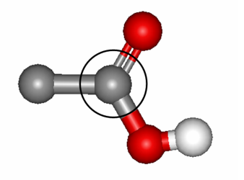
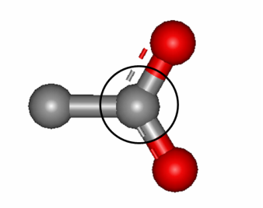
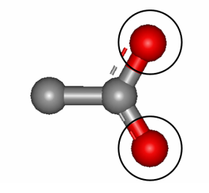
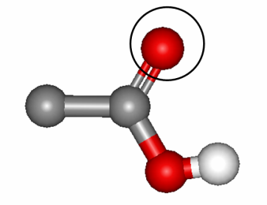
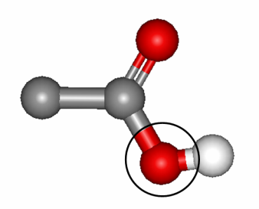


Characterisation of 2-Dimensional TPA-Cu Nanostructures using X-Ray Photoemission Spectroscopy
Abstract
The careful design and fabrication of organic molecular nanostructures on metal surfaces offers a wealth of potential technological advances, particularly in the fields of microelectronics, catalysis and biotechnology. The study of such networks routinely involves characterisation with X-ray Photoemission Spectroscopy (XPS) thanks to its ability to characterise the chemical state of adsorbed molecules. Presently, XPS has been used to study two such monolayer networks fabricated using Terephthalic Acid (TPA) on a Cu(110) substrate.
2. Observed Nanostructures
The Cu(110) substrate demonstrates a strong templating effect and, above a certain threshold temperature, provides surface adatoms essential in fabrication of the metal-organic system [1]. TPA was selected as the organic linker molecule due to its planar geometry and its functional moieties which strongly interact with copper atoms. Two TPA monolayer nanostructures have been previously identified; the (10x2) consisting of metal-organic chains held together by inter-chain hydrogen bonds. Increased TPA coverage results in the formation of the (6x2) phase, an organic hydrogen-bonded network. Both networks have previously been characterised by STM and DFT, but further investigation is required to determine the chemical properties and charging state.
Figure 1. The (10x2) metal-organic (left) and (6x2) organic network (right)
4. Results
Figure 2. XPS spectra of the C1s signal (above) and O1s signal (below). Red is the (10x2), green is the (6x2) and blue is the TPA multilayer sample.
The data is in good agreement with data for similar systems [2,3]. Both spectra demonstrate that there is little difference between the two monolayer nanostructures; in both cases, the molecules are fully deprotonated. The peaks signals are detailed below:
284eV 288eV 290eV
531eV 533eV 534eV
Figure 3. C1s (top) and O1s (bottom) XPS signals
This work, coupled with LEED findings (not shown), is in good agreement with the STM and DFT data of these systems, giving a coherent picture of the adsorbates’ chemistry. Further work is required to analyse the subtle differences in the spectra, possibly attributable to the presence of adatoms within the network.
3.Methods
The samples were prepared by depositing different amounts of TPA onto a Cu(110) crystal under UHV conditions, using LEED to determine the structure. XPS measurements were performed on these systems, due to their surface sensitivity and ability to determine different chemical environments of the adsorbed molecules. The measurements were undertaken at the ELETTRA synchrotron in Trieste, Italy, in 2008 as part of a previous EPSRC funded project. Besides the two monolayer structures, a multilayer system was also prepared, such as to probe the unperturbed TPA molecules. This project deals with the analysis of the XPS data relative to the carbon and oxygen signals measured for each sample. Its aim is to determine the charging state of the molecular units and to correlate this information with the already existing STM and DFT data.
5. My Experience of the URSS
Throughout the process of this investigation, I have vastly improved my research skills and gained a practical experience of data handling and data interpretation. I have also had the opportunity to improve my working knowledge of the surface science field, something that will prove invaluable in my future. In particular, this project has cemented my conviction in pursuing a PhD in this field.
Thomas White
Supervisor: Dr Giovanni Costantini
[1] C. Perry et al, Surface Science, 1998, 409, 512–520
[2] T. Classen et al, J. Phys. Chem. A, 2007, 111, 12589-12603
[3] S. Stepanow et al, J. Phys. Chem. B, 2004, 108, 19392-19397

