Slide 1
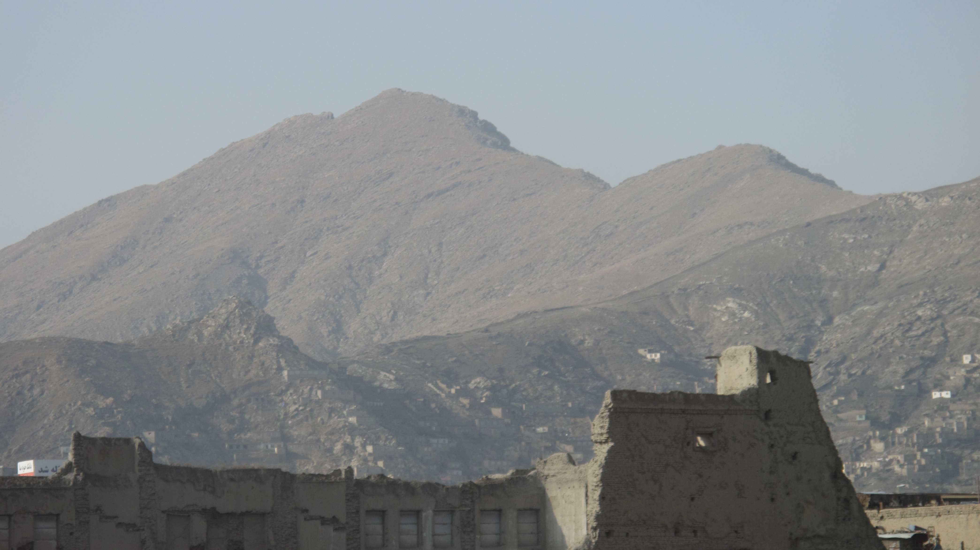
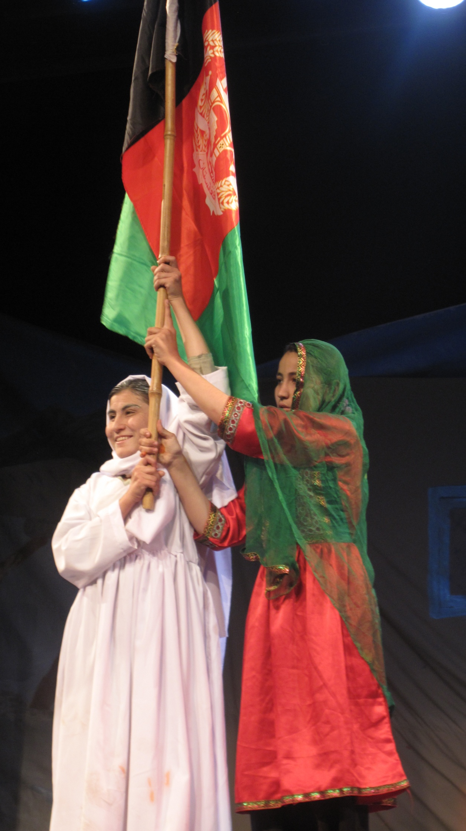
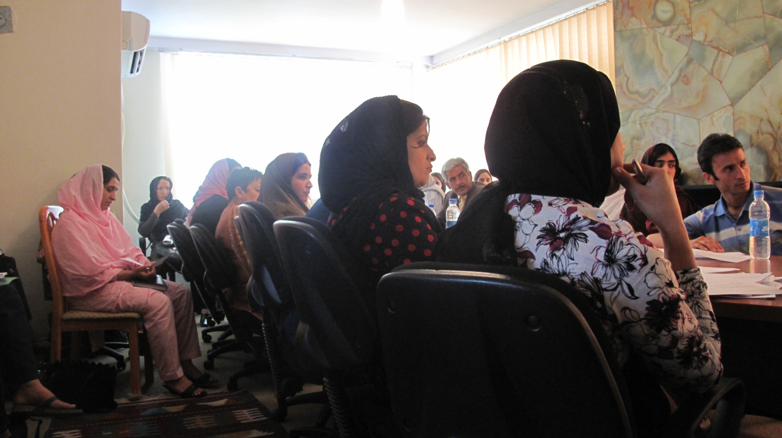


Writing Women’s Rights in Law The Afghan Experience
Introduction
In early 2009, I made a decision to travel to Afghanistan to document a historical episode of law-making to protect and promote the rights of women in Afghanistan. As a law student, I was very interested in understanding the process in which an idea is first conceptualised by women’s rights activists and then gradually presented in legal form. This took me through the birth and creation of a potentially important piece of legislation that may have far-reaching effects for the security and autonomy of Afghan women if accompanied by effective implementation throughout the country. No doubt Afghanistan was a difficult example to work on and in but it was an important one for my understanding as a lawyer of what role the law plays in post-conflict reconstruction and in peace-building. Women make up 50% of Afghanistan’s population but yet comprise of one of Afghanistan’s most vulnerable groups. Emerging from a history of 30 yrs of continuous warfare, the legal system struggles to live up to the needs of the Afghan women. Child marriage, forced marriage, sexual harassment and domestic violence are everyday occurrences in many homes. Shelters and women centres as well as women-backed movements and initiatives have existed for a long time even before international presence but it is only now that we are seeing a pro-active civil society engage at the legal level with law makers, donors and the government; officially representing the legal interests of Afghan women at large. From a legal perspective this is interesting because the content of women rights laws is being debated and constructed in the offices of women’s groups. They are developing their own technical expertise in legal research and drafting. Though a legislative drafting department exists in the Ministry of Justice, to a large part, the legal workability and effectiveness of this law lies in the original drafts of civil society groups. It is this that I am interested in. I want to understand who drafts them, who are consulted during the drafting, what resources are used, what method of drafting is followed, what standard criteria is there for reviewing and amending these drafts. These questions are important because the answers reflect the legal workability of these drafts; that is, the extent to which the police, prosecutors and judges can understand it, use it and be pressured to respond fairly in situations where a woman’s right is concerned.
Thus my mission here is to produce a resource book for civil society groups and individuals working in gender and legal reform on: Strategic Thinking in Legislative Drafting of Gender Law in Afghanistan: A Historical Documentation of Experiences with the Shia Personal Status Law and Elimination of Violence Against Women Law and Future Improvements
Process
Understanding my context
Spoke to activists and lawyers about the history of both the Shia Personal Status Law and Elimination of Violence Against Women law – the content, process of developing the content, who were involved, what they did, the process it took in the legislature, the politics behind the law, getting familiar with the legislative process and the role of civil society groups in law reform and their relationship with the government and parliament
Became familiar with existing family law and penal law provisions, the sources of law in Afghanistan and the implications of Constitutional provisions on laws
Analysed the drafts of the Shia and EVAW law submitted by various stakeholders
Understood the role of civil society groups in the amendment of the law and how they contributed towards the drafts
Collected reports that have been published on these laws to make sure that I am not replicating anything already produced
Spoke to an active Afghan lawyer about what would be useful, going through with him the themes I was going to explore and the kind of questions the paper would answer
Developed a research proposal and as the interviews progressed I redefined the scope of my research and the questions the paper would answer
Tried to find the right supervisors and an organisation to parent this research (here I learnt about working within and through existing networks and informal relationships)
Reading Preparations: Analysis of the drafts and Literature Review
My first step was to collect all the drafts on amendments of the EVAW Bill and Shia Personal Status Bill in English. These drafts were submitted by various individuals from both local and international organisations.
Analysed the different drafts and noted how it developed as more individuals and groups became involved in suggesting amendments to each Bill.
Noted what provisions was changed and how it was changed after Taqnin (legislative department of the Ministry of Justice) watered it down
To analyse the Afghan law critically, I had to make comparisons with similar laws in other countries. I read documents about good legislative practises when drafting laws on violence against women. These were based on the tested experiences of other countries around the world and comprised mostly of the entire series of expert papers submitted during the 2008 conference organised by the UN Division for the Advancement of Women (UNODC) in Vienna.
Present preparations
From this analysis (just the prior point above), I will develop a criteria for analysing the different drafts (format, language, consistency with drafting rules, extent to which it strategically thinks about its phraseology to ensure optimal receptivity, extent to which it follows the best legislative practices of other laws tested by the experience of other countries)
I will develop a contact sheet of all the key people I need to speak to. This involves finding out and noting down who these individuals and groups were.
I will interview the individuals who contributed to these drafts. I want to get the sense of how many individuals actually drafted these amendments and who they were (not just their names but their qualifications and their experience)
The interviews will allow me to understand why were certain provisions phrased in a certain way? Why were some offences left out? What preparations were done before drafting (study of credible statistical data and case studies, research and comparative reviews of laws and experiences of other countries, understanding of proper legislative drafting rules, consultation with legal advisors, human rights law advisors, legislative drafters)? Was there any strategic thinking involved when deciding the phraseology and language of the law to make sure to the best extent possible it would be well-received by conservative members of parliament (assuming the opposition would be an ‘Islamic opposition’)?
I will read and understand Taqnin’s (legislative department of the Ministry of Justice) role in legislative review and drafting.
I will interview members from Taqnin who were involved in each Bill about the process by which they reviewed the Bills – what standard procedure of review or protocol was followed (if there is one) or if not (or in addition to) what criteria of review did they undertake, what provisions were changed (either amended, repealed or added) and for what reason?
I will interview members of the Women’s Commission in Parliament about their general and specific impressions of the drafts of amendments submitted to them by international organisations and civil society groups.
I will ask what preparations (Shariah arguments) have been made and submitted to the Women’s Commission to counter the Islamic opposition?
Brief Findings (this is only based on an evaluation of the Violence Against Women Bill)
Many procedural guarantees (some necessary, some recommended) for the protection of victims are missing or otherwise incomplete
Equal application of legislation to all women and measures to address multiple discrimination;
Duties of police officers, duties of prosecutors, pro-arrest and pro-prosecution policies;
Rights of the complainant during legal proceedings
Issues related to the collection and submission of evidence
No adverse interference from delay in reporting
Removing the cautionary warning/corroboration rule/practice
Emergency orders
Consideration of fines in cases of domestic violence in impoverished households
Enhanced sanctions for repeated offences
Restitution and compensation for survivors
Alternative sentencing
Making effective use of a range of areas of the law, including civil redress and administration protection and prevention;
Allocation of adequate budget;
Specific provisions on training;
Protocols, guidelines, standards and regulations;
Penalties for non-compliance by relevant authorities;
Careful and regular monitoring to ensure that legislation in implemented effectively and does not have any adverse unanticipated effects, reveal gaps in the scope and effectiveness of the law, the need for training, lack of coordinated response etc;
Collection of statistical data disaggregated by sex, race, age, ethnicity etc.
2. The provision on rape still adopts the definition of an act that violates the victim’s chastity rather than her bodily integrity and sexual autonomy. This makes rape a crime of immorality (adultery) rather than an act of intrusion of autonomy or violence.
3. The Bill creates offences that already exist in the Penal Code; parallel criminal provisions exist simultaneously. It was recommended that the Bill amends/repeals existing provisions of the Penal Code to ensure the coherency and consistency of the criminal law system.
4. It is better to amend through the Penal Code because the articles in the Penal Code are already exhaustive, they have an integral place in Afghanistan’s laws, they have developed jurisprudence, familiarity and tested practice and they are gender-neutral to the most part (in this case, not biased against men).
5. The Bill, having been drafted to protect women creates unequal consequences for men and boys that need similar protection.
6. The material elements of certain crimes were not specified in sufficient detail and makes it difficult to prove the crime.
7. Some provisions in the draft makes unrealistic promises to victims of violence without consideration of finite state resources as well as the constitutionality of the protected rights of others in non violence-against-women related cases (for e.g. the Bill demands that all violence against women cases take priority over all other cases. But a man who has been in prison without trial for 20 years should be taken priority over a woman who has not been seriously hit by her husband).
8. Some behaviour like ‘verbal degradation’ and ‘deprivation of inheritance’ are not criminal behaviours and should not fall within the definition of ‘violence’. These behaviours are better corrected through educational and not criminal means.
9. Civil society groups are not clear what terms in law are to be defined under ‘Definitions’ and what terms do not require definition. In particular, the definition of crimes should not fall under ‘Definitions’ but should be defined within the provision of the crime itself.
10. The entire chapter on the ‘Obligations of the Ministries’ consist of very vague ineffective provisions with no due time or process included.
11. Some criminal offences have not been included: virginity testing, honour killings and accusation of zina (adultery).
12. The offence of rape is incomplete. There is no guidance as to the material elements of the crime; (mainly, what penetrates and what is being penetrated).
13. The material elements of other acts of sexual assault (short of rape) are not defined.
Acknowledgments
Professor Andrew Williams (Warwick Law School)
Professor Ann Stewart (Warwick Law School)
Zia Moballegh (Rights and Democracy)
DED (German Development Service)
Research conducted by:
Natasha Latiff
www.feminijtihad.webs.com

