Slide 1
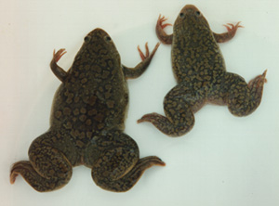


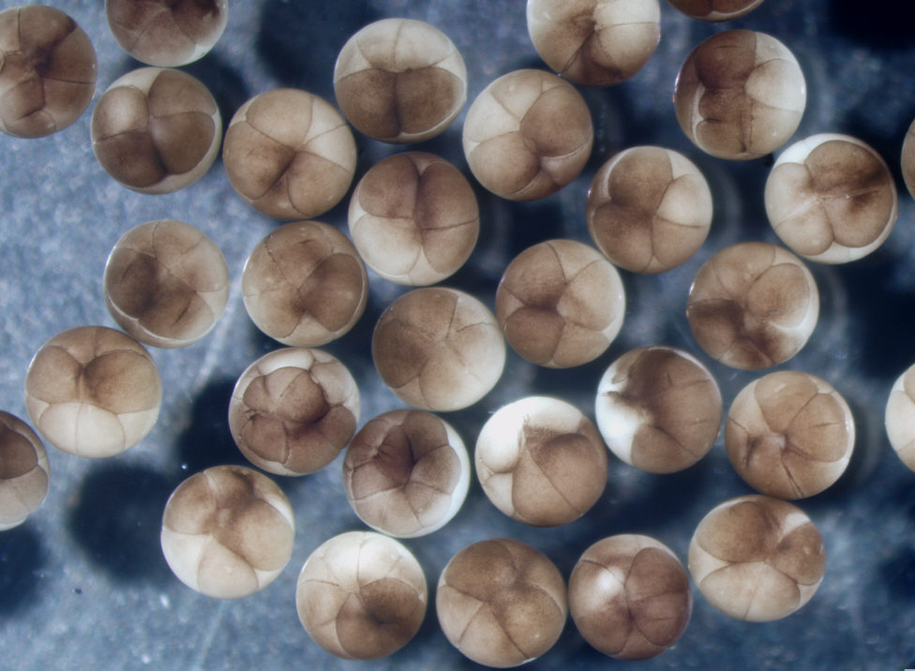
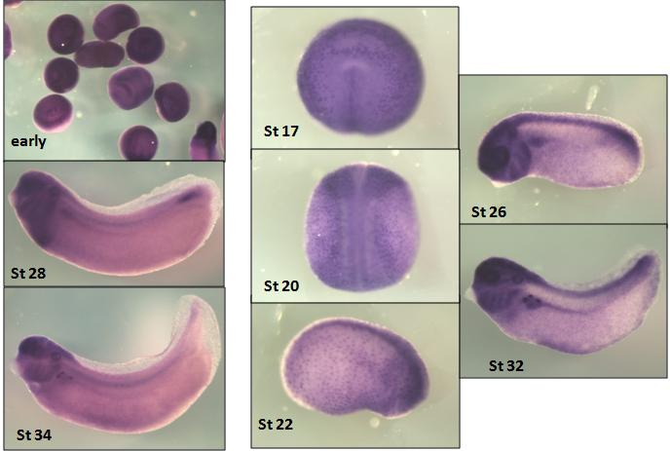
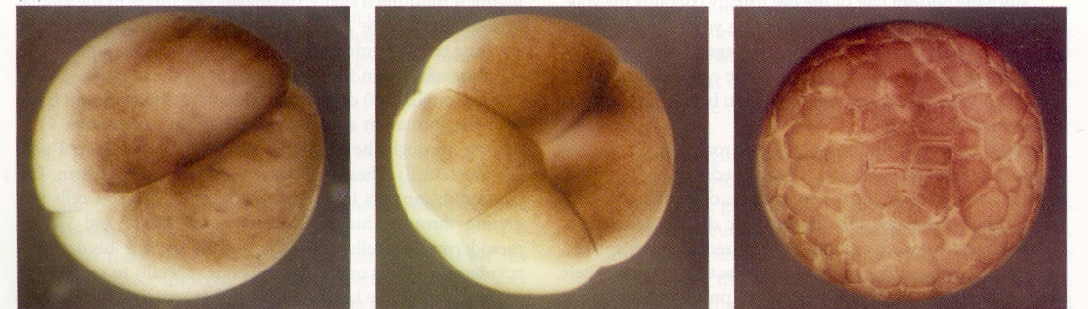

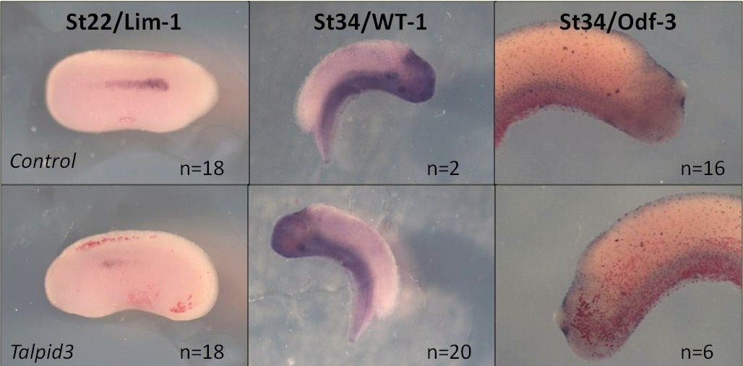
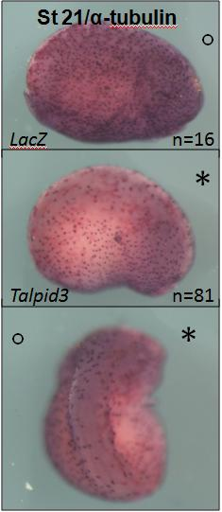
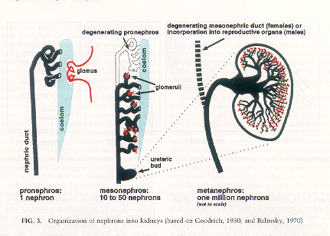
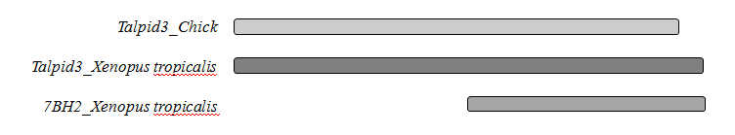

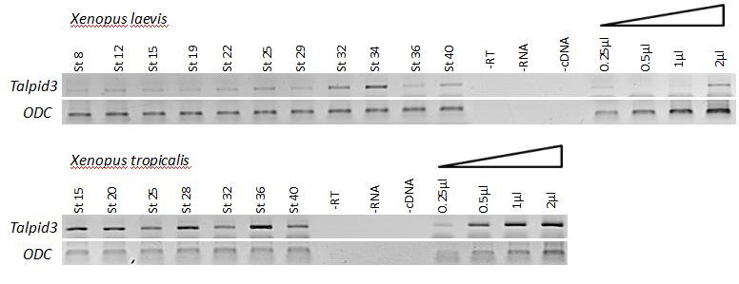
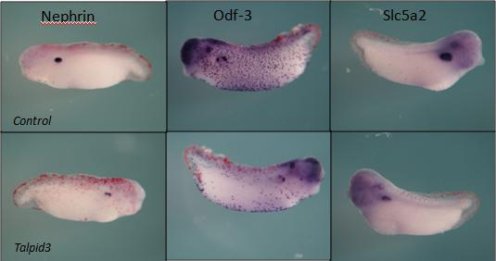
The frog as a research tool in developmental biology...
Saroor PATEL
Department of Biological Sciences
s.a.a.patel@warwick.ac.uk
Introduction
How a cluster of cells develops to become a fully functioning complex organism is one of the key problems in determining the origins humans (as well as all other life forms). Developmental biology aims to study this phenomenon using model organisms such as the chick, mouse or frog. However, the frog being an amphibian is evolutionarily very distant relative to humans, has a especially dissimilar development pattern but develops by conserved mechanisms. In order to demonstrate the use of the frog in developmental research, the role of a particular gene (talpid3) involved in Xenopus development was investigated.
1. Xenopus as a model organism
1.1. What are the advantages of using the frog?
Vertebrates
Can be induced to lay a large number of eggs by human hormones HCG and FSH.
Rapid development (only a few days to reach tadpole stage)
Easy to maintain (aquatic, eat dead food)
External fertilisation and development
A few disadvantages...
Not a mammal
Genetics are not as developed as other model organisms but more and more information is now becoming available
1.2. Why use Xenopus frog?
Common
Large eggs (1mm), easy to manipulate
Reproduce all year round
Two main species are Xenopus laevis and tropicalis
Xenopus laevis : most common and largest of Xenopus species, it is tetraploid (has four sets of chromosomes) and so genetic studies are difficult.
Xenopus tropicalis: good genetic model as it is diploid (two sets of chromosomes as in humans).
1.3. Experiments that can be performed on the frog:
In vitro fertilisation (artificial fertilisation of frog eggs).
Microinjection: injection of RNA, DNA or Morpholino
(see below) into developing embryos
In situ hybridisation: injection of labelled RNA or complementary DNA into embryos which bind to the target DNA allowing it to be localised.
Knock-out studies: inhibition of a gene by injection of a Morpholino oligonucleotides that can bind to a specific RNA thus inhibiting the expression of a particular gene. The Morpholino is made up of morpholine modified oligo nucleotides which are nucleic acid base analogs.
2. Case Study: The role of Talpid3 in the Xenopus kidney development
2.1. The Talpid3 gene
Talpid3 is a lethal chicken mutation in an autosomal gene (the talpid3 gene) leading to a recessive phenotype (the mutation must be present on both chromosomes to give a phenotype) of polydactylous limbs with morphologically similar digits and abnormalities in other parts of the embryo due to a lack of primary cilia and deficient Sonic Hedgehog signalling (Shh).
A talpid3 gene homologue (7BH2) has been identified in the Xenopus frog, altered levels of gene expression leads to irregularities in pronephros development, presumably by affecting ciliogenesis in this organ. The aim of this study is to determine the relationship between 7BH2 and the Shh pathway.
2.5. Talpid3 expression is located in ciliated cells of the nephrostomes in the Xenopus pronephros using whole-mount in situ hybridisation
A
B
Fig5. In situ hybridisation of whole embryos to localise Talpid3 gene expression in the Xenopus frog using the full length clones.
A: in Xenopus laevis
B: in Xenopus tropicalis
2.2. Development of the Kidney in the Frog
After fertilisation, the eggs undergo a series of cleavage steps
to form a blastula (ball of cells).
The Blastula has the organisation to form the tissues and the organs of the complete tadpole.
Fate map: diagram of the blastula showing the specification of the various cells.
Microinjection in specific areas of the blastula can target particular organs.
The pronephros is the kidney in the frog: only one nephron,
so simpler model of the human kidney
Different markers target the various areas of the pronephros.
These include : 1) Lim1 targets the early kidney
2) WT1 targets the glomus
3) Odf-3 targets ciliated cells in the nephrostomes
4) Na/K- ATPase targets the tubules.
Fig1. Image of cleavage steps.
Fig2. Diagram of the fate map.
The red cell develops into the pronephros
2.6. Overexpression of Talpid3 appears to reduce the number of ciliated cells leading to a loss of nephrostomes.
A
B
2.3. Multiple alignment of Talpid3 sequences in the Chick and Xenopus.
Fig6. In situ hybridisation of whole embryos after microinjection of Talpid3 mRNA in one ventro-animal blastomere (C).
A: using partial clone mRNA in X.laevis
B: using full length clone mRNA in X.tropicalis
C
1523aa
1549aa
709aa
Fig3. Schematic representation of sequence alignment of Talpid3 in the Chick and Xenopus.
7BH2 was the initial clone, it was found to be only a partial sequence of Talpid3 and the full length clone was then determined.
2.4. Temporal expression pattern of Talpid3 in Xenopus
2.7. Knock-out studies using Morpholino oligonucleotides targetting Talpid3 confirm its role in ciliogenesis.
Fig4. RT-PCR on whole embryo stage series detects continuous Talpid3 expression in X. laevis and tropicalis (using identical cross-species primers for ODC and Talpid3).
Fig7. Stage32 Xenopus tropicalis embryos injected with Talpid3 Morpholino
Phenotype: loss of ciliated cells on the injected side of the embryo
Conclusion
Talpid3 is expressed in the ciliated cells of the pronephros located in the nephrostomes; the involvement of Talpid3 in ciliogenesis confirms its relationship with the Shh pathway (since Hedgehog signalling is dependent on ciliogenesis). Overexpression and knock-out of the gene causes loss of cilia in the nephrostomes suggesting that Talpid protein is required for proper development of the nephrostomes in the kidney. Talpid being a highly conserved gene (c.f. Sequence analysis), the above may apply to Human kidney development.
Therefore, using the frog as model organism, it was possible to determine a relationship between Talpid3 and Hedgehog signalling. Further studies are however required in order to find the precise role of the Talpid gene.
References
Jun-ichi Kyuno, Karine Masse, Elizabeth A. Jones (2008). Mechanisms of Development 125, 571-586.
Yili Yin, Fiona Bangs, Alan Prescott et al. (2009). Development 136, 655-664.
Acknowlegdements
Special thanks to my supervisor Prof. Elizabeth Jones, Dr. Richard Naylor who worked with me on this project, the lab technician Surinder Bhamra, Paul Jarrett for preparing the frogs and all the other lab members for their support throughout this project.

