Slide 1


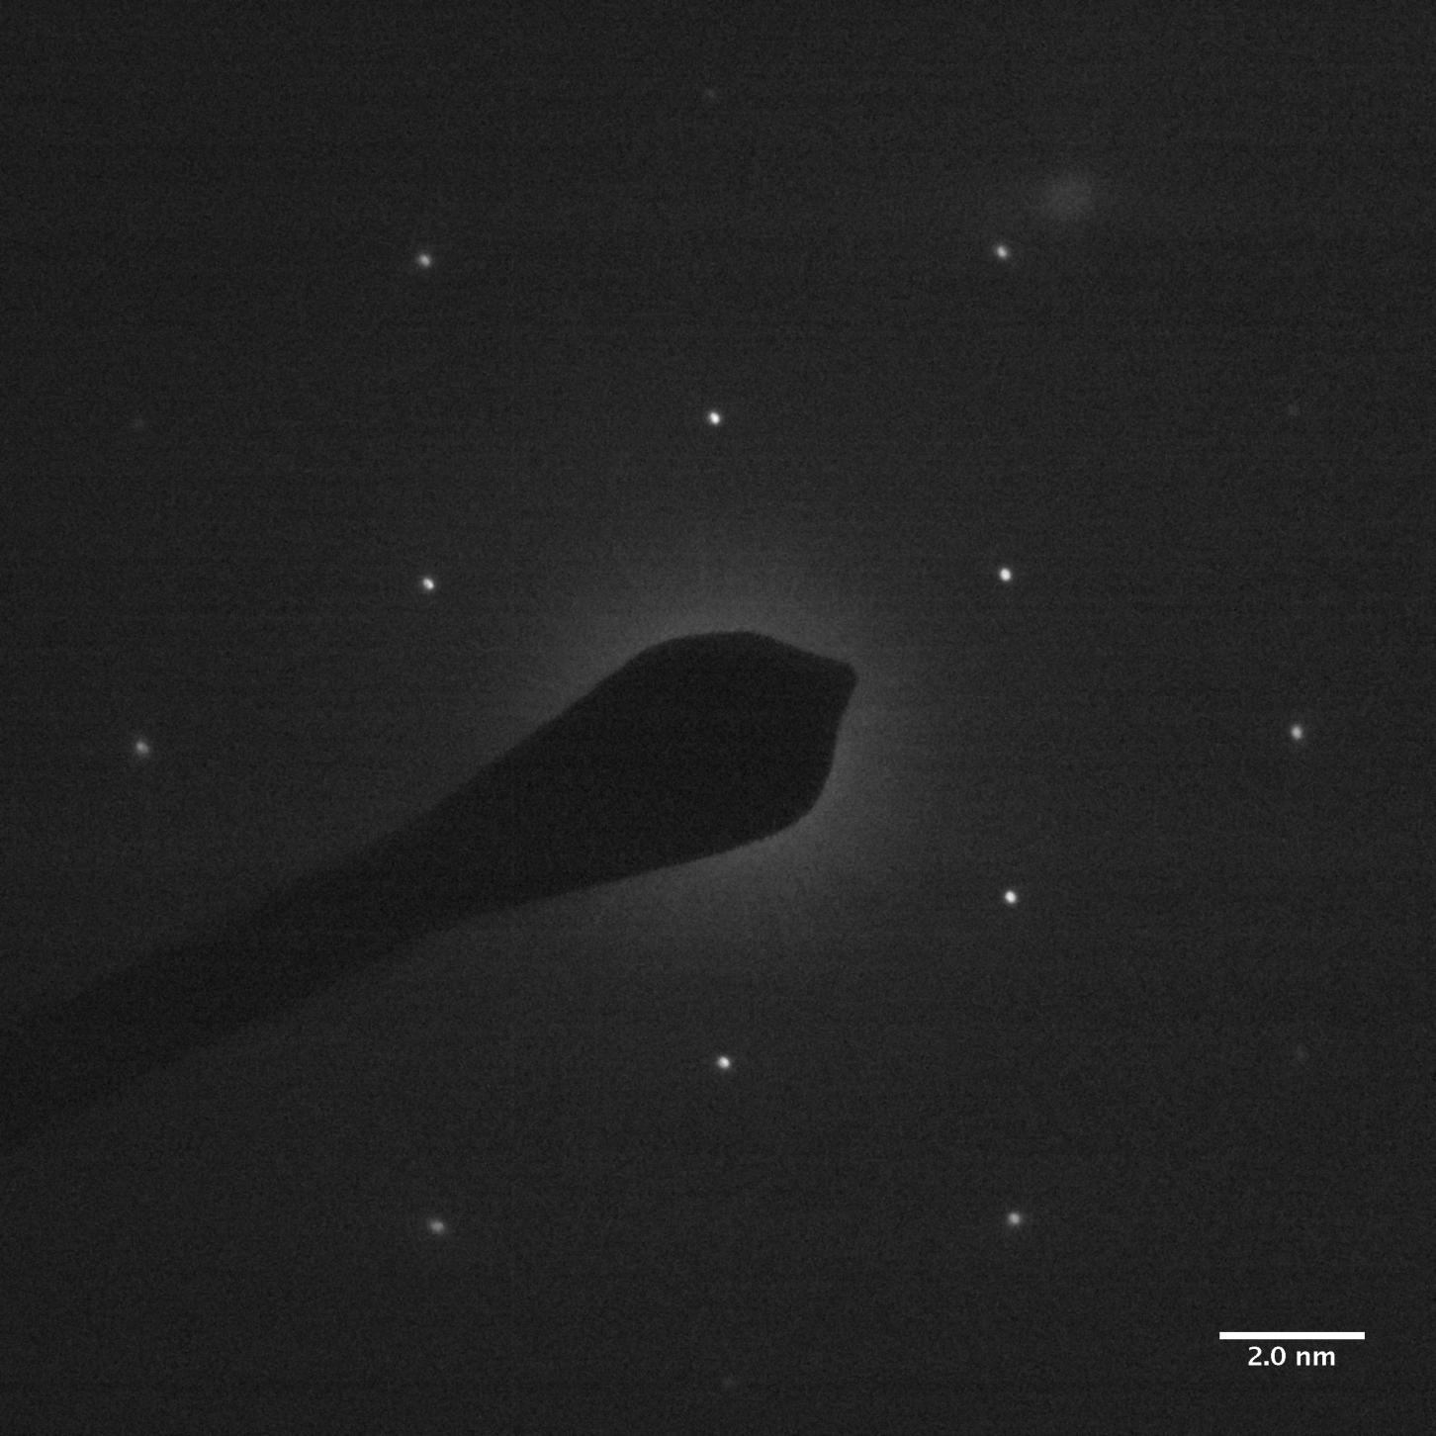
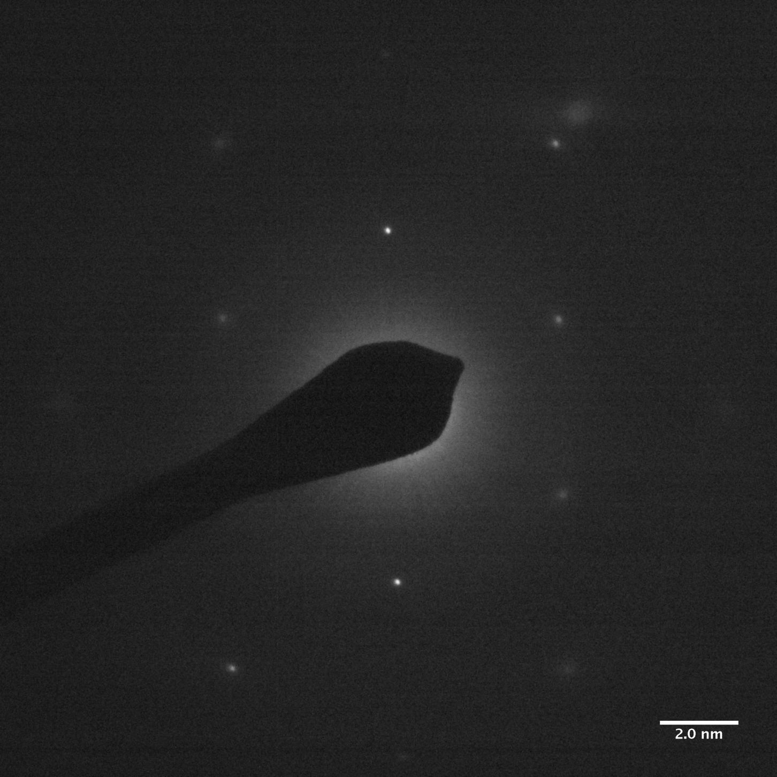
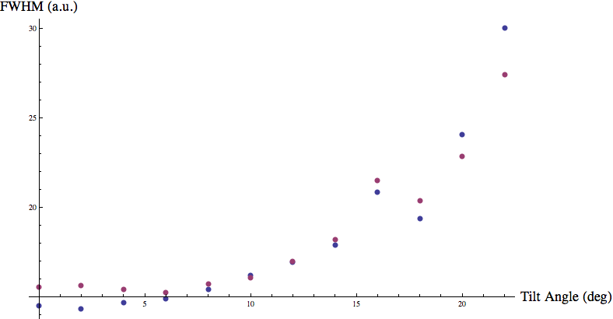
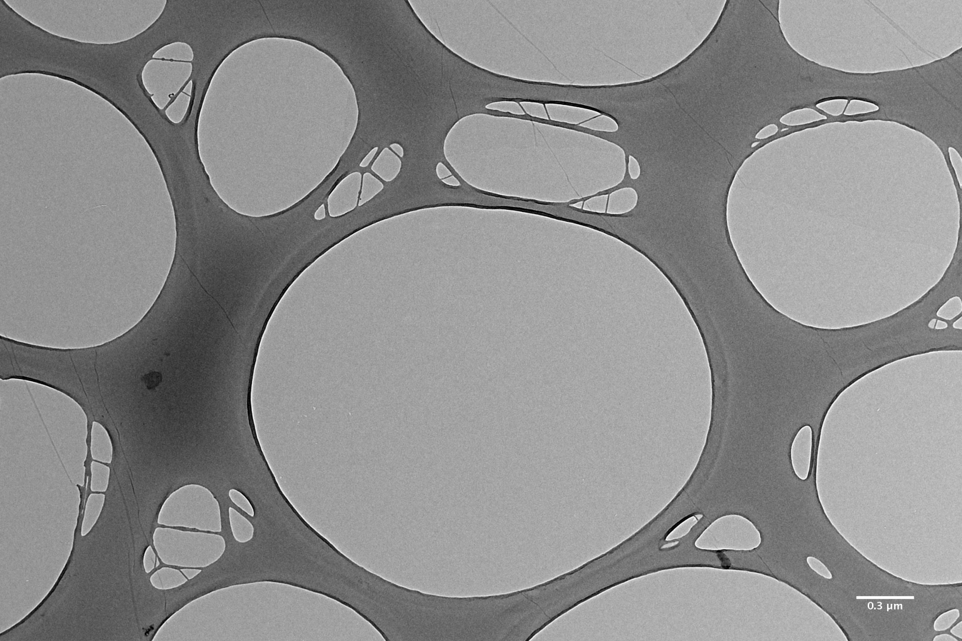
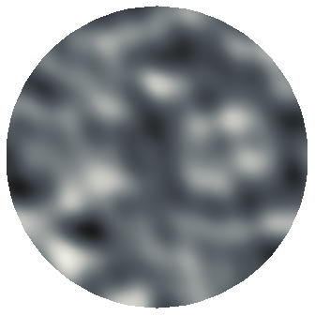
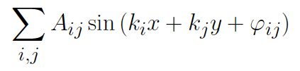


2D or not 2D:
That is the (Graphene) Question
Umberto Lupo & Dr. Neil Wilson
Department of Physics
Abstract. The aim of this 10-week project was to investigate the structure of graphene-based materials such as chemically converted graphene (CCG) and graphene oxide (GO). Selected area electron diffraction (SAED) was performed on samples of CCG and GO, and the experimental results compared with numerical simulations of diffraction events. Striking similarities were observed with published results^{[1]} from sheets of pristine graphene, suggesting that these one atom thick sheets may be intrinsically three-dimensional.
Artistic impression of a single sheet of graphene. What can be said about its structure, and how? What insight can selected area electron diffraction (SAED) experiments give on the configuration of such one-atom-thick layers?
Broadening of the diffraction peaks appears to be a recurring feature in specimens of various graphene-based materials, such as pristine graphene^{[1]}, chemically converted graphene (CCG) and graphene oxide (GO, see pictures).
A considerable section of this summer project was (successfully) devoted to the production and implementation of Mathematica® code for routine recognition and fitting of the diffracted peaks over whole tilt series. This was believed to be a key step towards a more quantitative analysis of the broadening phenomenon, and possibly an improvement over the method used in ^{[1]}.
Tilt the specimen by 20º
Left: bright-field TEM image of the GO sheet on its lacy carbon support. Right: colour plot of a simulated graphene sheet, with intrinsic (static) rippling modeled as an out-of-plane displacement given by an expression of the form
where A_{ij}, k_{i}, k_{j}, φ_{ij} are random parameters varying in specific ranges. Code was also written to simulate diffraction experiments, which allows the user to directly observe the effects of arbitrary structural deformations on the evolution of diffraction patterns.
Tilt angles vs. extracted full-width half maxima (FWHM) for the diffraction spot indicated by the blue arrow. Best fits were looked for amongst three-dimensional Gaussian curves with elliptical cross-sections and axes along the radial (green) and tangential (blue) directions. To a good approximation, this peak shows isotropic broadening: we believe this to be a non-trivial observation, which calls for further theoretical investigation.
According to ^{[1]}, the observed broadening explicitly reveals that graphene sheets are not flat within the sub-micrometre area of the electron beam. If that is indeed the case, then numerical simulations of diffraction events should successfully reproduce such behaviour, provided that the rippling being introduced is ‘realistic’.
In any case, the broadening of the peaks in SAED patterns of graphene-based materials would strongly contradict the classical theory of diffraction (in its kinematical approximation), if we believed that the latter were perfectly flat sheets of atoms. Almost certainly not 2D, then.
References
^{[1]} Meyer, J. C. et al. The structure of suspended graphene sheets. Nature 446, 60–63 (2007).

