Slide 1


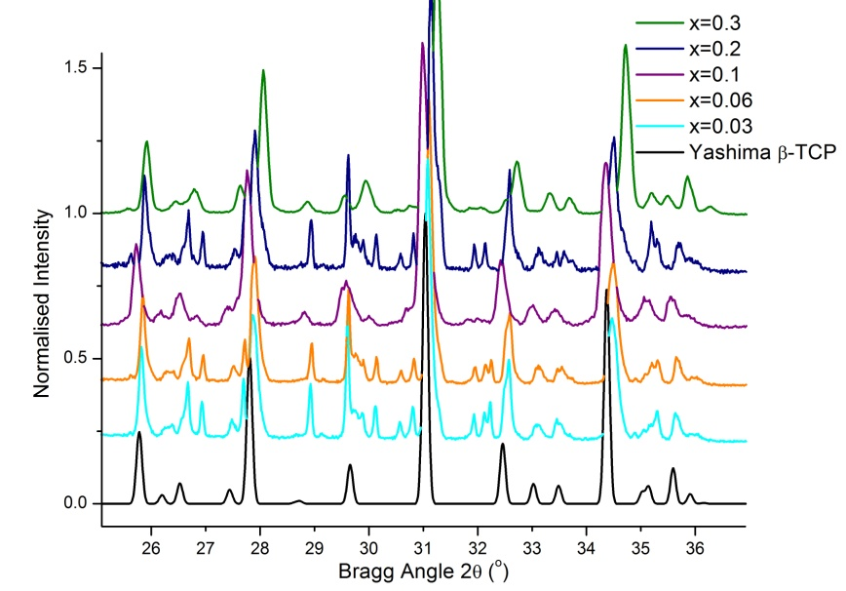
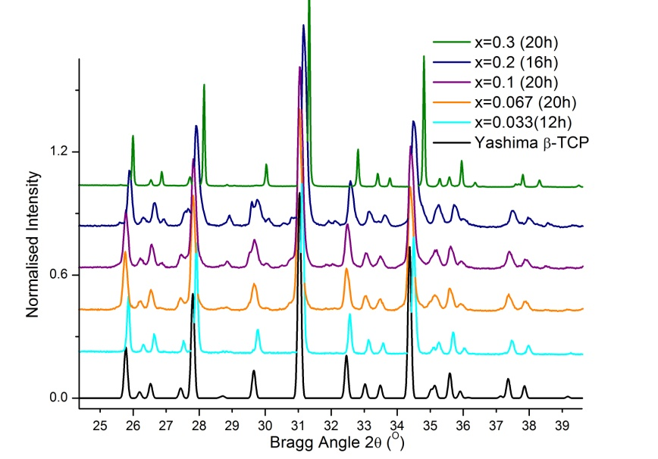
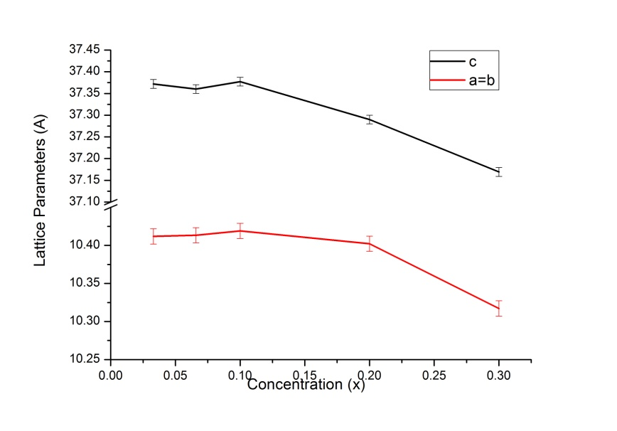
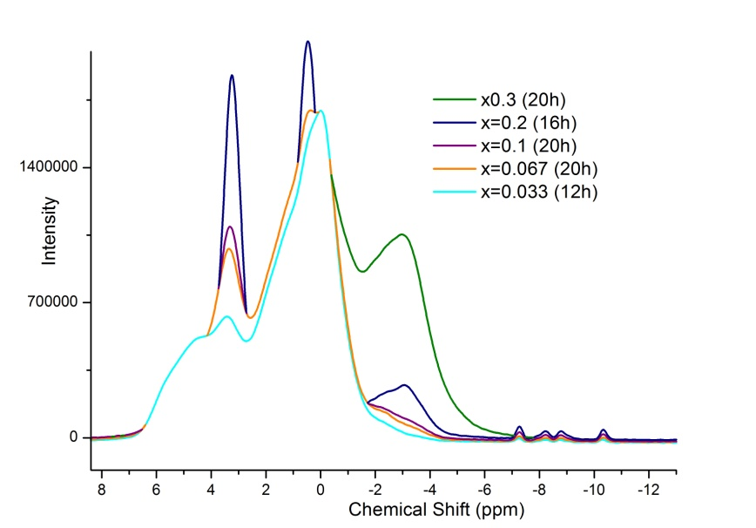
Investigation of Sodium Doping and Sodium and Aluminium Co-doping in Beta-Tricalcium Phosphate
Alex Marsden, a.j.marsden@warwick.ac.uk Nina Van der Pyl, n.van-der-pyl@warwick.ac.uk
Nuclear Waste Solutions
Introduction
There has been a growing demand on finding a suitable and sustainable method of disposing the increasing amount of high level nuclear waste being produced and immobilisation is studied in detail to form a multi barrier approach to disposal. Recent studies have shown the possibility of using beta-tricalcium phosphate (β-TCP) as a crystal host for radioactive atoms and the focus of this project was to investigate the substitution of sodium and both sodium and aluminium into β-TCP. The possible effects on its internal structure were investigated through X-Ray powder diffraction, from which the lattice cell parameters were calculated by Pawley refinement, and Nuclear Magnetic Resonance (NMR).
Sample preparation and Characterisation
Sodium doped samples of β-TCP were prepared using the following stoichiometric formula Ca_{21-x}Na_{2x}(PO₄)₁₄ with x values of 0.2, 0.4, 0.6 and 1.0. Similarly, sodium and aluminium co-doped samples of formula Ca_{3-2x}Al_{x}Na_{x}(PO₄)₂ were prepared with x values of 0.033, 0.067, 0.1, 0.2 and 0.3.
Both samples were heated at 300°/hr up to 1050° and left at that temperature for four hours, after which they were cooled (300°/hr).
X-Ray diffraction was carried out using CuK_{α} on a Bruker D5005 set to 40kV and 50mA and a PANalytical PRO set to 45kV and 40mA. All scans were performed over the Bragg angle range 10° to 50°. Phase identification was performed using the JCPDS database. Lattice parameters were determined by Pawley refinement using the Topas Academic software suite.
³¹P MAS NMR spectra were obtained at 202.5MHz using a Bruker 500 NMR spectrometer with a 4 mm rotor at 10kHz MAS frequency. The pulse length was 1μs and pulse delay 60s. ²⁷Al and ²³Na NMR studies were also performed using the same equipment with 1s delay and 0.5 μs pulse length and 10 s delay and 4 μs pulse length respectively.
Results
Co-doping with Sodium and Aluminium
XRD was initially used to identify if β-TCP was produced and if any other phases were present. They showed that β-TCP had been created and in most cases another phase, calcium pyrophosphate, had been created (Fig.1). Firings were repeated and the second phase was gradually removed (Fig.2).
XRD spectra were analysed using Pawley refinement to find values for the lattice parameters. There is little precision in this method but the results gave the general patterns. It seems that the structure does not change greatly at low concentrations but with significant amounts of doping, the unit cell contracts uniformly (Fig.3). With more time improved resolution spectra could be taken and these analysed with Rietveld refinement to give much more accurate values.
NMR studies were performed using ³¹P, ²⁷Al and ²³Na. Each of these providing information on the respective environments to try and understand the substitution method.
Phosphourous NMR has been used extensively for studying β-TCP . The spectra produced for these samples were found to be very complex, and were very difficult to fit (Fig.4). The patterns did show that large changes were taking place with change in concentration suggesting that some sites are only used at higher concentration, agreeing with the lattice parameter study.
Aluminium NMR gave some insight into the calcium sites that the aluminium is substituted onto. It seems the size of the aluminium ion is causing the coordination number of the sites to be different than expected.
Doping with Sodium
  X-Ray diffraction (XRD) scans were performed after each firing. For all the samples, the second phases present in the first and second firings were mainly identified as hydroxylapatite (Ca₅(PO₄)₃OH) and the latter completely disappeared to become phase-pure after three firings as it is shown on Fig.5. However, in the case of Ca_{20.8}Na_{0.4}(PO₄)₁₄ three firings were not sufficient to obtain a nearly phase-pure β-TCP-type material.
  The unit cell parameters were determined by Pawley refinement and both a and c exhibit a general decrease as the sodium content increases (Fig.6). These results are not in perfect agreement with previous work which suggest an increase of a [1] and a perfect linear relationship for c [2]. Therefore, Rietveld refinement seems to be necessary in order to obtain more accurate and more precise results.
  ³¹P solid-state MAS NMR spectra show gradual and systematic changes occurring as the level of doping increases and ultimately, an additional peak is observed at 2.1 ppm (Fig.7). Also, the substitution of sodium on the calcium sites produces a shift in the peaks intensities which are initially found at 4.3 and 0.1 ppm in “pure” β-TCP. This suggests a splitting of the peaks due to the presence of sodium on the calcium atoms. Assuming the sodium atoms substitute on the Ca(4) sites, the spectra can be fitted to ten resonances.
  ²³Na MAS NMR spectra are shown on (Fig.8) however no further analysis was done in this study due to the complexity of quadrupolar molecules’ NMR spectra.
Figure 1:Spectra of samples fired only once. Peaks not TCP are pyrophosphate.
Figure 5:Comparison of the XRD patterns of β-TCP for different levels of doping. Yashima’s pure β-TCP is used here as a reference. The grey dashed lines show the shift of the peaks’ intensity as the level of doping increases.
Figure 2: Final firings of each sample. X=0.3 seems phase pure.
Figure 6: Variation of the unit cell parameters as a function of the Na content in Ca_{21-x}Na_{2x}(PO₄)₁₄ compounds.
Figure 3: Changes in lattice parameters with change in concentration.
Figure 7: ³¹P single-pulse MAS NMR spectra of Ca_{21-x}Na_{2x}(PO₄)₁₄ compounds, as a function of x.
Figure 4: ³¹P spectra of each sample, showing patterns observed with changing concentration.
Conclusions and further work
Sodium cations were successfully substituted into β-TCP giving further evidence for the feasibility of using the latter as a solution for nuclear waste issues.
For single sodium doped samples, phase-pure β-TCP-type materials were obtained after three firings apart for the lowest concentration.
Understand the substitution process by studying NMR data in more depth.
Find a more efficient firing method, involving less re-firings.
Determine accurately the structural details of β-TCP materials using XRD data and Rietveld refinement.
Figure 8: ²³Na single-pulse MAS NMR spectra of Ca_{21-x}Na_{2x}(PO₄)₁₄ compounds, as a function of x.
References
[1] L. Obadia et al, Chem. Mater., 18, [6], 2006, 1425-1433.
[2] K. Yoshida, H. Hyuga, N. Kondo, H. Kita, J. Am. Ceram. Soc., 89, [2], 2006, 688-690.
[3] M. Yashima, A. Sakai, T. Kamiyama, A. Hoshikawa, J. Solid State Chem., 175, 2003, 272-277.
[4] R. J. B. Jakeman, A. K. Cheetham, N. J. Clayden, C. M. Dobson, J. Solid State Chem., 78, 1989, 23-24.
[5] B. Dickens, L. W. Schroeder, W. E. Brown, J. Solid State Chem., 10, 1974, 232-248.

