Slide 1




Campus France UK
Helps you to prepare for your outward mobility to France
1.Etudes en France platform
2.Visa application procedure and administrative requirements
3.Life in France after you arrive

Slide 2



1.The Etudes en France platform
Summary
3. Life in France
2. France-Visas and types of visas

Slide 3


Before we begin, a brief introduction to the French Higher Education System

Slide 4
The French system is organized in three levels (following the Bologne protocol for the EU):
Licence (3 years / 6 semesters) equivalent BA/BSc
Master (2 years / 4 semesters) equivalent MA/MSc
Doctorat (typically 3 years), equivalent PhD.
The LMD System
A Brief Introduction

Slide 5
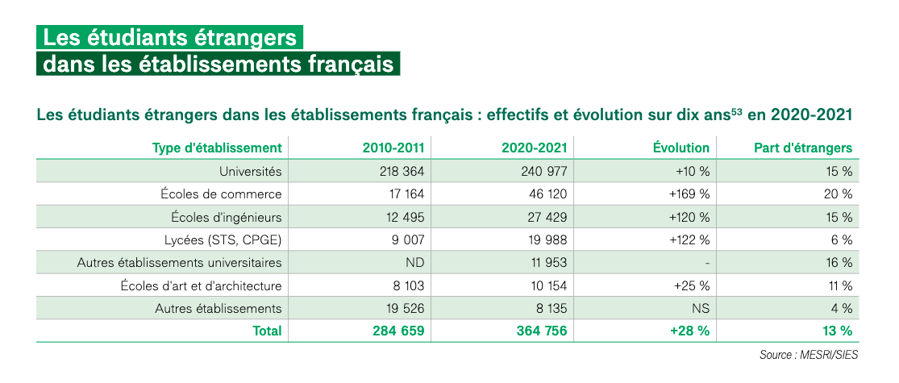
Some Figures 1/2
A Brief Introduction
Numbers of international students in French Higher Education Institutions

Slide 6
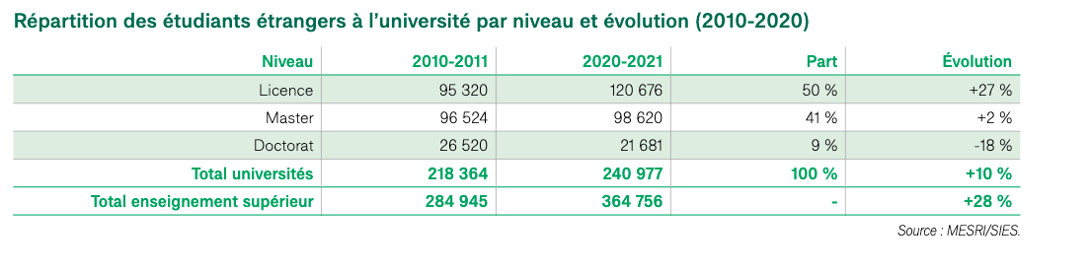
Some Figures 2/2
A Brief Introduction
Numbers of international students by university study level through the past 10 years

Slide 7
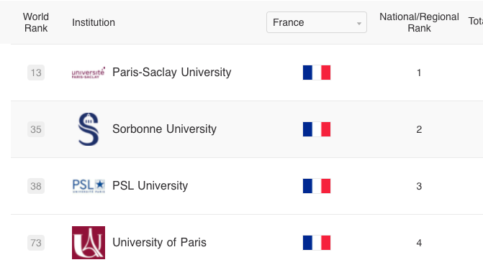
Rankings
A brief introduction
Four French universities are in the top 100 of the Shanghai Universities Ranking 2021

Slide 8
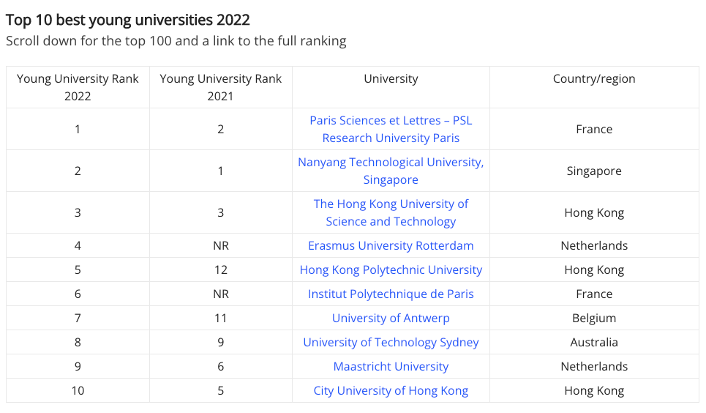
Rankings
A brief introduction
Two French universities in the top 10 of Times Higher Education rankings for universities under 50 years old

Slide 9
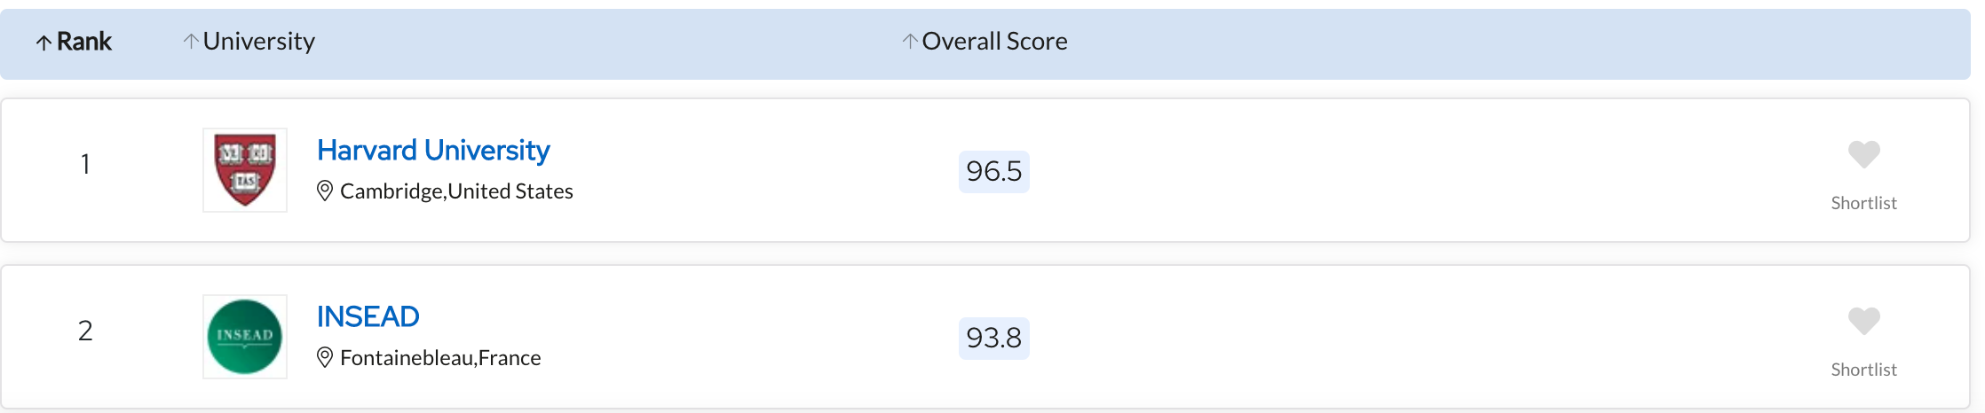
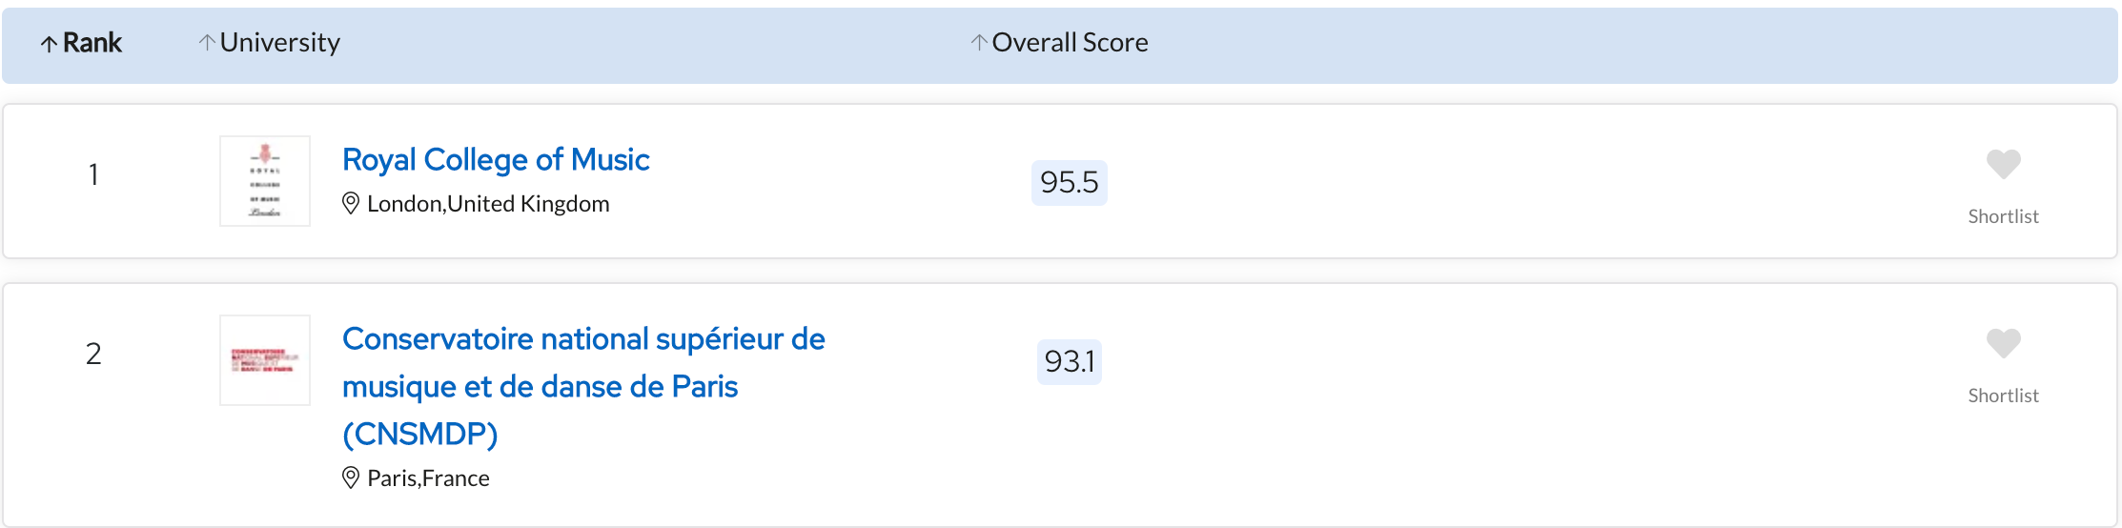
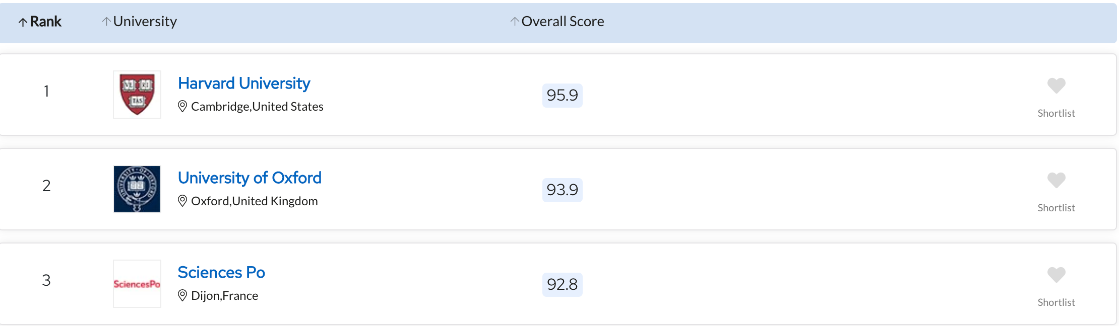
Rankings
diversity in academic excellence
2nd place in the "business and management" ranking
3rd place in the "politics" ranking
2nd place in the "performing arts" ranking
QS World University Rankings by Subject 2023

Slide 10

1. The etudes en France Platform
1. Register on Etudes en France
2. What documents you will need
3. How to fill in your form

Slide 11
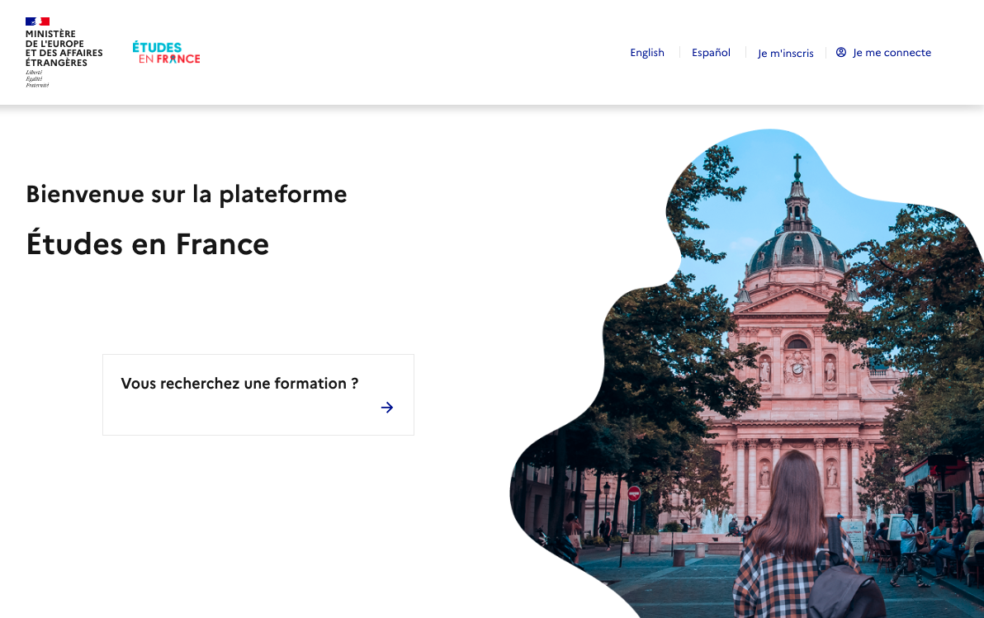

Who needs to register?
1. register on etudes en france
Etudes en France:
If you are going to France for more than 90 days
If you are not a EU citizen
If you are going to France for a study placement

Slide 12
Register on etudes en France Platform
1. Register on etudes en france
Etudes en France:
It gives you an EEF number (GB-XXXX) and a confirmation of registration (to be downloaded from Etudes en France)
It precedes the checks done at the consulate by verifiying your academic background
You will need to bring your Etudes en France confirmation at your TLS appointment

Slide 13
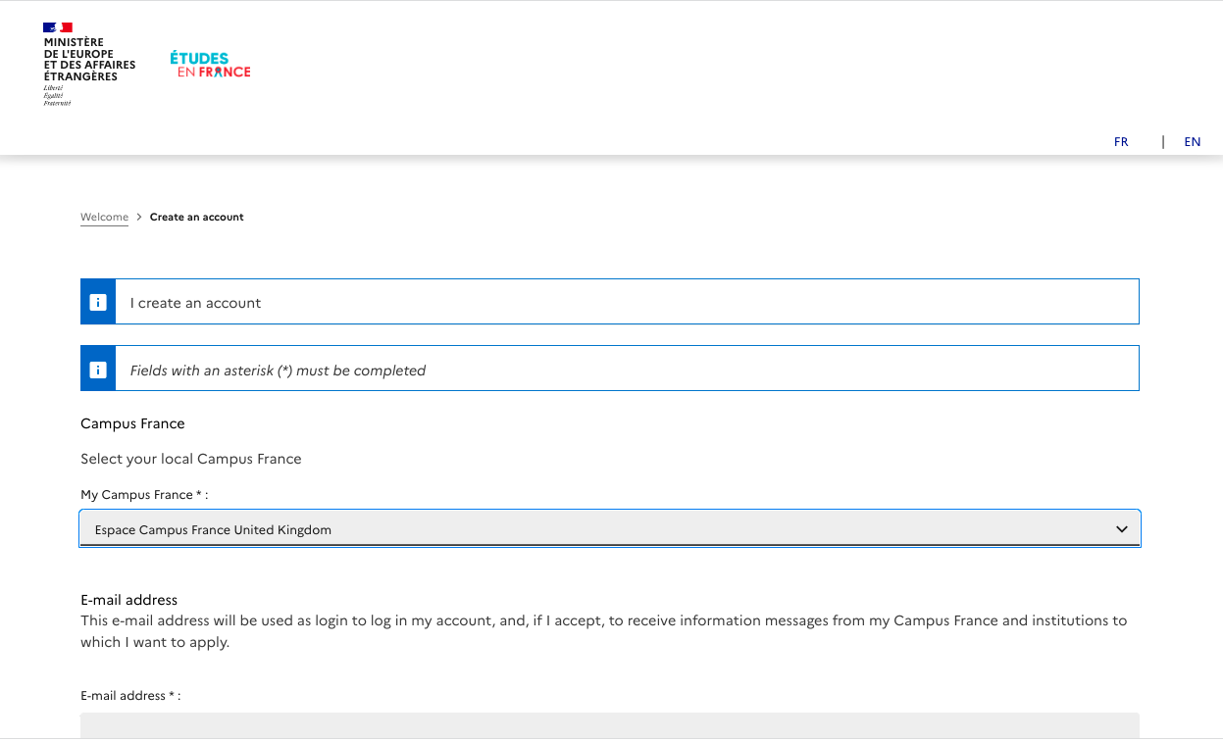

How to create your account
1 register on etudes en france
Select « Campus France United Kingdom »
Register under «Students already accepted »
The whole process can take about two weeks

Slide 14




SUPPORTing DOCUMENTS TO register on Etudes en France
2. What supporting documents Do you need
Your passport → Must be legible and still valid for your time in France. Check that your passport won’t have expired or plan well in advance to renew it!
Proof of enrolment from your current institution→ Signed certificate of registration or last transcript of records
Your letter of acceptance from the French higher education institution → signed and stamped by the institution. It must also specify the dates of your study period in France
Your scholarship certificate, if applicable to you (for instance your Turing grant agreement) signed by your university

Slide 15
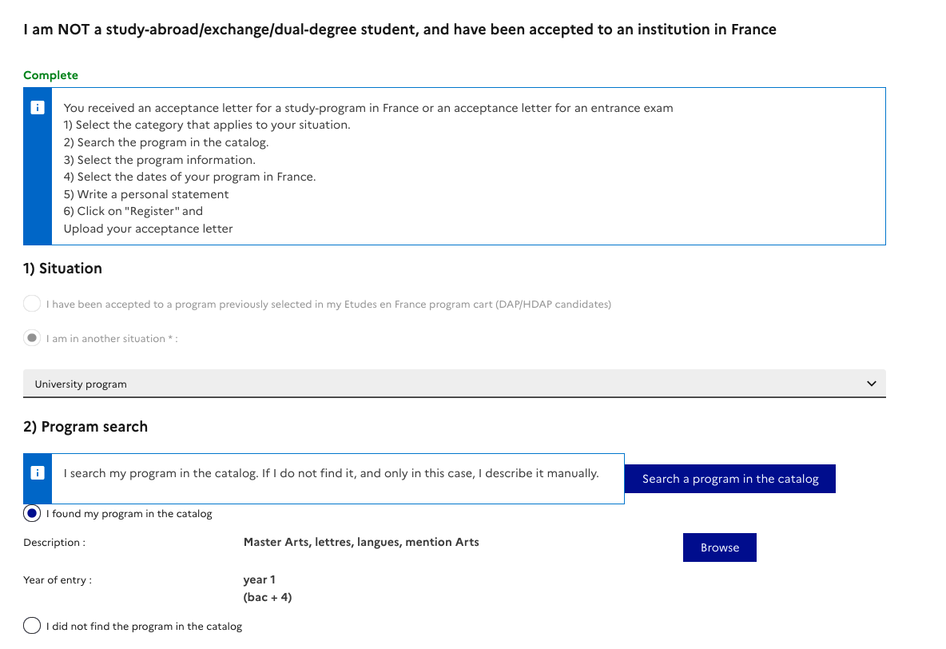
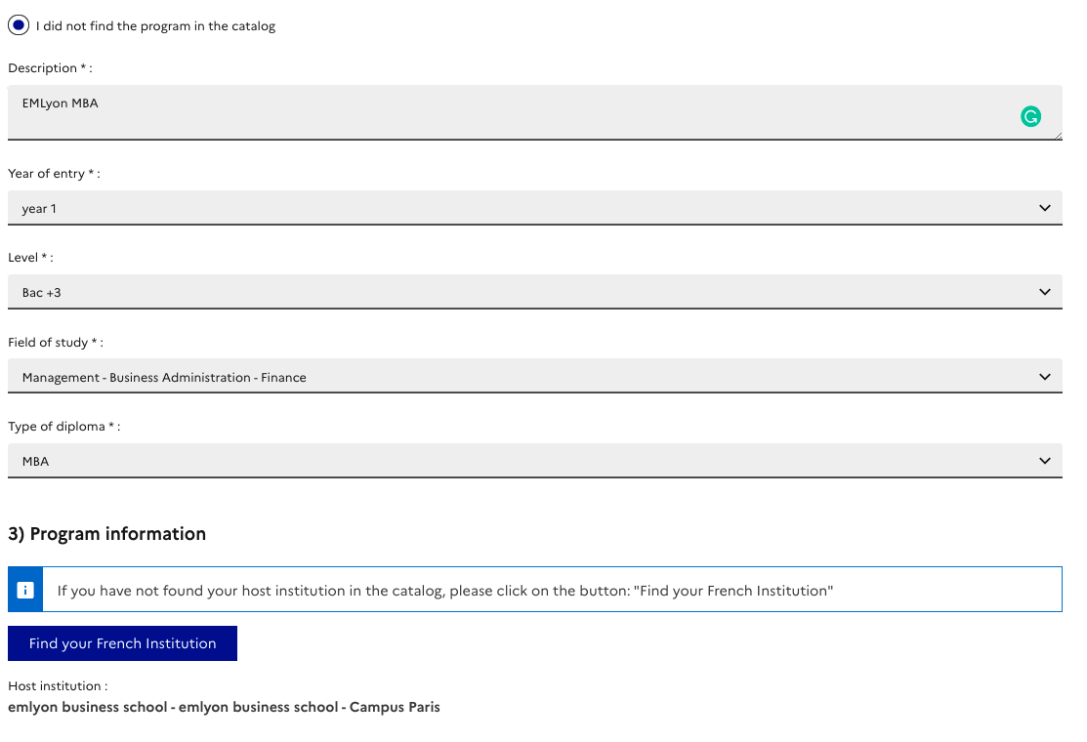
Register your programme
3. How to feel in the form
Select your programme in the online catalogue or enter it manually if you don’t find the course in the list
Enter the dates of your programme
Write a short additional motivation statement explaining why you wish to study at this institution in France

Slide 16
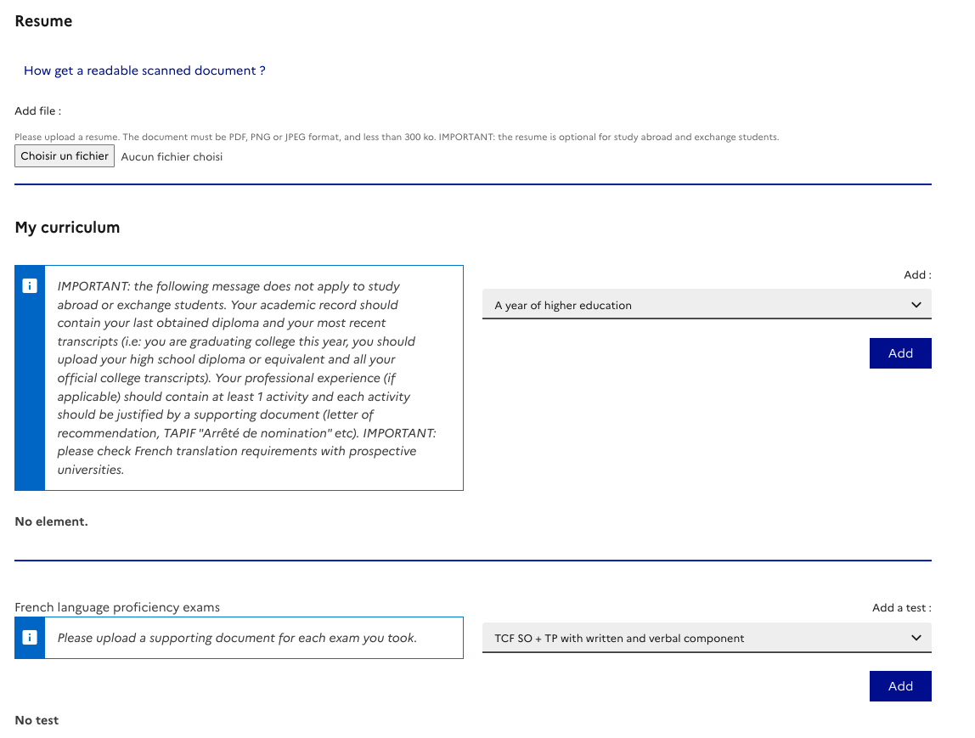
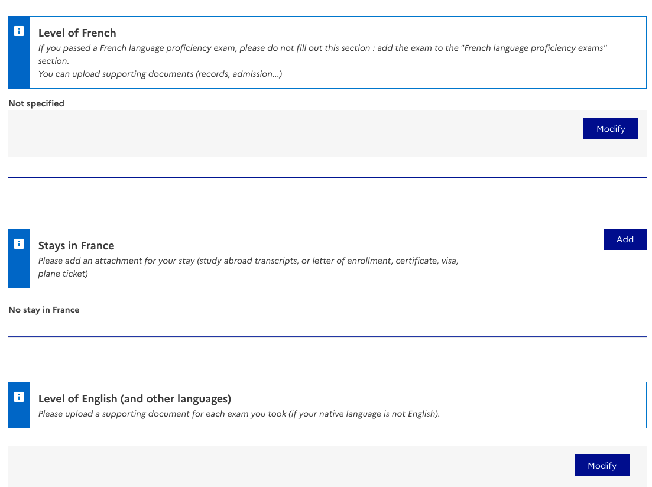
Academic curriculum and language skills
3. How to feel in the form
Fill in your academic curriculum with a transcript of records for at least one previous academic year
Language section : please only indicate your level of French and/or English and you will be able to complete the section (no certificates needed!)
Submit your application

Slide 17
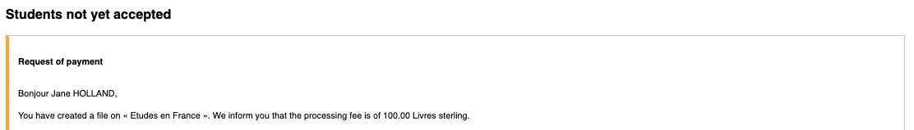
The payment
1. How to fill in your for:m
During your process of registration on the Etudes en France plaform, you will receive a payment request:
£100 for administrative fees
You will be able to pay via bank transfer, please send your confirmation of payment to: londres@campusfrance.org
Once we accept your payment, you will receive both an email and a notification on the platform
Once you have payed we will quickly issue your confirmation of registration. Please bear in mind that the whole process takes about two weeks.

Slide 18

2. Before departure : Visa and Things to know
The visa application process
The study placement visa
The student-internship visa

Slide 19


from France visas to tls contact
1. Visa PRocess
Fill in a form online on the France-Visas platform
Upload your supporting documents
Book an appointment in at TLS Center to give your passport (between 3 months and 3 weeks before the start of your programme in France)
Get your passport back with your visa about 2 weeks later

Slide 20
Timeline, payment and word of caution
1. Visa PRocess
The whole process can take about 1 month
Start your application online as soon as possible (after receiving the letter of acceptance)
Book an appointment at TLS Center as early as possible within the 3 months-3 weeks period
Don’t miss your appointment: there is £29 (not refundable if you don’t come) fees for booking service + 50€ of visa fees

Slide 21
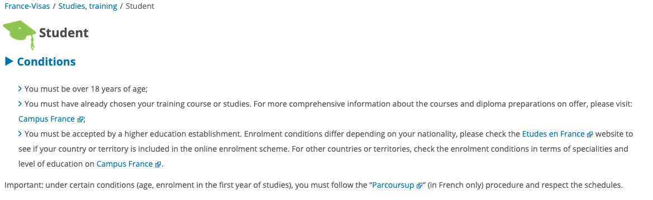
When do you need a student visa
1. The Student visa
You will need a « Student visas » after registering on Etudes en France if:
You have been accepted in a graduating programme in France OR
Your are doing a study placement for a semester or a year abroad OR
You are doing a study placement + a work placement (you will need to add your internship agreement on Etudes en France)
Please note:
If you are doing a study placement for semester in another country + a study placement for a semester in France: you will have to require your French visa at the French consulate of your first country of studies

Slide 22


Which documents for the Student visa
2. The student visa procedure
Your passport → Still valid for the first year of your stay in France
Proof of funds →Proof of sufficient funds (at least 615€ per month) e.g. bank statement or student loan eligibility or proof of parental income
Proof of accommodation → A proof of accommodation for the 3 first weeks at least or a signed and statement about future plans if it is not permanent
Your document generated by the Etudes en France platform with you EEF number as well as all the documents previously requested on Etudes en France! (proof of enrolment / last diploma / letter of acceptance / grant agreement)

Slide 23
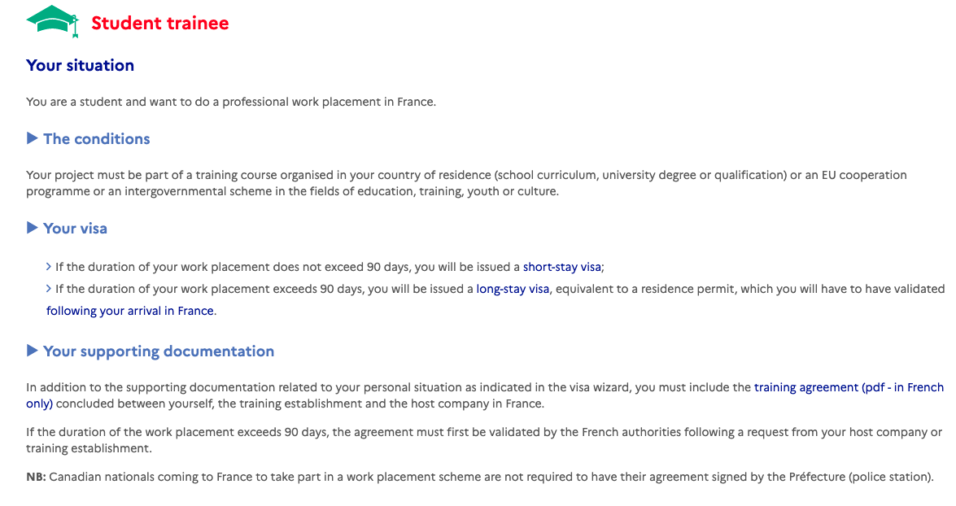
When do you need a student-Trainee visa
(stage/internships)
1. The Student-trainee visa
No need to register on Etudes en France with a « Work placement » (for a semester or a year abroad)
Select the « Study » <« Student internship visa » on France-Visas

Slide 24
SUPPORTING DOCUMENTS for the STUDENT-TRAINEE visa procedure
2. The student trainee visa
Your passport → Still valid for the first year of your stay in France
Proof of funds →Proof of sufficient funds (at least 615€ per month) e.g. bank statement or student loan eligibility or proof of parental income
Proof of accommodation → A proof of housing for the 3 first weeks at least or a signed and statement about future plans if it is not permanent
Your internship agreement signed by the three parts and approved by the French administration → The employer has to ensure that they request the authorisation from the French Office for Immigration (avis favorable sur convention de stage)

Slide 25
FINDING AN ACCOMODATION
1. Before your departure
To find accommodation in France, you have several options
Housing in university residences (Crous, international student residence of Paris)
Housing in the private real-estate market (le bon coin, se loger , lodgis, de particulier à particulier)
Sharing an appartment or a house, the colocation (appartager, roomlala, immojeune, la carte des colocs)
Living with a family or elderly people (cohébergement, roomlala)
Try to anticipate your accommodation search (especially in Paris!)
Ask the staff at your educational institution if they can help
Book a temporary place to sleep and store your belongings when you arrive
TIPS !

Slide 26

Get a Free rental Deposit to Find an Appartment
1. Before your departure
Visale:
A free rental deposit to rent your appartment (if you do not have a guarantor)
Apply online before you arrive in France and before you get your appartment
Fill in the form as soon as you have your visa and acceptance in your university
Find more information on where to find an accomodation here

Slide 27

Prepare TO HAVE A EHIC OR GHIC CARD
1. Before your departure
European Health Insurance Card (EHIC) / Global Health Insurance Card (GHIC)
If you still have a EHIC card you can use it in France.
You can now apply for a UK Global Health Insurance Card (GHIC) instead but please be mindful of the delays!
If you use your EHIC/GHIC you won’t be able to get refunded while in France. You will have to keep all of your prescriptions and health invoices.
You should also have travel insurance and private complementary healthcare cover.
More information : https://www.gov.uk/guidance/uk-residents-visiting-the-eueea-and-switzerland-healthcare

Slide 28

Prepare your documents to register to free health care
1. Before your departure
Assurance maladie: Etudiant-etranger.ameli.fr
Assurance maladie is free and mandatory
You should also have travel insurance and private complementary healthcare cover.
List of official translators here
Gather the documents to register to free health care «Assurance Maladie» This is one of the first thing you need to do once you arrive.
→ To increase the amount of their healthcare expenses that is reimbursed, we advise you take out complementary health insurance, or a mutuelle with a repatriation clause
Notes:
You will need to have an address in France and a proof of enrollment NOT acceptance
You will then receive your social security number that will allow to ask for your social security card and get refunded up to 70%

Slide 29

3. After arrival : Life in France
1.Before arrival
2.After arrival
3.Useful information

Slide 30

Find your nearest Welcome desk
2. After arrival
Welcome Desk:
They are your main information centers and will help you on site with every administrative tasks and cultural information
All services an international student should contact during the first weeks after their arrival in France : university services, CROUS, Prefecture, healthcare, complementary health insurance, banks, student unions, etc.
Identify the closest « Welcome Desk » to help you with all the administrative procedures
Notes:
Since 2019 welcome desks have been created in every student city in France and in most universities

Slide 31
Validate your Student visa
2. After arrival
Validate your student visa:
Go on the official French government website
You will need:
    A valid email address
    Information on your visa
    Your date of arrival in France
    Your home adress in France
    A bank card to pay online the fee for validating the residence permit (50€)
Validate your student visa online on the French Home Department website

Slide 32





COST of life – Some examples
2. After arrival
Please note that the prices below are given on an indicative basis and are subject to change
Housing
€650 / month in Paris
€450 / month in province
Transport
€84,10 for a monthly transport pass in Paris
€20-35 in province
€49 for the SNCF Jeune Card for the 12-27 years old
Leisure
€5-9 for 1 cinema ticket*
€5-15 for 1 museum ticket*
From €10 for 1 theatre ticket*
*You will often have access to discounts and special rates on presentation of your student card if you are under 26 years old
Groceries
€200 - 250 / month in Paris
€150 - 200 / month in province
Some examples :
~ €1 for a baguette or a croissant
~ €1,20 for 1kg of pasta
~ €0,95 for 1L of milk

Slide 33



Open a bank Account
2. After arrival
To open a bank account, you need :
    Your ID
    A proof of accommodation
    Your certificate of registration in your university
Open a bank account → To facilitate your life and transactions in France

Slide 34


Enjoying being a student
In France
3. Useful information
Enjoy the benefits of being a student in France ! → Being a student in France means having access to a lot of benefits as well as to a lot of discounts and offers.
Sports and cultural activities → Lower rates and discounts are available for students in museums, cinemas and many other cultural activities
Transports → your visa gives you access to the entire Schengen area. Public transportation is affordable and reliable. Railroad network is affordable and developed

Slide 35

Register
On France Alumni
3. Useful information
France Alumni is your network to connect with France once your back
France Alumni UK is a network launched in September 2022 to connect you with UK-based alumni who went to France
Join France Alumni network as soon as possible !

Slide 36
Benefits of joining the France Alumni UK network
3. Useful information
5 reasons why you should join France Alumni UK :
1) A global network
2) A career accelerator
3) Annual events and activities
4) International visibility
5) Maintaining a connection with France on your return
Join France Alumni network as soon as possible !

Slide 37


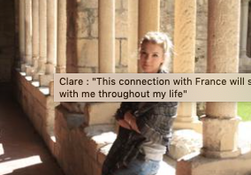

Oraza
Oraza
This experience has allowed me to be more confident!
Ross
HAVING A FRONT-ROW SEAT TO FRANCE’S RICH AND HISTORIC DEMOCRATIC CULTURE WAS A FASCINATING EXPERIENCE !
Clare
THIS CONNECTION WITH FRANCE WILL STAY WITH ME THROUGHOUT MY LIFE!

Slide 38
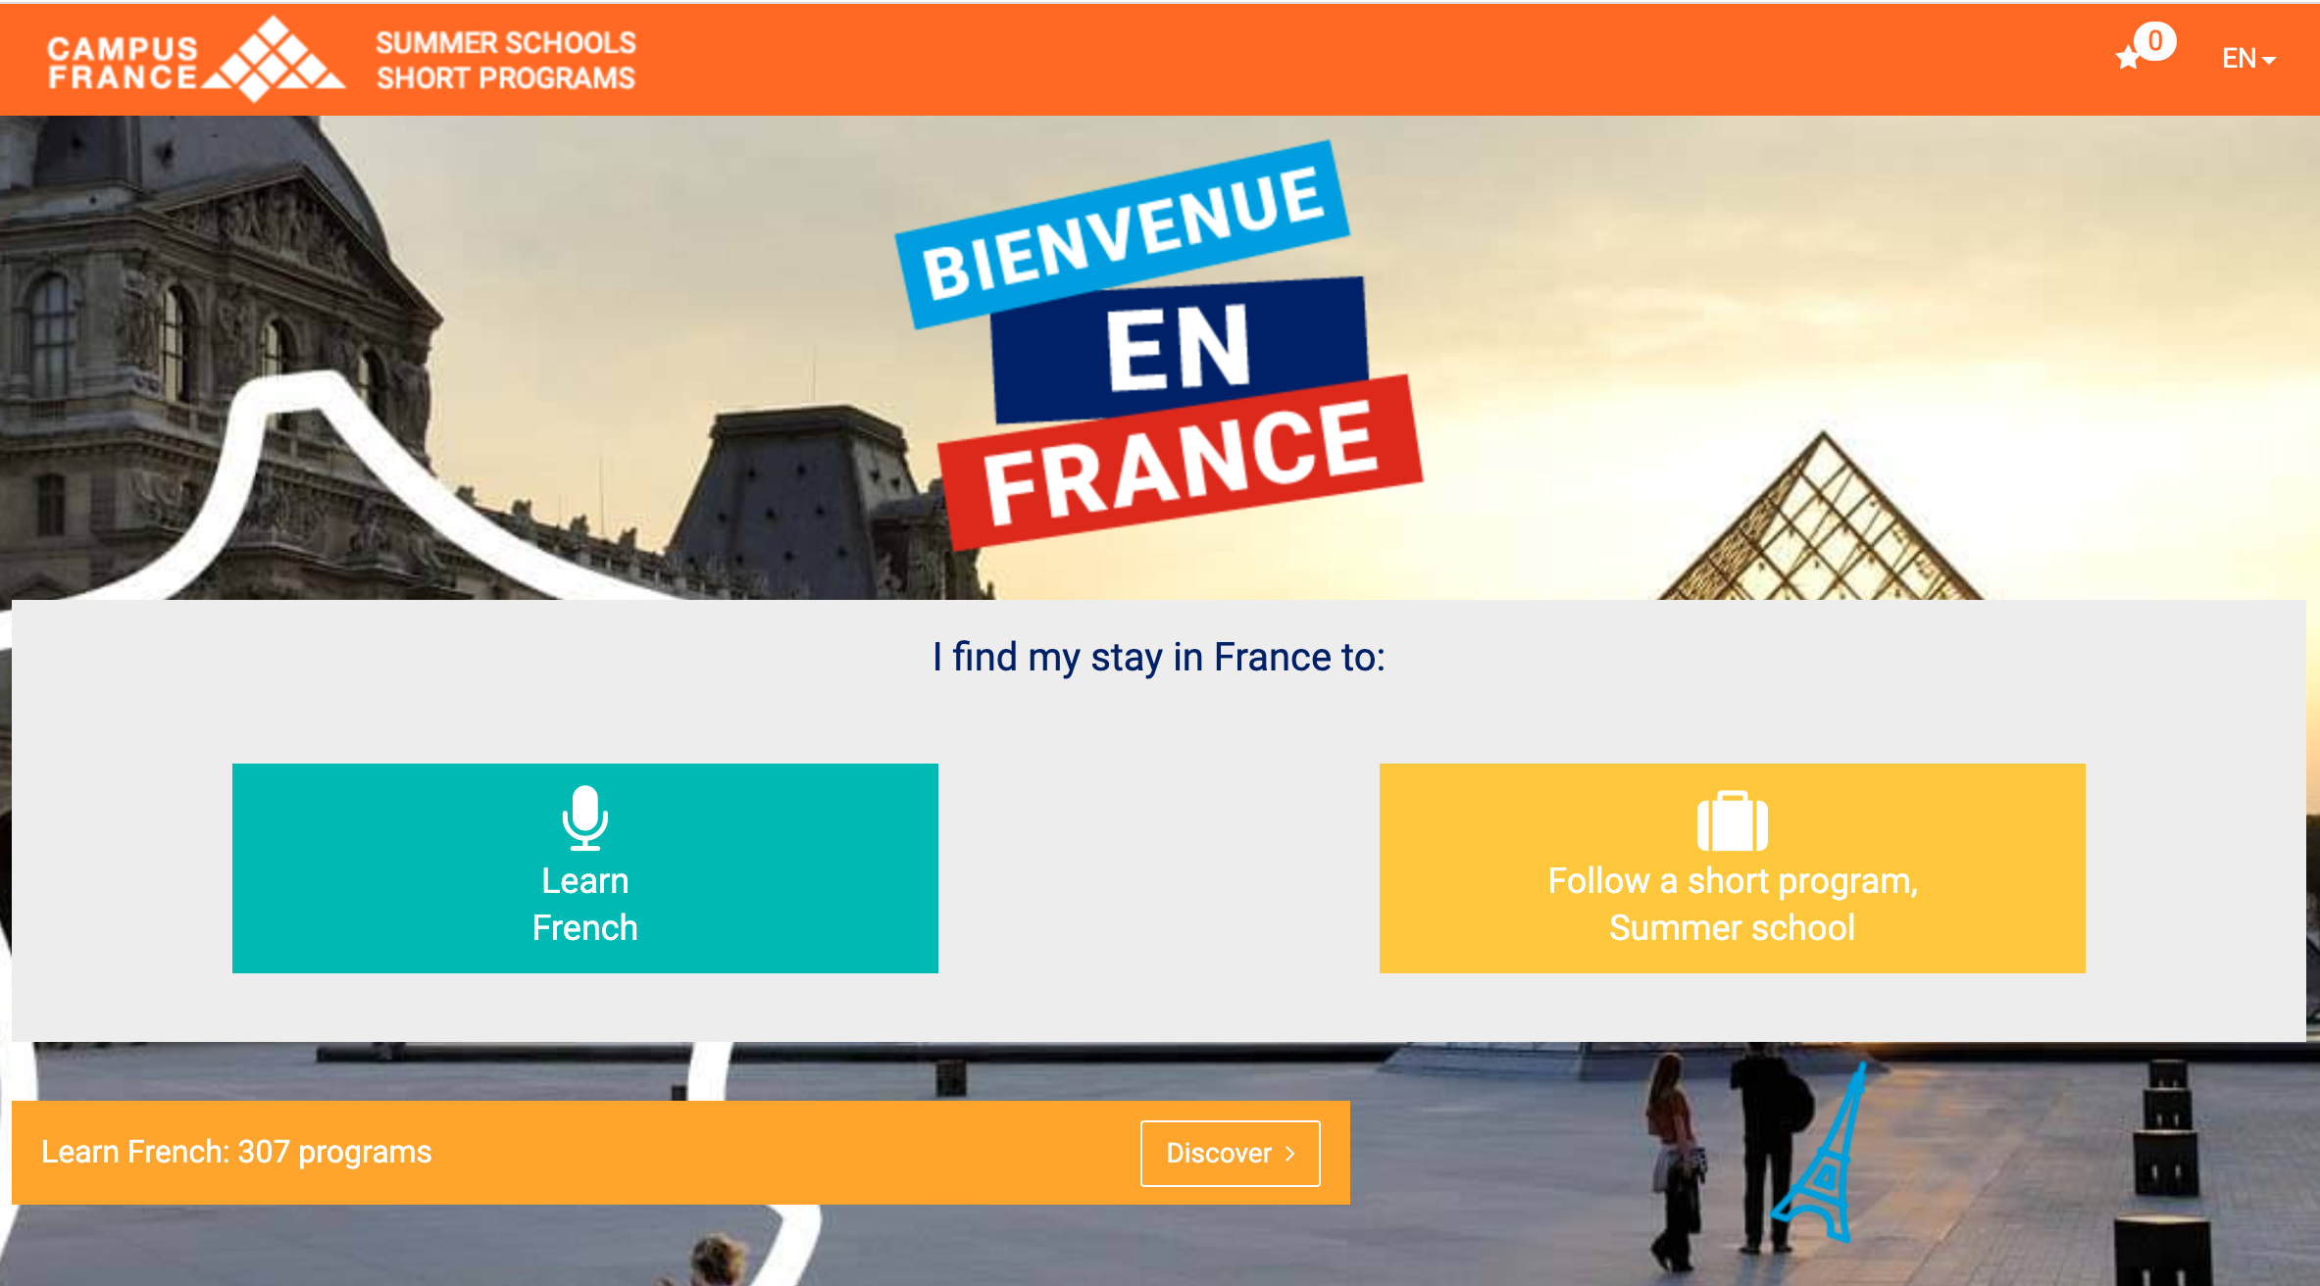
Prepare by Following a Summer School or a short programme
3. Useful information
In the aftermath of the Bienvenue en France road map, French universities and schools have developped many summer programmes
French intensive courses
Short courses on a specific topic
From three weeks to 3 months
Accessible without a visa
It can be a way for you to gain a first experience in France or to learn French before leaving for your exchange year !

Slide 39
Espace Campus France UK
CONTACT US
6, Cromwell Place
SW7 2EW
www.uk.campusfrance.org
londres@campusfrance.org
@CampusFranceUK
Campus France UK
To attend a personal orientation session to discuss your project in France you can book an appointment with us !

Slide 40
THANK YOU !

