Slide 1

Student Mobility Pre-departure
Briefing Update to include Covid-19 Guidance
Updated 18 August 2020
Notes:
HJ

Slide 2
Covid-19 Impact
If as anticipated the FCO advice is updated and travel is permitted to named countries, you will be able to go ahead and make your plans to travel to your nominated destination.
You will need to check if your nominated university is offering face to face teaching or distance learning. Each university is different and there are frequent updates.
Please note: the situation keeps changing, and it is advisable to sign up for the FCO alerts for your destination. In this way you will be able to track any additional requirements or guidance for entering your chosen destination. You may be required to undertake a period of quarantine, or to take health precautions such as wearing a mask and it will be your responsibility to follow the country guidance.

Slide 3
Covid-19 potential recall (repatriation)
Your wellbeing and safety is important and in the case of a second outbreak of Covid-19 Warwick will financially support you to return home. Our team will contact you via email on your Warwick email address.
You would be expected to return to your home within 15 calendar days of the repatriation call to be eligible for financial support which will include:
The cost of one return economy flight to your home country (not necessarily the UK) from the mobility destination, if an existing return ticket cannot be utilised. Any refund you receive relating to any pre-booked return flight will be deducted from the amount paid by the University.
Costs that will not be covered by the university include:
The cost of current or future rental payments in apartments/university housing will not be covered.
Return of any belongings left in-country will be your responsibility.
The offer of a return flight home will be valid for 15 calendar days from the date of notification of advice to return home. Exceptional circumstances will be considered on an individual basis.

Slide 4
Covid-19 Risk Assessment
All students will need to complete a Risk Assessment.
Link to risk assessment document here
You may wish to consider:
Timing of your travel. Is an FCO ban in place? Or is there still a country specific ban (for example, USA, Japan – see the FCO).
Are quarantine procedures in place?
Do you have sufficient funds to cover a potential additional two weeks if you need to quarantine?
Are you expected to find a place to quarantine outside of your planned accommodation? Or, will your planned accommodation provider offer support?
Have you researched the safety measures at your proposed host?
Have you considered the cost of living may have increased? You may not be able to find a part-time job to supplement your funds.
Would you be able to manage if there was another lock-down?
Upload the completed Risk Assessment to Evision before you travel.

Slide 5
Fees for Student Mobility Students Impacted by Covid-19
Students who are intending to spend either a term or a full-year on a student mobility programme for 2020-21 will be charged the standard 15% of the relevant fee as set out in the link below
https://warwick.ac.uk/services/academicoffice/finance/fees/ugtuitionfees2017/year_abroad_20-21_new.pdf
This will apply if due to the Covid-19 restrictions you are now spending part of your planned year at Warwick, distance learning with a partner university, or engaged with an internship programme at a business.
If your circumstances change and you revert to a three year degree, the standard relevant undergraduate fee will apply.

Slide 6
Covid-19 Business Travel Insurance
Details on the standard Business Travel Insurance cover are detailed later in this presentation.
Update: 18 August 2020
The University’s Business Travel Insurance policy will cover you for Emergency Health cover for your placement. Please ensure you have completed your risk assessment and uploaded it to your Evision portal prior to travel.

Slide 7
Covid-19 Erasmus+ and Distance Learning
If you have not departed for the country where you will study or work and will undertake distance learning, your Erasmus+ grant will only be paid from the date you physically attend the university or placement.
This is the current advice from the British Council and if the situation changes, we will advise you, but please be aware that you will not automatically receive a grant if you have not travelled.

Slide 8
Covid-19 Evision
Evision: make sure your details are up to date.
Ensure you have an updated mobile number
If you leave your placement for more than 5 days, update your Evision record with where you are staying.
Our team may need to contact you in the case of emergencies, your updated details are essential.
After three attempts to contact you by email or phone in the case of an emergency our team will contact your named next of kin/named contact. Our only reason for doing this is to ensure you are OK – it is much better if you contact us directly.

Slide 9
Change of Plans due to Covid-19: Accommodation at Warwick
If your plans have changed due to Covid-19 and you are now concerned about your accommodation at Warwick for the autumn term 2020, you will find information by
following this link.

Slide 10
And now to the pre-Covid-19 information originally presented in in the spring term 2020:

Slide 11
Enrolment at Warwick
You MUST re-enrol for Warwick in September when you receive the email reminder this allows you to:
retain your Warwick email address to receive (for example):
Next years’ accommodation
Next years’ modules choices
have access to all student support services
be able to register for the Student Mobility modules (usually 120 CATS) for your department to ensure that your placement will be recorded on your HEAR.
Notes:
HJ

Slide 12
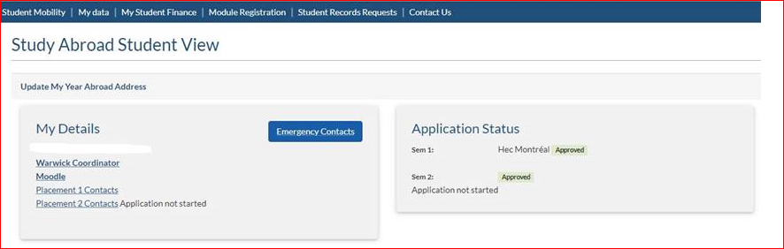
CONTACT
Notes:
HJ

Slide 13
https://www.erasmusplus.org.uk/brexit-update
Notes:
HJ

Slide 14
EUROPEAN HEALTH INSURANCE CARD (1)
https://www.nhs.uk/using-the-nhs/healthcare-abroad/moving-abroad/studying-abroad/
If you have a regular EHIC, you must return it and apply for a student EHIC
You are not entitled to use a student EHIC if you are on a work placement
(this includes British Council Language Assistantship students)
An EHIC application will require a letter from Warwick confirming you are a student, address of where you are studying overseas; your qualification, start and end dates. Our team can provide this letter for you. The letter will be uploaded to your Evision portal.
We would advise you purchase private health insurance (the Business Travel Insurance is for emergency cover only) and in the event the Student EHIC/EHIC is no longer in place (but see the next slide).
Notes:
HJ

Slide 15
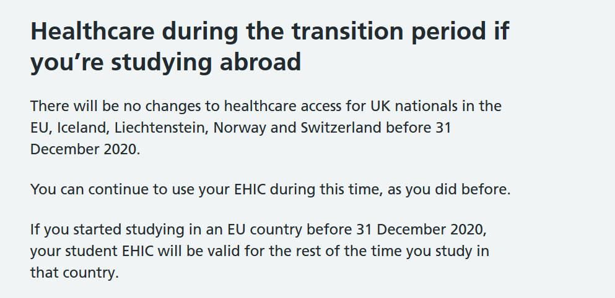
EUROPEAN HEALTH INSURANCE CARD (2)

Slide 16

Travel Insurance – Student Mobility 2020
16

Slide 17
Key Policy cover
Emergency medical insurance in the case of serious illness or an accident.
This is not private medical insurance.
If you require private medical insurance you are advised to take out an individual policy. Some universities will insist you purchase their own private health insurance – for example Australian universities, many North American universities, Turkish universities.

Slide 18
What is not covered (updated 7.9.20)
Personal travel unless incidental i.e.1 day per week abroad capped at 7 days after completion of studies to be taken within the same country and prior written approval by University of Warwick Insurance Services Department.
Travel after medical advice has been given not to travel.
Personal health cover (non-emergency) - students to source and pay for own cover or use the relevant EHIC card if appropriate/valid.
Travel to areas where the Foreign and Commonwealth Office state travel should be avoided and, if without justification, areas where essential travel only is recommended.
Travel over 12 months must be referred to the Insurance Services Office.

Slide 19
What is not covered continued
Covid-19 curtailment of your placement (no travel costs will be covered only medical emergency)
Motor insurance; you must obtain the correct license and ensure you are insured.
Accommodations scams – we cannot reimburse you.
Airline failure
Liability for third party injury/damage as a result of the use of firearms, wilful acts, part of a criminal act or being under the influence of alcohol or drugs.
Loss of or accidental damage to mobile phones, tablets or laptops.
Insurers will review carefully each claim submitted.

Slide 20
Assistance
Personal letters available for visits to Schengen Area to assist with visa applications.
Aviva 24/7 helpline.
Personal insurer examples but not recommendations
World Nomads
True Traveller
Foreign and Commonwealth Office https://www.gov.uk/foreign-travel-advice
WorldAware https://my.worldaware.com/affiliates/aviva (quote policy number 100005565GPA when registering)
Warwick Insite - https://warwick.ac.uk/services/finance/insurance
Claims report form online.
Insurance Office email insuranceservices@Warwick.ac.uk
Insurance Services Office – Argent Court (near Tesco).

Slide 21

Wellbeing Support Services
Taking care of your wellbeing while studying abroad

Slide 22

Things to think about before you go
Emotional support and preparation is just as important as the practical steps
What do you need to feel happy/content and secure?
Do you know your wellbeing “red flags?” How do you know when you are not feeling “yourself”? If you are able to recognise these changes, then you can be proactive in seeking support before things escalate
Who do you usually turn to?
Will you still be able to contact them?
Do you have professional support in place at Warwick, that you need to consider at your host university or from elsewhere?
Do you know about the online resources you can access while away?

Slide 23
Warwick’s Support Network
Telephone brief consultations
Telephone wellbeing appointments
Email counselling
Disability appointments by telephone
Mental Health Mentor can do sessions via Skype
You can still access support from Warwick’s Wellbeing Support Services while you are away

Slide 24


Online Support

Slide 25
Remember…
Talk about what you are feeling and experiencing while abroad. You are all going to be in similar situations and it helps to know you are not alone in how you feel.
Share suggestions with friends for coping techniques and support options - let them know what helps you.
Make the most of your time abroad, but also know it is okay and normal to have ups and downs while away.
Look after each other – check in with each other and remind friends of what support is available if they need it.

Slide 26

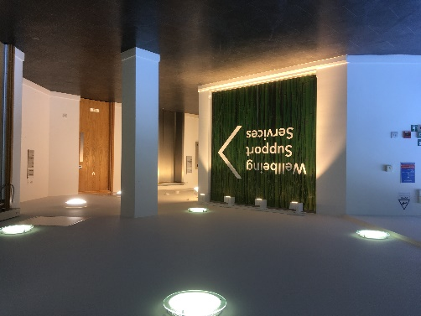
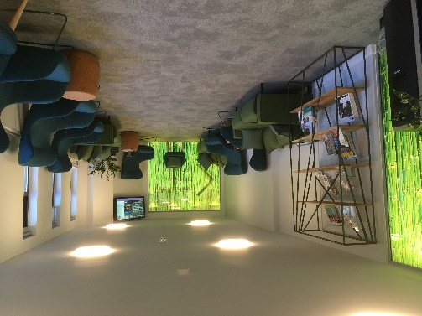
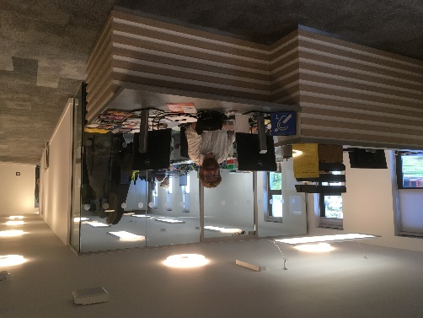
Wellbeing Support Services
 024 7657 5570
 wellbeing.warwick.ac.uk
Telephone consultations available every working day from 10am-3pm to identify the correct support for you.
Notes:
.

Slide 27
Next Steps
Notes:
AO

Slide 28
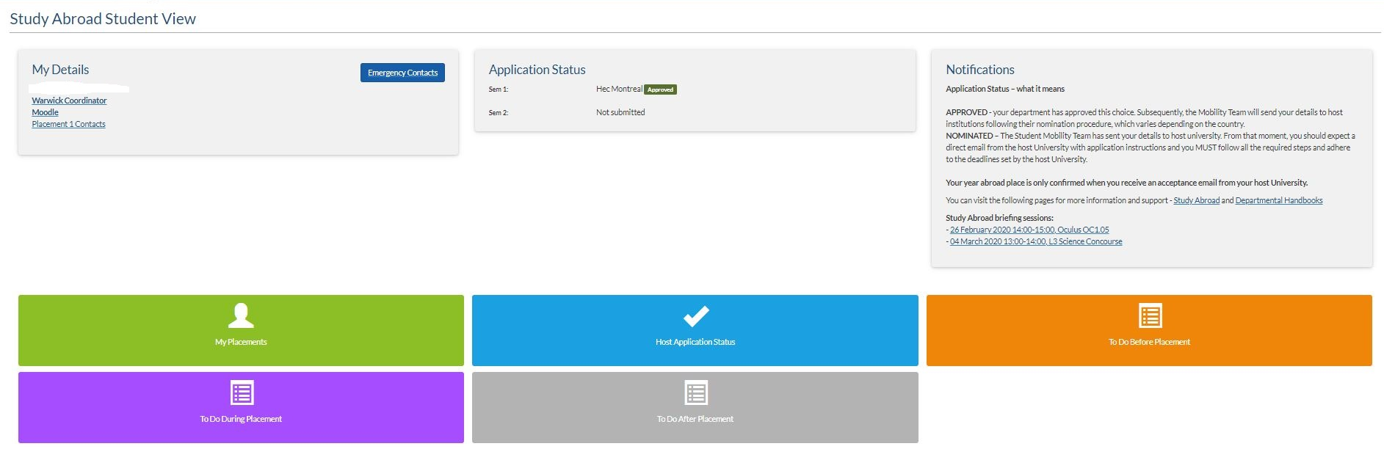


E-Vision Portal – view your application status and to ensure you have completed all your forms before, during and after your placement
Notes:
AO

Slide 29
Two Placements
If you intend to spend your time at two destinations, remember to :
Check the term dates are compatible. Visit the FAQ Partnership link
Do not make assumptions:
check the second university/work place has accepted you
Leave time for visa applications. This can take time and if you need to return home to get your visa for a 2nd placement, you must factor in the time involved
Check you have all the documentation you require. It is essential you leave time to apply for your visas for both placements. If you are intending to work: ensure you apply for the correct visa – do not gamble on a cheaper route.
Notes:
AO

Slide 30
Language
You may be requested to prove your language competency by the partner:
online testing
request for certification
confirmation from a tutor
This will be part of the application process and you must action the request, evidence must be provided in the form specified by the partner
Notes:
AO

Slide 31
Confirmation of your Place at the Host University
Confirmation of your place at the partner is subject to their approval
Your host will send you confirmation of your placement, by email or hard copy
Warwick will confirm your end of year results –there is an overall expectation that you are at 2:1 level. If you have any concerns about this please get in touch with your departmental/academic contact
Book your travel when you have received final confirmation from the host and are sure no travel restrictions are still in place (see the FCO website https://www.gov.uk/government/organisations/foreign-commonwealth-office)
Notes:
AO

Slide 32
Accommodation
On campus accommodation may be offered particularly for worldwide exchanges
European universities may offer support but you must actively secure accommodation as soon as possible. It is your responsibility to find your accommodation.
Your host university will be able to provide sources of information
Speak to other students
Look on the Student Mobility Facebook page
Consider the length of contract before committing to a contract.
Be careful, each year there will be accommodation scams and even links from partner universities have caused problems.
Notes:
AO

Slide 33
Funding
Notes:
LM

Slide 34
Funding
Eligibility for funding and bursaries does not change because you will be overseas - apply as normal and make sure that you meet the Funding Companies deadline dates
Warwick’s student finance team informs the funding companies who will be going abroad for the coming academic year, they include Host institution term dates
If the Host academic year starts more than a month before the Warwick academic year, the funding company will try to make payments earlier, for all other students payments will be made in accordance to Warwick's academic year - Early payments are NOT guaranteed
We strongly RECOMMEND that alternative financial arrangements are made to cover the time between the start of your placement and receipt of funding. Consider the additional cost of any period of quarantine if required.
Notes:
LM

Slide 35

Scotland
https://www.saas.gov.uk/
Northern Ireland
https://www.studentfinanceni.co.uk/
England
https://www.gov.uk/student-finance
Wales
https://www.studentfinancewales.co.uk/
You may be eligible for a travel grant.
Notes:
LM

Slide 36
Erasmus+ Funding
Grant rates are set by the British Council as the Erasmus+ National Agency for the UK
Participants will receive at least the amount shown below per month, per country of destination:
Study minimum of €370
Work minimum of €470
The grant is paid in 2 instalments:
70% at the start on receipt of accurately completed arrival forms;
30% at the end on receipt of accurately completed completion forms
Split placements = 2 sets of forms, 2 sets of grant allocations
Full year placement Split placement
70% on submission of arrival paperwork 70% on submission of arrival paperwork – placement 1
30% on submission of completion paperwork 30% on submission of completion paperwork – placement 1
70% on submission of arrival paperwork – placement 2
30% on submission of completion paperwork – placement 2
Notes:
BM

Slide 37
Erasmus+ - Form filling!
All through Evision!
Notes:
BM

Slide 38
Sponsorship
If you are currently being sponsored for your degree; a government scholarship;
Institution sponsorship; other kinds of bursaries
- check the terms of your funding, not all schemes allow you to undertake mobility programmes
Notes:
BM

Slide 39
Travel

Slide 40
If you require a visa to enter your destination country, you will receive support and information from your host university.
Timings- make sure you plan in sufficient time for this Investigate the process, some countries take longer than others, remember it could mean an appointment over the summer vacation
Make sure you have all of your documentation together for your appointment
If you intend to work on your placement, you must ensure that you enter the country on the correct visa to entitle you to work. It is your responsibility to ensure you apply for the correct visa. You may be refused entry to a country if your visa is not accurate.
Notes:
MR

Slide 41
Students entering Warwick on a Tier 4 Visa
Monitoring plans are essential for students holding a Warwick Tier 4 visa.
We will contact all students on a Tier 4 visa. 10 monitoring points will be required throughout your stay.
It is essential that a monitoring plan is maintained and you respond to each request to update your monitoring plan. This is a condition of your Tier 4 visa.
Notes:
MR

Slide 42
Looking After Yourself When Travelling
https://warwick.ac.uk/services/healthsafetywellbeing/guidance/travel_health
Medicines
Vaccinations
Dentists
Register at a medical centre as soon as you arrive
Check your medication is legal in your destination country.
Speak to your own doctor to arrange for your medication to cover your time overseas, they may need to find an alternative for you that is allowed in your destination country
Research cost of dental or eye treatment. Book appointments before you go
Notes:
MR

Slide 43
Placement

Slide 44
Studying – Your Warwick department will be able to advise on the content you must study.
Working – your job description
Your Warwick department will have a process for approval of work placements.
Full-time attendance is expected.
Your academic co-ordinator must authorise your plans, including changes
Check your departmental handbook for specific details:
warwick.ac.uk/studentmobilitydepartmental-handbooks
Notes:
TP

Slide 45
Transcripts
Transcripts are required by your academic department at Warwick to progress your degree
Study
Your host university will be able to provide this but may need you to request it
Work
Your host should provide you with a reference for your work placement, but to be able to assess your placement more accurately your academic department will look for a transcript of work. The template for this can be downloaded from the study abroad website
Notes:
TP

Slide 46
Feedback
Your views and experiences are very valuable
Please participate in any of the different opportunities that we let you know about to give us feedback wherever you feel able. Particularly our FAQ section of the website is reliant for much of the information on what you tell us
Notes:
HJ

Slide 47
WISHING YOU A SUCCESSFUL AND SATISFYING YEAR OVERSEAS
warwick.ac.uk/studentmobility
Notes:
HJ

