Slide 1
Student Mobility Pre-departure
For Autumn Term 2021
Notes:
HJ

Slide 2
Welcome to the Pre-departure Briefing 2021-2
You may be interested to see how many students are going out to work and study from Warwick in 2021-2.
576
Please do be pro-active with contacting your host university and in managing your year abroad.
Also add: no-reply@warwick.ac.uk
To your permitted emails
Notes:
HJ

Slide 3
Covid-19 Impact
Education is a permitted reason to travel.
Face to face or distance learning: you need to keep in close contact with the host as the situation is changing regularly.
The link to the Foreign Commonwealth and Development Office (FCDO) is here: https://www.gov.uk/foreign-travel-advice
The student mobility team also post the most important information into the FAQs: Frequently Asked Questions (warwick.ac.uk)
There will be specific requirements to enter different countries and you need to follow the instructions from the FCDO, your host and Warwick.
Notes:
HJ

Slide 4
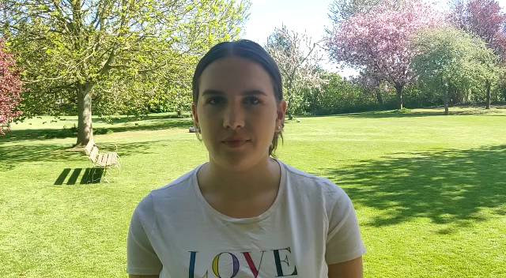
The Experience of Covid-19 on a Work-placement 2020-21
Notes:
HJ

Slide 5
Vaccination Programme:
We advise you talk to your GP as soon as possible regarding the vaccination programme.
International students who live in the UK and are registered with a General Practitioner (GP) will be able to access the COVID-19 vaccine, just as they are currently able to access healthcare.
NHS England FAQ document on second doses which confirms that:
In exceptional circumstances different vaccines can be used for first and second doses. Exceptional circumstances include “if the first product received is unknown or if they received a brand that is not available in the UK” meaning that international students who have had the first dose of vaccine outside of the UK are able to receive their second dose in the UK even if they are unsure what vaccine they received for their first shot or that vaccine is not available in the UK.
There are exceptional circumstances in which second doses may be given outside of the standard interval period but travel or plans to leave the UK are not included in this list. This means international students leaving the UK or current students intending to travel abroad for placements will not be able to access the second dose of vaccine at a shorter than normal interval.
DHSC have useful FAQs.
Updated 6 May
Notes:
HJ

Slide 6
Risk Assessment – Compulsory
In person or distance learning?
FCDO advice: do you have the correct documentation?
Are quarantine procedures in place? Potential cost of hotel for 2 weeks.
Are you expected to find a place to quarantine outside of your planned accommodation? Or, will your planned accommodation provider offer support? Your host will be able to advise.
Have you researched the safety measures at your proposed host?
The cost of living may have increased? You may not be able to find a part-time job to supplement your funds.
Would you be able to manage if there was a lock-down in your host country?
The link to the Risk Assessment is here: Frequently Asked Questions (warwick.ac.uk)
This must be uploaded to Evision before your travel.
Notes:
HJ

Slide 7
Emergency Contact
The University (either your department or the Student Mobility Team) may need to contact you if there is an emergency situation, please ensure your details are current on Evision.
Please see this FAQ: Frequently Asked Questions (warwick.ac.uk)
Even if you are out of the country for 5 days or more, ensure your contact details and mobile phone number are updated.
Notes:
HJ

Slide 8
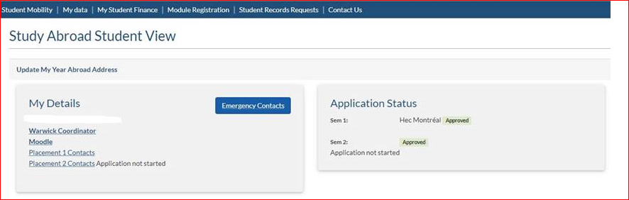
CONTACT
Notes:
HJ

Slide 9
Business Travel Insurance

Slide 10
Key Policy Cover
Emergency medical insurance in the case of serious illness or an accident.
For details of the policy, see the FAQ: Frequently Asked Questions (warwick.ac.uk)
This is not private medical insurance.
If you require private medical insurance you are advised to take out an individual policy. Some universities will insist you purchase their own private health insurance – for example Australian universities, many North American universities, Turkish universities.
Notes:
HJ

Slide 11
What is not covered 1
Personal travel unless incidental i.e.1 day per week abroad capped at 7 days after completion of studies to be taken within the same country and prior written approval by University of Warwick Insurance Services Department.
Travel after medical advice has been given not to travel.
Personal health cover (non-emergency) - students to source and pay for own cover or use the relevant GHIC card if appropriate/valid.
Travel to areas where the Foreign and Commonwealth Office state travel should be avoided and, if without justification, areas where essential travel only is recommended.
Travel over 12 months must be referred to the Insurance Services Office.
Notes:
HJ

Slide 12
What is not covered 2
Covid-19 curtailment of your placement (no travel costs will be covered only medical emergency)
Motor insurance; you must obtain the correct license and ensure you are insured.
Accommodations scams – we cannot reimburse you.
Airline failure
Liability for third party injury/damage as a result of the use of firearms, wilful acts, part of a criminal act or being under the influence of alcohol or drugs.
Loss of or accidental damage to mobile phones, tablets or laptops.
Insurers will review carefully each claim submitted.
Notes:
HJ

Slide 13
Key Policy Cover
Personal letters available for visits to Schengen Area to assist with visa applications.
Aviva 24/7 helpline.
Personal insurer examples but not recommendations
  World Nomads
  True Traveller
Foreign and Commonwealth Office https://www.gov.uk/foreign-travel-advice
WorldAware https://my.worldaware.com/affiliates/aviva (quote policy number 100005565GPA when registering)
Warwick Insite - https://warwick.ac.uk/services/finance/insurance
Claims report form online.
Insurance Office email insuranceservices@Warwick.ac.uk
Insurance Services Office – Argent Court (near Tesco).
Notes:
HJ

Slide 14
Preparation

Slide 15
Enrolment at Warwick
You MUST re-enrol for Warwick in September to:
retain your Warwick email address to receive (for example):
  Next years’ accommodation
  Next years’ modules choices
have access to all student support services
be able to register for the Student Mobility modules (usually 120 CATS) for your department to ensure that your placement will be recorded on your HEAR.
Notes:
HJ

Slide 16
GHIC Health Card
UK-issued European Health Insurance Cards (EHICs) are still valid and offer the same cover as GHICs in the EU.
Once your EHIC has expired, you’ll be able to replace it with a GHIC
UK students going to the EU (work or study)
If you're planning to study in an EU country, you need to apply for a GHIC that’s time limited to the length of your course. You cannot apply for this online.
You’ll also need a letter from your university confirming:
name and address of the UK educational institution (if you’re going as part of a UK course)
address of where you're studying in the EU
details of the qualification you're studying for
dates your course started and is due to finish
Complete a GHIC application form (PDF, 678kb) and post it along with your university/college letter to:
Overseas Healthcare Services
NHS Business Services Authority
Bridge House
152 Pilgrim Street
Newcastle upon Tyne
NE1 6SN
https://www.nhs.uk/using-the-nhs/healthcare-abroad/apply-for-a-free-uk-global-health-insurance-card-ghic/
The GHIC is valid within anywhere within the EU. It is not valid in Iceland, Liechtenstein, Norway or Switzerland. Until a new agreement is settled on, you are still entitled to necessary medical treatment in Norway (show your passport). The UK government has said that it is working towards agreements with Iceland, Liechtenstein and Switzerland. (added 12.5.21)
Notes:
HJ

Slide 17
Confirmation Letter: Use for GHIC Health Card / Placement Accommodation/ confirmation for Student Finance
A UK Global Health Insurance Card (GHIC) gives you the right to access state-provided healthcare during a temporary stay in the European Union (EU). We have had some reports (spring 2021) of health services in Europe not accepting the GHIC card – and you may consider also purchasing private health insurance.
Please complete the online form and your letter will be available in Evision. Your details need to be uploaded asap.
Find the form here
Notes:
HJ

Slide 18
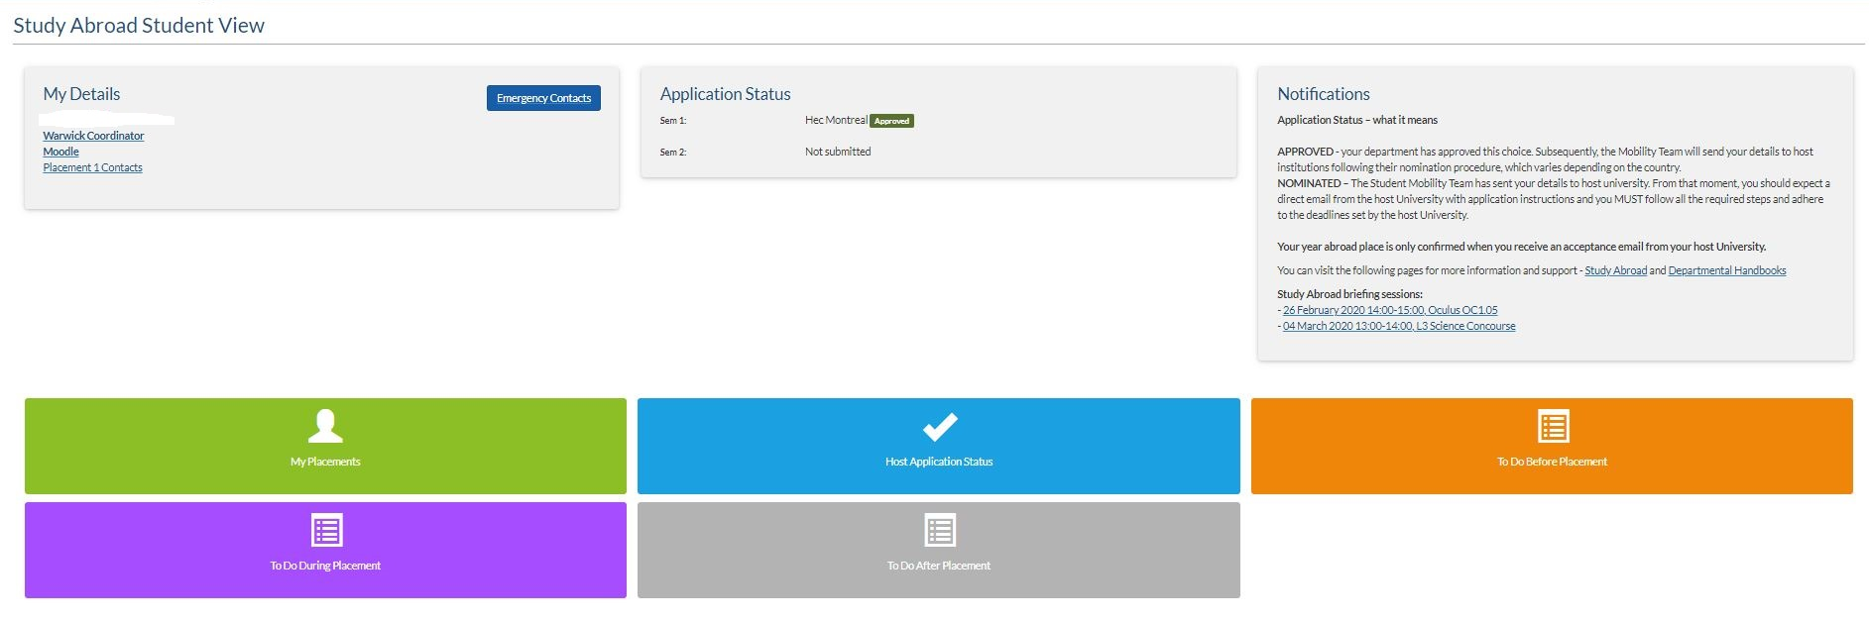


E-Vision Portal – view your application status and to ensure you have completed all your forms before, during and after your placement
Notes:
AO

Slide 19
Two Placements
If you intend to spend your time at two destinations, remember to :
Check the term dates are compatible. Visit the FAQ Partnership link
Do not make assumptions:
check the second university/work place has accepted you
Leave time for visa applications. This can take time and if you need to return home to get your visa for a 2nd placement, you must factor in the time involved
Check you have all the documentation you require. It is essential you leave time to apply for your visas for both placements. If you are intending to work: ensure you apply for the correct visa – do not gamble on a cheaper route.
Notes:
AO

Slide 20
Language
You may be requested to prove your language competency by the partner:
online testing
request for certification
confirmation from a tutor
This will be part of the application process and you must action the request, evidence must be provided in the form specified by the partner
Notes:
AO

Slide 21
Confirmation of your Place at the Host University
Confirmation of your placement is subject to your host.
Your host will send you confirmation of your placement, by email or hard copy
Warwick will confirm your end of year results –there is an overall expectation that you are at 2:1 level. If you have any concerns about this please get in touch with your departmental/academic contact.
Book your travel when you have received final confirmation from the host and are sure no travel restrictions are still in place (see the FCDO website https://www.gov.uk/government/organisations/foreign-commonwealth-office)
Notes:
AO

Slide 22
Accommodation
On or off campus accommodation may be offered
European universities may offer support but you must actively secure accommodation as soon as possible. It is your responsibility to find your accommodation. Covid-19 has made planning more difficult, try not to commit to any deposits until you know you are able to travel.
Your host university will be able to provide sources of information
Consider the length of contract before committing to a contract.
Be careful, each year there will be accommodation scams and even links from partner universities have contained scams. If possible do not sign an accommodation contract and pay a deposit until you have seen the premises.
Notes:
AO

Slide 23
Funding
Notes:
LM

Slide 24
Erasmus+ and the Turing Scheme
Erasmus+ funding will be available for European work and study placements until May 2023.
Turing Scheme: this is the new mobility scheme to enable students to receive funding internationally.
Warwick has applied for funding but the outcome of the bid will not be known until late July / August 2021.
In the meantime, please see our FAQs regarding the Turing Scheme:
Frequently Asked Questions (warwick.ac.uk)
UK students and international students are eligible for Turing funding (should we receive a grant).
You do not need to contact Student Mobility, if a grant is paid, we will advise you as soon as possible.
The process is likely to be similar to the current Erasmus+ process (not confirmed).
Notes:
LM

Slide 25
Fees for Student Mobility Students Impacted by Covid-19
Students who are intending to spend either a term or an intercalated full-year on a student mobility programme for 2021-22 will be charged the standard 15% of the relevant fee as set out in the link below
https://warwick.ac.uk/services/academicoffice/finance/fees/ugtuitionfees2017/year_abroad_20-21_new.pdf
This will apply if due to the Covid-19 restrictions you are now spending part of your planned year at Warwick, distance learning with a partner university, or engaged with an internship programme at a business.
If your circumstances change and you revert to a three year degree, the standard relevant undergraduate fee will apply.
Notes:
LM

Slide 26

Scotland
https://www.saas.gov.uk/
Northern Ireland
https://www.studentfinanceni.co.uk/
England
https://www.gov.uk/student-finance
Wales
https://www.studentfinancewales.co.uk/
You may be eligible for a travel grant.
Notes:
LM

Slide 27
Funding: https://www.gov.uk/student-finance
Apply as normal and make sure that you meet the Funding Companies deadline dates
Warwick’s student finance team informs the funding companies who will be going abroad for the coming academic year, they include Host institution term dates
If the Host academic year starts more than a month before the Warwick academic year, the funding company will try to make payments earlier, for all other students’ payments will be made in accordance with Warwick's academic year - Early payments are NOT guaranteed.
Turing: If possible you may receive a Turing grant, you should tick the appropriate box and the application will be pended while waiting for the evidence. If you do not receive the grant, you would then need to submit a change once that is confirmed.
Notes:
LM

Slide 28
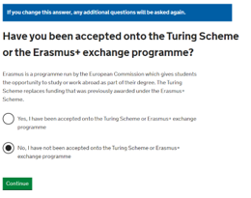
Erasmus+ and the Turing Scheme
You can tick yes if you are going on an international placement – but will have to amend if Warwick does not gain a Turing Scheme grant.
(We should know in late July / early August)
Notes:
LM

Slide 29
Student Finance (England as an example)
What you'll get
The amount you get depends on your total household income. This means your income, if you have one, combined with that of your parents or guardians, or spouse or partner if you live with them. Do not count income from other family members you live with.
You must pay the ﬁrst £303 of your travel costs - and your travel grant will be reduced by £1 for each £8.73 of household income over £39,796.
Keep your travel costs as low as possible without being impractical.
If you’re studying abroad
You can apply for:
up to 3 return journeys between your home and the overseas institution during a full academic year abroad
help with essential expenses, medical insurance and travel visas
We advise you apply for the full tuition fee loan amount. This is because in case of discrepancy, finance are able to decrease the loan amount without the student involvement, however, an increase of the loan needs to be generally requested by the student and it is a lengthier process.Even if student askes for a full loan, the University confirms/requests only the amount which is actually charged after the student is fully enrolled for the course. (added 13.5.21)
Studying abroad: travel grants for students (England): What you'll get - GOV.UK (www.gov.uk)
Notes:
LM

Slide 30
Erasmus+ and Worldwide Forms
Correctly completed forms will be processed as soon as possible. Do not email to follow up. Thank you!
Study and Work ERASMUS+ Forms (warwick.ac.uk)
Worldwide Forms (warwick.ac.uk)
As a guide, the first payment to you will be made early in November following recent of your correct paperwork.
What about Turing?
If the Turing Scheme does allocate Warwick funding, we anticipate the process being very similar: but this is still to be confirmed. We will notify eligible students as soon as possible, but the Government confirmation is not likely before early August.
Notes:
BM

Slide 31
Erasmus+ Funding: Distance Learning
If you have not departed for the country where you will study or work and will undertake distance learning, your Erasmus+ grant will only be paid from the date you physically attend the university or placement.
This is the current advice from the British Council and if the situation changes, we will advise you, but please be aware that you will not receive a grant if you have not travelled.
Please see the FAQ here: Frequently Asked Questions (warwick.ac.uk)
Notes:
BM

Slide 32
Erasmus+ Funding
Frequently Asked Questions (warwick.ac.uk)
Grant rates are set by the British Council as the Erasmus+ National Agency for the UK
Participants will receive at least the amount shown below per month, per country of destination:
        Study minimum of €370
        Work minimum of €470
The grant is paid in 2 instalments:
    70% at the start on receipt of accurately completed arrival forms;
    30% at the end on receipt of accurately completed completion forms
Split placements = 2 sets of forms, 2 sets of grant allocations
Full year placement Split placement
70% on submission of arrival paperwork 70% on submission of arrival paperwork – placement 1
30% on submission of completion paperwork 30% on submission of completion paperwork – placement 1
70% on submission of arrival paperwork – placement 2
30% on submission of completion paperwork – placement 2
Notes:
BM

Slide 33
Bank Account Details
Frequently Asked Questions (warwick.ac.uk)
The link to the FAQ (see above) will advise you how to upload your bank account details.
Do not upload your bank account details to Evision.
Notes:
HJ

Slide 34
Erasmus+ Funding: Arrival Plan
If you have not received your grant, one of the main reasons is that your Arrival Plan has not been completed or signed as requested.
It is useful to read the templates provided to make sure you do not miss critical information:
For details of the Arrival Plan, please see the FAQ link here: Frequently Asked Questions (warwick.ac.uk)
Notes:
BM

Slide 35
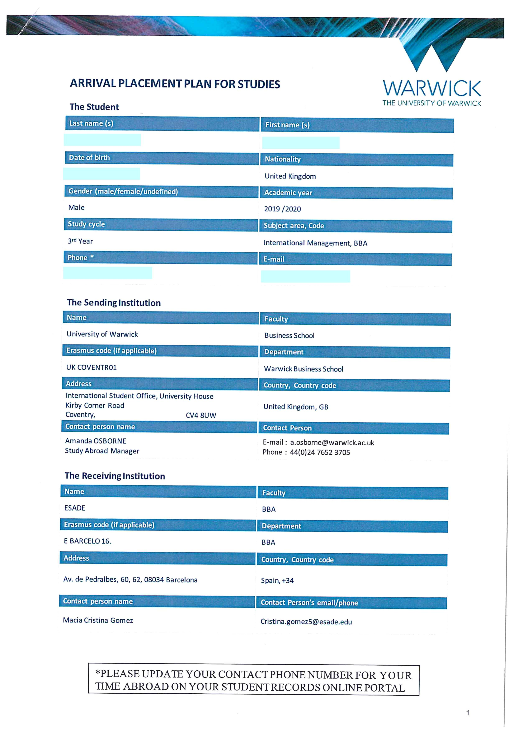
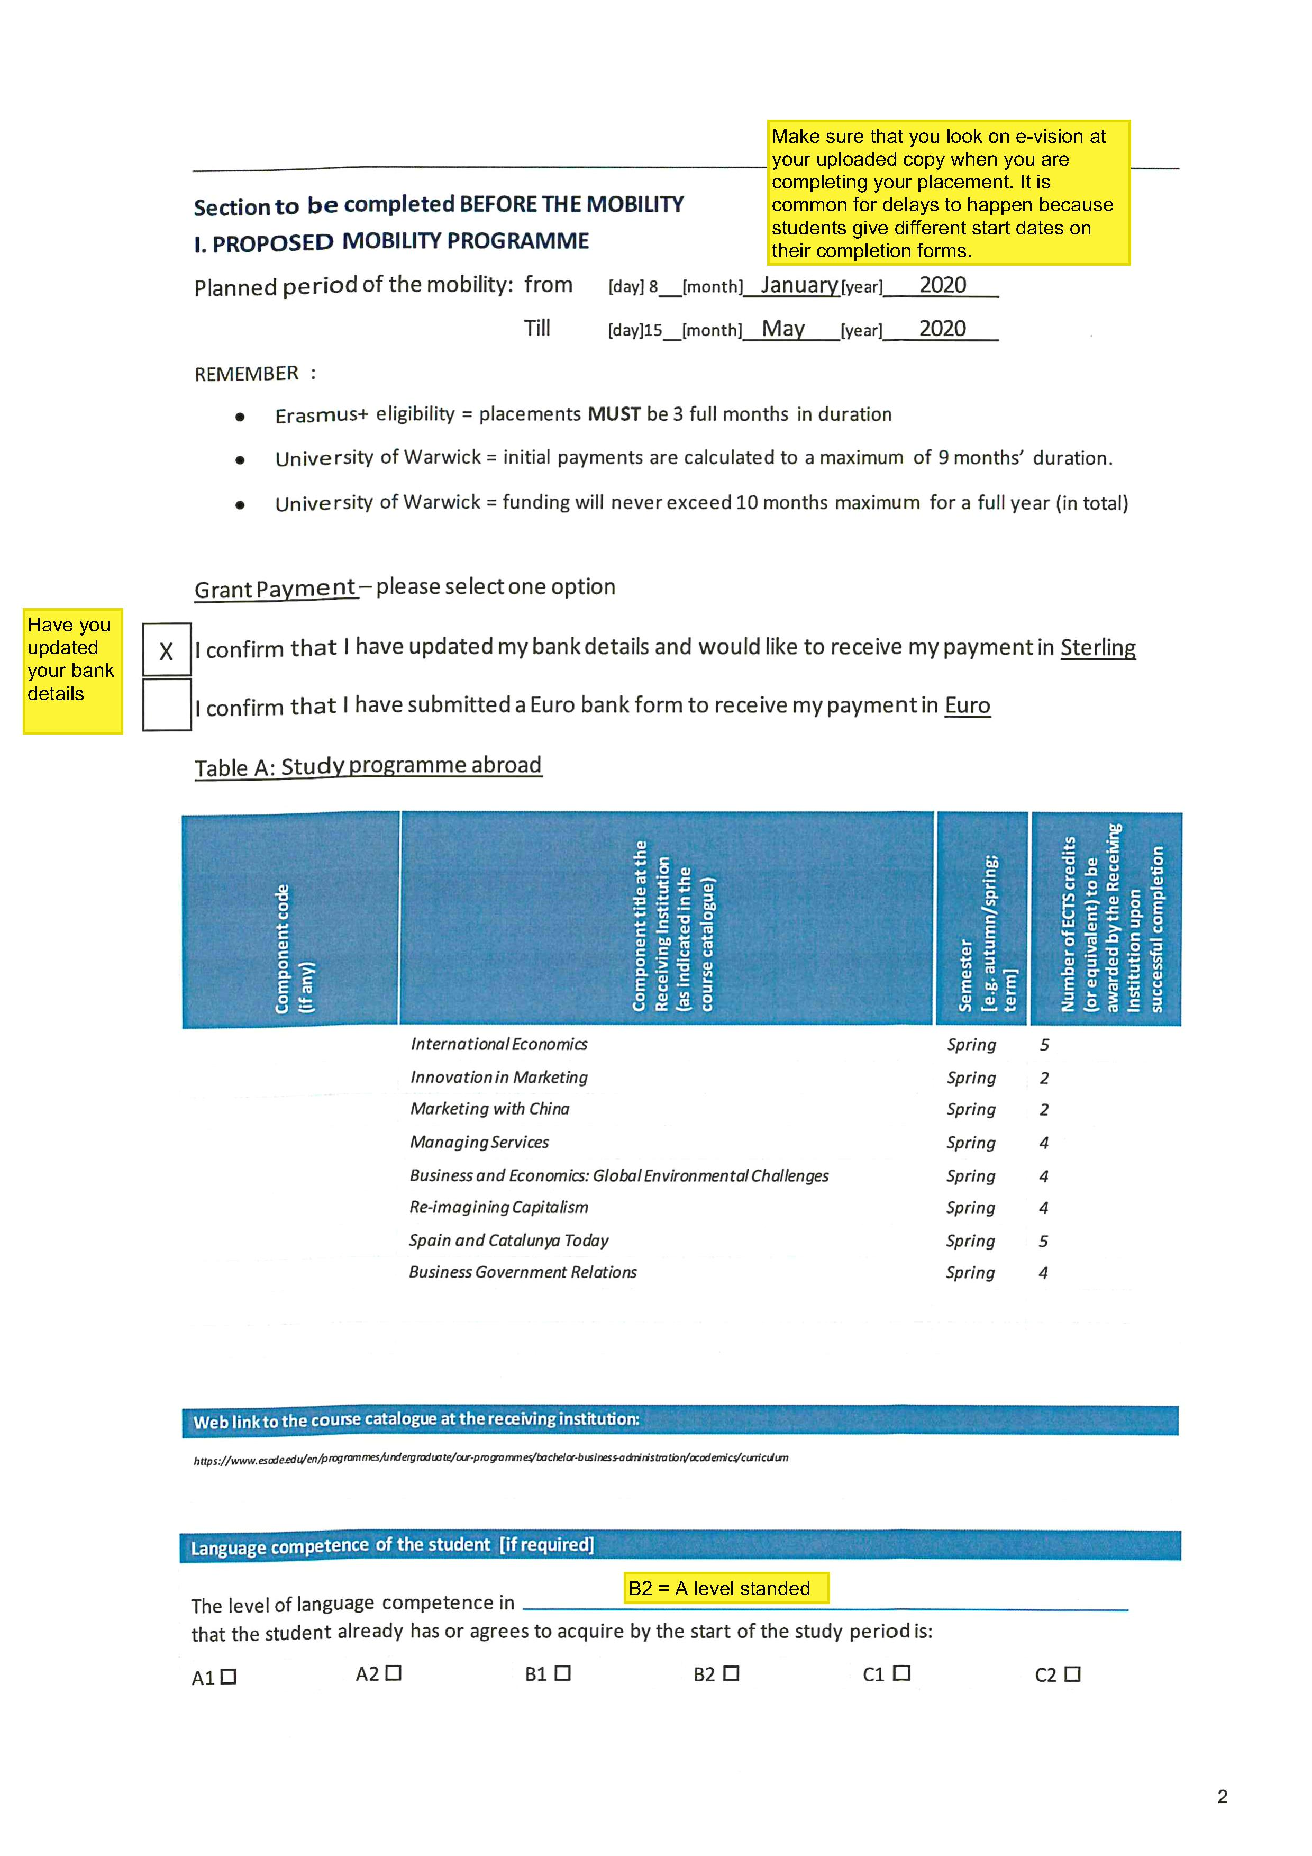
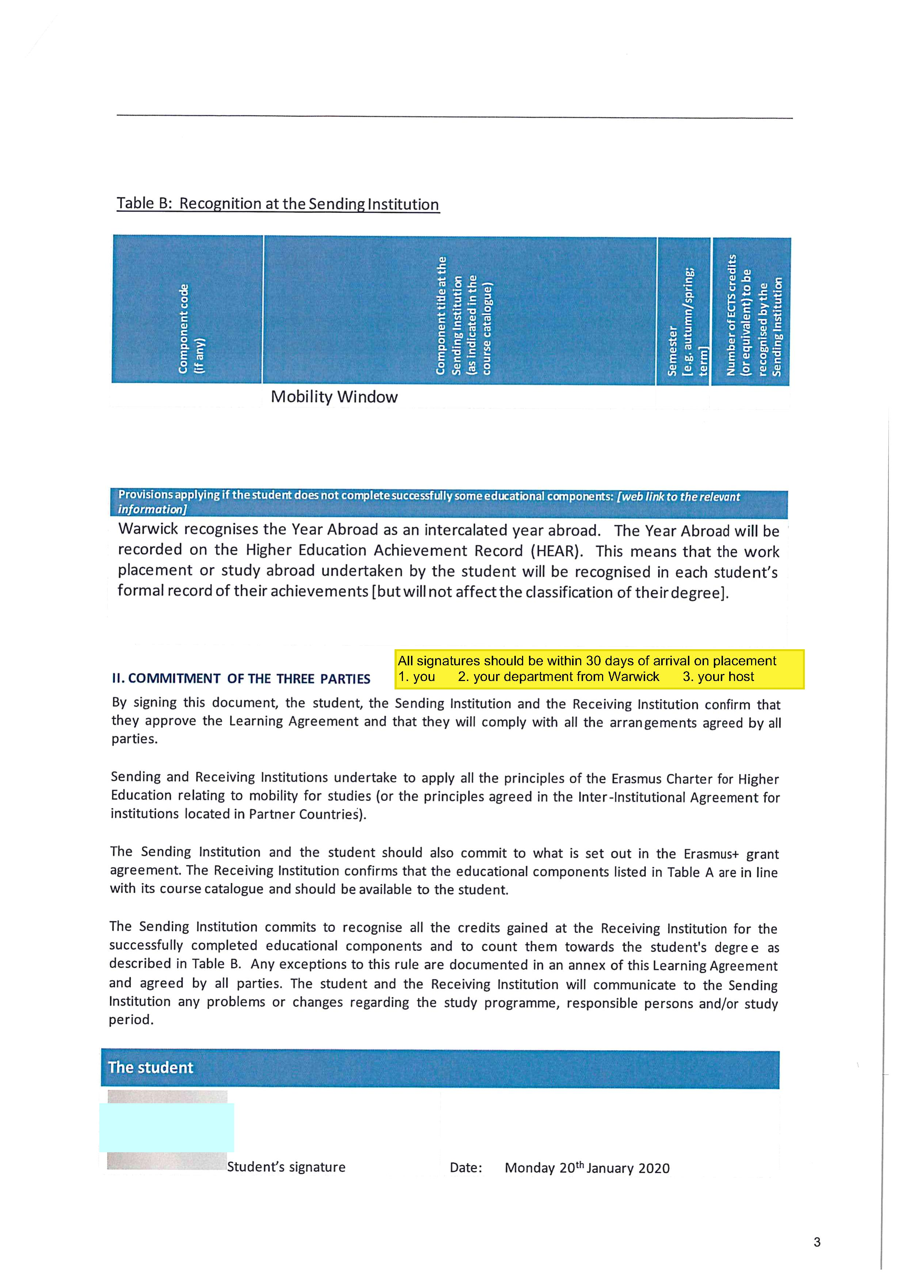
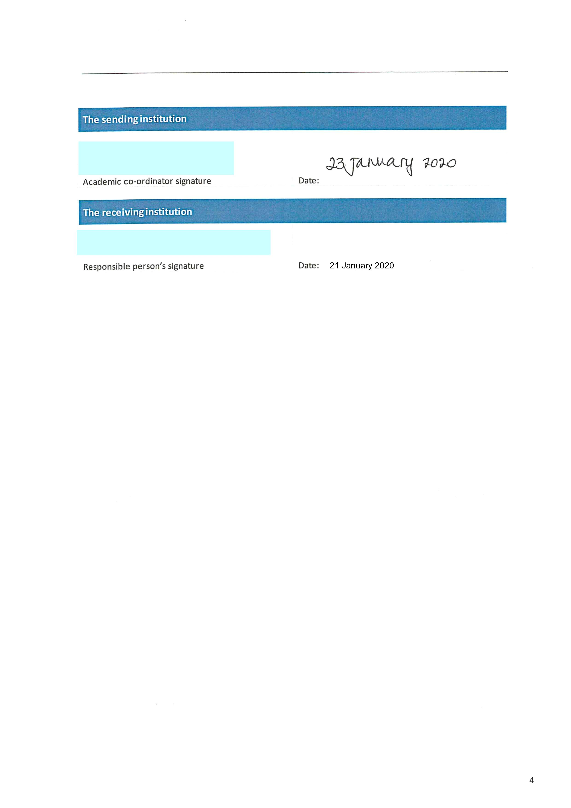
Erasmus+ Funding: completing the form 1st time!!
Notes:
BM

Slide 36
Erasmus+ Funding: Completion Plan
At the end of each of your placements if you receive a grant it is essential to finalise your Completion Plan to receive your final 30% of the Erasmus+ grant:
See the FAQ here for further details:
Final 30% payment of your grant: Frequently Asked Questions (warwick.ac.uk)
Do you need to wait for your exam results: Frequently Asked Questions (warwick.ac.uk)
Notes:
BM

Slide 37
Sponsorship
Check the terms of your sponsorship before committing to a year abroad.
Notes:
BM

Slide 38
Travel

Slide 39
Travel Documentation
Ensure you follow the advice of the host university/work place regarding documentation required. Leave time to plan. Your host university/work place will provide details of the documentation and process you will need to follow (not our team in this instance).
If you intend to work you must apply for a visa that entitles you to work. You risk being turned away from a country if you do not have the correct documentation.
Visa applications to countries may take longer than usual. The USA has reported long wait times and you may need to go through the Expedited appointment route. Entry from the UK is currently not permitted. However, as a J-1 student, you are eligible to apply for a National Interest Exception Waiver (NIE Waiver) to these travel restrictions. The waiver will allow you to enter the US directly from the UK, Ireland, or EU Schengen-area countries. As we learn more we will update our FAQs with the details. 5 May
See the FCDO for visa advice or contact the relevant Embassy.
With Covid-19 restrictions the process is much longer than in the past so ensure you have all documents ready.
Notes:
MR

Slide 40
Travel Documentation
Currently you are required to carry the following document to prove you have a legitimate reason to travel. The document you require will be made available on your Evision portal from May 2021 for students intending to travel in September 2021.
https://www.gov.uk/guidance/coronavirus-covid-19-declaration-form-for-international-travel
The letter can be used for proof of your identify, reason for travel and you will be able to download multiple copies for different purposes: accommodation, travel, GHIC etc.
Notes:
MR

Slide 41
Travel Documentation : helpful resources
https://www.gov.uk/guidance/travel-advice-novel-coronavirus#before-you-travel
Country Travel guides: https://travelaware.campaign.gov.uk/
Post-Brexit immigration rules in Europe (universitiesuk.ac.uk)
Canada: https://travel.gc.ca/travel-covid/travel-restrictions/flying-canada-checklist
east_asia_visa_overview_for_uk_students_-_for_guidance_only.pdf (warwick.ac.uk)
https://uk.diplo.de/uk-en/02/information-on-brexit/brexit-information-faq?openAccordionId=item-2425346-2-panel
USA: As a J-1 student, you are eligible to apply for a National Interest Exception Waiver (NIE Waiver) to these travel restrictions. The waiver will allow you to enter the US directly from the UK, Ireland, or EU Schengen-area countries.
Hong Kong: compulsory quarantine to enter HKSAR: added 14.5.21: current quarantine requirement of HKSAR Government for Inbound Traveler
Notes:
MR

Slide 42
Looking After Yourself When Travelling
https://warwick.ac.uk/services/healthsafetywellbeing/guidance/travel_health
Medicines
Vaccinations
Dentists
Register at a medical centre as soon as you arrive
Check your medication is legal in your destination country.
Speak to your own doctor to arrange for your medication to cover your time overseas, they may need to find an alternative for you that is allowed in your destination country
Research cost of dental or eye treatment. Book appointments before you go
Notes:
MR

Slide 43
Placement

Slide 44
Keep in Contact with your Dept at Warwick
Studying – make sure your modules are approved by your department
Working – Your Warwick department will have a process for approval of work placements.
If you change from study to work or vice versa, your department must authorise this in advance.
Full-time attendance is expected.
Check your departmental handbook for specific details: https://warwick.ac.uk/services/studentopportunity/studentmobility/studyabroad/departmental-handbooks
Notes:
TP

Slide 45
Transcripts
Transcripts are required by your academic department at Warwick to progress your degree
Study
Your host university will be able to provide this but may need you to request it
Work
Your host should provide you with a reference for your work placement, but to be able to assess your placement more accurately your academic department will look for a transcript of work. The template for this can be downloaded from the study abroad website
Notes:
TP

Slide 46
Wellbeing

Slide 47

What is available at Wellbeing Support?
What support is available?
Brief Consultation Sessions
Wellbeing Support Team
Disability Team
Counselling and Psychology Interventions Team (CAPIT)
Notes:
We have three teams in Wellbeing Support Services, the Wellbeing Support Team, the Disability Team and the Counselling and Psychology Interventions Team. To access the support, students have a brief consultation with one of the Wellbeing Advisers to ensure that you are accessing the right support for you.

Slide 48

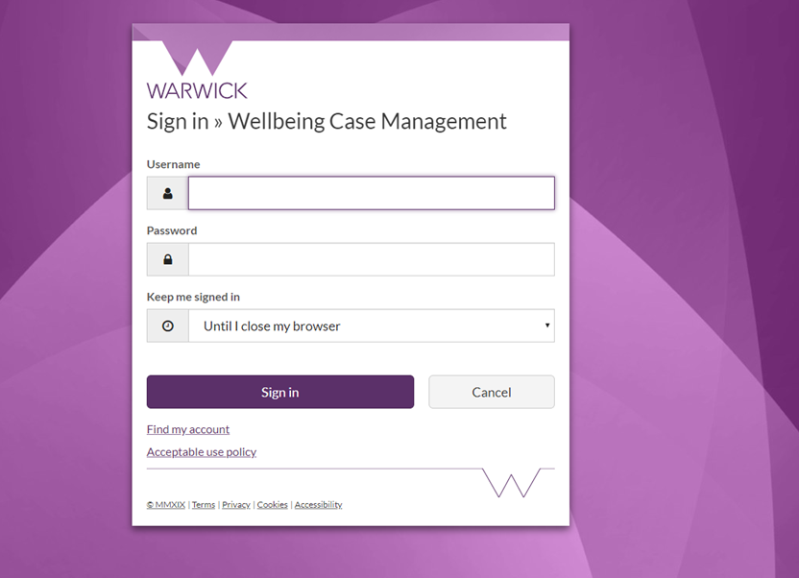
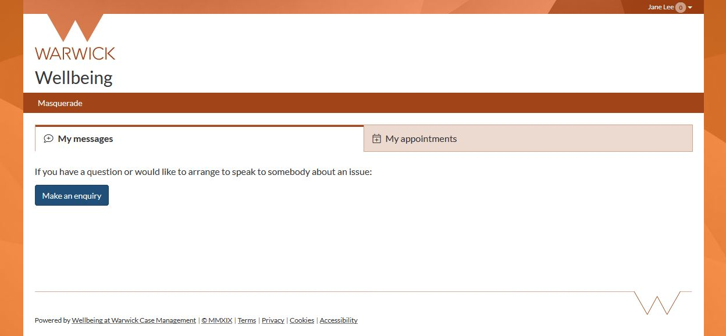
How to access support
Visit wellbeing.warwick.ac.uk
  Log in using Warwick ID
  Submit an enquiry
  Have a brief consultation
  Receive guidance about the most appropriate form of support
Notes:
So, how do you access this support?
Firstly, go to our secure wellbeing portal at wellbeing.warwick,ac.uk
Log in using Warwick ID
Submit an enquiry
Have a brief consultation
Receive guidance about the most appropriate form of support

Slide 49
Support for students with disabilities
Support from application to graduation
Supporting with accommodation requirements
Early arrival programme offered to students with AS/Asperger’s
Putting in place reasonable adjustments, including exam arrangements, informed by supporting evidence
Advice about the Disabled Student Allowances and other available funding
Specialist study skills support, specialist (AS and MH) mentoring and other enabling support
Advice on assistive technology and productivity tools
Notes:
The disability team supports students from application stage to graduation to manage the impact of disability, including mental health disabilities, on student life and study. When an applicant has declared a disability on their UCAS or other application form, the team will reach out to discuss support requirements in advance. That could include looking into any accommodation requirements as a result of a disability.
An early arrival programme is offered to students with AS/Asperger’s for a smoother transition to university.
Following enrolment, students are invited to meet with a disability adviser to formalise the reasonable adjustments required for the duration of their studies. These adjustments are informed by supporting evidence that students are asked to provide and they can include alternative exam arrangements such as extra time, use of a computer, rest breaks etc. With the student’s consent, the disability team will also liaise with academic Departments to provide advise and guidance on how these adjustments can be implemented.
Home students are eligible for the Disabled Student's Allowances which is government funding and the disability team can advise students on how to access this and other available funding. Through the disability team students can access specialist study skills support, specialist AS and mental health mentoring and other enabling support such as campus orientation, conversions and note taking assistance through assistive software.
The team advises students on available assistive technology and signposts to other resources and services across the institution.

Slide 50
Additional Information
Prospective Students
International Students
Wellbeing Support Website
University Library
Students’ Union
Additional Information and Support
Notes:
Applicants can find additional information in the prospective student and International student pages, together with some videos of students with ASD/Asperger’s talking about the transition to University. Information about the Disabled Student Allowances that Home students are eligible for is also available on our website. The University’s Library also offers a range of support, services and assistive technology to students. The Disability team works closely with Warwick Enable, a disabled student society, and the disabled students’ officer in the student union that can also provide information and support.

Slide 51
CAPIT
Counselling and Psychology Interventions Team
Ways to engage with therapy
Video Therapy
Email Therapy
Different Interventions available
CBT
Person Centred Approaches
Group Therapy (online)
ACT
Solution Focused Techniques
EMDR
Help for a range of personal, psychological and emotional issues from a team of qualified, professional Counsellors and Psychologists
Notes:
CAPIT - Counselling and Psychology Interventions Team - are a dedicated team of qualified, professional Counsellors and Psychologists experienced in working within the Higher Education sector helping students at Warwick thrive.
Students engage with CAPIT to help them work through a range of personal, psychological and emotional issues that may emerge, for example: anxiety; depression/low mood; self-esteem/confidence; trauma; loss; disordered eating; identity and many more.
A brief course of therapy can help students understand themselves better, which in turn helps them to get the most out of their student experience – both academically and personally.
The Psychological Therapists offer a range of options to engage with therapy:
Video Therapy (like face to face therapy, but using an online platform) for individuals at allocated appointment times
Email Therapy - for people who want to explore their issues in written form via email exchanges: they can write their issues, and read their personalised responses from the same therapist at a time that’s convenient to them*
Group Therapy (online) – for people who want to explore how they relate to others in a group setting**
The therapists use a range of interventions to help work through issues, such as, for example Cognitive Behavioural TherapyCBT, person-centred approaches, solution-focussed techniques, ACT (acceptance and commitment therapy), EMDR (for trauma) and many more to meet each individual person’s needs.
*NB email therapy – is NOT instant messaging, an appointment time is sent out and people are invited to write in 24 hours before the allotted time, the therapist will reply around the appt time.
** people will be invited to an initial appointment for a pre-group meeting to discuss how group therapy works and to assess whether group is right for them. It requires a weekly commitment (so it’s a regular weekly intervention); people in the group come with a range of issues, focussing on interpersonal development; there are up to 8 people in a group. It is different from a psycho-educational workshop which focuses on how to manage a specific issue.
Once someone has decided to engage in therapy, there will be usually be approximately 7 to 14 days to prepare for a therapy appointment. (Unfortunately community-based, equivalent-level services can incur a much longer wait - some times of up to 18 months - but we recognise that our students at Warwick benefit from been seen for therapy in a timely way, hence our endeavour to offer a therapy appointment promptly. However, we don’t offer ‘emergency counselling/therapy’ (that’s a contradiction in terms) - therapy is a reflective process that helps work out sometimes long-standing or recurring issues and problems.

Slide 52
Wider Support at Warwick
What wellbeing support is available?
Personal Tutor System
Residential Life Team
On Campus Security
Independent Sexual Violence Adviser
Dean of Students
Health Centre
Student Funding
Warwick Accommodation
Chaplaincy
Student Immigration and Compliance
Students’ Union Advice Centre
Local Police/PCSO

Slide 53

Togetherall
A free digital platform all about mental health and wellbeing that is available 24/7 for students at Warwick
Sign up using your Warwick email address
Notes:
Students at the warwick can access Togetherall, an online platform all about mental health and wellbeing. Togetherall is available 24/7 and has three main parts to the support it offers. There is a supportive online community where you can share your experiences and get and offer support to other members. There is a range of short online courses available covering a wide range of subjects and a library of self help materials.

Slide 54

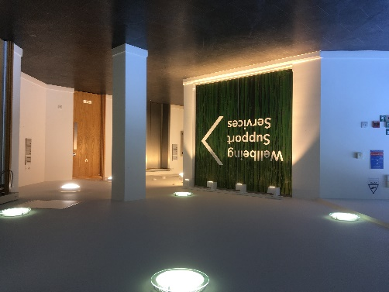
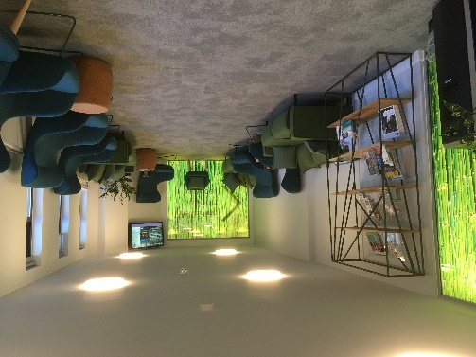
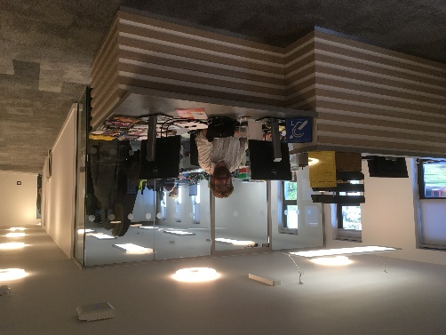
Wellbeing Support Services
 024 7657 5570
wellbeing.warwick.ac.uk
Consultations available every working day from 10am-3pm to identify the correct support for you.
Notes:
. Please access support from Wellbeing Support Services if you need it. Go to our secure portal at wellbeing.warwick,ac,uk and submit an enquiry and then you can have a brief consultation. These are available every working day between 10am and 3pm

Slide 55
Feedback
Your views and experiences are very valuable
Please participate in any of the different opportunities that we let you know about to give us feedback wherever you feel able. Particularly our FAQ section of the website is reliant for much of the information on what you tell us
Notes:
HJ

Slide 56
WISHING YOU A SUCCESSFUL YEAR AHEAD
warwick.ac.uk/studentmobility
Notes:
HJ

