Slide 1




Campus France UK helps you prepare your outward mobility to France
1. The Higher Education system in France
2. How to apply for a student visa
3. Your student life in France

Slide 2
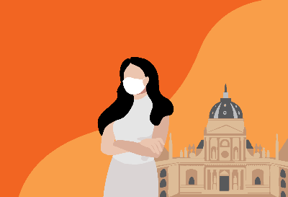
five reasons to study in France
A world class education
A wide choice of academic programmes
An attractive destination for international students
French language, an added bonus for your resume
The french way of life

Slide 3

1.The higher education system in france

Slide 4



The different types of higher education instiutions
The higher Education SYSTem in France
Universities
Anyone with a highschool diploma can enrol. Small tuition fees, public fundings.
Grandes Ecoles (Sciences Po / Business Schools / Management schools / Engineering Schools.
Selective. Competitive entry exam after two years of preparatory classes or directly after high school after a selective entry exam. Higher tutions fees.
Specialised Schools and Institutes (communication, journalism…)
Competitive entry exam or review of the applicant's file
Schools of Art and Applied Arts
Competitive entry exam or review of the applicant's file
The National Schools of Artchitecture (ENSA)
Competitive entry exam or review of the applicant's file

Slide 5
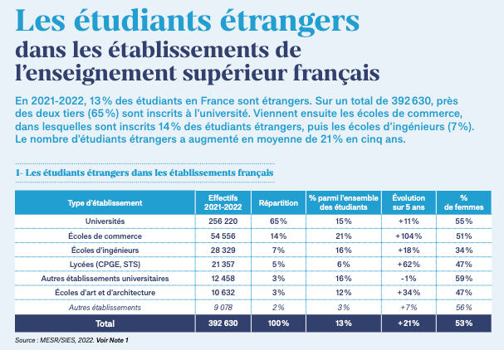
An internationalized student body
400 000 international students in France in 2023
+8% since 2022
Number of international students in French Higher Education Institutions

Slide 6
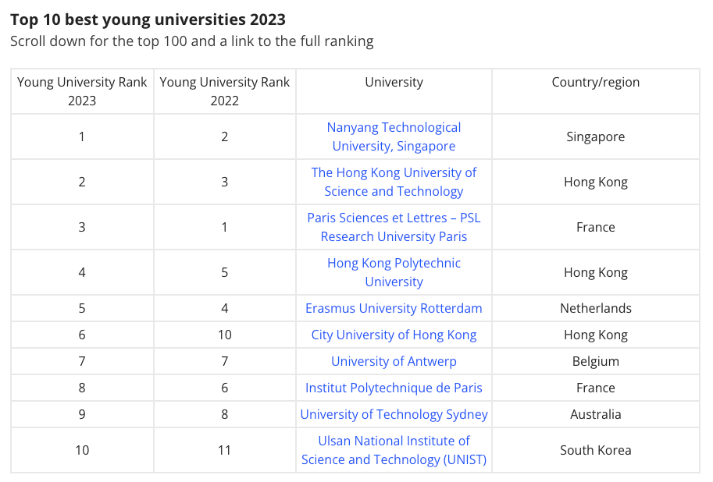
A world class education
Two French universities in the top 10 of THE’s universities under 50

Slide 7
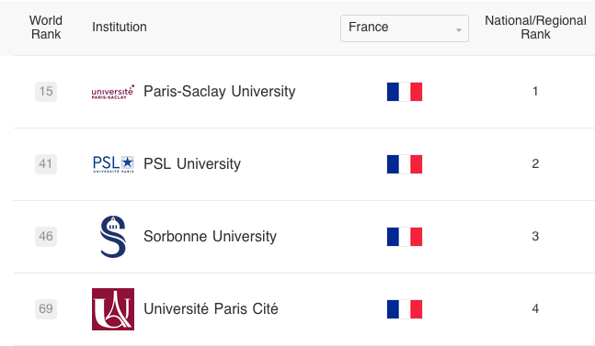
A world class education
Four French universities are in the top 100 of the Shanghai Universities Ranking 2023

Slide 8
2. How to Apply for a student visa

Slide 9
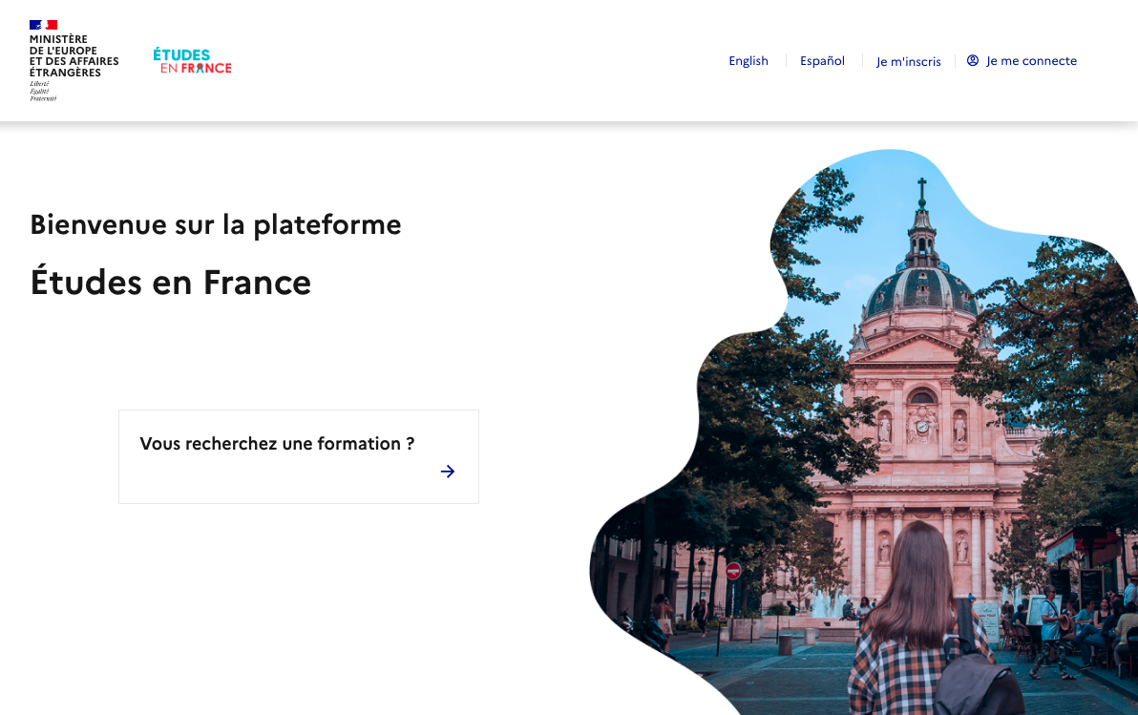

Register on etudes en France
1. Etudes en France platform
If you are accepted in your higher education programme through a specific application process, you can start your registration on Etudes en France:
Register under «Students already accepted »
Fill in your application form with your acceptance letter from your French higher education programme
Fees: £100
Within a week your application is reviewed !

Slide 10


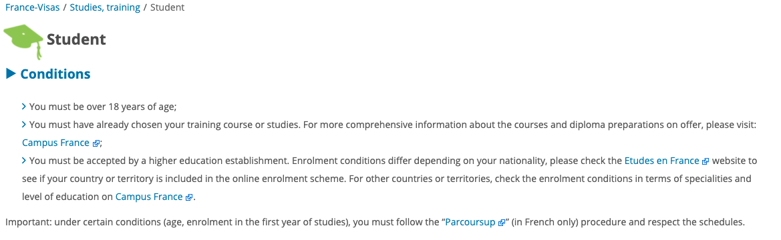

from France visas to tls contact
2. Visa PRocedure
Once you have your confirmation from Etudes en France you can start you visa application on the France Visas platform:
Select the « Student visas »
Fill in your application form and book your appointment at the TLS Contact Center
Come to TLS Contact center with the requested documents and your Etudes en France confirmation
Fees: France Visas £43.18, TLS £48.40
You can apply on France-Visas from 3 months to 3 weeks before the start of the course

Slide 11
3. Your student life in France

Slide 12
How to find an accommodation
France offers a wide range of accommodation solutions for students :
Rooms in university residences (CROUS : https://trouverunlogement.lescrous.fr/ )
Private student residences
Private landlords
Shared student accommodation
Intergenerational housing
Good to know : Some universities and schools have agreements with the CROUS. For more information, contact the school's international relations department. Foreign students are entitled to the same housing benefits as French students

Slide 13


Health : Prepare TO HAVE A EHIC OR GHIC CARD
1. Choose which card suits your situa tion
European Health Insurance Card (EHIC) / Global Health Insurance Card (GHIC)
If you still have a EHIC card you can use it in France.
You can now apply for a UK Global Health Insurance Card (GHIC) instead but please be mindful of the delays!
If you use your EHIC/GHIC you won’t be able to get refunded while in France. You will have to keep all of your prescriptions and health invoices.
You should also have travel insurance and private complementary healthcare cover.
More information : https://www.gov.uk/guidance/uk-residents-visiting-the-eueea-and-switzerland-healthcare

Slide 14

Prepare your documents to register to free health care
2. Before your departure
Assurance maladie: Etudiant-etranger.ameli.fr
Assurance maladie is free and mandatory
You should also have travel insurance and private complementary healthcare cover.
List of official translators here
Gather the documents to register to free health care «Assurance Maladie» This is one of the first things you need to do once you arrive.
→ To increase the amount of refund, students can take a complementary health insurance (mutuelle)
Notes:
You will need to have an address in France and a proof of enrollment NOT acceptance
You will then receive your social security number that will allow to ask for your social security card and get refunded up to 70%

Slide 15

Find your nearest Welcome desk
Welcome Desk:
They are your main information centers and will help you on site with every administrative tasks and cultural information
All services an international student should contact during the first weeks after their arrival in France : university services, CROUS, Prefecture, healthcare, complementary health insurance, banks, student unions, etc.
Find all the useful information about your host city in France
Notes:
Since 2019 welcome desks have been created in every student city in France and in most universities

Slide 16






COST of life – Some examples
Please note that the prices below are given on an indicative basis and are subject to change
Housing
€650 / month in Paris
€450 / month in province
Transport
€84,10 for a monthly transport pass in Paris
€20-35 in province
€49 for the SNCF Jeune Card for the 12-27 years old
Leisure
€5-9 for 1 cinema ticket*
€5-15 for 1 museum ticket*
From €10 for 1 theatre ticket*
*You will often have access to discounts and special rates on presentation of your student card if you are under 26 years old
Groceries
€200 - 250 / month in Paris
€150 - 200 / month in province
Some examples :
~ €1 for a baguette or a croissant
~ €1,20 for 1kg of pasta
~ €0,95 for 1L of milk

Slide 17


Enjoying Being a student in france
Enjoy the benefits of being a student in France ! → Being a student in France means having access to a lot of benefits as well as to a lot of discounts and offers.
Sports and cultural activities → Lower rates and discounts are available for students in museums, cinemas and many other cultural activities
Transports → your visa gives you access to the entire Schengen area. Public transportation is affordable and reliable. Railroad network is affordable and developed

Slide 18


Student life in France: culture
France has a rich and varied cultural offering all year round
52 UNESCO world heritage sites
🏛️8,000 museums
🎭32,000 theatrical performances
🎶35,000 musical performances
🎥 2,000 cinemas

Slide 19


Student life in France: trips
Situated at the heart of Europe.
🏰France is the world's No. 1 tourist destination: studying in France means discovering its colourful regions and exceptional heritage.
🚆Rail network is well developed (good discounts for students!)

Slide 20
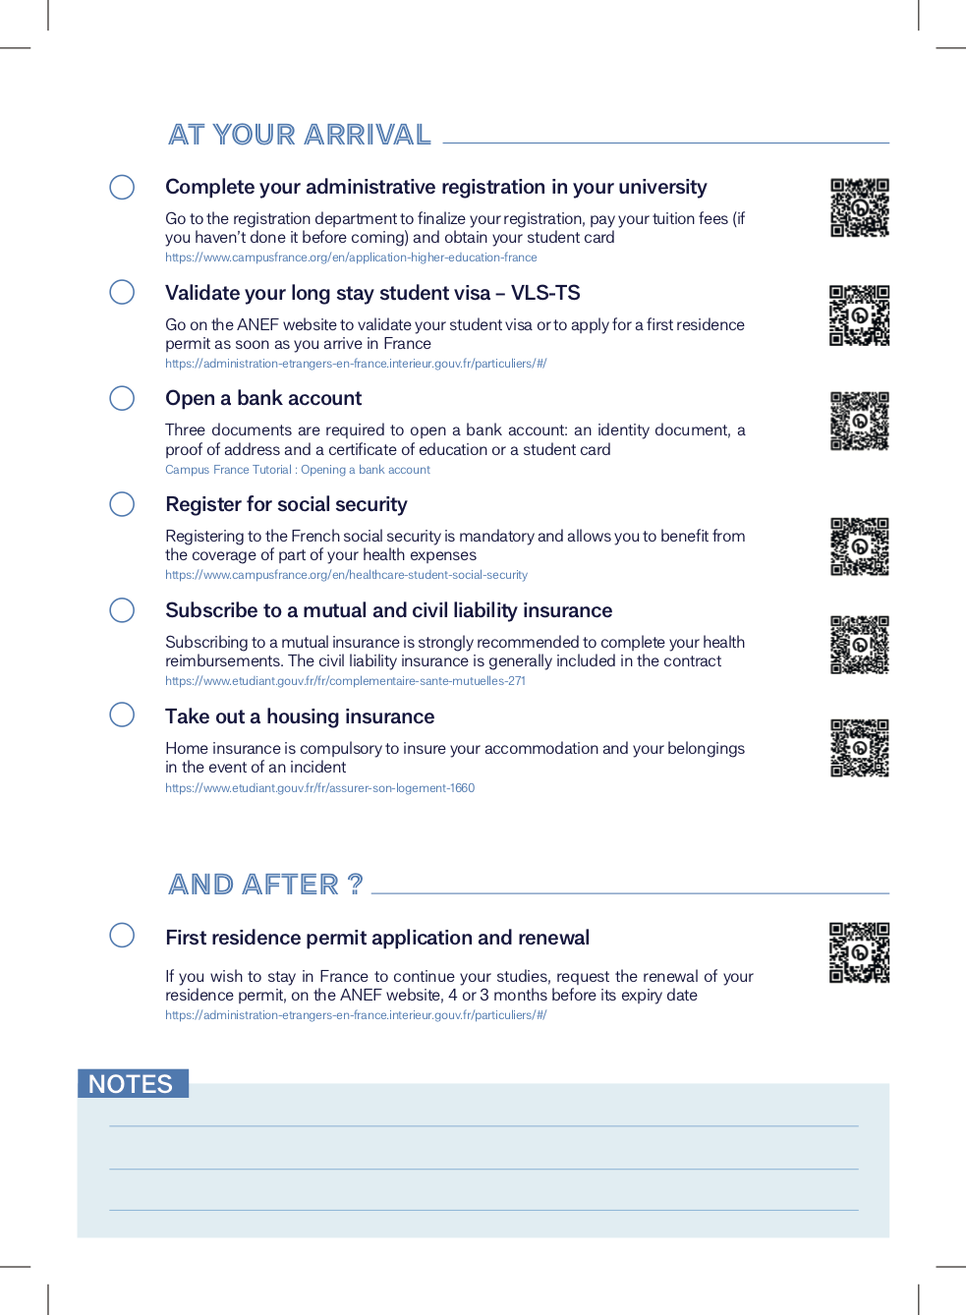
Your Check list

Slide 21
Benefits of joining the France Alumni UK network
5 reasons why you should join France Alumni UK :
1) A global network
2) A career accelerator
3) Annual events and activities
4) International visibility
5) Maintaining a connection with France when you are back in the UK
Join France Alumni network as soon as possible !

Slide 22
Espace Campus France UK
CONTACT US
6, Cromwell Place
SW7 2EW
www.uk.campusfrance.org
londres@campusfrance.org
@CampusFranceUK
Campus France UK
Listen to our podcast « Studying in France » at https://shows.acast.com/652e64f28cd7770012334f37
To attend a personal orientation session to discuss your project in France you can book an appointment with us !

Slide 23
THANK YOU !

