Slide 1

Marketing short term opportunities
Getting ready to go
What motivated you to study abroad
What you hope to get out of it
Preparations – packing, vaccinations, etc
First impressions
Stepping off the plane
Finding your accommodation
People / food / weather

Slide 2
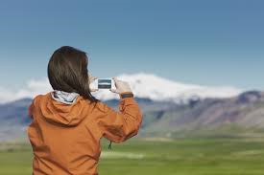
Similarities and differences
Teaching styles - lecture / seminar
Campus environment
Life outside study
Culture / food / weather
New country’s culture
What have you seen, where have you explored, visited?
What have been the highlights
Have you tried anything new? How did it feel?

Slide 3
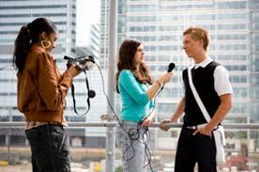
Reflection
What did you get out of the experience?
How will it help to shape your future study?
How will it help to shape your future career?
What do you think about your experience?
Any challenges? How did you overcome them
Inspiring other students
What do you think about studying abroad?
Would you recommend choosing the host country?
Would you recommend the host university?

