Slide 1
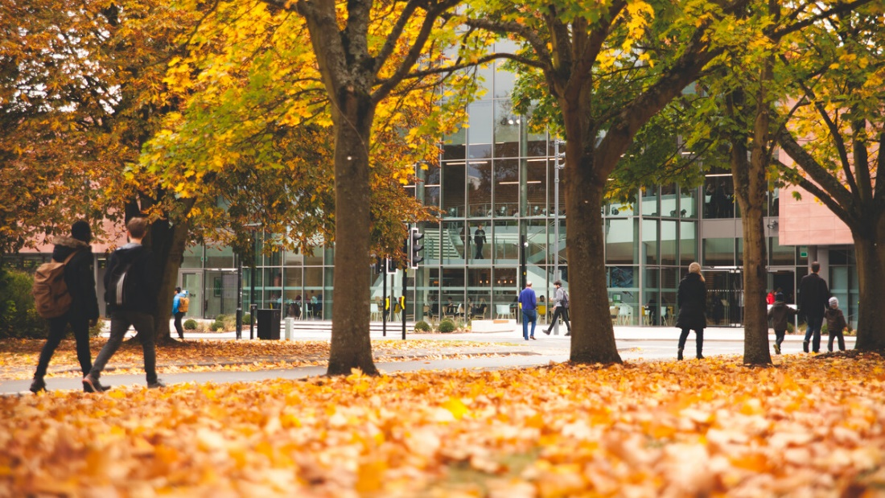


University of Warwick
Notes:
Hi, greetings from England! My name’s Sarah and I represent the University of Warwick. Warwick is a highly selective, campus university located right in the heart of England.

Slide 2








UK Rankings
6
th
The Guardian Ranking 2022
CONSISTENTLY RANKED IN THE
TOP 10
9
th
The Complete University Guide 2022
UK UNIVERSITIES
8
th
The Times Good University Guide 2022
Notes:
Through entrepreneurialism, academic excellence and a desire to do things differently, we have now firmly established ourselves as one of the UK’s top Universities
Since UK league tables were introduced, Warwick has consistently been ranked as one of the top 10 Universities in the UK in all three major national rankings.

Slide 3
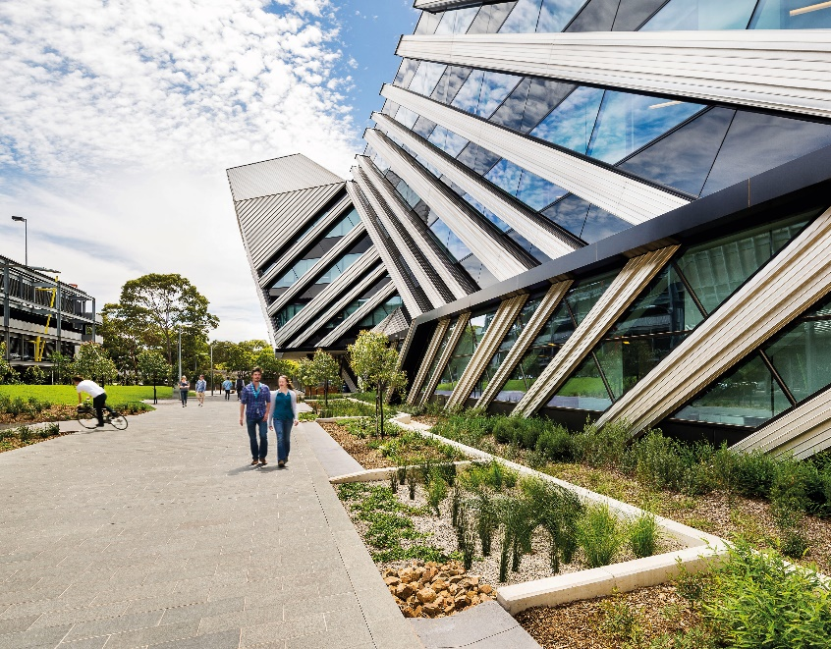

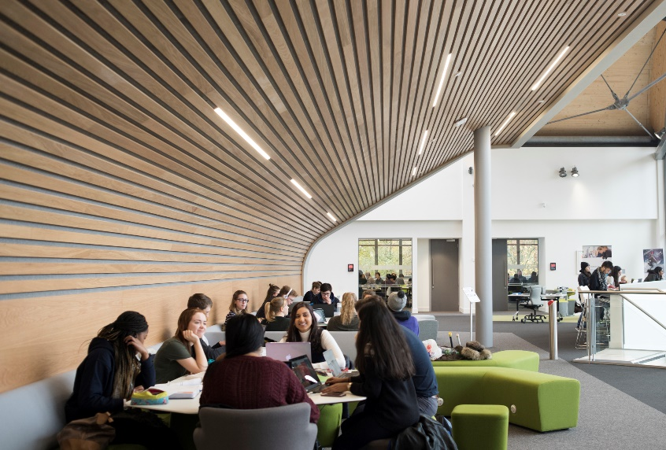

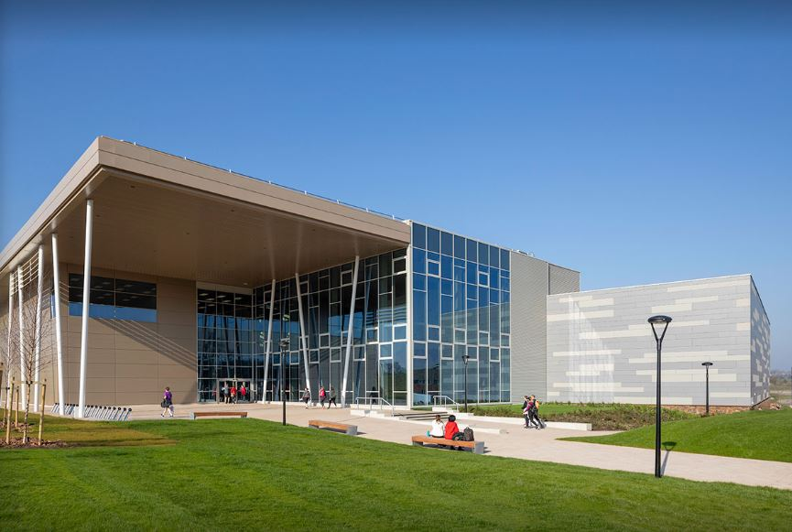
University of Warwick
29,500+ students
29 academic departments
More than 250 student run societies
More than 65 student run sports clubs

Slide 4
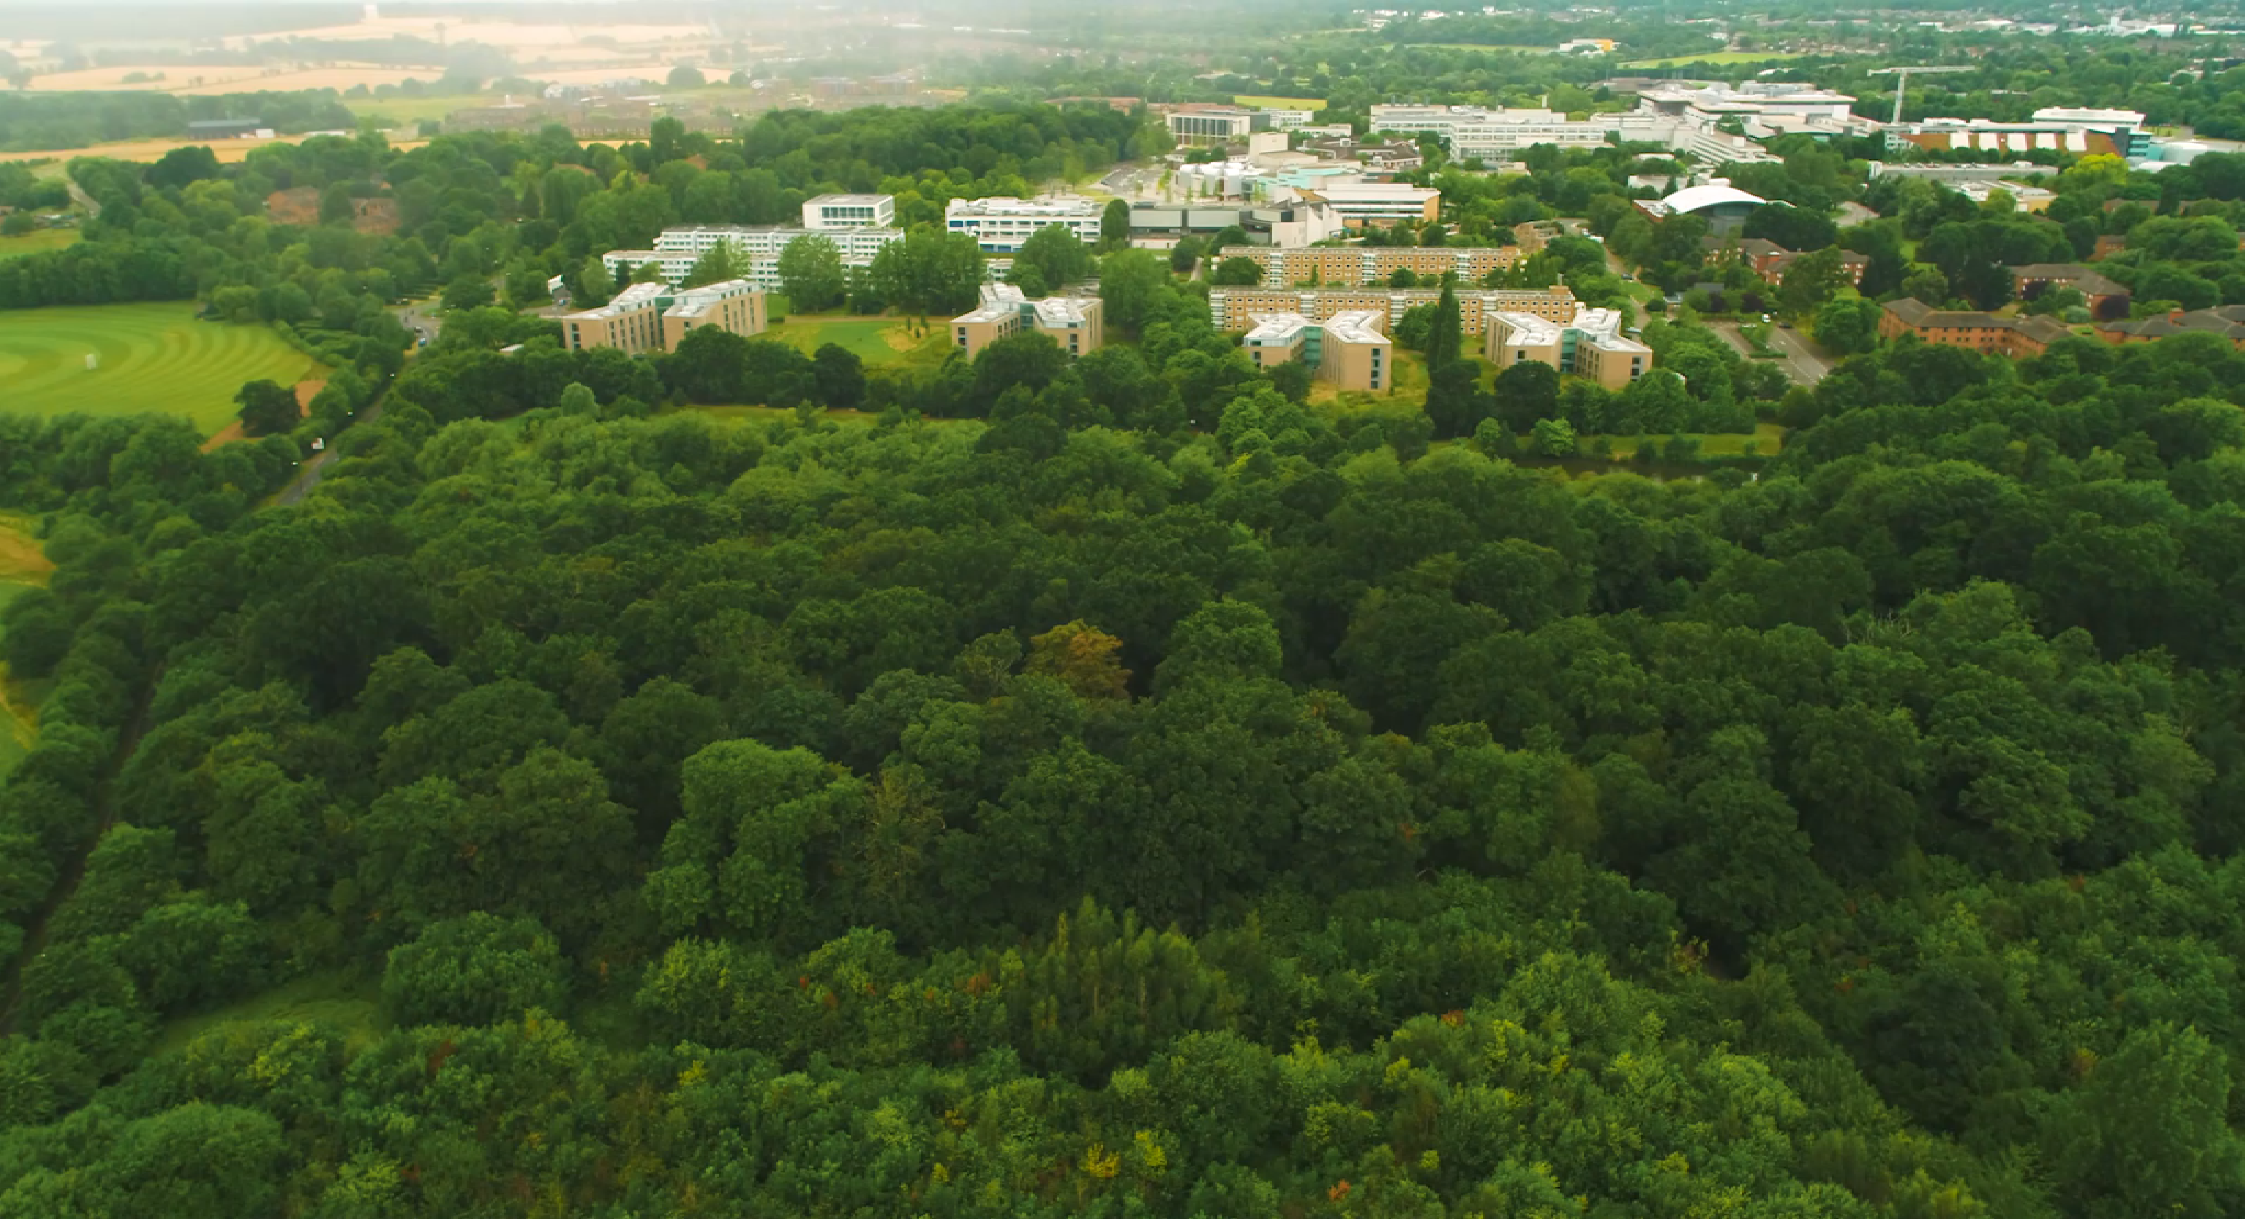
Inclusive, diverse, and welcoming campus:
Suburban location
Easy access to city life
Welcoming, community atmosphere
700+ acres
Accommodation for exchange students
click here to take a virtual tour
Notes:
Section introduction: Warwick’s a place that’s always prepared to find space for something new. That’s why our campus, with its home in Coventry, is so exciting.
It’s constantly evolving, constantly investing in new facilities. Our campus transforms before your eyes, yet remains surrounded by beautiful green spaces.
And, in a location in the heart of England that situated between ancient castles and modern cities, we’re in the perfect spot for any international student to explore Warwick and explore the wonderful diversity that can be found throughout the UK.

Slide 5
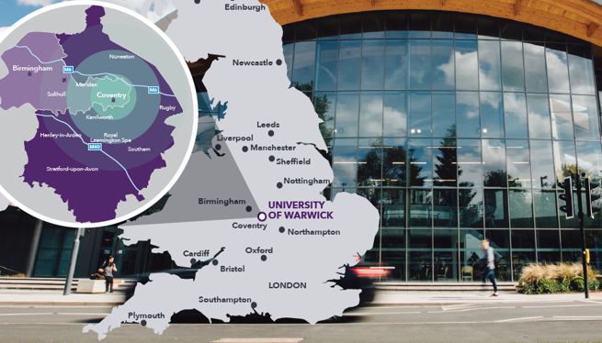


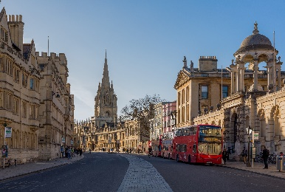

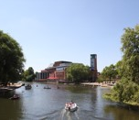

1 hour from:
London (train)
Oxford (car)
30 minutes from:
Birmingham (second largest city in the UK)
Stratford upon Avon (Shakespeare’s birthplace)
Birmingham Airport

Slide 6




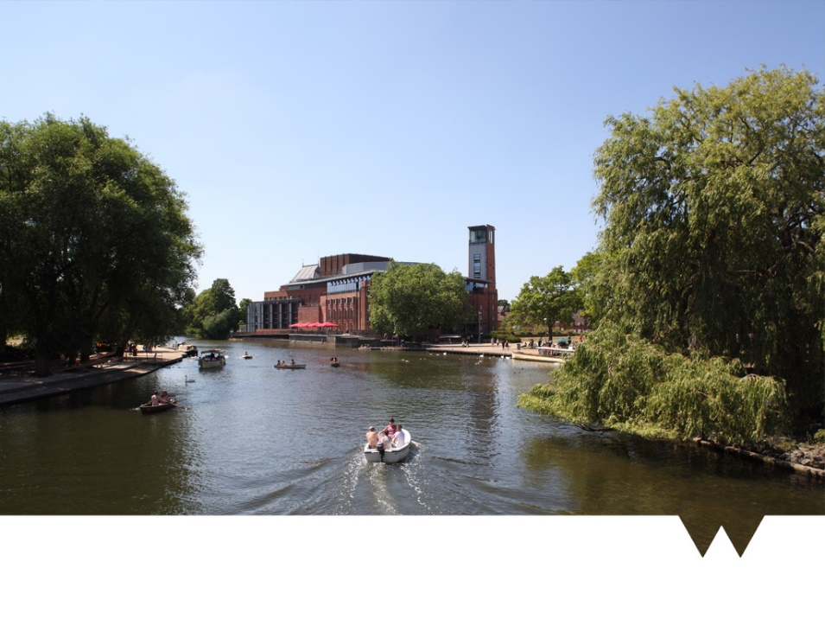

COVENTRY
LEAMINGTON SPA
KENILWORTH
WARWICK
STRATFORD-UPON-AVON
BIRMINGHAM

Slide 7


YouTube
Straight from the Students
Life at Warwick
Wellbeing at Warwick
Discover our Departments
Sports & Societies
Accommodation at Warwick
https://www.youtube.com/uniwarwick
Notes:
While our campus gives you access to some lovely green spaces, we are less than a 10-minute bus journey from Coventry city centre. Coventry is one of the biggest cities in England, where modern city life sits hand-in-hand with a rich history.
Our campus also gives you easy access the beautiful Warwickshire countryside, and the towns of Leamington, Kenilworth, Warwick and Stratford Upon Avon.
City life or calm, peaceful countryside – our campus is perfectly positioned to give you all of this on your doorstep.
Coventry’s central location means that London is only an hour’s journey by train and Birmingham, the UK’s second largest city, is only 21 minutes away by train.

