Slide 1

Locations that we volunteered in in 2025

Slide 2
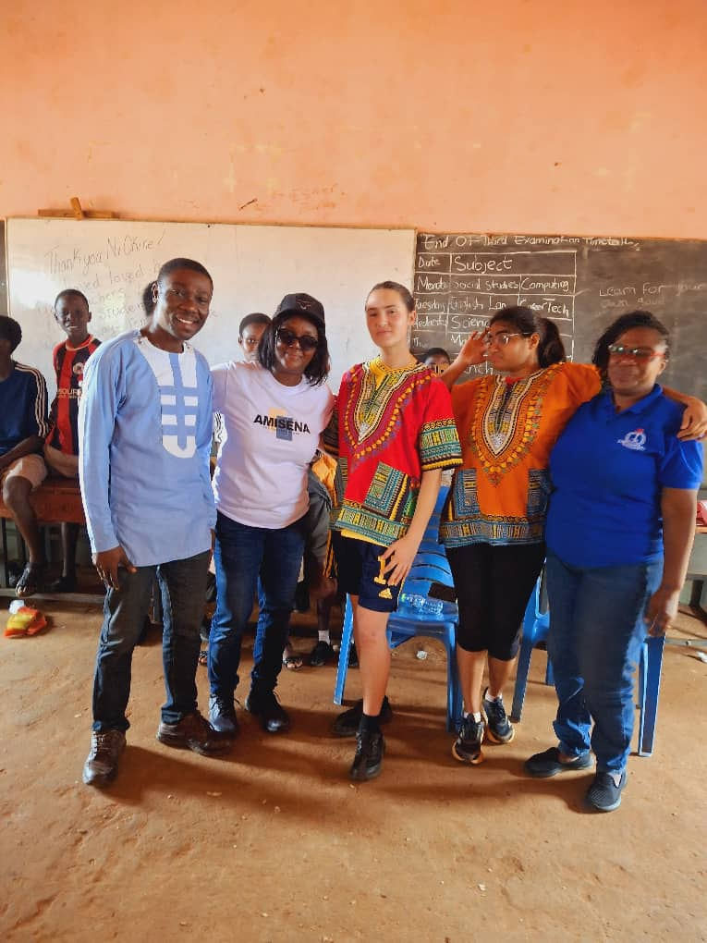
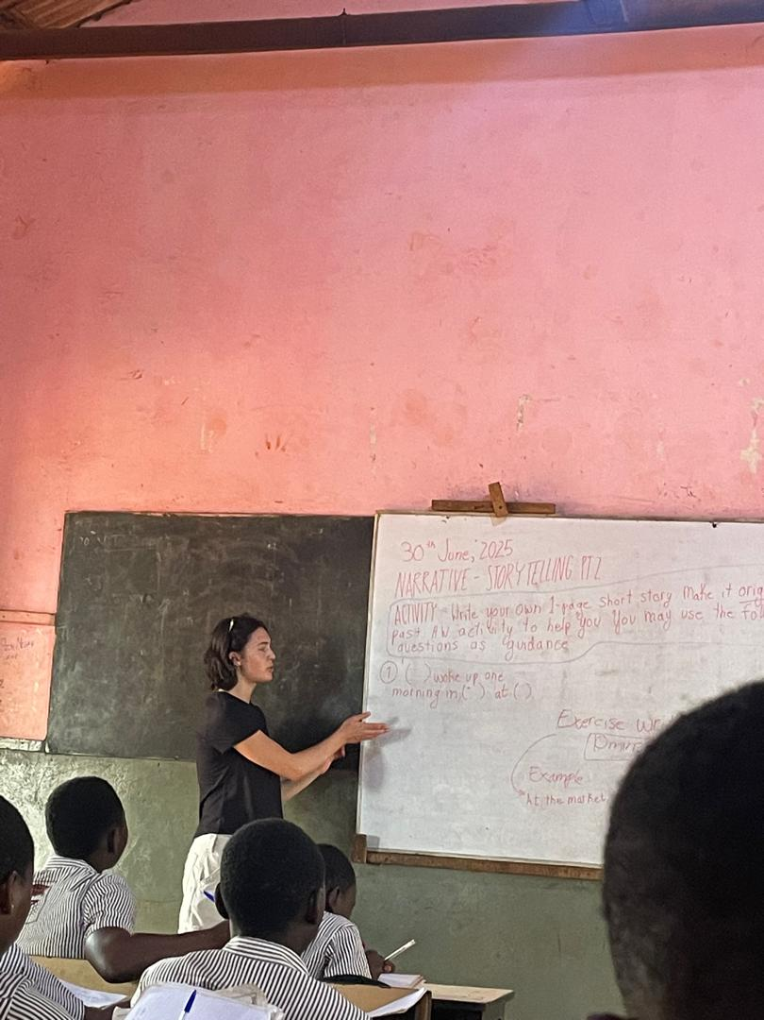
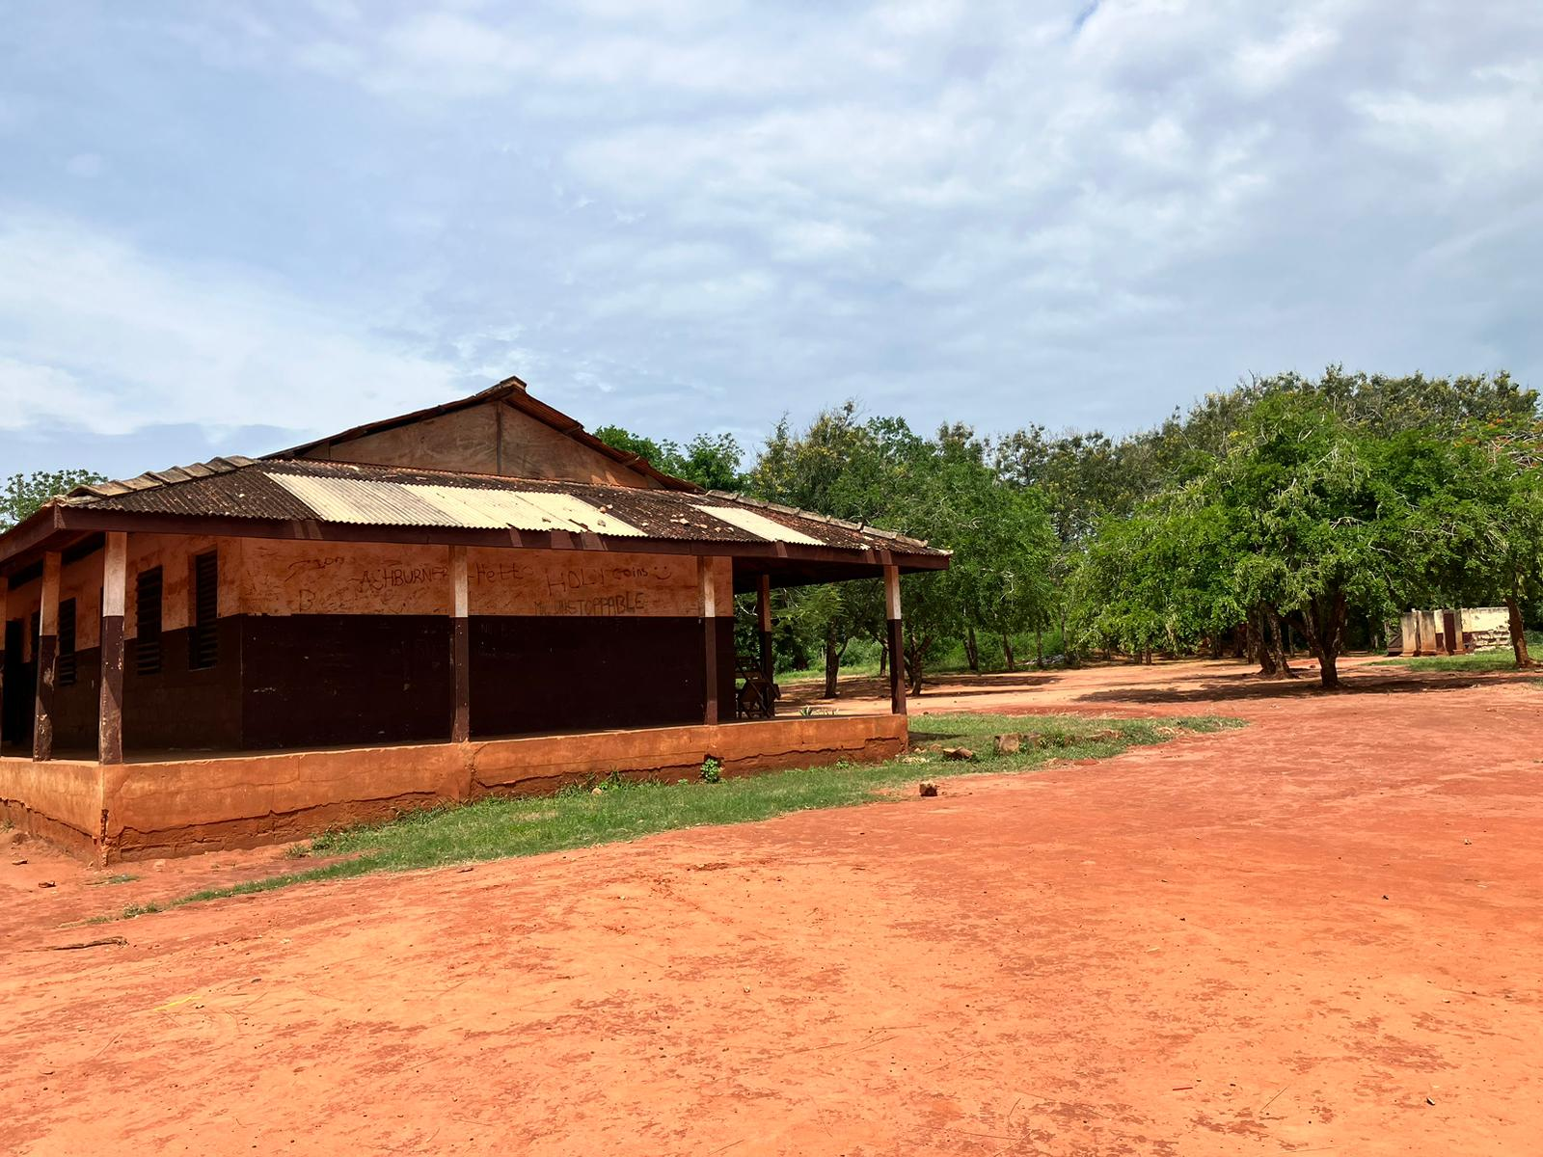
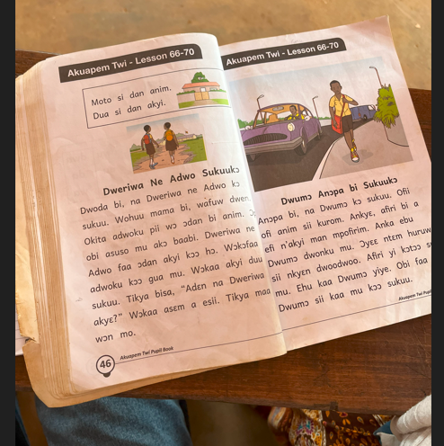
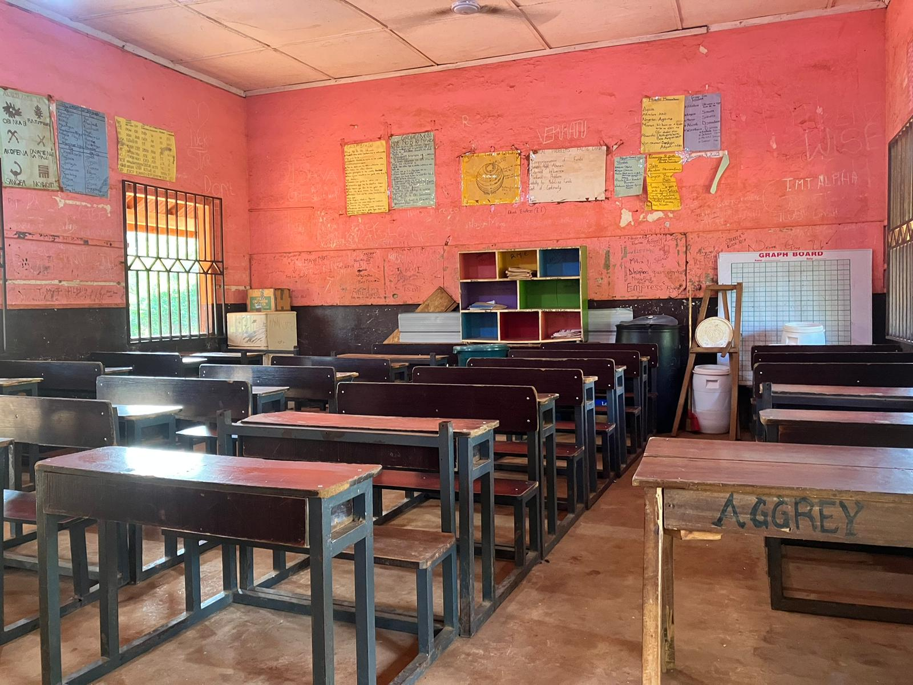
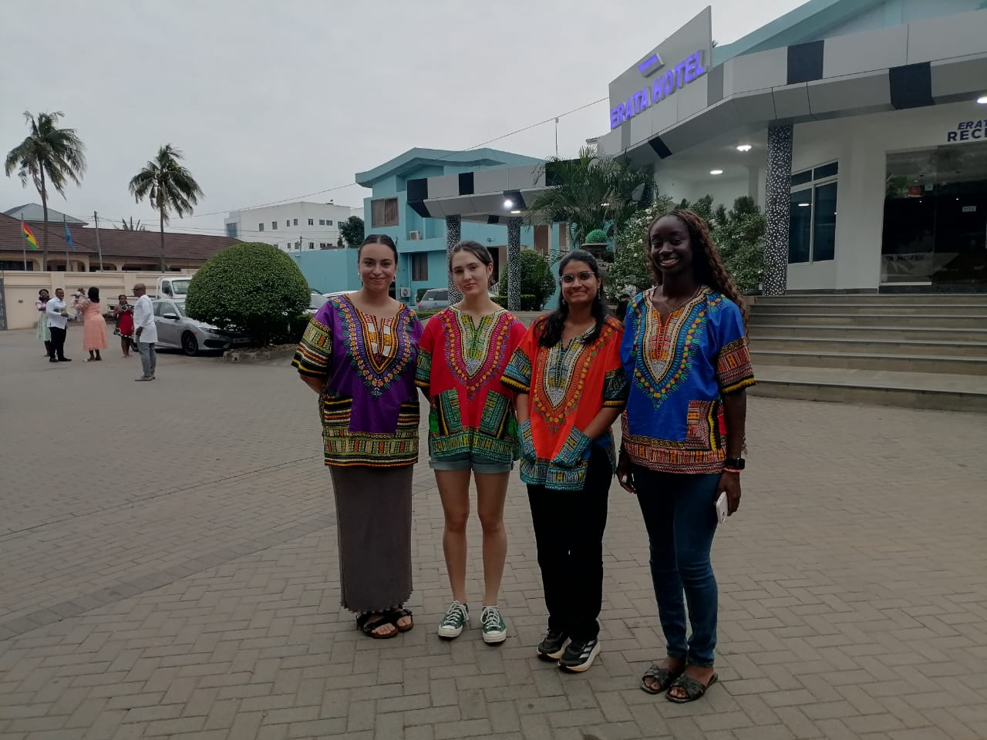
Location: Accra, Ghana
Type: Urban
School: 2 schools in a wider cluster of schools.
Teaching types: Predominately solo-teaching
Accommodation: hotel
Things to note: The class sizes are between 50 and 60. There are whiteboards for use at the schools. Projectors have been purchased with project money. The Uni of Ghana is down the road. You are in the capital city so there is plenty to get up to.

Slide 3
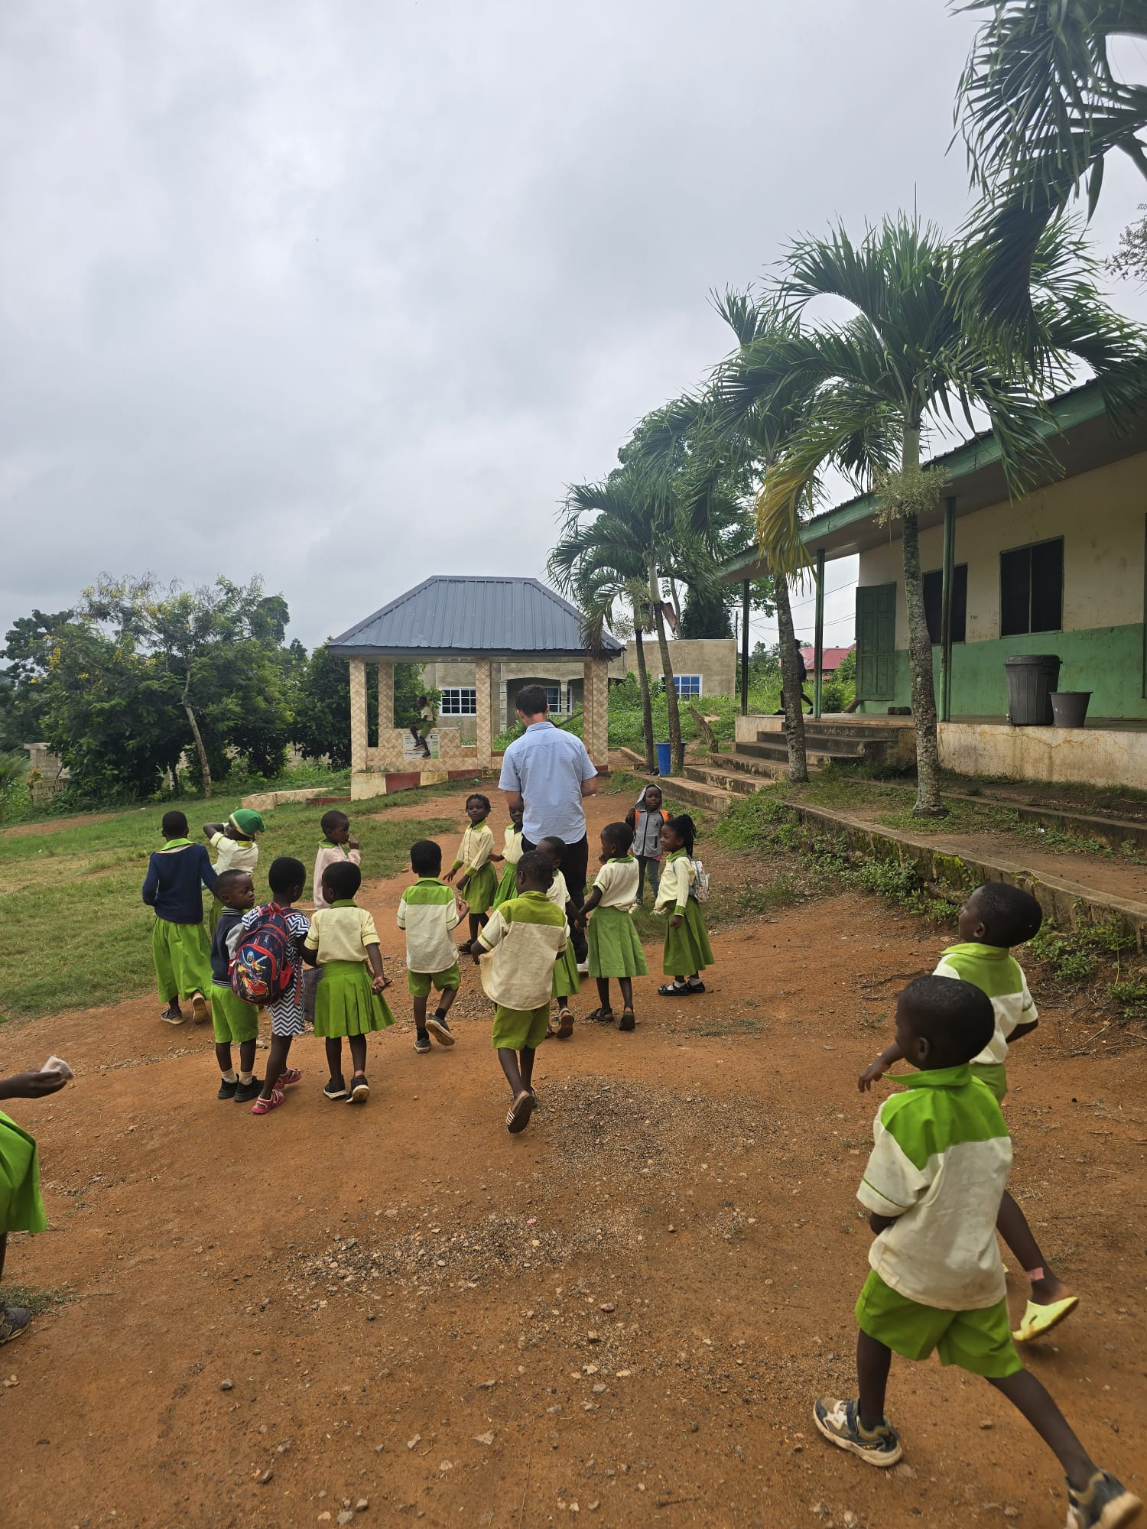
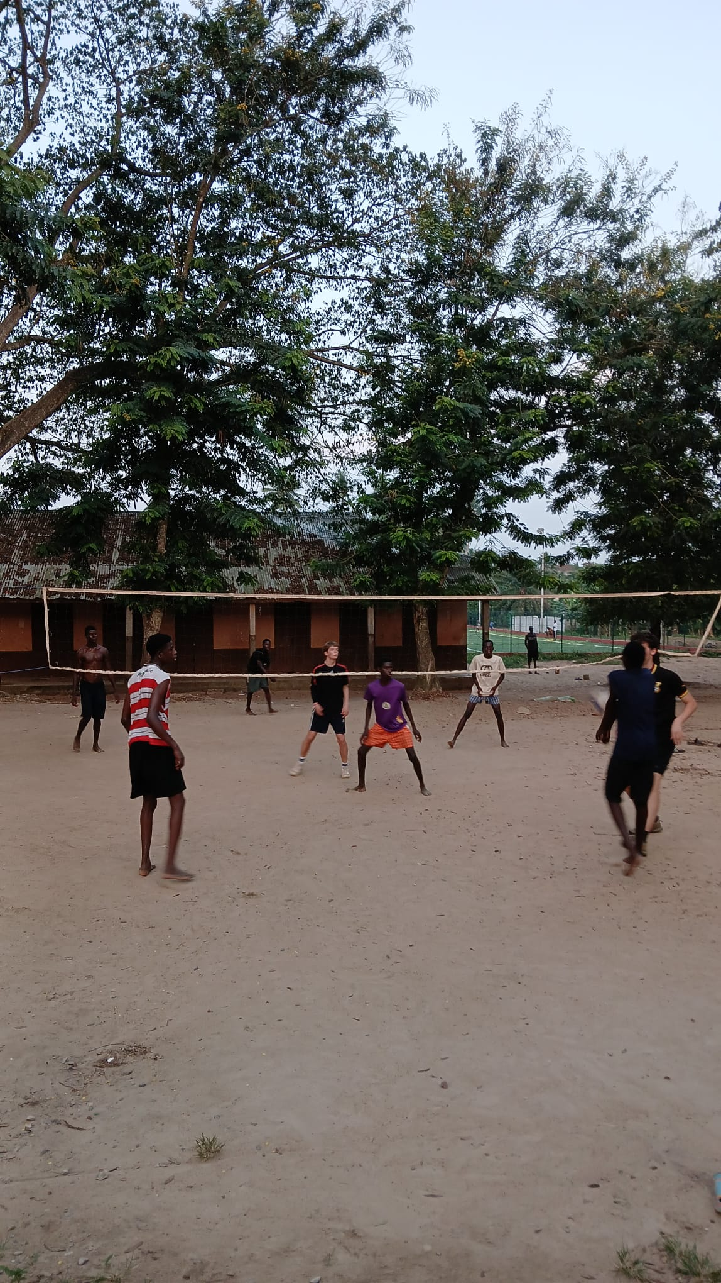
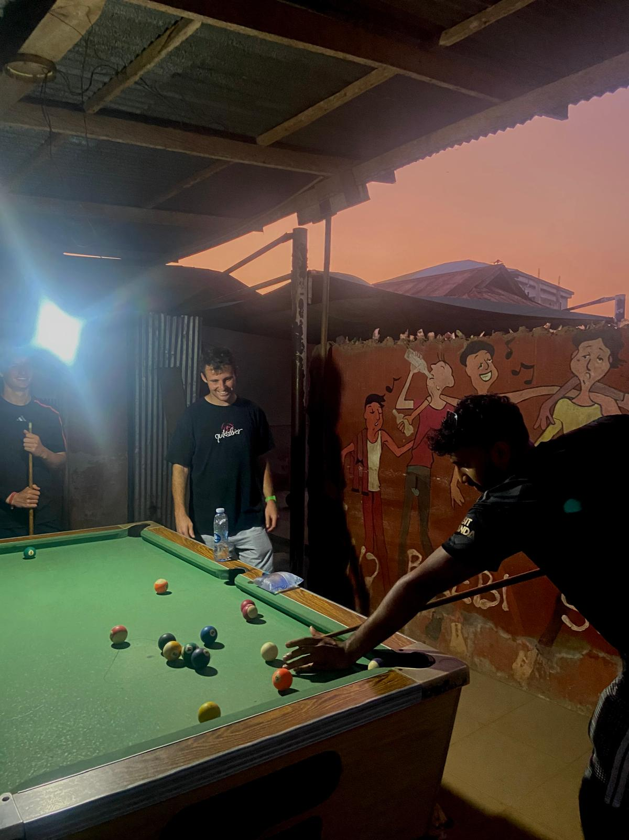
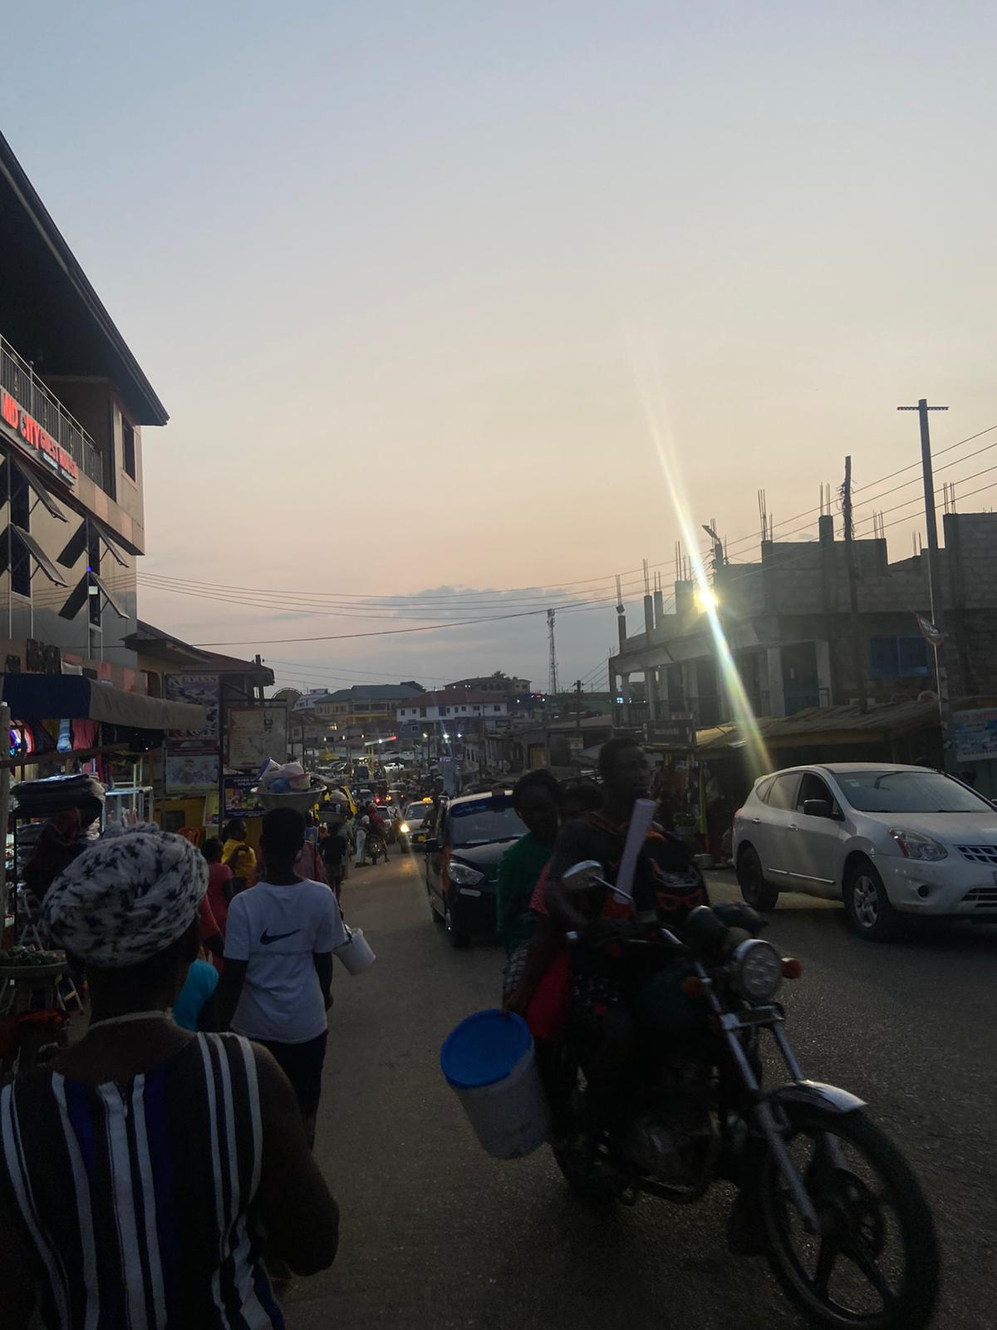
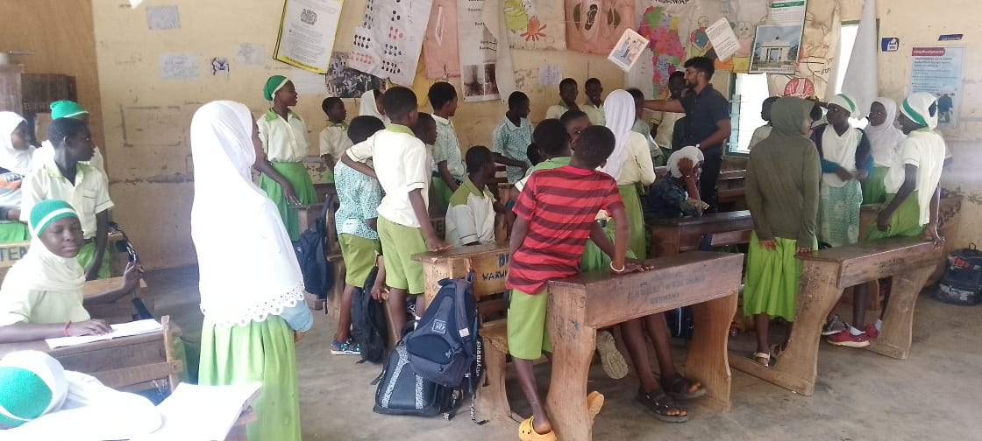
Location: Agona East/Agona Swedru, Ghana
Type: Rural
School: 2 schools in separate towns
Teaching types: Predominately solo-teaching with observation
Accommodation: hotel
Things to note: These schools are in smaller agricultural towns. The pupils have fewer resources with many lacking pens, exercise books, and textbooks.
The internet connection in the accommodation is poor so you will need to rely on getting local sim cards for data. There is much to do in the town, but you'll feel quite exposed and will rely on making your own fun there.

Slide 4
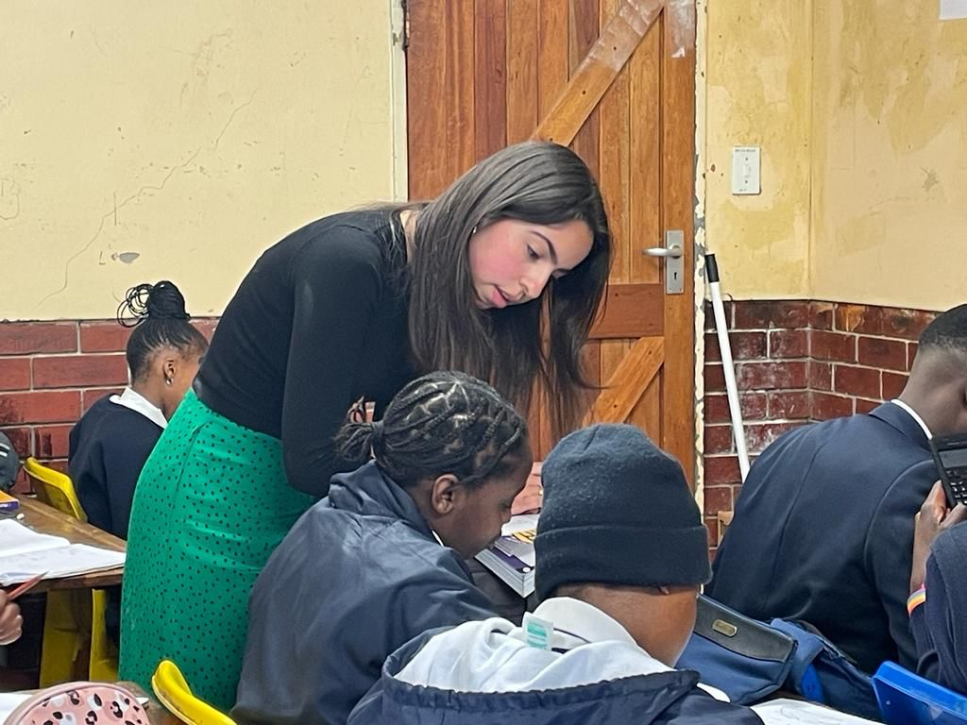
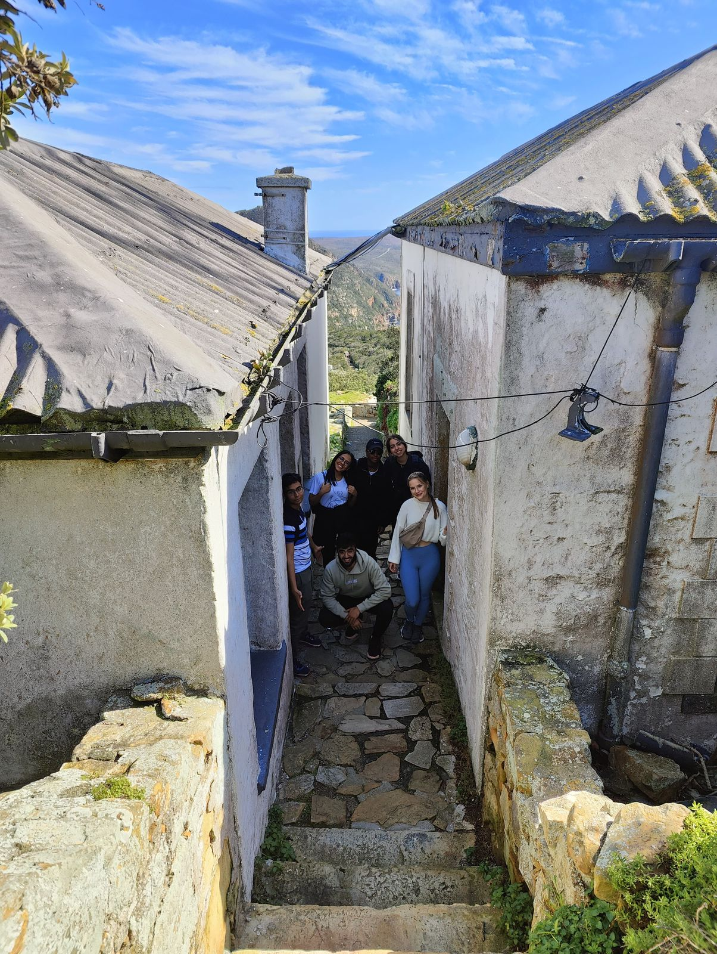
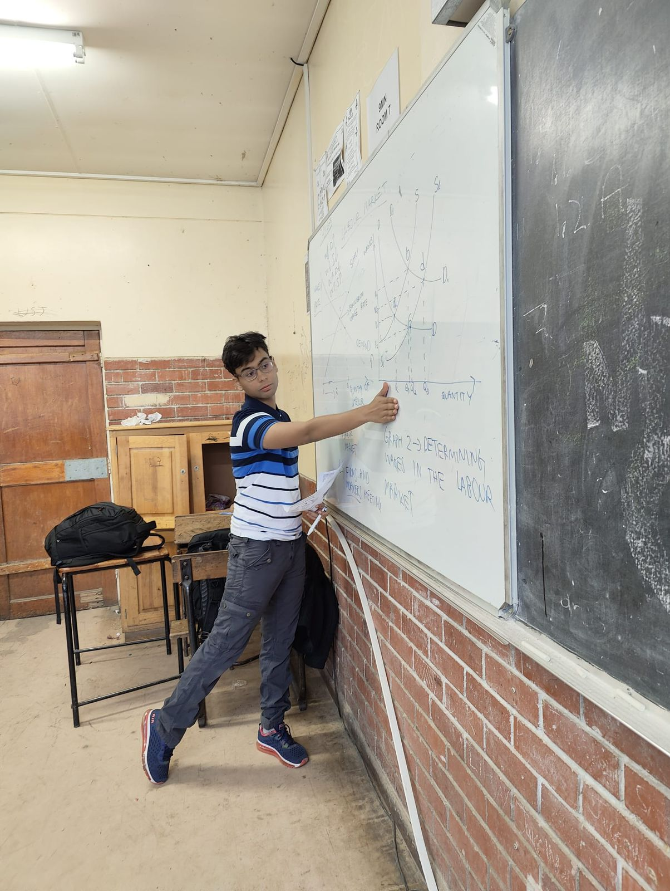
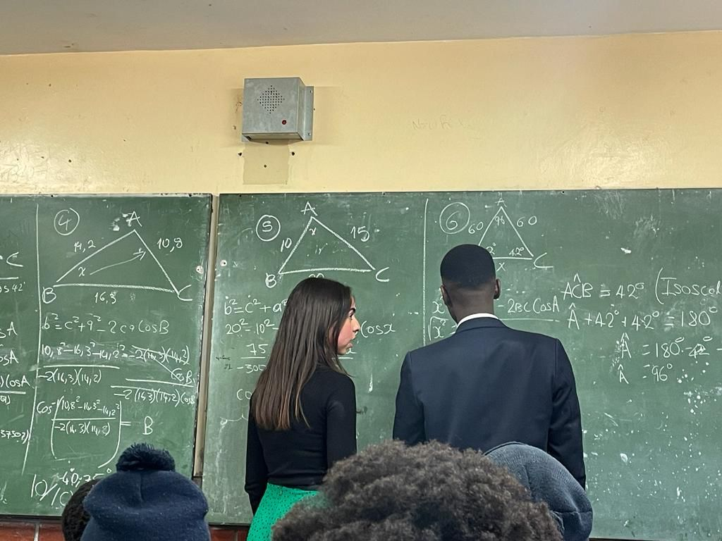
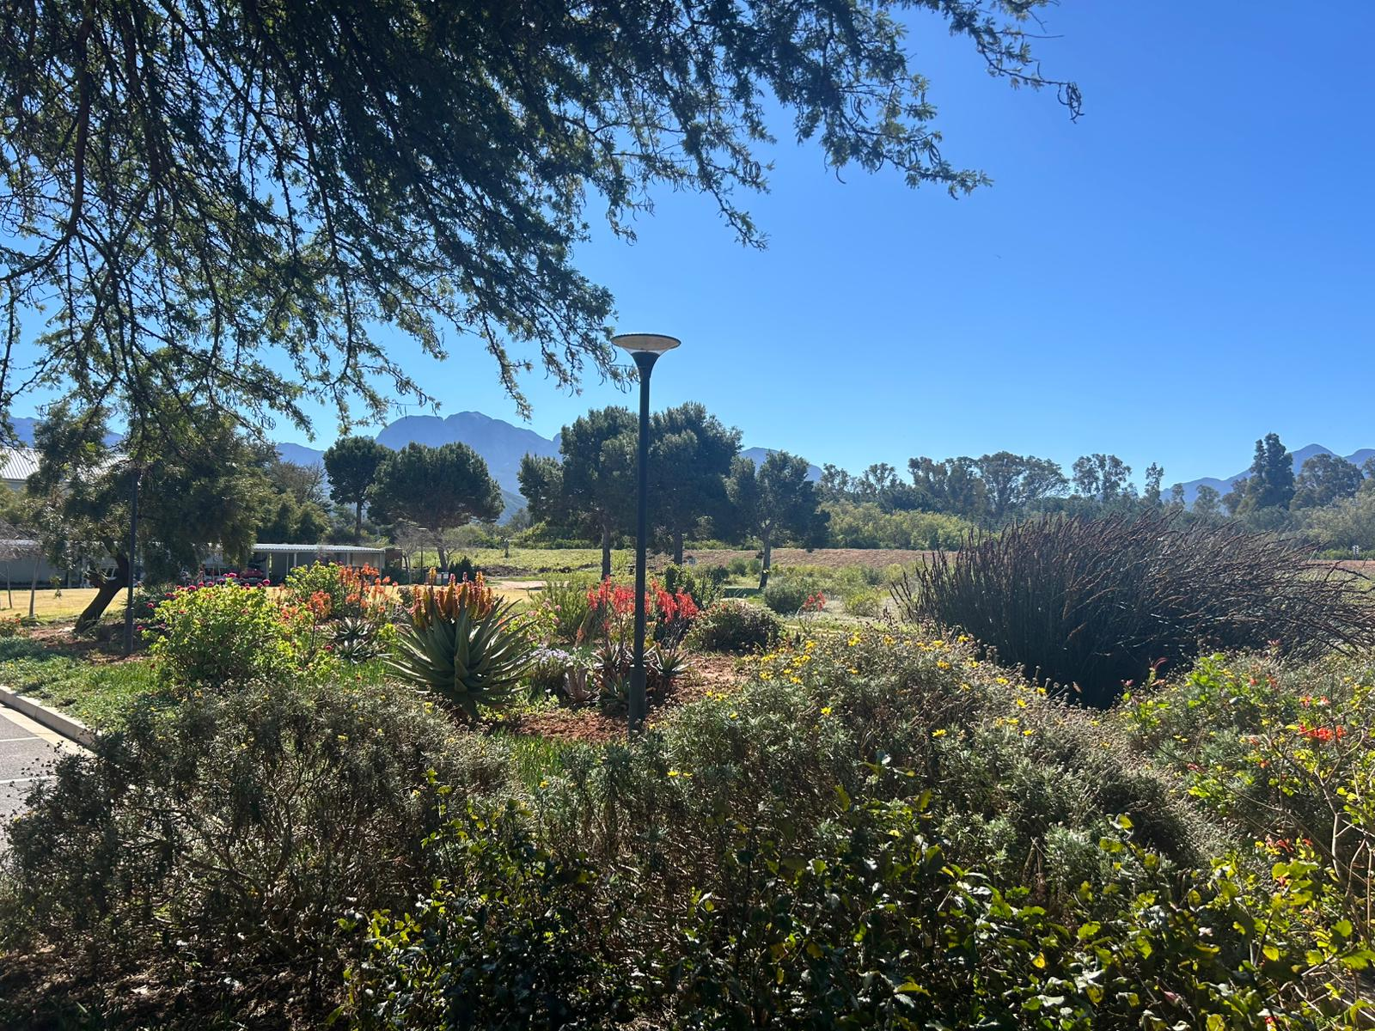
Location: Stellenbosch/Kayamandi, South Africa
Type: Urban
School: 1 school - a township school
Teaching types: Co-teaching
Accommodation: University halls
Things to note: The volunteers are based at the University of Stellenbosch and travel to the township to volunteer. The township school is large, has a dedicated teaching team with the volunteers working very closely with the established teacher. This allows the volunteers to help the teacher build capacity in the classroom to reach more pupils.
Based at the university, you are fully engaged with campus life.

Slide 5
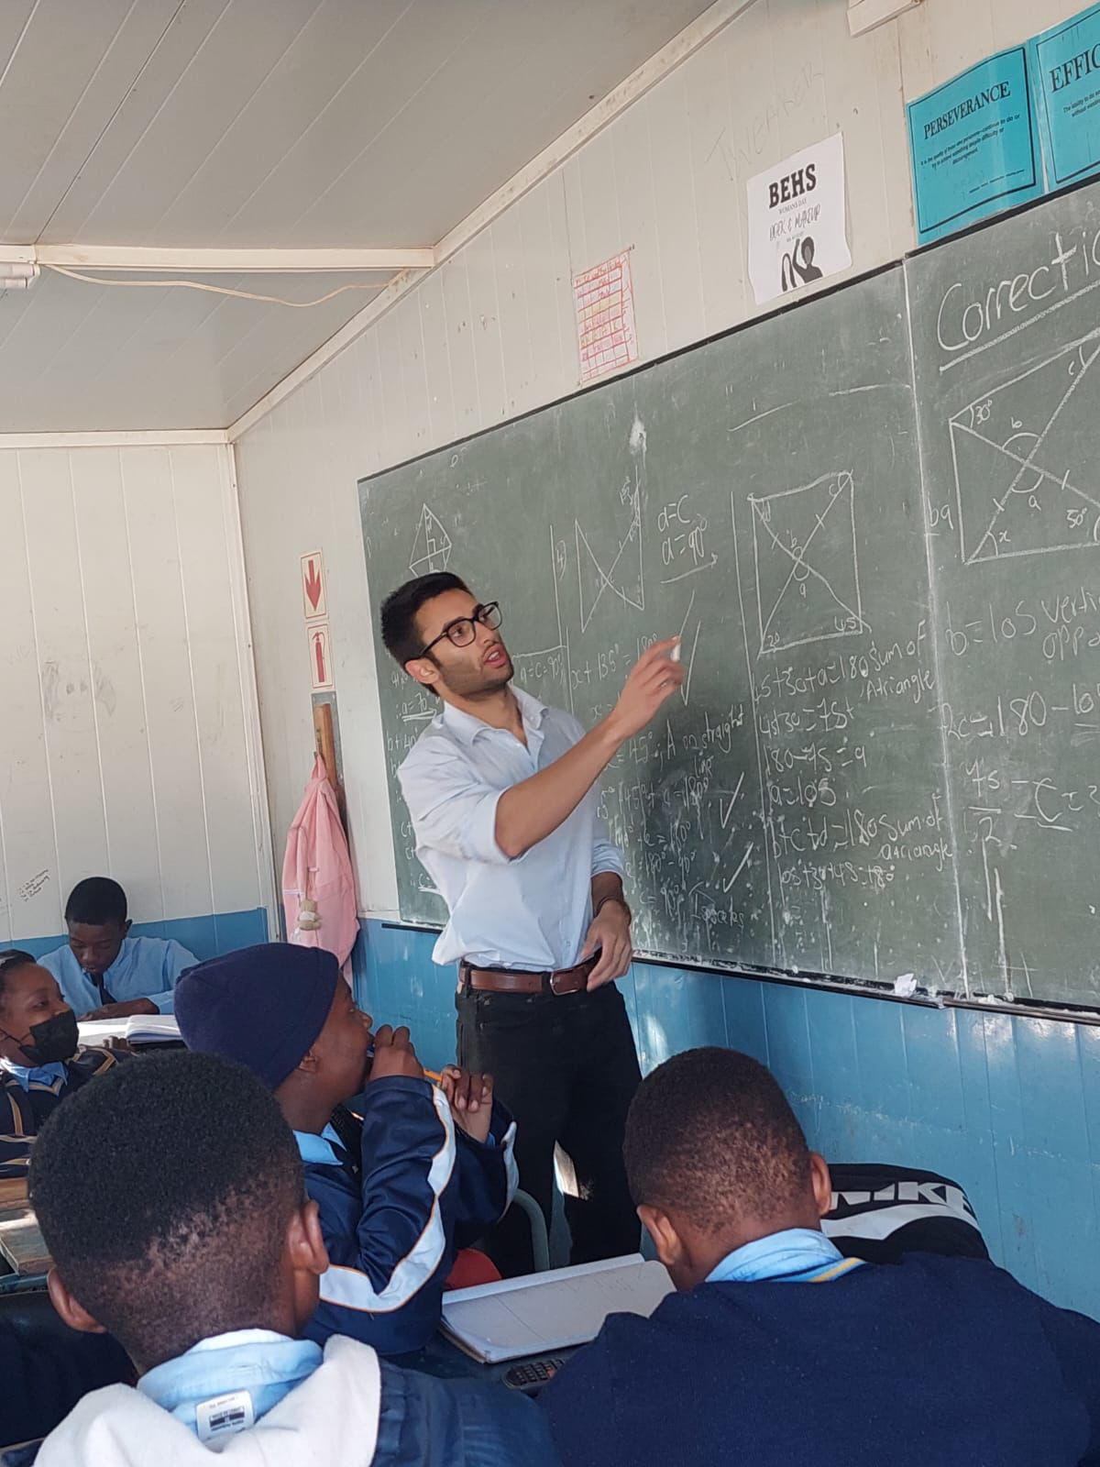
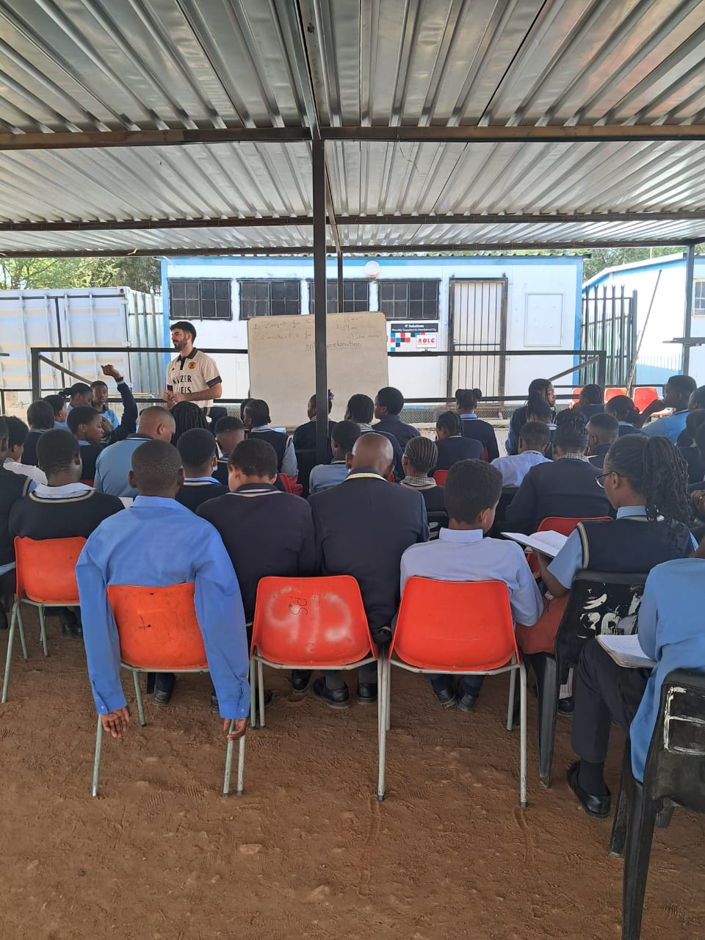
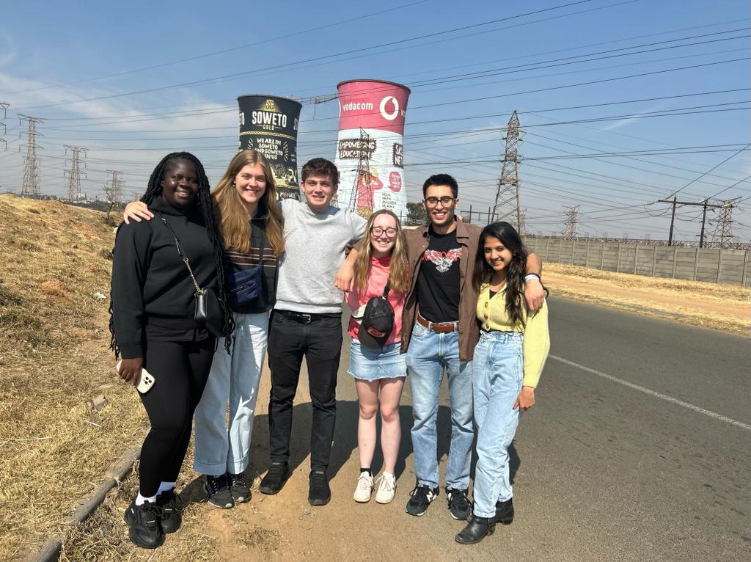
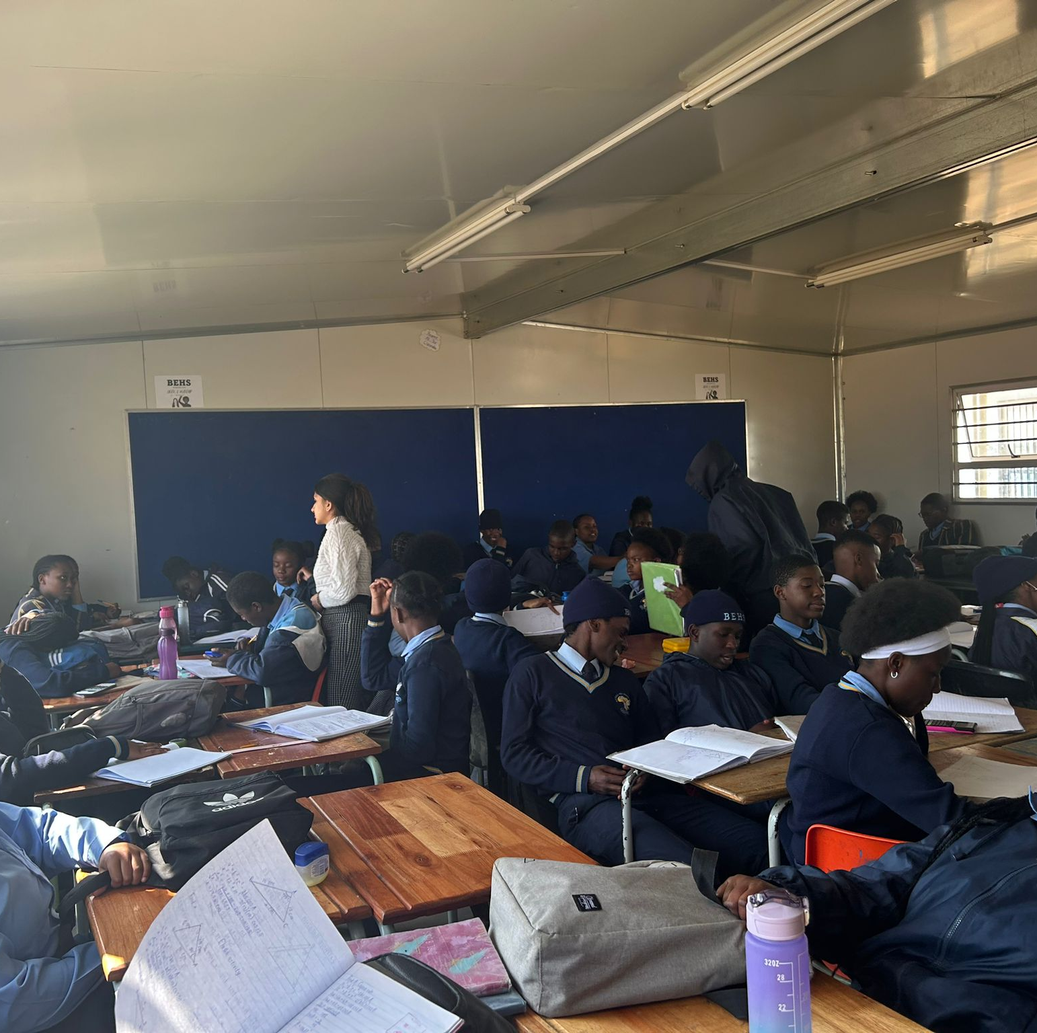
Location: North Johannesburg/Cosmo City, South Africa
Type: Urban
School: 2 townships schools
Type of teaching: Co-teaching and solo-teaching
Accommodation: hotel
Things to note: You are based in central Johannesburg but travel each day to Cosmo City.
The classes are large, and the staff are very dedicated and run robotics and coding clubs for their pupils which we encourage our volunteers to get involved in.
The 2 schools are down the road from one another.

Slide 6
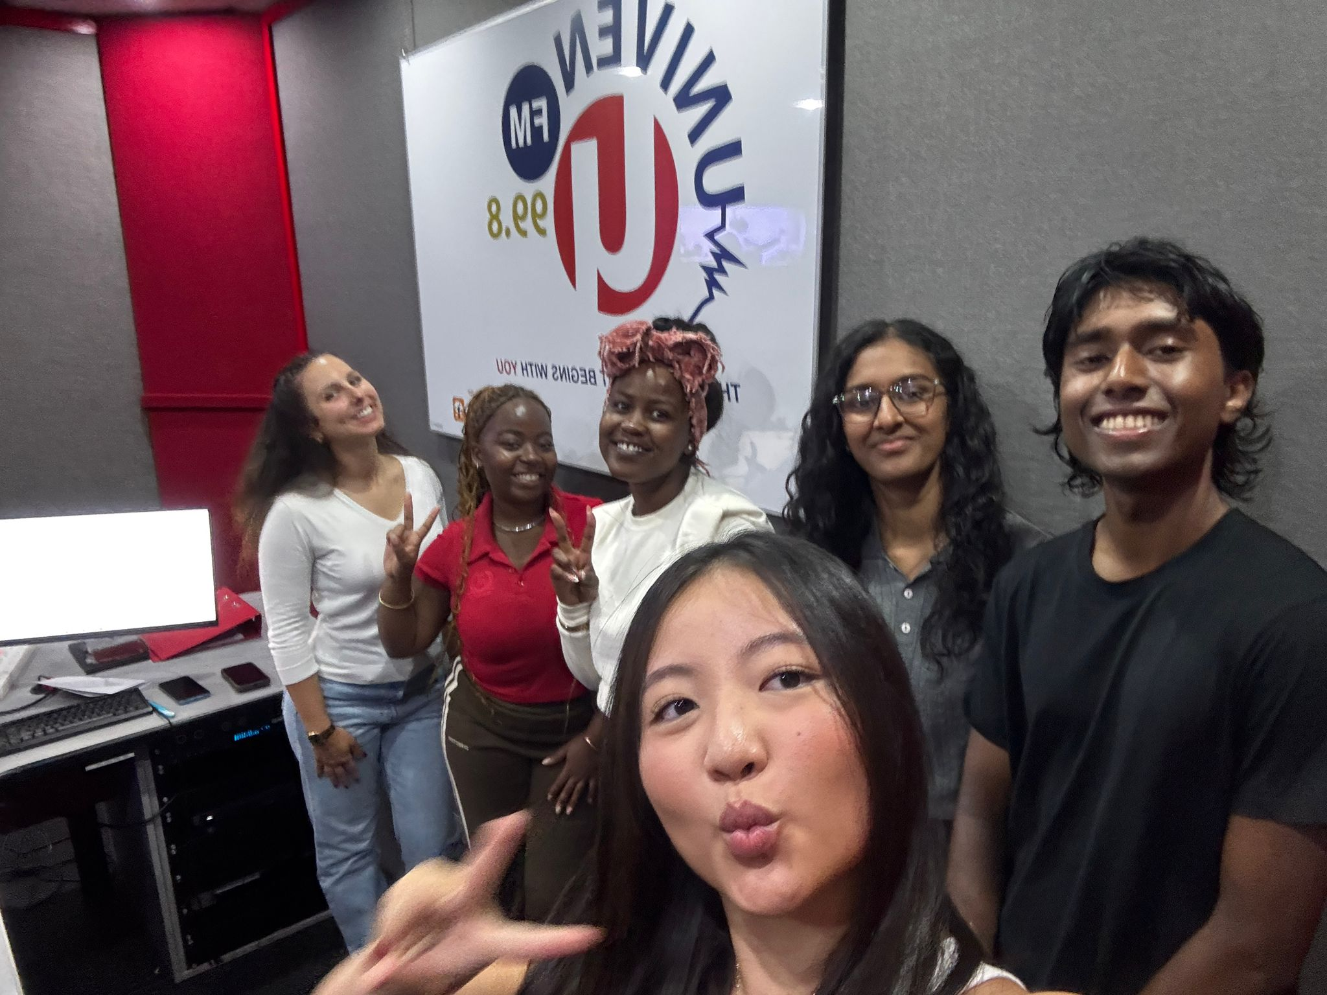
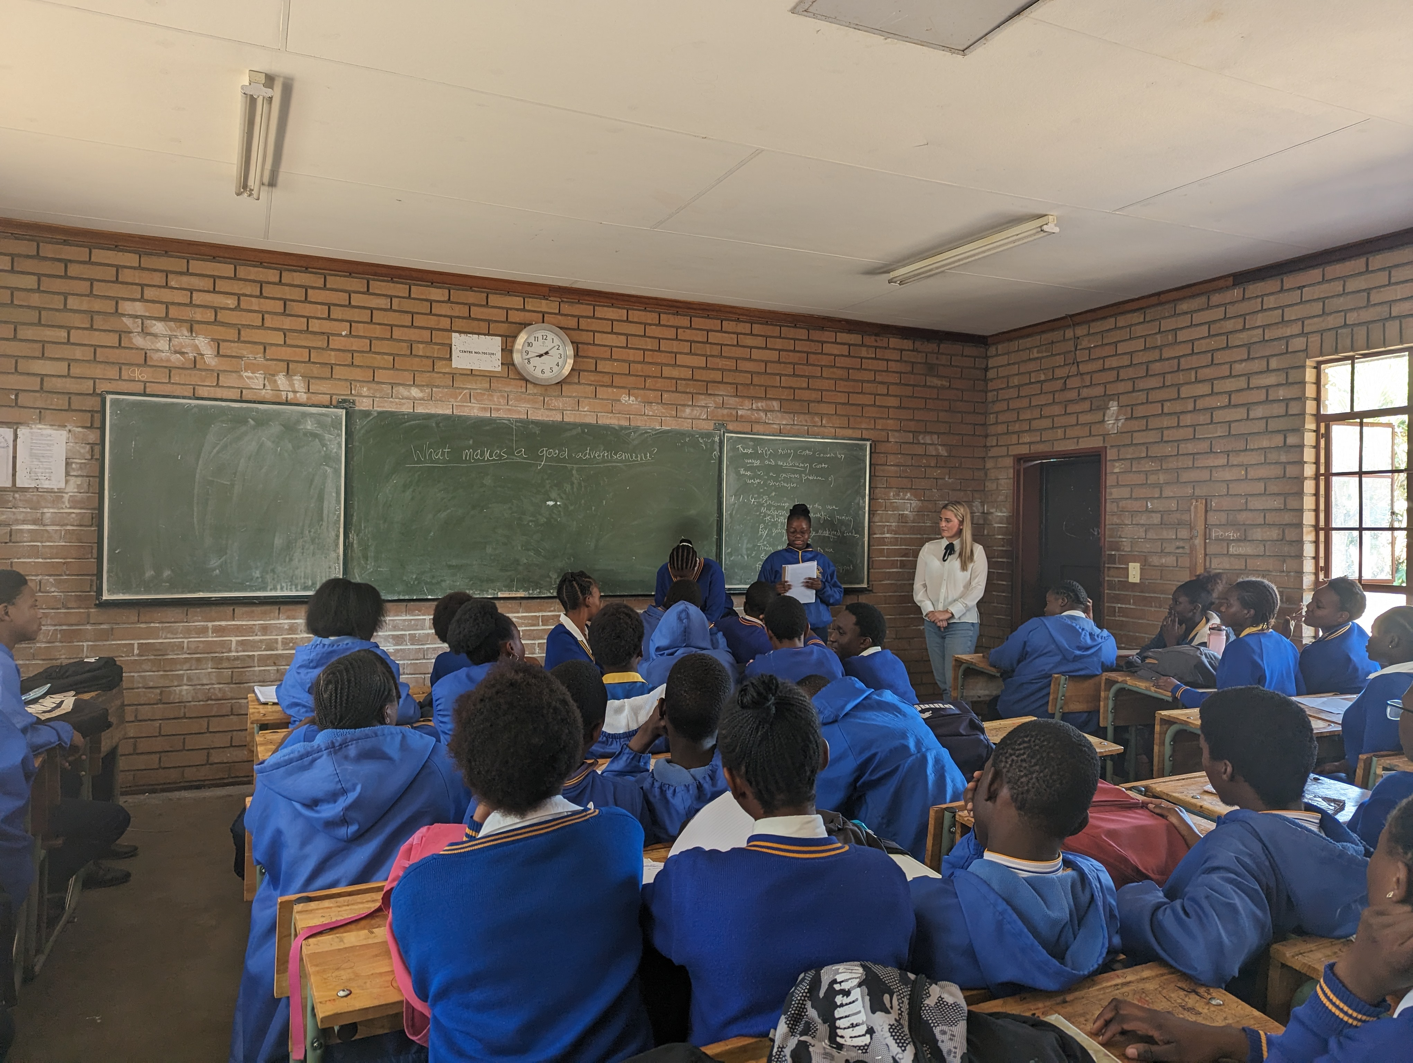
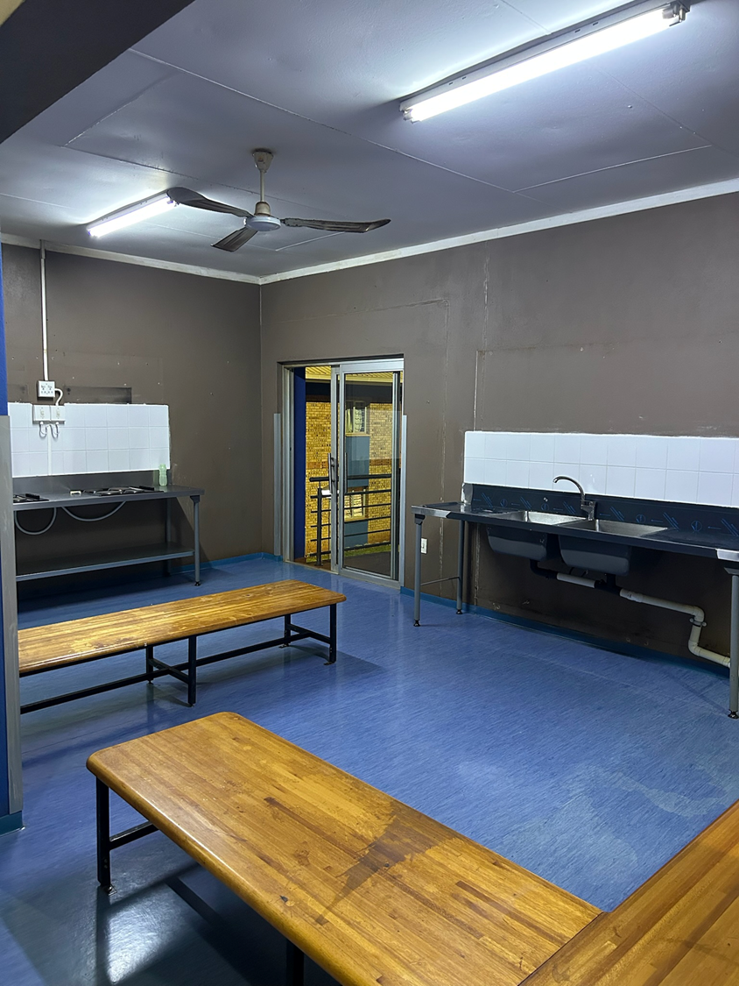
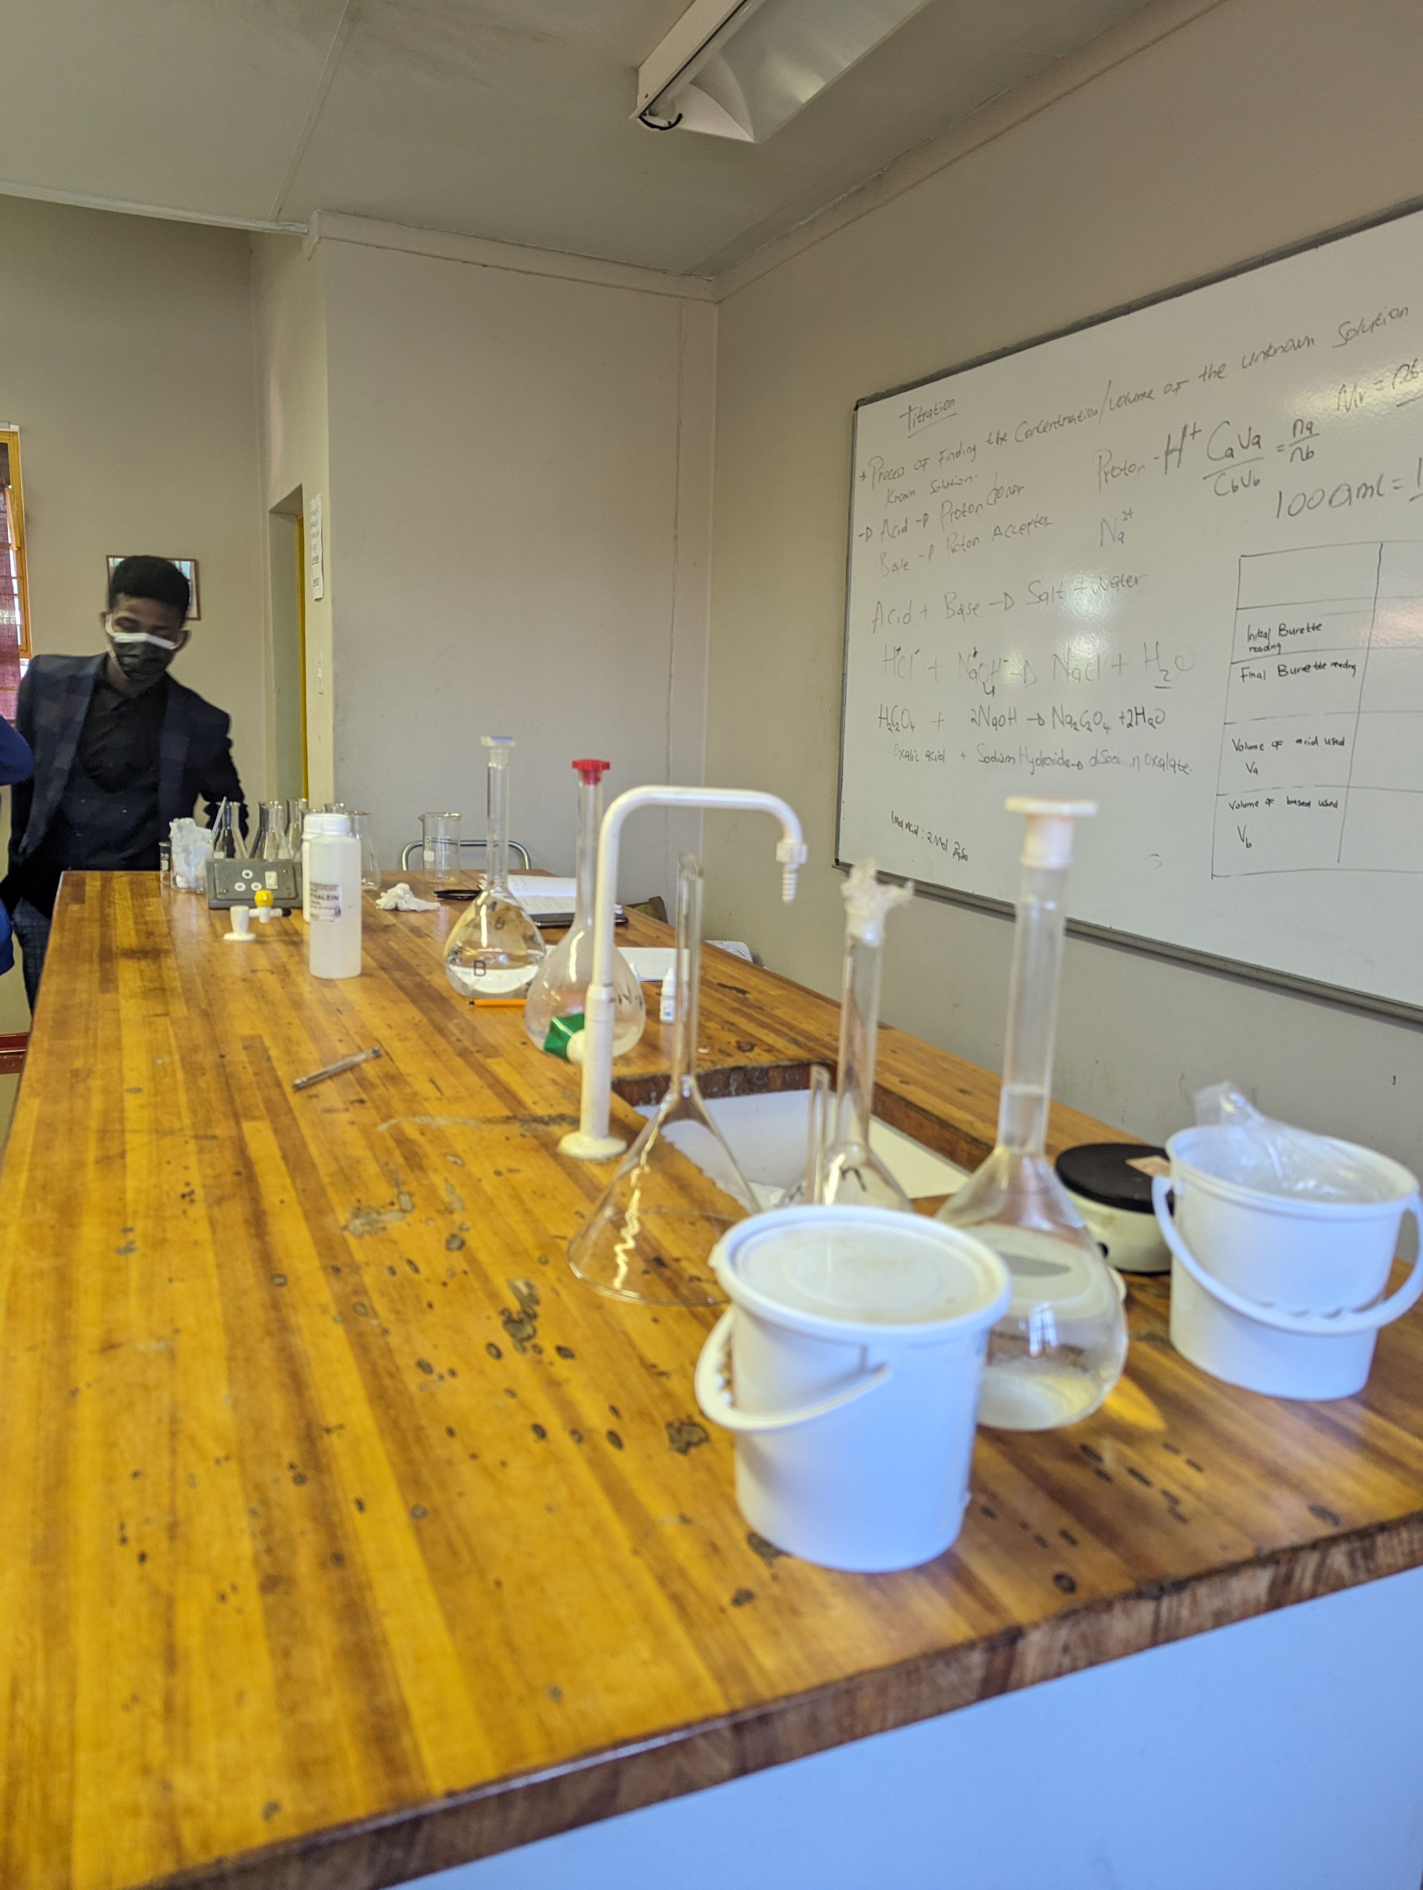
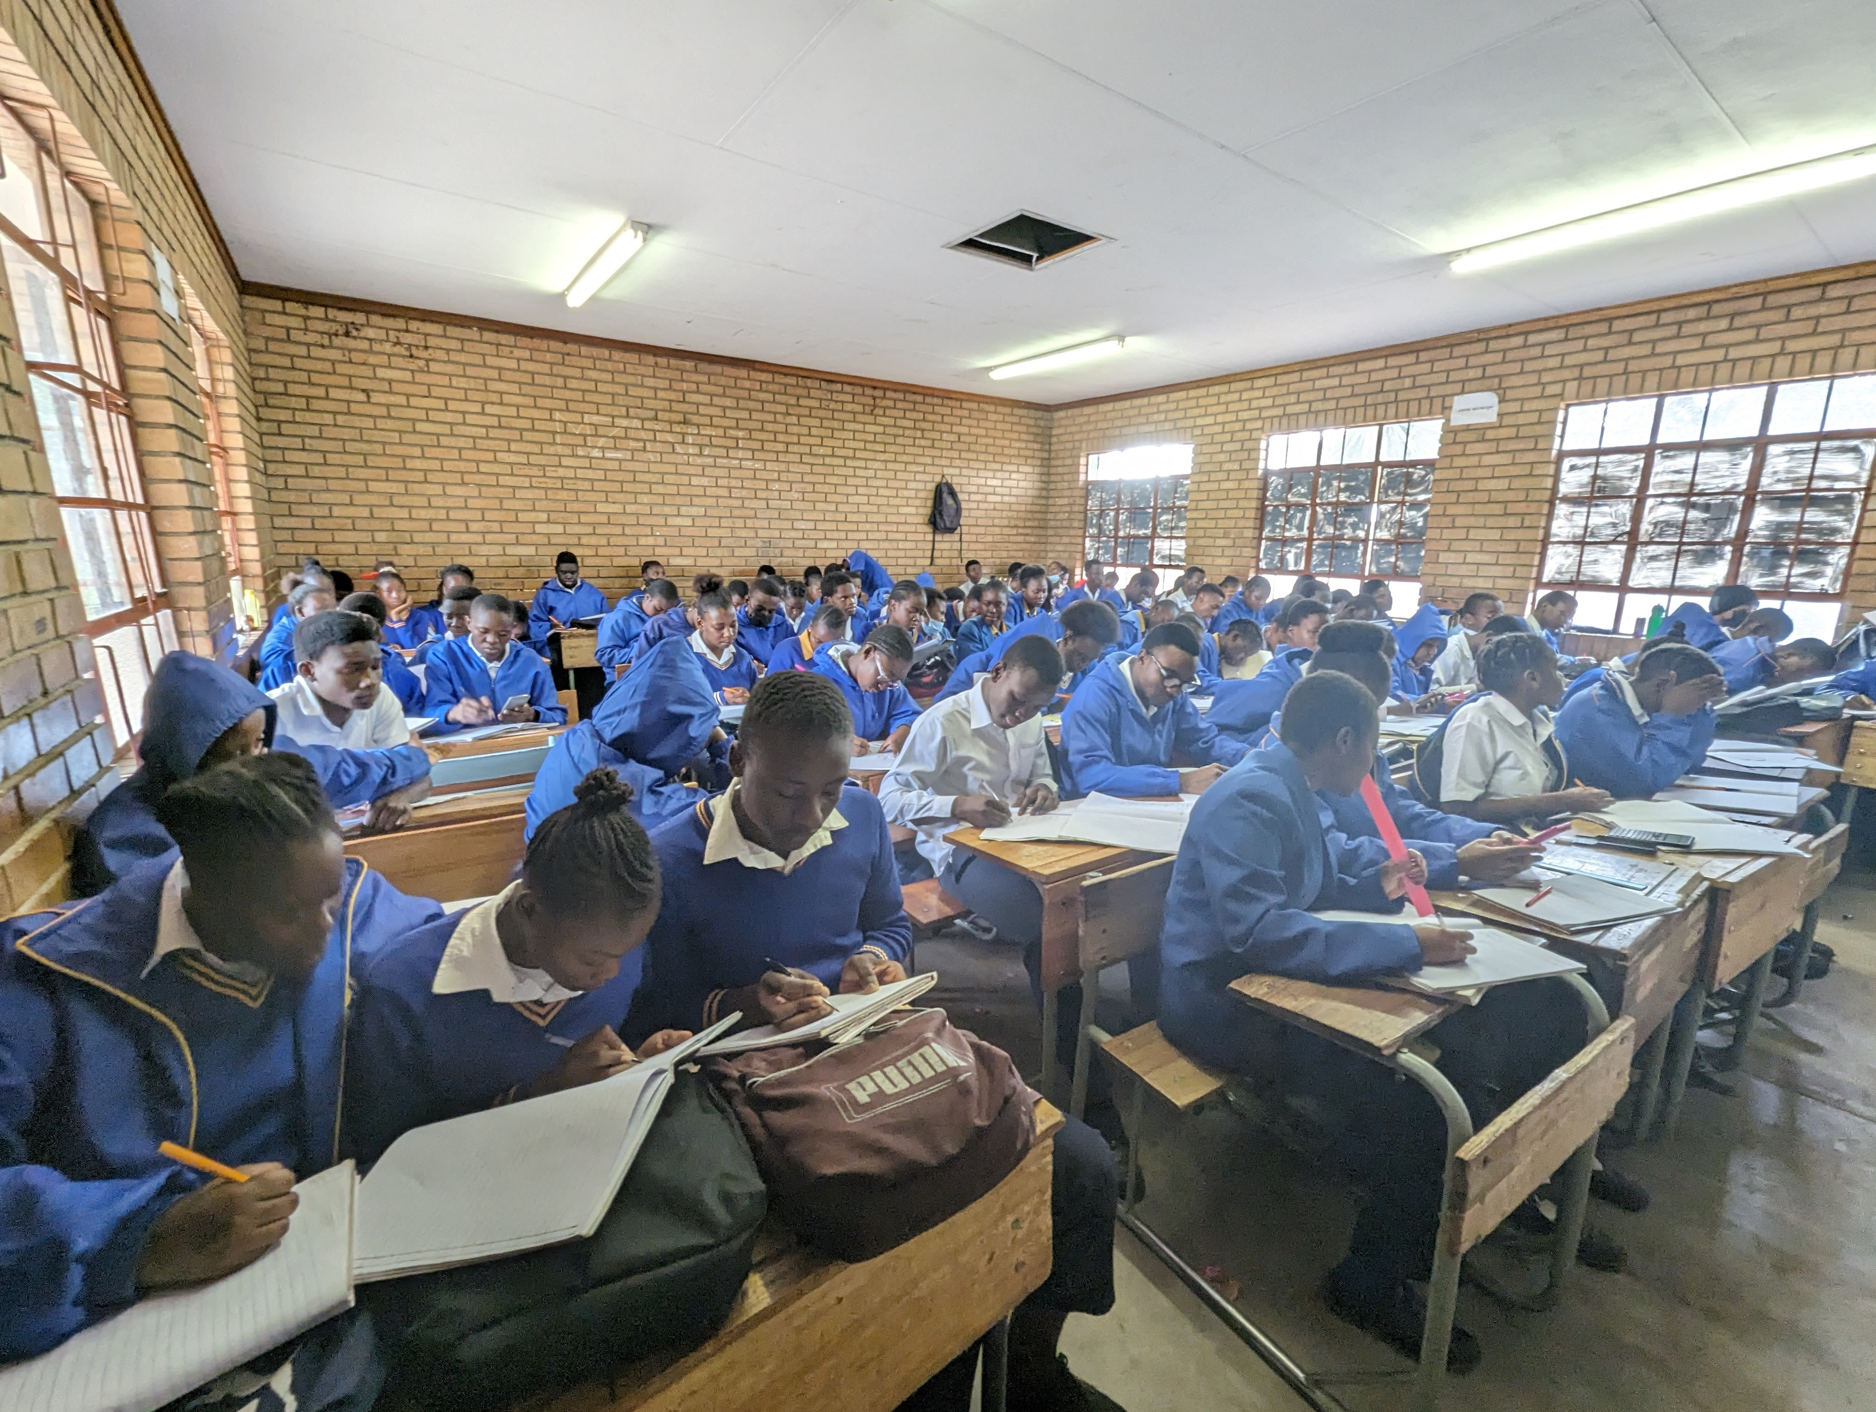
Location: Limpopo, South Africa
Type: Rural
School: 2 schools in separate villages
Type of teaching: Co-teaching and solo-teaching
Accommodation: University halls
Things to note: These schools have large class sizes. The PGCE students from the University of Venda may be in the schools with you and so you may find yourself working alongside them too.
Based at the university, you are fully engaged with campus life.

Slide 7
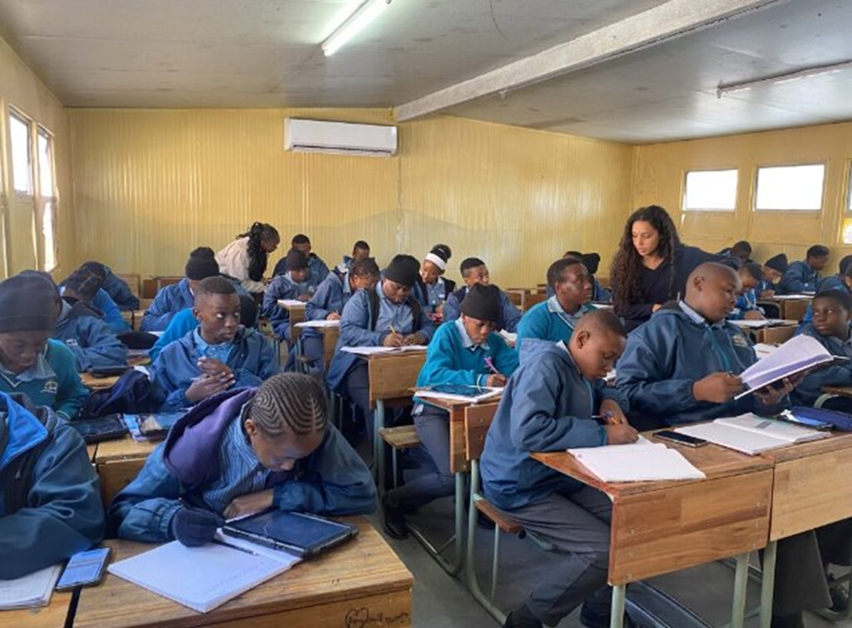
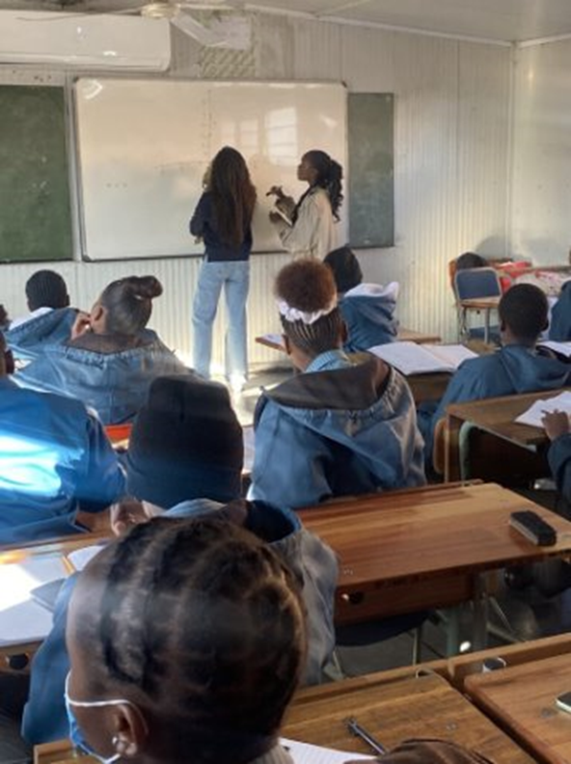
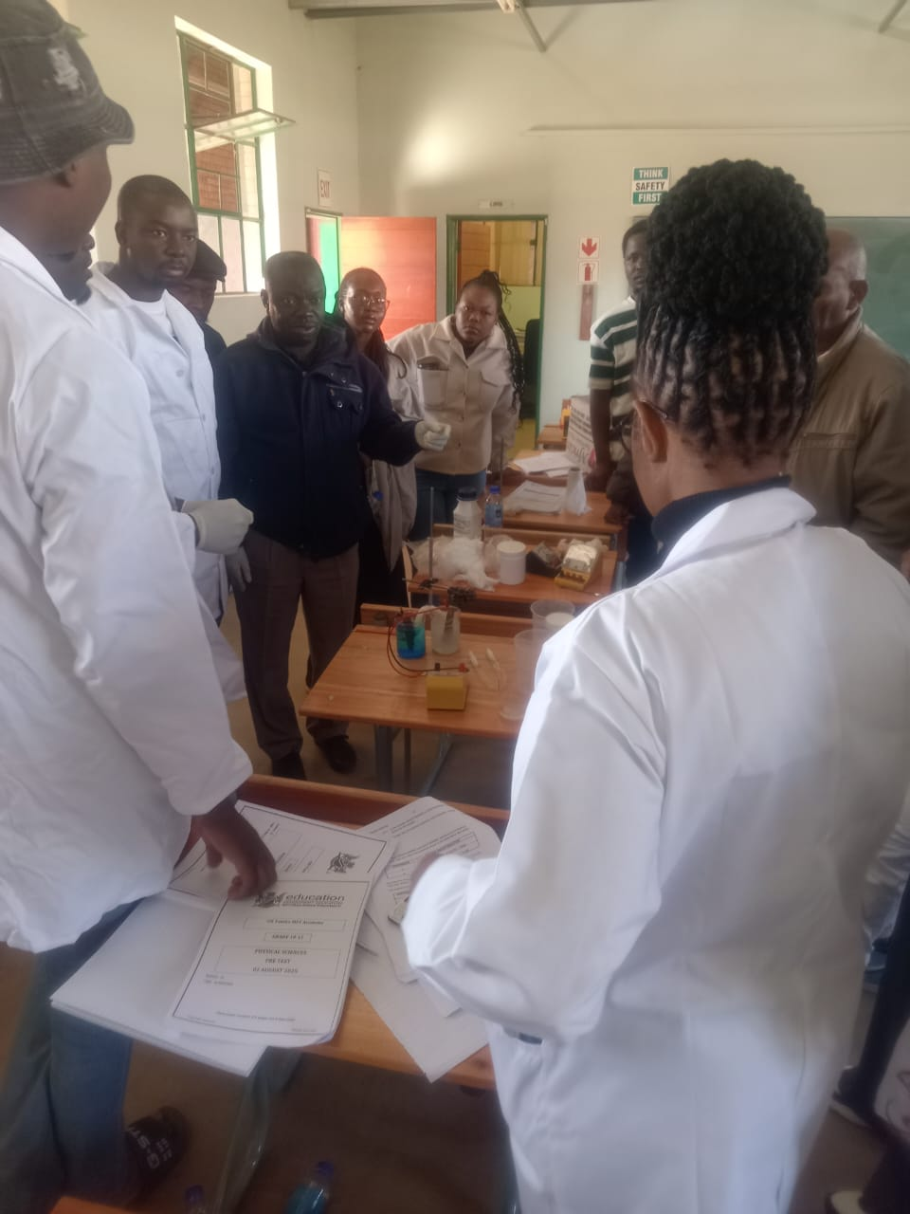
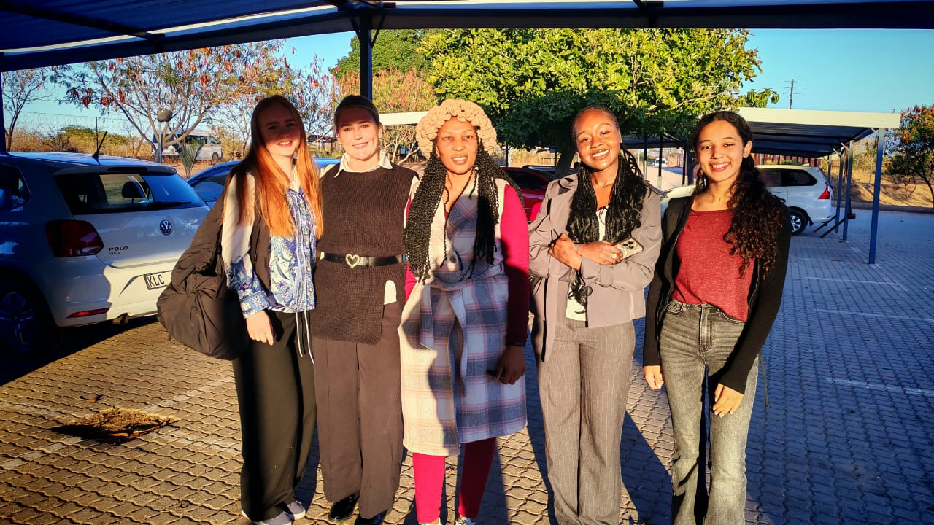
Location: Mpumalanga/Acornhoek
Type: Rural
School: 1 school
Accommodation: Lodge
Things to note: This is an isolated location where you will be reliant to make your own fun. You are close to the national parks, but mid-week transportation is limited compared to other locations.

