Slide 1

Warwick in Africa Application Support workshop
George Hill
Ian Scrase

Slide 2



In this session
Attendees should be able to:
Identify the key features of a strong application
Understand that all experience is good experience
Consider how to write your application For Warwick In Africa

Slide 3

What is Warwick In Africa?
Notes:
https://warwick.ac.uk/giving/projects/wia/about/ourvalues

Slide 4
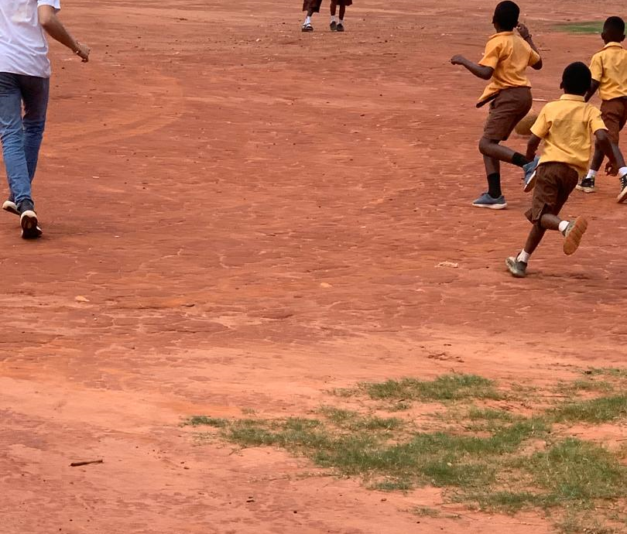
Tell us what motivates you to want to be a Warwick in Africa volunteer teacher

Slide 5

What is important to you in life?
What have you enjoyed doing from your Degrees?
What in your life right now makes you happy?
(Your job, a project, friends/family, a hobby?)
What activities can you lose yourself in and forget about time and place?
(Music, sport, travel planning, essay writing?)
What are you passionate about?
(Helping others? The Law? Making money? Learning new things? )
Self-Awareness Moodle course
Career Orientation:
Functional competence
Managerial competence
Autonomy
Stability
Creativity
Service/dedication to a cause
Lifestyle
Pure Challenge
WiA Values:
We hold our core values at the heart of everything we do. These are: Collaboration, Respect, Aspiration, Impact, Commitment and Resilience.
Notes:
Link to motivations
Link to strengths

Slide 6
Please outline any experience you have had which has helped you to develop those skills required to support learners

Slide 7
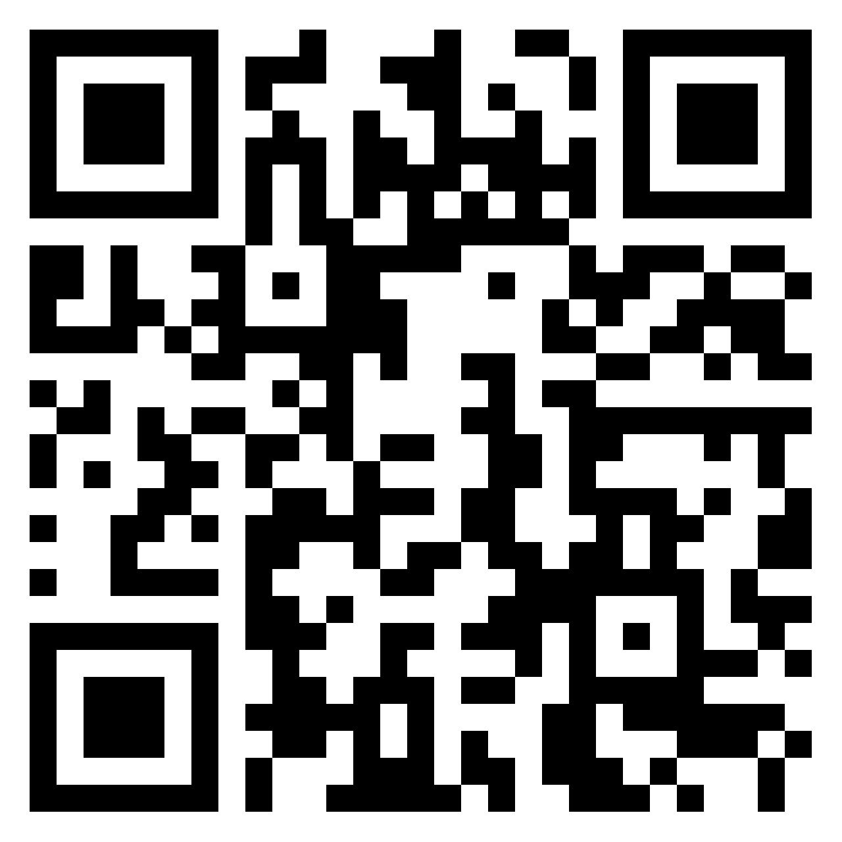
Skills required to support learners
Notes:
https://padlet.com/ijscrase1/skills-required-to-support-learners-3nnc4bb8gw1maei5

Slide 8
Employability – what is it?
Employability is not just about students making deposits into a bank of skills, it is a combination of personal qualities, skills of various kinds and subject understanding.
It’s about having developed self-awareness and confidence in what you have to offer as an individual.
The real focus is on developing critical, reflective abilities, with a view to empowering and enhancing you as a learner. Employment is a by-product of this process.
Notes:
IS
Emphasise the need to understand what you are getting out of your experience, not just taking part
Employers from this study emphasised the importance of applicants to “sell themselves” within their application and within the interview, by not just simply listing, but explaining what skills and attributes they have managed to develop and maintain through extracurricular activities (such as sport).(Stuart et al 2011)

Slide 9

Breakdown Your Activities:
Skills for work, Not of work!
Have you “organised social events for the society?”
OR have you:
“Implemented changes to society social events based on feedback from the society members, such as a “sober Sunday paintball” event, collaborating with Exec members to plan and schedule. Which increased member involvement by 20%.”
HOW---------------WHAT-----------WHY/RESULT
Show Not Tell !!
Notes:
Relate to the CAR model

Slide 10


Framework
S ituation
T ask
A ction
R esult
C ontent
A ction
R esult
Use 15 - 20% of your word limit to set the Scene
Use 60 -70% to talk about your action & the skills you used and Developed
Use 15 - 20% to explain the outcome of the situation & learning points

Slide 11
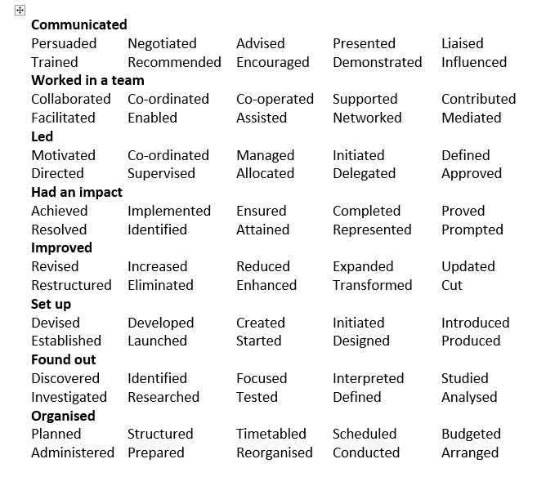

Active verbs have impact
Active Words

Slide 12
Describe a situation where you have had to demonstrate self-reliance and personal resilience

Slide 13
Why resilience will be needed:
Limited drinking water
Power cuts
People looking at you and even calling out at you for being foreign
Accomodation: shared/expectations/gated
Your lesson plans may fall apart mid-class

Slide 14

How do you manage challenges and setbacks?
Problem solving
Reflection
Development/ learning
Goal setting
Community
Be Authentic!
Notes:
KB/DS
Double Act –
Reverse chronological order
Use bullet points
Avoid personal pronouns
Length is important
Finance/Consultancy → 1 page
Engineering/Law → 2 pages
Academic → as long as you need
Other → 1 or 2 pages
No ½ pages!
Facilitator 1- Go through each point
Facilitator 2 – After Facilitator 1 finishes each bullet point facilitator 2 adds how AI could help
Article: How to Write an AI-Friendly Resume? https://www.linkedin.com/pulse/article-how-write-ai-friendly-resume-ashok-surana-jain-vgqhc/

Slide 15

Tell us what challenges or problems you anticipate. Think about how you might you overcome them
Notes:
Problem-solving generally involves a structured approach that can be broken into seven stages. Here's an outline of these stages:
Identify the Problem:
Clearly define what the problem is.
Understand the scope and impact of the issue.
Ask questions like: What exactly is wrong? Why is it a problem? Who does it affect?
Gather Information:
Collect data, facts, and insights related to the problem.
Talk to stakeholders, consult resources, or review past experiences.
Understand any constraints or limitations.
Analyze the Problem:
Break the problem into smaller, manageable parts.
Look for patterns, root causes, or contributing factors.
Use tools like SWOT analysis, the Five Whys, or cause-and-effect diagrams.
Generate Potential Solutions:
Brainstorm and list all possible solutions.
Encourage creativity and avoid prematurely judging ideas.
Involve others for diverse perspectives.
Evaluate and Select the Best Solution:
Assess the feasibility, pros, and cons of each solution.
Consider criteria like cost, time, effectiveness, and risks.
Choose the solution that best aligns with your goals and constraints.
Implement the Solution:
Develop an action plan with specific steps and deadlines.
Assign responsibilities and allocate resources.
Communicate the plan to everyone involved.
Review and Reflect:
Monitor the implementation process to ensure the solution is working.
Evaluate the results against your goals.
Identify lessons learned and document them for future problem-solving.
This systematic approach helps ensure thoughtful and effective solutions to a wide range of challenges.

Slide 16
How To Solve a Problem
Problem-solving generally involves a structured approach that can be broken into seven stages. Here's an outline of these stages:
Identify the Problem:
Gather Information:
Analyze the Problem:
Generate Potential Solutions:
Evaluate and Select the Best Solution:
Implement the Solution:
Review and Reflect:

Slide 17
Describe how you would approach fundraising £1,000 from the general public and any experience you have that would help you to achieve the target

Slide 18
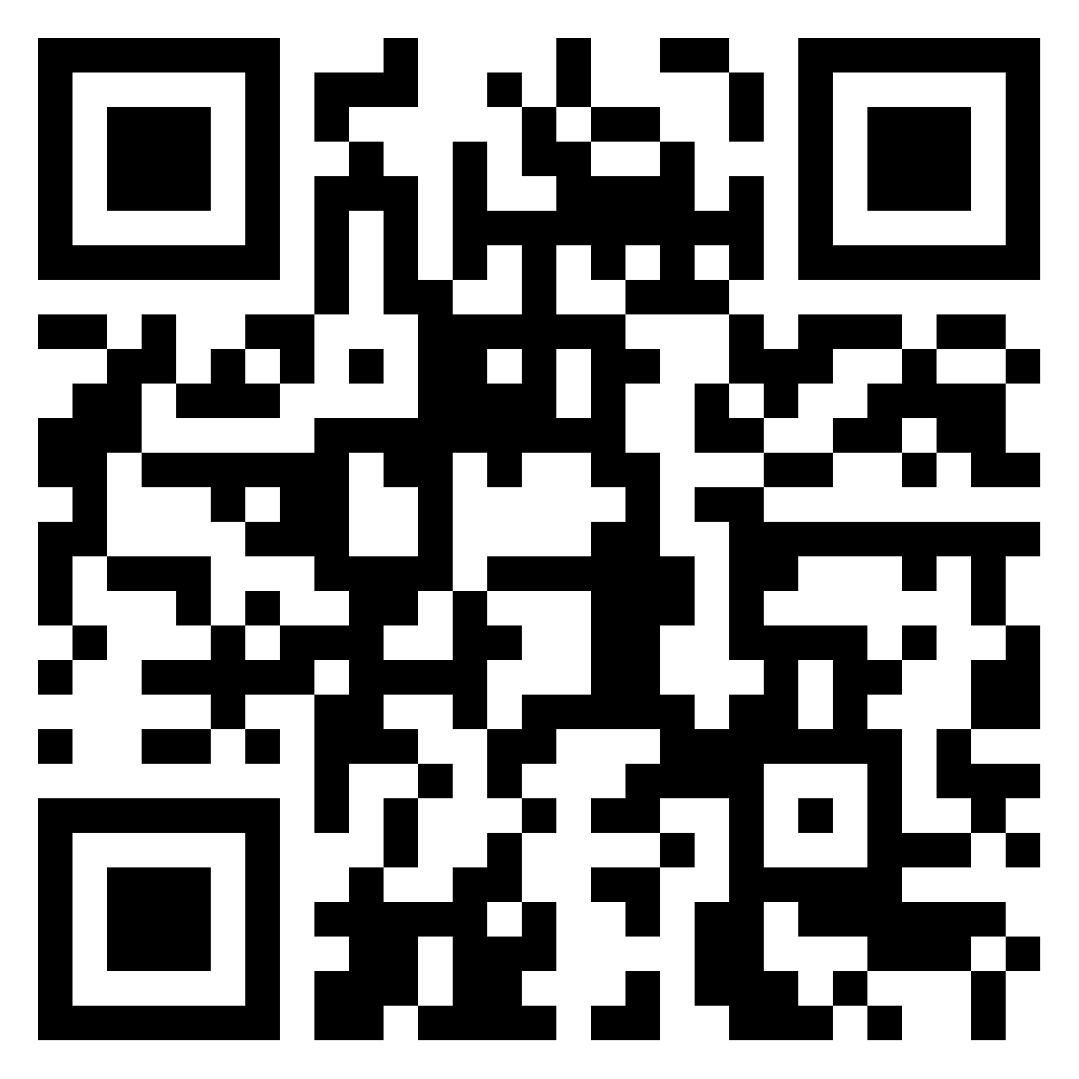
How to make £1000
Notes:
https://padlet.com/ijscrase1/how-to-make-a-1000-7fsc0teoasyxaucv

Slide 19


Examples of fundraising:
Busking (with council permission)
Cake sales
Working with other societies and adding on to one of their events
Film evenings
Sponsored events – team or individual sports
Working with the placement team
Non-school uniform day at your former school
Shaved head
Board games night – entry fee
Raffles
Selling secondhand clothes
Karaoke night
But how do you make these a success!
Skill Areas: Organisation and Planning

