Slide 1

Market insight summary
28th May – 3rd June 2020

Slide 2
HEADLINES
1
Prospective students who are considering changing their university decisions are tending not to take action right now. 57% are waiting for results day to make a decision.
3
Providers need to be mindful of the impact the period away from education and exams has had on September/October entrants. Identify and address subject deficits/other educational gaps.
2
Most universities are considering a blended approach to teaching in the autumn.
4
Birmingham, Bristol, Liverpool and York are all developing social induction programmes.
5
Students from households with below average income are more likely to have experienced stress and anxiety

Slide 3
Summary
Prospective students have concerns that they may miss out of the university experience, but consideration of changing choices has plateaued at just under half having considered changing their choices. This sentiment is not resulting in action, with deferrals lower than last year and just 8% of UK UG respondents* have decided to defer. The opportunity for universities now is to reassure applicants that they will still receive a university experience at a top university (and allay their concerns over future job prospects), and to tap into the excitement many have for starting their university experience, as many are waiting until results day to make a final decision.
Concerns have changed over the past few weeks with prospective UG UK students increasingly concerned about how long this will go on for, and missing school/ college. QAA reports advise institutions to consider the impact of the period away from education on new entrants. Not just the subject specific deficits, but also the loss associated with not being able to formally finish the year and ‘prove themselves’ in exams. Social inductions and interactions (as UCAS have highlighted) are important to induction and less easy to facilitate online; institutions are now introducing social induction programmes to facilitate settling in.
Some student groups are likely to require more pastoral and welfare support; students from BAME communities and those that may need to find part time work to support themselves. Students from below average income households are more likely to take a gap year (less likely to be related to their studies), and more likely to have experienced stress and anxiety during this period.
* Youthsight/ UCAS

Slide 4
Summary
Over 50% of institutions* were considering delaying the start of term by a month, however of our competitors only Bristol has announced a short delay , with many now announcing a blended approach to delivery for the new term, in line with recent UUK guidance on flexible provision. The barriers to recruitment considered most important to Universities at the start of May (visa centre closures and travel restrictions) may begin to be removed, however concern over perceived student preference for face to face delivery, and the UK’s handling of the pandemic remain.
More institutions have released details on the safety measures they are planning for the beginning of term, with scheduling staggered arrivals, details on social distancing measures, cleaning and one way systems.
* UUK international survey with 45 providers

Slide 5
Sources
What’s happened in the last 7 days:
UK Government have outlined their approach to student number controls.
Universities UK has released guidance for institutions on emerging from lockdown
QAA have published reports detailing what higher education provision may look like in 2020/21, and the impact on admissions
Lockdown is easing with schools, colleges and nurseries on track to begin phased reopening
NHS Test and Trace service went live on May 28 in England
UCAS/ Youthsight release latest tracker survey results
The Student Hut
Weekly tracker
Prospective and current Students
UCAS/Youthsight
Tracking survey with UK prospective Students
University of Warwick enquiries
Anecdotal feedback from markets
QAA
Impact of Covid on admissions paper was informed by discussions with directors of admissions from a number of higher education providers, and by the views of a panel of experts drawn from the school and higher education sectors.
Guidance on planning for next academic year- quality and standards
Universities UK International
Survey of 45 UK institutions
UUK
Principles and considerations for universities to address when emerging from lockdown

Slide 6
Market sentiment and external updates

Slide 7
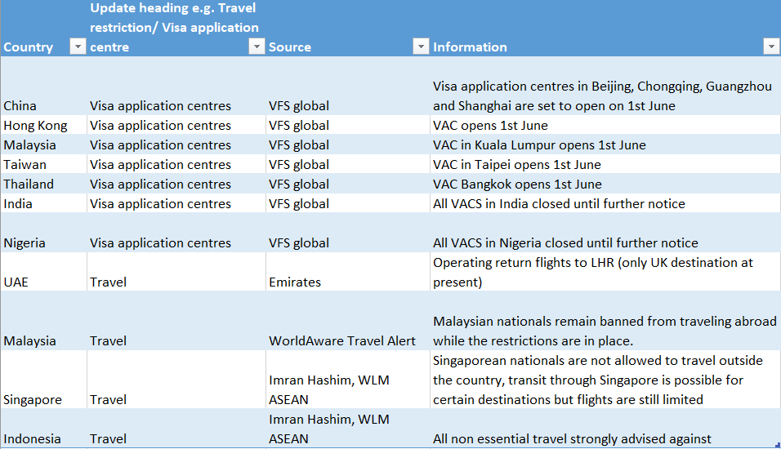
International Travel Restrictions/Visa Updates
Visa application centres are beginning to reopen, but remain closed in India and Nigeria.
Travel restrictions are still in place in Malaysia, Singapore and Indonesia

Slide 8
The Student Hut- student sentiment tracking (1)
Concerns about coronavirus remain high (93%), however the % of those who are ‘very concerned’ continues to decline (34% in week 10). This indicates that concerns over coronavirus and it’s impact are lessening.
Whilst the health of friends and family and the impact on the NHS are still key concerns, students are now increasingly concerned about how long this will go on for and missing school/college/uni.
The % of students still planning on going to university remains high (91%).
Source: Student Hut tracker, 343 responses, fieldwork 25th-31st May 2020

Slide 9
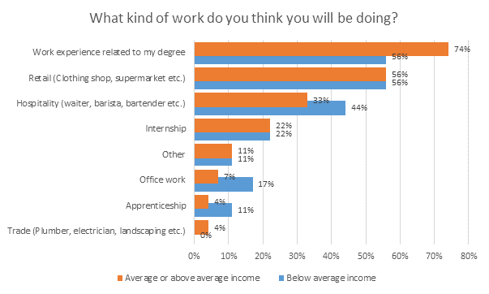
The Student Hut- student sentiment tracking (2)
Overall students are now more likely to consider taking a gap year compared to before the Coronavirus pandemic.
However students from below average income households are even more likely to take a gap year (+27%) when compared to students from above average income households (+16%).
Students from households with below average income are less likely spend their gap year doing work related to their degree, instead they are more likely to spend their gap year working in hospitality, in an office or in an apprenticeship.
The research also shows that students from below average income households have experienced higher levels of stress and anxiety compared to those from above average income households.
Source: Student Hut tracker, 343 responses, fieldwork 25th-31st May 2020

Slide 10
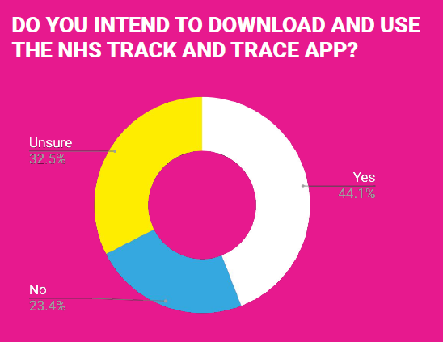
The Student Hut- student sentiment tracking (3)
57% of students think that Covid-19 will negatively impact their future job prospects, this has increased by 8% since week one of the lockdown.
80% of current students said they will not defer a year, only 2% said they were deferring, the remaining students were unsure.
There is a mixed response in students’ intentions to download and use the ‘Test and Trace’ app. The majority of students are not currently intending to download and use the app (32% being unsure and 24% not intending to) . These students are concerned about data privacy and the government having access to this information. There are also concerns over how effective the app will be.
I don’t want the government to misuse my personal data
I don’t see how it would effect me personally as I’m fully self-isolated
I don’t believe the government should have access to people’s location in such a way

Slide 11
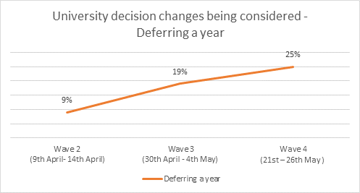
Headline UK intentions- UCAS/Youthsight (1)
As the pandemic has progressed the % of applicants considering changing their university decisions has plateaued.
8% of students have decided to defer for a year, 25% are considering deferring (this has risen by 16% since the start of April)
The majority of students who are considering changing their university decisions have only undertaken light research so far.
UCAS data shows students are not making real changes yet, so the intention maybe there but they are not yet driven to action.
57% of students say they are waiting until results day to make their decision.
Source: UCAS/ Youthsight applicant tracker, representative sample by UK region, school type and gender. Wave 1 = 500, Wave 2 = 500, Wave 3 = 500, Wave 4 = 500.

Slide 12
Headline UK intentions- UCAS/Youthsight (2)
The number one worry for students is missing out on the university experience.
The majority of students considering deferral are hoping this would give them a true university experience (26%) or avoid online teaching (38%).
Those considering changes want to get into a better university, or make sure they get into their chosen university
Communications to provide details of how Warwick will offer a true University experience in the initial few months and beyond
Reassure applicants that Warwick is a top university and an excellent choice for their future
Provide clear ways for applicants to ask questions and seek reassurance
Source: UCAS/ Youthsight applicant tracker, representative sample by UK region, school type and gender. Wave 1 = 500, Wave 2 = 500, Wave 3 = 500, Wave 4 = 500.

Slide 13
QAA – the impact of Covid-19 on admissions and transitions in higher education (1)
The paper outlines ways in which providers can support students and builds on the advice given in QAA's initial guidance on standards and quality.
Providers should be mindful of the impact the period away from education and exams has had on September entrants.
Consider how to identify and address subject deficits - or other educational gaps - in teaching and academic support plans.
Consider how to build practice in revision and examination technique into the teaching and academic support plans.
It will also be helpful for providers to brief academic and support staff about the likely range of new students' feelings concerning the truncation of their secondary experience and the cancellation of examinations.
Feelings of anti-climax, ‘unfinished business’, potential impact on self-worth having not been able to ‘prove’ themselves in their exams
Source: Quality Assurance Agency for Higher Education: https://www.qaa.ac.uk/news-events/news/the-impact-of-covid-19-on-admissions-and-transitions-into-higher-education#
The paper was informed by discussions with directors of admissions from a number of higher education providers, and by the views of a panel of experts drawn from the school and higher education sectors.

Slide 14
QAA – the impact of Covid-19 on admissions and transitions in higher education (2)
The use of contextual information in admissions is likely to be at least as important, if not more important, this year compared to previous years given the likely variance between calculated grades and offer grades.
When it comes to settling in on campus, inductions can be done ‘virtually’ relatively easily, however social activities – highly important to settling in – are less straightforward.
It will be important to involve the Student Union in social inductions
Some student groups are likely to need increased levels of pastoral care to support their wellbeing and mental health
Students from BAME communities
Students that can’t afford computers or fast broadband if teaching moves online
Students that would normally work to support themselves, who are unlikely to find work given the economic consequences of the pandemic
Personal tutors, module and course tutors are likely to play a key role in supporting the academic engagement of new students.
Source: Quality Assurance Agency for Higher Education: https://www.qaa.ac.uk/news-events/news/the-impact-of-covid-19-on-admissions-and-transitions-into-higher-education#
The paper was informed by discussions with directors of admissions from a number of higher education providers, and by the views of a panel of experts drawn from the school and higher education sectors.

Slide 15
QAA – the impact of Covid-19 on admissions and transitions in higher education (3)
Overall recommendation is for ‘clear, regular and frequent communication’
There is a need to plan for a range of possibilities and ensure that applicants and continuing students understand both what is intended and the parameters within which any of those intentions can operate
e.g. even at this stage it is clear given social distancing that lectures can not be delivered in person – and communicating this can reduce some of the uncertainty for students
Effective student engagement is key to the successful management of quality and standards. It will be important in the new academic year to encourage constructive feedback over what is and is not working, and ensure students understand what is and is not possible to support swift resolution and strong partnership working.
Source: Quality Assurance Agency for Higher Education: https://www.qaa.ac.uk/news-events/news/the-impact-of-covid-19-on-admissions-and-transitions-into-higher-education#
The paper was informed by discussions with directors of admissions from a number of higher education providers, and by the views of a panel of experts drawn from the school and higher education sectors.

Slide 16
QAA – the impact of Covid-19 on admissions and transitions in higher education (4)
Reflective questions prompted by (and outlined in) the QAA’s paper:
How are you checking for - and accommodating - any difficulties that students might be facing as a consequence of a lengthy and forced break from formal learning?
What additional support will be necessary to address less experience and/or confidence in formal assessment than is usual in many students?
How are your own observations and data around predicted grades, entry qualifications and subsequent performance from previous admissions cycles informing contextual decisions in admissions?
How are you working with your students' union or equivalent to prepare for induction activity, manage potential complaints, and ensure an effective student representation system?
What adjustments to a personal tutor system (or equivalent) would enable effective communication and support for an online or blended experience?
How are you consulting with applicants about changes to programmes ahead of and during their first year, taking into account the fact that there may be a need to make changes rapidly and repeatedly?
How is your communication strategy to applicants/students supporting dialogue in both directions, building relationships of trust, and achieving coherence and coverage?
Where there are uncertainties, are you clear on the circumstances that will govern decisions and what will limit your ability to offer a particular experience or opportunity?
How are you evidencing decision-making, both in terms of process and the basis on which those decisions are being made?
Are there ways in which the approaches you have adopted to move delivery and assessment online rapidly could be used to inform future quality assurance or evaluative activity?
Source: Quality Assurance Agency for Higher Education: https://www.qaa.ac.uk/news-events/news/the-impact-of-covid-19-on-admissions-and-transitions-into-higher-education#
The paper was informed by discussions with directors of admissions from a number of higher education providers, and by the views of a panel of experts drawn from the school and higher education sectors.

Slide 17

QAA – Preserving Quality and Standards Through a Time of Rapid Change
QAA has now published guidance – aimed at providing strategic approaches that will assist institutions in planning for the next academic year, with a particular focus on quality and standards and the student experience.
Principle 1: That any move to onsite activity is safe and secure for staff and students
Principle 2: That degree-awarding bodies maintain quality and standards in the move to flexible provision
Principle 3: That providers engage with students and staff in planning changes to delivery and assessment of teaching and learning
Principle 4: That provider planning scenarios are flexible and responsive to students' needs
Source: Quality Assurance Agency for Higher Education: https://www.qaa.ac.uk/docs/qaa/guidance/preserving-quality-and-standards-through-a-time-of-rapid-change.pdf

Slide 18
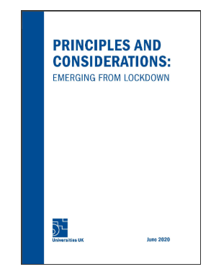
UUK – Principles and Considerations emerging from lockdown (1)
9 Principles offer a framework for universities to adapt to their own institutional settings and content
The health, safety and wellbeing of students, staff, visitors, and the wider community will be the priority in decisions relating to the easing of Covid-19 restrictions in universities.
Universities will make appropriate changes to university layout and infrastructure in accordance – at minimum – with public health advice, including guidelines on social distancing.
Universities will review their teaching, learning and assessment to ensure that there is the required flexibility in place to deliver a high-quality experience and support students to achieve their learning outcomes in a safe manner.
Universities will regularly review the welfare and mental health needs of students and staff, and take steps to ensure preventative measures and appropriate support are in place and well communicated as restrictions are eased
Source: Universities UK: https://www.universitiesuk.ac.uk/policy-and-analysis/reports/Pages/principles-considerations-emerging-lockdown-uk-universities-june-2020.aspx

Slide 19
UUK – Principles and Considerations emerging from lockdown (2)
Universities will develop effective processes to welcome and support international students and staff, including throughout any self-isolation period.
Universities will regularly review their hygiene and cleaning protocols in all university spaces, and adapt them in response to changing public health advice and risk levels, to ensure students, staff and visitors have confidence in their safety.
Following appropriate risk assessment, universities will introduce measures to enable research to be conducted in a safe and responsible manner, following government guidance specifically designed to protect researchers in laboratories and other research facilities and spaces.
Universities will engage with students and staff, including consultation with recognised trade unions, to ensure the transition from lockdown both protects the wellbeing of staff and students and enables the safe resumption of university activities.
Universities will work with civic or local partners wherever appropriate including councils, local resilience forums (in England) and community groups.
Source: Universities UK: https://www.universitiesuk.ac.uk/policy-and-analysis/reports/Pages/principles-considerations-emerging-lockdown-uk-universities-june-2020.aspx

Slide 20
Warwick enquiries/ concerns

Slide 21
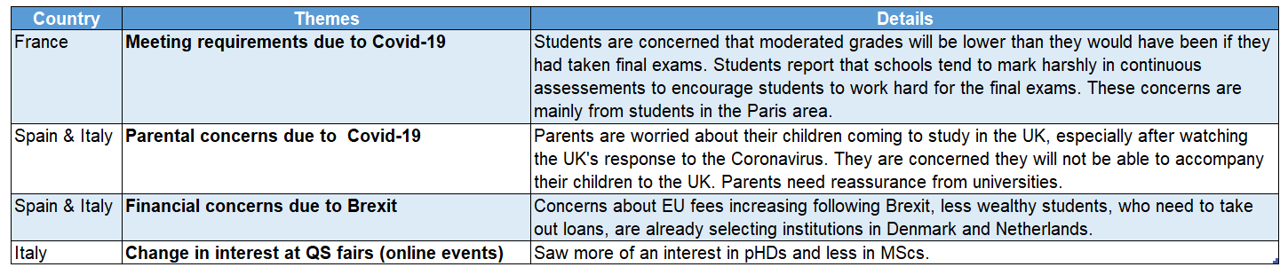
Anecdotal feedback from Europe- May’s key themes
The most mentioned theme from was about meeting requirements. Students from the Paris area report that their schools mark continuous assessments harshly to motivate students to work harder. This means their moderated grades will be lower than they deserve.
The next most mentioned theme was parental concern about their children studying in the UK. IEC suggested measures that could help - including a free and widely-available airport transfer service for students; extensive Welcome Week; and earlier pre-departures, plus communications directed more specifically at parents.

Slide 22
Website unique page views to Warwick department pages
The data shows the % change in web traffic to the department pages comparing April 2020 traffic to April 2019 traffic. There is a mixed picture, some departments have since an increase and others a decrease.
When compared to the March picture traffic has increased, suggesting an upturn in interest and recovery
Source: Data includes changes in Unique Page Views to academic department webpages (excluding the central study pages). It includes all visitors, across current and prospective students, staff and other stakeholders, but provides a broad indication of overall changes.

Slide 23
Competitor activity

Slide 24
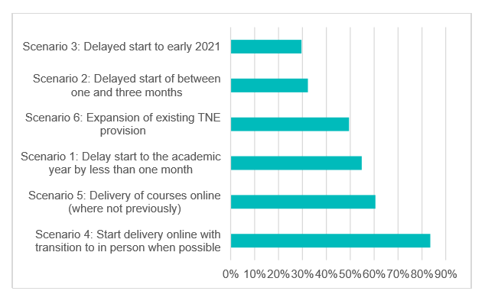

Course delivery in 2020/21 – summary of findings
Most universities are looking at a blended approach to teaching in the autumn
20% of universities surveyed had made a final decision about course delivery methods, and most of the remaining 80% planned to decide in the next month
The most popular solution sees 84% of universities very/somewhat likely to go for a blended approach with new students in Autumn 2020
Starting delivery online and then transitioning to face to face when possible
85% felt starting with a blended approach was somewhat or very likely among continuing students too
Over 50% are also looking at delaying term start by less than one month
However respondents felt a delayed start was much more likely for PG international students (47% somewhat or very likely) compared to domestic UG (14% somewhat or very likely).
“What scenarios are you considering for course delivery to new students starting in 2020/21?”
Percentage somewhat or very likely
Source: Universities UK International – survey of 45 UK institutions, April 2020

Slide 25
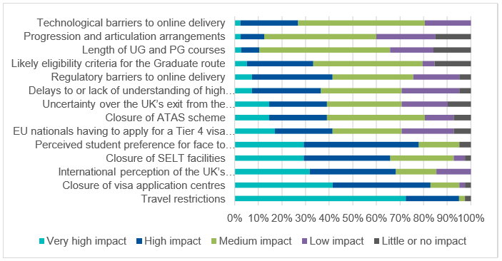
Course delivery in 2020/21 – summary of findings
Travel restrictions and visa issues are having a major impact on institutions’ decision making
A number of factors are having a major impact on institutions’ decision making regarding new international students
Travel restrictions (96%)*
Visa application centre closures (82%)*
Perceived student preference for face-to face delivery (78%)*
Perceptions of the UK’s handling of the C-19 outbreak (67%)*
Travel restrictions are also having a major impact on decision making regarding continuing international students
93% of respondents surveyed said travel restrictions were having a high/very high impact
Student preference for face-to face delivery and perceptions of the UK’s handling of the C-19 outbreak big factors here too (65%)*
“Which of the following factors are impacting your decision making for new international students starting in 2020/21?” (tick all applicable)
*Scores are ‘top 2 box’ (combined ‘high’ or ‘very high’ impact)
Source: Universities UK International – survey of 45 UK institutions, April 2020

Slide 26
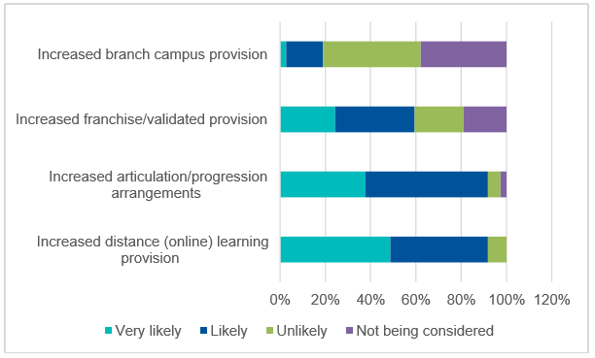
Course delivery in 2020/21 – summary of findings
Many institutions have also been thinking about the longer term impacts regarding international student strategy
82% of respondents had started to consider how Covid-19 will affect their longer-term international strategy
Of these, 92% felt that both increased online programs and articulation and progression arrangements were likely or very likely
“Which of the following actions are you likely to consider?”
Source: Universities UK International – survey of 45 UK institutions, April 2020

Slide 27
Russell Group activity
Settling in support
Blended delivery
Safety reassurances
Term start dates
Several universities are developing academic / social induction programmes:
Birmingham are “developing plans to be able to welcome you fully into the University experience.”
Bristol “Your welcome week is being developed with our Students’ Union....”
Liverpool - academic and social induction programme prior to term
York - virtual welcome programme
Birmingham, UCL and Liverpool have announced plans for a blended approach
Edinburgh plan a blended approach – where international students may be able to start their courses if not able to travel initially
KCL now saying they are planning ‘like others’ for possibility of a blended approach
York say Autumn term lectures will be online, any lab work will be delayed to later in the year
Some briefly talk about ‘putting safety measures in place’ (e.g. Birmingham, KCL) while others give great detail about what they are doing to ensure students’ safety (Bristol, Liverpool, Southampton, UCL)
Liverpool are scheduling staggered arrivals to accommodation (across one week)
Bristol has announced term start 5 Oct (was in Sept)
Liverpool – foundation week 5 Oct, teaching starts 12 Oct – with induction programme end Sept

