Slide 1
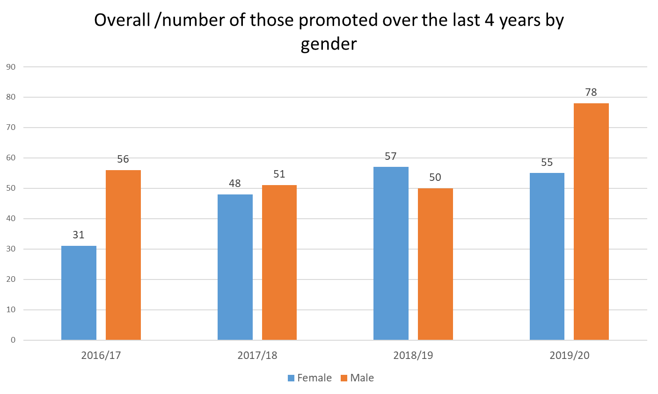
Academic Promotions by Gender

Slide 2
Academic Promotions – Current Talent Pipeline
Level Applying For | Female % | Male %
Level 6 Research/ Teaching Fellow | 50 | 50
Level 7 Senior Research/Teaching Fellow Assistant Professor | 66 | 34
Level 8 Associate Professor | 56 | 40
Level 8 Reader | 36 | 64
Level 9 Professor | 40 | 60
Overall the gender split of current applications is 48% Female : 52% Male
We have a healthy female talent pipeline in the more junior grades, although this dips from senior level 8.
It will take time for this talent to continue their career development to Reader / Professor
Currently 24.4% of our Professors are female compared to 21% in 2017.

