Slide 1
Accessible materials

Slide 2
Objectives
Explain what we mean by accessible materials.
Some practical tips on how to create accessible materials.

Slide 3
Tips
Inclusive visuals.
Word styles and why they are important.
PowerPoint ‘rules’.
Accessibility checker.
Notes:
Please see the handout ‘some basic tips for inclusive visuals’.
Again these are good basic rules for everything that you create. On the other side of the handout is an example of the same piece of text presented in 2 ways. Look at the difference! So follow these rules and you are immediately making a really big improvement in terms of accessibility.

Slide 4
Don’t Forget
Staff have disabilities and learning differences too!

Slide 5
Inclusive visuals
See the handout ‘basic tips for inclusive visuals’.
Simple basic rules regarding fonts types and sizes, spacing, emphasis etc.
Apply the rules to everything you create.
Follow these rules and you make an immediate impact in terms of accessibility.
Notes:
Please see the handout ‘some basic tips for inclusive visuals’.
Again these are good basic rules for everything that you create. (electronic, printed materials, websites, printed literature…. On the other side of the handout is an example of the same piece of text presented in 2 ways. Look at the difference! So follow these rules and you are immediately making a really big improvement in terms of accessibility.

Slide 6
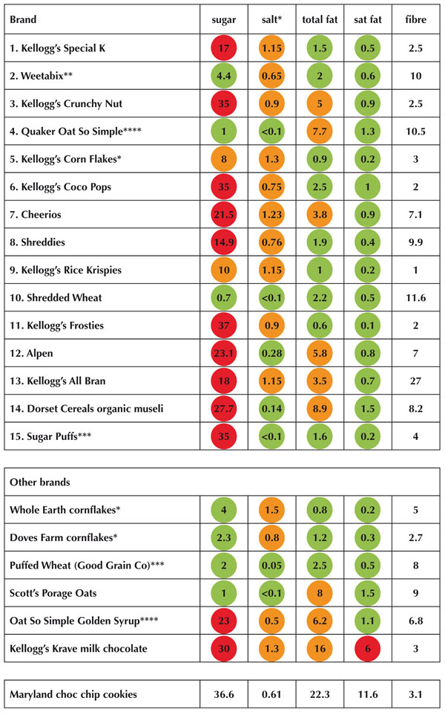
Colour - Traffic Light Systems
x ✓ ?

Slide 7
Colour
When creating presentations, it’s important to choose elements that increase visual contrast so viewers who cannot rely on colour distinction can still understand what they’re seeing.
Do not use colour as the only indicator of meaning, such as priority items shown in red. Also label or differentiate.
Use texture in graphs, instead of colour, to highlight points of interest.
Circle or use animation to highlight information, rather than relying on laser pointers or colour.
Notes:
One in 12 men are colour blind. 1 in 200 women are colour blind.
Avoid traffic lights! ( I mean on documents!)
There are a number of interesting sites that try and show you colour blindness.
My husband is very colour blind – real traffic lights judged on position and light on, no idea about ‘goes with’. Never let him pick your raspberries or tomatoes …
I laugh but problematic – imagine if you are a chemistry student and using litmus paper or identifying solutions…..

Slide 8

Word styles and why they are important
Essential for screen reading software.
The importance of punctuation.
Text descriptions for pictures/graphs in Word and PowerPoint.
Right click on the image, click on ‘format picture’, select ‘size and properties’ icon and then select ‘alt text’ and add description.
Notes:
Word Styles:
Create all documents in a structured way using the ‘styles’ feature in Word so that a document map is created – this makes it easier for students, including those using assistive technology, to navigate the document.
GUILTY!
By using keyboard commands such as ‘shift’ the user of screen reading software can move from one heading to the next for example. If you have not used a proper style for your document then the software will not know which are headings and the user loses the flexibility of moving through the document, jumping to certain sections etc. Imagine having to read everything from the beginning and not knowing when you are moving on to a new section or sub section.
End bullet points with full stops. The software pauses very slightly to indicate a new sentence for example. If there is no full stop it will string the words together which makes comprehension very difficult.
By the way, the screen readers do not need large text!

Slide 9
Using Styles in Word
Demonstration

Slide 10
PowerPoint rules
Use unique titles for each slide.
Use pre-defined PowerPoint slide templates.
Always include alternative text for images.
Use sans-serif fonts and use full stops at the end of bullet points.
Don’t over-complicate by using every function known to man!
Check reading order.
Notes:
See handout ‘creating Word and PowerPoint files that are accessible for screen reading software.
I have stolen the ‘creating accessible PowerPoint presentation from the official Windows website.. Use this website – it is clear on HOW to do things and has links to more information . Particularly see ‘Learn more’ for accessibility checker guides which I will cover in a moment.

Slide 11
Accessibility Checker
Use Microsoft’s useful tool for checking accessibility of Word and PowerPoint documents.
https://support.office.com/en-us/article/Check-for-accessibility-issues-a16f6de0-2f39-4a2b-8bd8-5ad801426c7f?ui=en-US&rs=en-US&ad=US
Guide to creating accessible PowerPoint presentations.
Guide to https://support.office.com/en-nz/article/Creating-accessible- PowerPoint-presentations-6f7772b2-2f33-4bd2-8ca7-dae3b2b3ef25

Slide 12
In summary…..
Following good pedagogic practices, creating accessible documents and providing online resources delivers access for almost everyone and removes ‘disabling’ elements.

Slide 13
More Information
Disability Service’s webpage about creating accessible materials.
http://www2.warwick.ac.uk/services/tutors/disability/guidance/accessible_documentation

