Slide 1
Supporting Students on the Autism Spectrum
Jenny Quinn – Mental Health Coordinator

Slide 2
The Autism Act
The Autism Act 2009 was the first ever disability-specific law in England.
The Act did two key things:
The first was to put a duty on the Government to produce a strategy for adults with autism, which was published in March 2010.
The second was a duty on the Government to produce statutory guidance for local councils and local health bodies on implementing the adult autism strategy by the end of 2010. This guidance was published in December 2010.

Slide 3
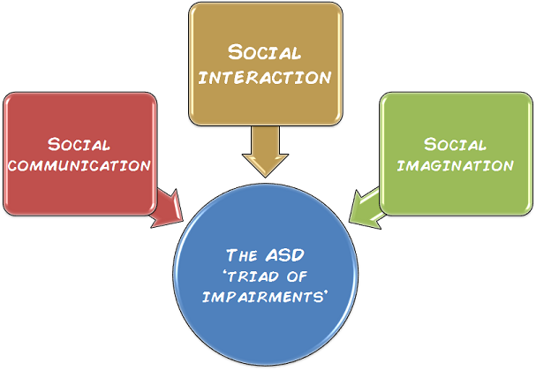
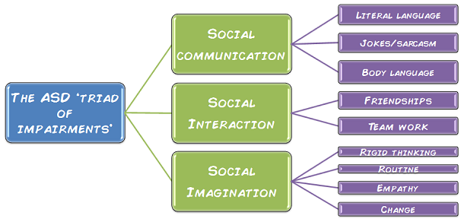
Diagnosis(1)
What do we already understand about diagnosis?
http://thegirlwiththecurlyhair.co.uk/blog/2014/10/08/no-two-people-are-alike/
Notes:
Every individual on the autistic spectrum is different. There is a cliché, “when you’ve met one autistic person, you’ve met one autistic person.” Despite our differences however, there is one common thing that binds us, and that is the ‘triad of impairments.’ These are:
Social communication. This is to do with language, for example we have problems understanding: jokes and sarcasm, social niceties (small talk), metaphors and analogies, and body language.
Social interaction. Social and emotional difficulties mean it’s hard for us to make friends and work co-operatively.
Social imagination. There is a difference between imagination and social imagination. We have difficulty with social imagination, which is flexibility of thought. This presents itself as a need for routine and a desire for things to stay the same. We have trouble coping with change and can be very rigid. Our imagination however, can be fantastic, and lots of us are highly creative.
Now here is where it gets confusing! Assuming that everyone with autism will behave the same is unhelpful and fails to recognise that autism exists on a spectrum. This means that, although we all have the three impairments listed above, the collection, symptoms and severity of them can vary so greatly that every person will be unique in their needs – just like people without autism. I will try to explain what I mean using diagrams.
Asperger syndrome is a form of autism. It is a lifelong developmental disability that affects the way a person communicates and relates to people around them. People with Asperger syndrome are usually of average or above average intelligence. Social interaction can be difficult for people with Asperger syndrome and they can experience high levels of stress and anxiety. The condition affects people in different ways, but everyone with an autism diagnosis (including Asperger syndrome) shares a difficulty in making sense of the world. A number of traits are common to people with Asperger syndrome including:
Difficulty in communicating - people with Asperger syndrome can often be very fluent in their speech, but find it difficult to make conversation and small talk, and may seem to lack interest in what someone else is saying. They may be quite literal in their understanding of spoken language, but struggle with metaphors and sarcasm.
Difficulty in social relationships - many people with Asperger syndrome do want to be sociable, but find it hard to understand the social rules that other people take for granted. This includes difficulties in knowing what to do when with other people. Group environments can be particularly difficult and they can find it hard to make friends. People with Asperger syndrome may also find it difficult to understand non-verbal signals and facial expressions.
Difficulties with imaginative thought and flexible thinking - people with Asperger syndrome often find it hard to think in abstract ways and may find it hard to cope with change. Changes to timetables, and when things don't go to plan can cause stress and anxiety. They can also find it hard to know what someone else is thinking.

Slide 4
Diagnosis(2)
The triad of impairments outlined in DSM – IV (2013) have been replaced with difficulties in 2 main areas:
Social communication and social interaction.
Restricted, repetitive patterns of behaviour, interests or activities including sensory difficulties which were not included in DSM-IV-TR (2000)
Studies have shown that changing the diagnostic criteria from a triad to a dyad increases sensitivity and specificity of diagnosis.
Women are now highlighted; woman without a LD are underdiagnosed.
Notes:
“People with autism also commonly experience difficulty with cognitive and behavioural flexibility, altered sensory sensitivity, sensory processing difficulties and emotional regulation difficulties. The features of autism may range from mild to severe and may fluctuate over time or in response to changes in circumstances.” (June 2012.P4.) NICE clinical guideline 142. Autism: recognition, referral, diagnosis and management of adults on the autism spectrum:

Slide 5
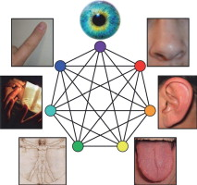
We actually have 8 Senses
Tactile (touch)
Visual
Auditory (hearing)
Olfactory (smell)
Gustatory (taste)
Proprioception
Vestibular
Interoception (visceral sense)
Notes:
When we talk about senses these are the senses referred to.
1-5 exteroceptors – receive information from outside the body
8. Interoception – the sense of the physiological condition of the body. Receive information from inside the body

Slide 6
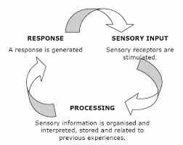
Sensory Processing - What is it? (1)
“the neurological process that organises sensations from one’s own body and from the environment and makes it possible to use the body effectively within the environment.”
Ayres (1972)
Notes:
SI is an evolving theory. More is discovered and more research is continuously published the ways therapists practice will continue developing

Slide 7
Sensory Processing - What is it? (2)
“Our central nervous system (brain) processes all the sensory information we receive and helps us to organise, prioritise and understand the information. We then respond through thoughts, feelings, motor responses (behaviour) or a combination of these…
People who struggle to deal with all this information are likely to become stressed or anxious, and possibly feel physical pain. This can result in challenging behaviour.”
Autism.org.uk

Slide 8

Where did it all start?
Dr. Jean Ayres (1920-1988)
Occupational Therapist and Educational Psychologist
Defined sensory dysfunction and related difficulties
Developed standardised test
Developed an intervention –
Sensory Integration Therapy
Notes:
As an adult she said she reflected back and some of the problems she had as a child were due to organising sensory information.
She did large studies to standardise the sensory integration and praxis test. This is still valued as the gold standard assessment. It is standardised for 4-8 year olds.

Slide 9
Assumptions of SI Theory
Neural plasticity – brain, especially the young brain, is naturally malleable
Sensory integration is a developmental process
The brain functions as an integrated whole
Adaptive interactions are critical to sensory integration
People have an inner drive to develop Sensory Integration through participation in Sensori-motor activities
(Sensory Integration Network – Module 1 course presentation)

Slide 10
Facts & Figures
“Sensory processing difficulties can been seen in isolation or, more frequently, in combination with other diagnoses - including Autistic Spectrum Disorders, Attention Deficit, Learning Disabilities, Developmental Coordination Disorder and Regulatory Disorder.” (SI Network)
Studies with Autistic Spectrum Disorder (ASD) populations estimate the prevalence to be as high as 90% having differences in their processing of sensation (Tomcheck & Dunn, 2007).
Studies by the SPD foundation suggest that more than ¾ of children with ASD have significant symptoms of SPD. (Note: The reverse isn’t true! Children with SPD do not have ASD)
Autism/ASD :
Individuals can experience difficulties integrating senses effectively.
Difficulties processing more than one sense at a time.
If you are interested in research I have lots of articles I can email to you!

Slide 11
Sensory Processing Dysfunction (1)
“For some people, sensory integration does not develop as efficiently as it should. This is known as sensory processing disorder (SPD) or dysfunction in sensory integration (DSI).
DSI and SPD are both ways to describe the difficulty some people's nervous systems have with taking in, integrating and making use of sensory information.
This changes how the person then responds to changes in their own body, the environment and how they interact with it and others around them.

Slide 12
Sensory Processing Dysfunction (2)
Sensory processing difficulties can influence self-regulation, movement, learning and interaction with others (Allen and Smith 2011).
SPD can interfere with skills that support performance, such as engagement and attention, as well as skills that enable the learning of new motor skills (Cosby, 2010; Jasmin, 2009).
Sensory processing difficulties can occur across the lifespan.”
http://www.sensoryintegration.org.uk/about-sensory-processing-disorder

Slide 13
What is SPD video
https://www.youtube.com/watch?v=6O6Cm0WxEZA

Slide 14
Synaesthesia
“Synaesthesia is a rare condition which some people with an ASD experience. A sensory experience goes in through one system and out through another. So a person might hear a sound but experience it as a colour. In other words, they will 'hear' the colour blue.”
Autism.org.uk

Slide 15
Modulation…

Slide 16
Modulation (1)
“Sensory modulation refers specifically to the brain’s ability to respond appropriately to the sensory environment and to remain at the appropriate level of arousal or alertness.”
(http://www.sensationalbrain.com/sensory-modulation-disorder/)
What does a modulated nervous system look like?
Adapts to change in the environment.
A level of arousal and attention appropriate for task.
Blocks out irrelevant information.
Attends to relevant stimuli.
Respond appropriately and in direct proportion to the input.
Murray-Slutsky and Paris, 2000

Slide 17
Arousal Level
Over aroused
Calm alert
Under-aroused
Notes:
All have different arousal levels from the couch potato to the human dynamo
All need to use sensory input to bring ourselves up or down to where we are calm and alert
The size of the calm/alert window is variable. Stress has a huge impact on this refer to abused children, fight/flight mode, moving between under and over rapidly.
We need to spend time in this window to make it bigger.

Slide 18

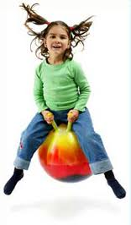


Registration Thresholds
Some people need lots of input to register
Some people need a much smaller amount of input to register
This can vary between our senses
Notes:
Ask for examples
Draw up on flip chart paper the scale under aroused, calm, over aroused etc and discuss registration thresholds.
When messages are familiar they have an INHIBITORY effect.
Refer back to video clip – ask the group - do you think she had a high or low registration threshold?

Slide 19
Response Variation
Under-responsive
Over-responsive
Fluctuating responses – can appear confusing

Slide 20
Shutdown
Mono processing/need to focus on one sense at a time
Avoiding stimuli
Withdrawing
Engaging in rituals to cut out stimuli
‘The sharp sounds and the bright lights were more than enough to overload my senses. My head would feel tight, my stomach would churn and my pulse would run my heart ragged’

Slide 21
http://www.youtube.com/watch?v=IcS2VUoe12M Autism sensory overload simulation

Slide 22
Delayed Processing
‘…it appeared as though I didn’t feel pain or discomfort, didn’t want help, didn’t know what I was saying, didn’t listen or didn’t watch. By the time some of these sensations, responses or comprehensions were decoded and processed for meaning and personal significance, and I’d accessed the means of responding, I was fifteen minutes, one day, a week, a month, even a year away from the context in which the experience happened’
Donna Williams ‘Somebody Somewhere’ Double day
Notes:
Not attending quick enough and making a suitable response.

Slide 23
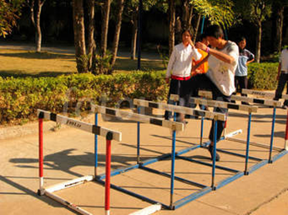
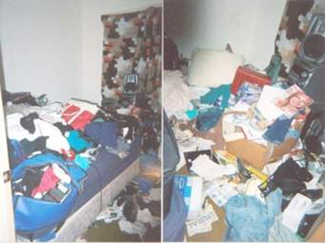
Praxis
Praxis is more than just motor planning!

Slide 24

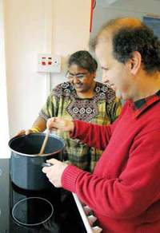
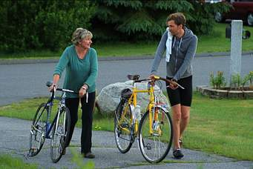
Praxis (1)
There are three components to praxis:
Ideation; coming up with the idea of what to do.
Motor planning; putting the sequence of steps together required for the task.
Execution; the action is performed and adapted to achieve the desired outcome.
Notes:
In addition to these three well-established problems in praxis (Reeves & Cermak, 2002),
deficits in ideation, or the ability to generate ideas for motor actions, have only recently
begun to be examined (May-Benson, 2001).

Slide 25
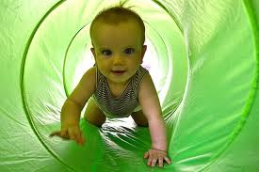
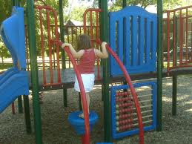
Praxis (2)
Praxis is a learnt skill which a child develops over time through interactions with their environment.
Through rehearsal of actions an individual’s motor planning skills improve.
Dependant on whether the sequence is new or pre-learned, different neural systems are activated in the preparation and generation of the sequence.
(Praxis references: Dewey & Tupper 2004, Ripley 2001, Aquilla et al 2003, Stock & Kranowitz 2005)
Notes:
Praxis can be complex to get your head around.
There’s lots of different types of praxis.

Slide 26
Dyspraxia
Sensory or cognitive?
Top down or bottom up difficulty?
Sensory not assessed in majority of needs assessment reports we receive.
The assessments used focus on cognitive based dyspraxia.
Food for thought…
How do we know if this is actually a sensory processing problem?
Would they benefit from sensory assessment/strategies?
Do they have difficulties with self-regulation?
Do they have difficulties processing tactile, vestibular or proprioceptive information?

Slide 27
Back to Modulation…

Slide 28
Your sensory profile
Remember - There is no ‘good’ or ‘bad’ sensory profile. We all have sensory preferences – this is different to a sensory processing difficulty.
How do you self-regulate?
How might this impact on the way you engage with students?
Think about who you share an office with…
Think about who you live with…
Notes:
Give out sensory profiles for everyone to do.
Talk about how our thresholds/tolerances change e.g. when tired and tv sounds loud.

Slide 29
Sensory Profile Results
Bystanders
Seekers
Avoiders
Sensors
Your sensory patterns can change in different environments

Slide 30
Seekers
Want more sensory input
Daily routines will be packed with sensations
Find ways to make repetitive activities different
Use a lot of body language and gestures
Squeeze errands into an already busy schedule
Try new things
Change morning and night time routines
Winnie Dunn – Living Sensationally – Understanding Your Senses
Notes:
Winnie Dunn – Living Sensationally – Understanding Your Senses

Slide 31
Bystanders
Easy-going about their daily life routines
Will have a basic plan but loosely organised for life management
Leave the house without things you need
Tend to leave items piled around the house
Lose track of time
Like seekers benefit from more sensory input to feel alert and organised – strategies for seekers also work for bystanders
Winnie Dunn – Living Sensationally – Understanding Your Senses

Slide 32
Avoiders
Feel very disrupted by changes in schedule/routine
The idea of encountering unfamiliar sensory experiences can be overwhelming – need to control
Keep the lights low when getting ready in the morning
Plan ahead of time – organised
Leave space for time alone away from others, stimulating environments
Winnie Dunn – Living Sensationally – Understanding Your Senses

Slide 33
Sensors
Very picky because their sensory needs are precise
Particular about daily routines – a little sensory input goes a long way
Shops during off peak hours
Uses unscented cleaning products
When you find clothing that is comfortable buy the item more than once
Find quiet places for conversations rather than distractions
Winnie Dunn – Living Sensationally – Understanding Your Senses
Notes:
Discuss we could do a follow up session, if interested, to learn more about each sensory system specifically and sensory strategies.

Slide 34
Comfort Break

Slide 35
Policies & Legislation

Slide 36
NICE Guidelines (1)
The National Institute for Health and Care Excellence (NICE) provides national guidance and advice to improve health and social care.
https://www.nice.org.uk/about
Autism spectrum disorder in adults: diagnosis and management
NICE guidelines [CG142] Published date: June 2012 (Reviewed July 2016, no updates made)
Autism spectrum disorder in under 19s: recognition, referral and diagnosis
NICE guidelines [CG128] Published date: September 2011 (Next review due in September 2016)

Slide 37
NICE Guidelines (2)
General Principles of Care –
1.1.1 All staff working with adults with autism should:
work in partnership with adults with autism and, where appropriate, with their families, partners and carers
offer support and care respectfully
take time to build a trusting, supportive, empathic and non-judgemental relationship as an essential part of care.
1.1.2 All staff working with adults with autism should have an understanding of the:
nature, development and course of autism
impact on personal, social, educational and occupational functioning
impact of the social and physical environment.
1.1.3 All health and social care professionals providing care and support for adults with autism should have a broad understanding of the:
nature, development and course of autism
impact on personal, social, educational and occupational functioning
impact of and interaction with the social and physical environment
impact on and interaction with other coexisting mental and physical disorders and their management
potential discrepancy between intellectual functioning as measured by IQ and adaptive functioning as reflected, for example, by difficulties in planning and performing activities of daily living including education or employment.

Slide 38
NICE Guidelines (3)
1.1.4 All health and social care professionals providing care and support for adults with autism should:
aim to foster the person's autonomy, promote active participation in decisions about care and support self-management
maintain continuity of individual relationships wherever possible
ensure that comprehensive information about the nature of, and interventions and services for, their difficulties is available in an appropriate language or format (including various visual, verbal and aural, easy-read, and different colour and font formats)
consider whether the person may benefit from access to a trained advocate.
1.1.5 All health and social care professionals providing care and support for adults with autism and their families, partners and carers should:
ensure that they are easily identifiable (for example, by producing or wearing appropriate identification) and approachable
clearly communicate their role and function
address the person using the name and title they prefer
clearly explain any clinical language and check that the person with autism understands what is being said
take into account communication needs, including those arising from a learning disability, sight or hearing problems or language difficulties, and provide communication aids or independent interpreters (someone who does not have a personal relationship with the person with autism) if required.

Slide 39
NICE Guidelines (4)
1.1.6 All health and social care professionals providing care and support for adults with autism and their families, partners and carers should ensure that they are:
familiar with recognised local and national sources (organisations and websites) of information and/or support for people with autism
able to discuss and advise on how to access and engage with these resources.
1.1.7 Encourage adults with autism to participate in self-help or support groups or access one-to-one support, and provide support so that they can attend meetings and engage in the activities.
1.1.8 In all settings, take into account the physical environment in which adults with autism are assessed, supported and cared for, including any factors that may trigger challenging behaviour. If necessary make adjustments or adaptations to the:
amount of personal space given (at least an arm's length)
setting using visual supports (for example, use labels with words or symbols to provide visual cues about expected behaviour)
colour of walls and furnishings (avoid patterns and use low-arousal colours such as cream)
lighting (reduce fluorescent lighting, use blackout curtains or advise use of dark glasses or increase natural light)
noise levels (reduce external sounds or advise use of earplugs or ear defenders). Where it is not possible to adjust or adapt the environment, consider varying the duration or nature of any assessment or intervention (including taking regular breaks) to limit the negative impact of the environment.

Slide 40
NICE Guidelines (5)
1.1.9 All health and social care professionals providing care and support for adults with autism should:
be aware of under-reporting and under-recognition of physical disorders in people with autism
be vigilant for unusual likes and dislikes about food and/or lack of physical activity
offer advice about the beneficial effects of a healthy diet and exercise, taking into account any hyper- and/or hypo-sensory sensitivities; if necessary, support referral to a GP or dietician.
1.1.10 All staff working with adults with autism should be sensitive to issues of sexuality, including asexuality and the need to develop personal and sexual relationships. In particular, be aware that problems in social interaction and communication may lead to the person with autism misunderstanding another person's behaviour or to their possible exploitation by others.
1.1.11 Ensure that adults with autism who have caring responsibilities receive support to access the full range of mental and physical health and social care services, including:
specific information, advice and support to parents about their parenting role, including parent training if needed, by professionals experienced in the care of adults and children with autism
social support, such as childcare, to enable them to attend appointments, groups and therapy sessions, and to access education and employment.

Slide 41
The Autism & Uni Project (1)
3 best practice guides for supporting ASD students:
For managers and policy makers.
For lecturers and tutors.
For professionals supporting autistic students within or outside HE Institutions.

Slide 42
Think Autism
The Think Autism strategy (2014) builds on rather than replaces the themes in Fulfilling and Rewarding Lives (2010).

Slide 43
Relevance to us at Warwick…
Group Discussion:
What can we take from the NICE guidelines and apply here to improve our services?
The autism & Uni project ‘calls to action’ and ‘takeaways’ - How can we use these to improve the services we offer?
What can we take from ‘Think Autism’ and apply here to improve our services?
Notes:
How can we include students with autism in future training?
Do we have sound knowledge of local services in order to signpost correctly and reduce students being passed around services?
Discuss current recommendations for service provision and how this relates to us.
Discuss coventrys Autism strategy

Slide 44
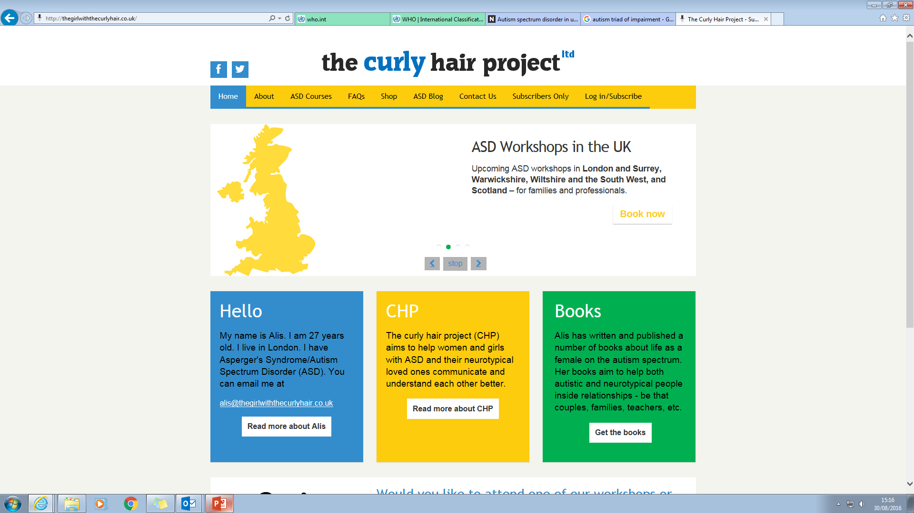
The Curly Hair Project – Supporting Women with ASD

Slide 45


Slide 46
References
Aquilla, P., Sutton, S & Yack, E,. (2003) Building Bridges through Sensory Integration: Therapy for Children with Autism and Other Pervasive Developmental Disorders. Texas: Future Horizons
AYRES. J (1972) Sensory Integration and Learning Disorders. Los Angeles: California: Western Psychological Services.
DEPARTMENT OF HEALTH (2009) The Autism Act. Long title: An Act to make provision about meeting the needs of adults with autistic spectrum conditions; and for connected purposes. Citation 2009 c 15. Introduced by Cheryl Gillan and Baroness Pitkeathley. Parliament of the United Kingdom
DEPARTMENT OF HEALTH (2014) 'Think Autism': an update to the government adult autism strategy.
DEWEY, D., TUPPER, D, E., (2004) Developmental Motor Disorders: A Neuropsychological Perspective. United States of America: Guilford Press.
MURRAY-SLUTSKY, C., PARIS, B. (2000) Is it Sensory or Is it Behaviour? Texas: Hammill Institute on Disabilities
NICE GUIDELINES [CG142] Autism spectrum disorder in adults: diagnosis and management. Published date: June 2012 (Reviewed July 2016, no updates made)
NICE GUIDELINES [CG128] Autism spectrum disorder in under 19s: recognition, referral and diagnosis. Published date: September 2011 (Next review due in September 2016)
RIPLEY (2001) Inclusion for Children with Dyspraxia: A Handbook for Teachers. Great Britain: David Fulton Publishers.
STOCK, C,. KRANOWITZ, M, A,. (2005) The Out of Sync Child: Recognising and coping with sensory processing disorder. New York: Penguin Books Ltd.
TOMCHECK, S,. DUNN, W. (2007) Sensory Processing in Children With and Without Autism: A Comparative Study Using the Short Sensory Profile. American Journal of Occupational Therapy, 61, 190–200.
WILLIAMS, D (1995) ‘Somebody Somewhere’ London: Jessica Kingsley Publishers
The Autism & Uni Project Best Practice Guides. Downloaded from: http://www.autism-uni.org/bestpractice/
Website: http://thegirlwiththecurlyhair.co.uk
Website: www.autism.org.uk
Website, Sensory Integration Network: http://www.sensoryintegration.org.uk/about-sensory-processing-disorder
Website: http://www.sensationalbrain.com/sensory-modulation-disorder/)

