Slide 1
Awareness overview
What is epilepsy?
Types of seizure
Impact of epilepsy on students
Summary

Slide 2
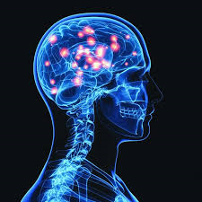
What is epilepsy?
Epilepsy is a neurological condition that means someone is prone to having repeated seizures that originate in the brain
The word repeated is key to this definition as an isolated seizure does not constitute epilepsy.
Epilepsy affects about 50 million people worldwide, including 112,00 young people in the UK.

Slide 3

What causes epilepsy?
Genetic disposition
Head trauma – stroke, blow to the head, head surgery, tumour, meningitis …..
No clear explanation

Slide 4
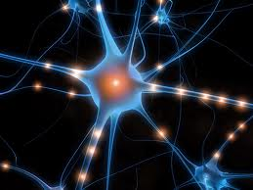
What is a seizure?
A seizure is a sudden excessive burst of electrical activity in the brain which temporarily interferes with the way it works
Effects vary but can result in alterations in a person’s movement, sensation, behaviour and memory and consciousness

Slide 5

What is a seizure?
Seizures usually last from a few seconds to a few minutes and stop without any treatment

Slide 6
What is a seizure?
There are over 40 different types of seizure
Everyone’s epilepsy is unique to them
Some people experience more than one type of seizure
Seizures can be triggered by different stimuli
Seizures can take many forms because the brain is responsible for such a wide range of functions

Slide 7
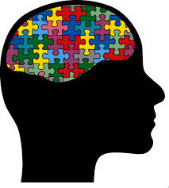
Seizure categories
Seizure types fall into two main categories
Generalised seizures
Focal seizures
A bilateral convulsive seizure is when a focal seizure spreads and becomes a generalised seizure

Slide 8
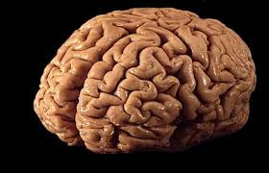
Generalised Seizures
All of the brain is affected by the electrical activity from the start.
The person will become unaware of their surroundings,

Slide 9
Types of generalised seizure
Tonic Clonic
Tonic
Atonic
Myoclonic
Absence

Slide 10
Types of generalised seizures
Tonic Clonic
These occur in two stages – first the ‘tonic’ or stiff phase followed by the ‘clonic’ or jerking phase
The tonic phase usually starts with a cry, loss of consciousness and a stiffening of the muscles that causes the person to go rigid and fall to the ground
During the clonic phase the muscles then relax and tighten rhythmically, causing the body and limbs to jerk
The seizure will generally last between 2 – 4 minutes

Slide 11
Types of generalised seizures
Tonic
During Tonic seizures the loses consciousness and their muscles suddenly stiffen causing them to become rigid. If standing they will fall to the ground
Although these seizures can occur at any time, they often occur at night
Tonic seizures are generally very short – less than 20 seconds

Slide 12
Types of generalised seizures
Atonic
During an atonic seizure the person becomes unconscious and muscle tone is lost causing the person to become floppy.
If standing they will fall heavily to the ground
The seizures are generally very short – less than 20 seconds

Slide 13
Types of generalised seizures
Myoclonic
During myoclonic seizures the person’s muscles briefly jerk as if they have had some sort of electric shock. Any muscle group can be affected but seizures often involve one or both arms, or the head. There is a brief loss of consciousness with each jerk.
These seizures usually occur shortly after waking or before retiring to bed when the person is
Atonic seizures are generally very short – less than 20 seconds

Slide 14
Types of generalised seizures
Absences
Can occur many times a day and may be difficult to spot, frequently being mistaken for daydreaming. Some people may not even be aware that they have had a seizure
Typical absence seizures are usually very brief (5 – 10 seconds) and result in a sudden loss of consciousness. During the seizure the person will usually stop what they are doing, stare blankly and become unaware of their surroundings.
Sometimes it’s difficult enough to follow a lecture without having to cope with missing parts of it.
Atypical absences do not start of finish as abruptly as typical absence seizures and usually last longer (more than 10 seconds). The person may also exhibit additional features such as changes in muscle tone, resulting in a slight nodding of the head, lip smacking and unusual eye or eye lid movements.

Slide 15
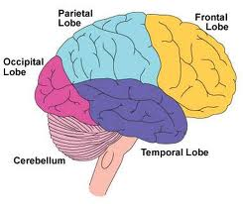
Focal seizures
Only part of the brain is affected by the electrical activity
The symptoms experienced will depend on the area of the brain that is affected
Consciousness may be disturbed or impaired or the person may remain fully alert

Slide 16
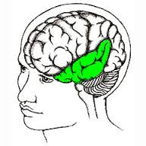
Focal seizure – temporal lobe
Temporal lobe is responsible for speech, language, short term memory, emotions…..
Typically people chew, lip smack and swallow, wander off confused, fumble & pluck at clothes, difficulty with word recall.

Slide 17
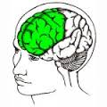
Focal seizure – frontal lobe
Frontal lobe is responsible for movement, emotion, behaviour, personality and executive functions
Seizures vary in nature depending what part of the lobe is involved. They tend to stat and end abruptly and usually occur during sleep.
- head turning
- thrashing and posturing of arms
- cycling movements of the legs
- screaming and crying

Slide 18
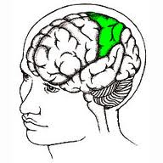
Focal seizure – parietal lobe
Parietal lobe is responsible for sensory information, orientation and visuospatial processing.
Seizures usually result in strange sensations, also known as sensory seizures
- tingling or warmness down one side of the body
- parts of the body feeling numb
- limbs feeling bigger or smaller than normal.

Slide 19
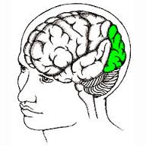
Focal seizure – occipital lobe
The occipital lobe is responsible for processing visual information and recognising shapes and colours.
Seizures occurring in this lobe are rare
- temporary blindness
- rapid eye blinking, seeing patterns or flashing lights
- lethargy, nausea – similar to migraine

Slide 20

Anti epileptic drugs
Antiepileptic drugs work by reducing the excessive electrical activity of the neurons which normally cause a seizure. Common side effects include:
Memory, learning and attention problems
Drowsiness and lethargy
Dizziness
Coordination problems
Double vision
Changes in mood or behaviour
Increase or decrease in appetite

Slide 21

Impacts of epilepsy
Epilepsy can impact a student’s life in many different ways
Educationally
Emotionally
Socially

Slide 22
Educational impacts
The majority of seizures will disrupt a person’s ability to learn
They disrupt ability to concentrate and process and consolidate information
Following a seizure a person may have headaches, tiredness, short term memory loss, muscle weakness and will need time to recover
Seizures during sleep disrupt sleep patterns and interfere with the brain’s ability to process and consolidate memories.
Imagine trying to revise, research or prepare for seminars when you are tired, lacking in concentration and forgetful

Slide 23

‘The most important help I gained …… was the ability to get extra time in an exam. Being nervous/stressed is a well-known cause of seizures, and for me they have always had a tendency to strike at the worst times – when on stage, doing a presentation, in exams, etc. Therefore to be able to put my head down and sleep after having one in a test, and be granted extra time to compensate, was incredible.‘
Maria, Recent graduate

Slide 24
‘One English exam required me to write two essays. I had just finished the first one when I had a complex partial seizure. I was given half an hour to recover but I was still in a terrible state and afterwards I could barely remember what I had written. Terrified, I contacted the relevant lecturer and asked her to base my overall marks on the first half of my exam. She kindly agreed and the relief was huge!’

Slide 25
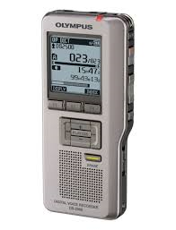

‘I had a digital voice record which I could turn on when I felt a seizure coming on in a lecture, and it would record the rest of the class so that I could listen to the recoding later and catch up’.
‘when I had been in hospital or ill for a while they offered me an extension on due dates for essays’

Slide 26
Educational impacts
Prodrome
Some people with epilepsy may experience abnormal electrical activity in the brain prior to a seizure – a prodrome
Prodromes can affect mood and behaviour – they may seem irritable, quiet or just not quite themselves
This can occur hours or days prior to a seizure and therefore may impact a student’s ability to concentrate and learn

Slide 27
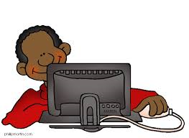
Educational impacts
Photosensitivity
Although rare, 5% of people with epilepsy have photosensitive epilepsy.
Computer monitors, whiteboards etc. are unlikely to trigger seizures although flashing images on them may do.
Important for teaching staff to be aware of triggers and avoid using flashing images or warn students in advance.

Slide 28

Educational impacts
Longer term effects
Seizures may cause longer term problems with memory, processing and concentration. This makes it more difficult to recall information during revision and exams.
Medication effects – drowsiness, lethargy, slower processing information, attention and memory difficulties. Can be mistaken for behavioural issues or disinterest.

Slide 29
In summary ……..
Epilepsy is a hidden disability that affects 1 in 100 people
Epilepsy manifests itself in many different ways and affects people differently
A student’s academic life can be impacted by epilepsy and by making staff and fellow students aware of their epilepsy they are likely to have a much better experience
Adjustments include extra time for exams and course work, recording of lectures, note takers, adjustments to accommodation but above all it’s about understanding and empathy.

