Slide 1
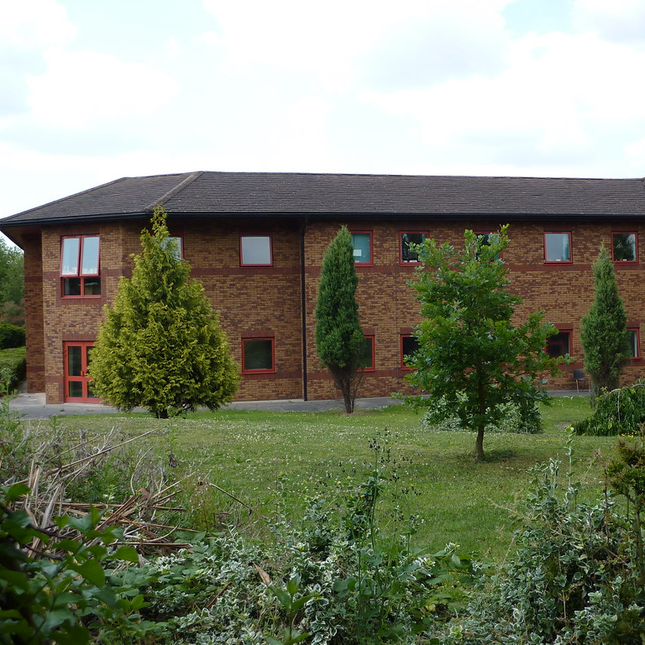

Mental Health - Local Services
Coventry and Warwickshire

Slide 2
Accessing Mental Health Support: Understanding the local services
Provisions across the UK can vary slightly in terms of names of teams, terminology used and referral criteria. However, they usually follow a similar pathway.
If this is your first time in the UK, you may find that the health care system you have used at home differs significantly. Below is a short summary of Mental Health Services within the Coventry and Warwickshire area.

Slide 3
GP – General Practitioner
You may be registered at the Campus Surgery or a GP close to your current accommodation. You can access your GP by calling first thing in the day for an appointment. A lot of GP surgeries also use online consultations which can be accessed via the NHS App or a surgery specific app, such as Patient Access which Warwick Health Centre uses.
Your GP is your key point of contact and can oversee and coordinate your health care. Your GP can refer you to specialists and for urgent care. Your local GP will have access to your health records within the NHS.
If you choose to access private health care or treatment, it’s useful for you to keep your GP updated on this, especially if you are prescribed medications or treatment.

Slide 4
IAPT –
Improving Access to Psychological Therapies
Access to this service is via your GP or online self-referral. IAPT is for people with mild and moderate stress, low mood, anxiety, OCD, panic, phobias or who may be dealing with difficult life events or long term health conditions.
They offer guided self-help, CBT (cognitive behavioural therapy) and counselling. You will be offered an initial appointment and then may be placed on a waiting list for support. https://www.covwarkpt.nhs.uk/service-detail/health-service/improving-access-to-psychological-therapy-iapt-93/

Slide 5
Local Mental Health Teams
Local services comprise of assessment teams, crisis teams, longer term community mental health teams and specialist services such as Early Intervention and Eating Disorders. Access to local teams is via your GP, Mental Health Nurses within Wellbeing support or via self-referral to single point of access.
The single point of access takes all local referrals for mental health and will offer an initial assessment of your needs and book an onward appointment for you if required https://www.covwarkpt.nhs.uk/service-detail/health-service/central-booking-service-cbs-12/

Slide 6
Other Mental health provision
The local area has a number of voluntary and third sector provision to aid your mental health and wellbeing. Such as MIND (national MH Charity), Change Grow Live (Coventry Drug and alcohol service) and such resources as the Recovery and Wellbeing Academy - this offers courses and workshops to equip you with skills and knowledge to better manage your mental health and wellbeing.

Slide 7
Apps and Online Support
Numerous apps now exist to aid you in managing your daily activities, sleep, anxiety, mood and self-harm thoughts. NHS approved apps can be found on the NHS website. Wellbeing support has information about support apps and helplines within its’ emergency support numbers. It’s also a good starting point to sign up to Togetherall which you can access via your Warwick email account.
Wellbeing Support can advise and assist in you either accessing support from within the university’s own Wellbeing Services or from local Mental Health Services - The important thing is to reach out if you need to.

