Slide 1
Athens Honours Oiniades
IG I² 118 (Fornara #160; Meiggs & Lewis #90)

Slide 2
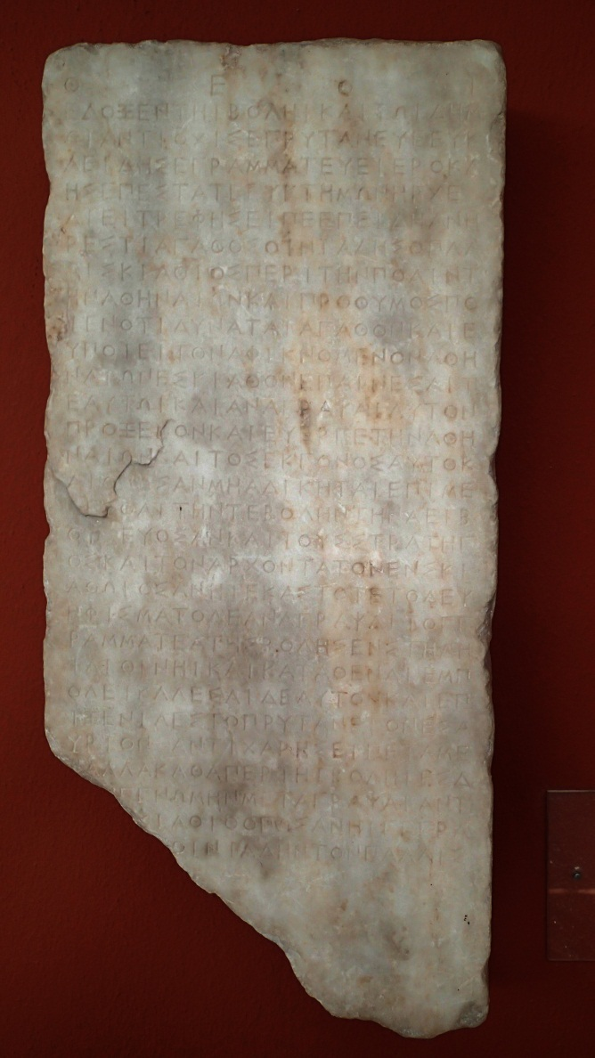
Athens Honours Oiniades
Dated to 408/7 B.C.
Inscribed on marble stele
One of the most complete fifth-century inscriptions we have (Woodhead)
Ionic lettering
Stoichedon

Slide 3
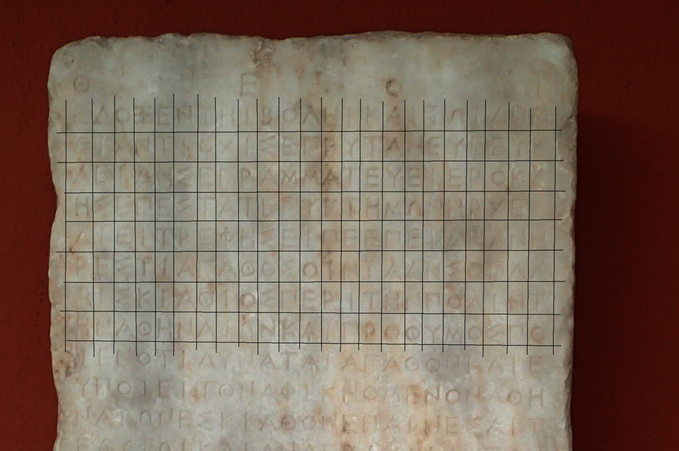
Stoichedon

Slide 4
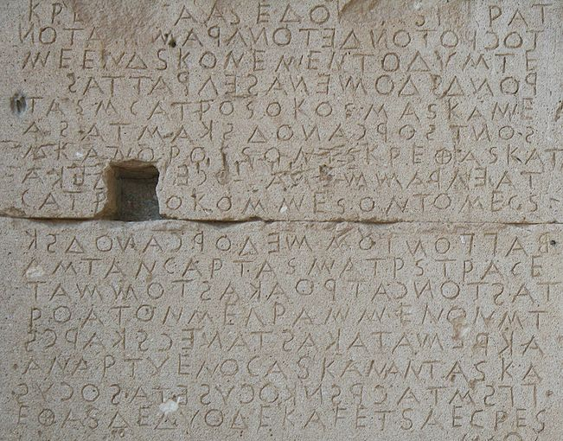
Not Stoichedon (Gortyn Law Code, Crete, 5th century/ Boustrophedon)

Slide 5
Athens Honours Oiniades: Text
Gods. | Resolved by the Boule and the Peop|le, Antiochis held the prytany, Euk|leides was Secretary, Hierokl||es presided, Euktemon was Archon (408/7). | Dieitrephes made the motion: Since | he is a good man, Oiniades of Pal|aiskiathos, to the city | of the Athenians, and zealous to d||o whatever good he can, and is of b|enefit to (any) Athenian who comes | to Skiathos, commendation shall be given | him and he shall be recorded | as proxenos and benefactor of the Athe||nians, and his descendants (as well); a|nd that he be not harmed shall be the | responsibility both of the Boule, whichever i|s in office, and of the gener|als and the (Athenian) governor in Ski||athos, whoever he may be on each occasion. This d|ecree shall be inscribed by the S|ecretary of the Boule on a stel|e of marble and shall be set up on the A|kropolis. He shall also be invited fo||r hospitality to the Prytaneion for t|omorrow. Antichares made the motion: Let all the | rest (be) as (resolved) by the Boule, but | there shall be an alteration made in the resolution in plac|e of ‘of Skiathos’, so that there be wri||tten ‘Oiniades of Palais|[kiathos’].

Slide 6
Athens Honours Oiniades: Text
Gods. | Resolved by the Boule and the Peop|le, Antiochis held the prytany, Euk|leides was Secretary, Hierokl||es presided, Euktemon was Archon (408/7). | Dieitrephes made the motion: Since | he is a good man, Oiniades of Pal|aiskiathos, to the city | of the Athenians, and zealous to d||o whatever good he can, and is of b|enefit to (any) Athenian who comes | to Skiathos, commendation shall be given | him and he shall be recorded | as proxenos and benefactor of the Athe||nians, and his descendants (as well); a|nd that he be not harmed shall be the | responsibility both of the Boule, whichever i|s in office, and of the gener|als and the (Athenian) governor in Ski||athos, whoever he may be on each occasion. This d|ecree shall be inscribed by the S|ecretary of the Boule on a stel|e of marble and shall be set up on the A|kropolis. He shall also be invited fo||r hospitality to the Prytaneion for t|omorrow. Antichares made the motion: Let all the | rest (be) as (resolved) by the Boule, but | there shall be an alteration made in the resolution in plac|e of ‘of Skiathos’, so that there be wri||tten ‘Oiniades of Palais|[kiathos’].

Slide 7
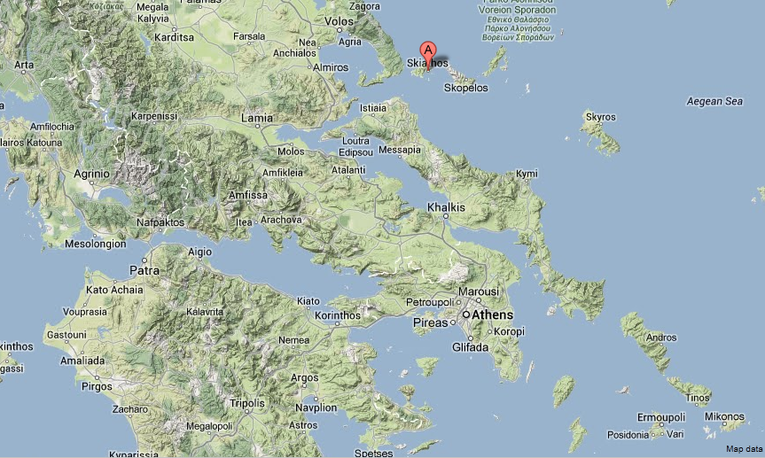
Island of Skiathos

Slide 8
IG I² 118
Fornara 160
Meiggs & Lewis 90

Slide 9
Athenian Democracy in Action (1)
Resolved by the Boule and the People.
ἔδοξεν τῆι βολῆι καὶ τῶι δήμωι.
A resolution passed by the Council (Boule) in conjunction with the People (Assembly).
Members of the Assembly presumably would have had opportunity to object if they wanted to.

Slide 10
Athenian Democracy in Action (2)
Antiochis held the prytany.
Ἀντιοχὶς ἐπρυτάνευε.
Mention of the executive branch – was he present? Or is this just a dating/accounting method?
Was Antiochis at the time of this proposal charged with looking after the keys and seals of the city (Epistates)?

Slide 11
Athenian Democracy in Action (3)
Eukleides was Secretary .
Εὐκλεὶδης ἐγραμμάτευε.
The proposal recorded by a secretary for future record and accountability.

Slide 12
Athenian Democracy in Action (4)
Hierokles presided.
Ἱεροκλῆς ἐπεστάτε.
The discussion of the proposal was chaired by an individual delegated with the task.

Slide 13
Athenian Democracy in Action (5)
Euktemon was Archon.
Εὐκτήμων ἦρχε.
The archon is cited – did he have to be present?

Slide 14
Athenian Democracy in Action
Dieitrephes made the motion.
Διειτρέφης εἶπε.
The proposal is put forward by a citizen in the Assembly.

Slide 15
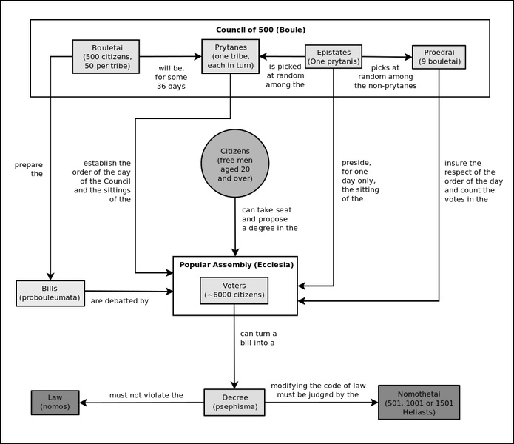
Athenian Democracy in Action

Slide 16
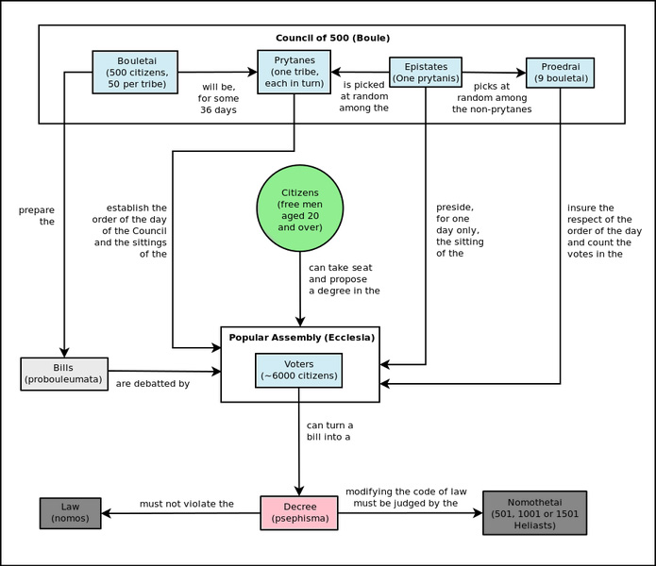
Athenian Democracy in Action

Slide 17
IG I² 118
Fornara 160
Meiggs & Lewis 90

Slide 18
Athens Honours Oiniades: Amendment
Gods. | Resolved by the Boule and the Peop|le, Antiochis held the prytany, Euk|leides was Secretary, Hierokl||es presided, Euktemon was Archon (408/7). | Dieitrephes made the motion: Since | he is a good man, Oiniades of Pal|aiskiathos, to the city | of the Athenians, and zealous to d||o whatever good he can, and is of b|enefit to (any) Athenian who comes | to Skiathos, commendation shall be given | him and he shall be recorded | as proxenos and benefactor of the Athe||nians, and his descendants (as well); a|nd that he be not harmed shall be the | responsibility both of the Boule, whichever i|s in office, and of the gener|als and the (Athenian) governor in Ski||athos, whoever he may be on each occasion. This d|ecree shall be inscribed by the S|ecretary of the Boule on a stel|e of marble and shall be set up on the A|kropolis. He shall also be invited fo||r hospitality to the Prytaneion for t|omorrow. Antichares made the motion: Let all the | rest (be) as (resolved) by the Boule, but | there shall be an alteration made in the resolution in plac|e of ‘of Skiathos’, so that there be wri||tten ‘Oiniades of Palais|[kiathos’].

Slide 19
Athens Honours Oiniades: Amendment
Gods. | Resolved by the Boule and the Peop|le, Antiochis held the prytany, Euk|leides was Secretary, Hierokl||es presided, Euktemon was Archon (408/7). | Dieitrephes made the motion: Since | he is a good man, Oiniades of Pal|aiskiathos, to the city | of the Athenians, and zealous to d||o whatever good he can, and is of b|enefit to (any) Athenian who comes | to Skiathos, commendation shall be given | him and he shall be recorded | as proxenos and benefactor of the Athe||nians, and his descendants (as well); a|nd that he be not harmed shall be the | responsibility both of the Boule, whichever i|s in office, and of the gener|als and the (Athenian) governor in Ski||athos, whoever he may be on each occasion. This d|ecree shall be inscribed by the S|ecretary of the Boule on a stel|e of marble and shall be set up on the A|kropolis. He shall also be invited fo||r hospitality to the Prytaneion for t|omorrow. Antichares made the motion: Let all the | rest (be) as (resolved) by the Boule, but | there shall be an alteration made in the resolution in plac|e of ‘of Skiathos’, so that there be wri||tten ‘Oiniades of Palais|[kiathos’].

Slide 20
Athens Honours Oiniades: Amendment
What was the timeframe between the original decree being inscribed, and the amendment?
Would there have been a copy of this inscription at Skiathos?
Is the ‘democratic’ formula of this decree significant, given it was inscribed post-411?

