Slide 1
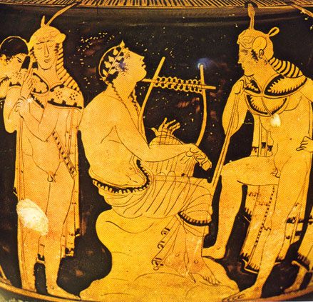
Orphism and Democracy
The figure of Orpheus.
What Orphism is and what an Orphic life entails.
Who the Orphics are.
What does this show us about democracy? What is their role in democracy?

Slide 2
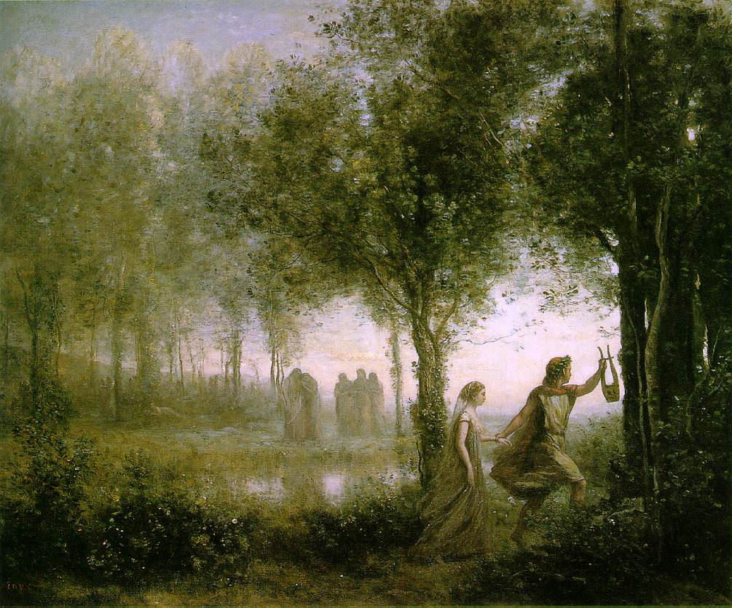
Who is Orpheus?
‘When one goes as a stranger into strange cities... To persuade one... To join one’s own circle... Disguise it in a decent dress, sometimes of poetry...mystic rites and soothsaying, as did Orpheus.’
Plato Protagoras 316c-d

Slide 3
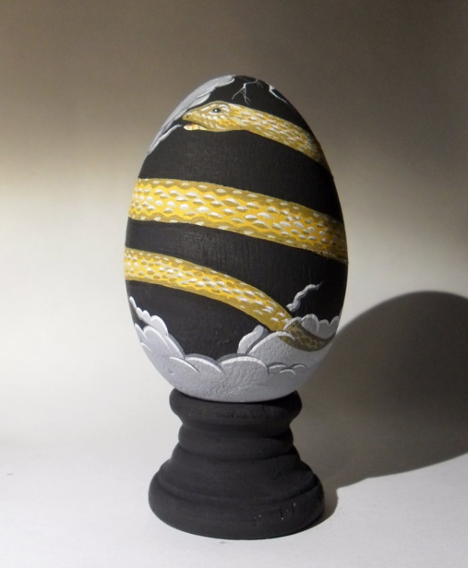
What is Orphism?
‘the soul is immortal and imperishable’ Plato Phaedo 107a
‘I flew out from the hard and deeply-grievous circle...and slipped into the bosom of the Mistress, the Queen of the Underworld... [who said] You shall be a god instead of a mortal’. Gold Plate from Thurii 4th-3rd century BC.
‘Since the souls of men in circles of times goes in turn among animals, now this one and now that. At one time a horse, then it becomes... Again a sheep’ Orphic Fragment 224 from Proclus.

Slide 4
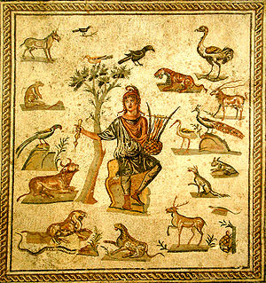
An ‘Orphic Life’
‘We hear of...the custom... when they were forbidden so much as to eat an ox, and their offerings to the gods consisted, of...bloodless sacrifices, and from flesh they abstained as though it were unholy to eat it or to stain with blood the altars of the gods; instead of that, those of us men who then existed lived what is called an “Orphic life,” keeping wholly to inanimate food and, contrariwise, abstaining wholly from things animate.’ Plato Laws 782c
‘For Orpheus taught us rites and to refrain from killing’ Aristophanes Frogs 1030ish
‘Take up a diet of greens and...make Orpheus your lord and engage in mystic rites’ Euripides Hippolytus 952-4
‘Their altar was not drenched by the unspeakable slaughter of bulls’ Empedocles Purification

Slide 5
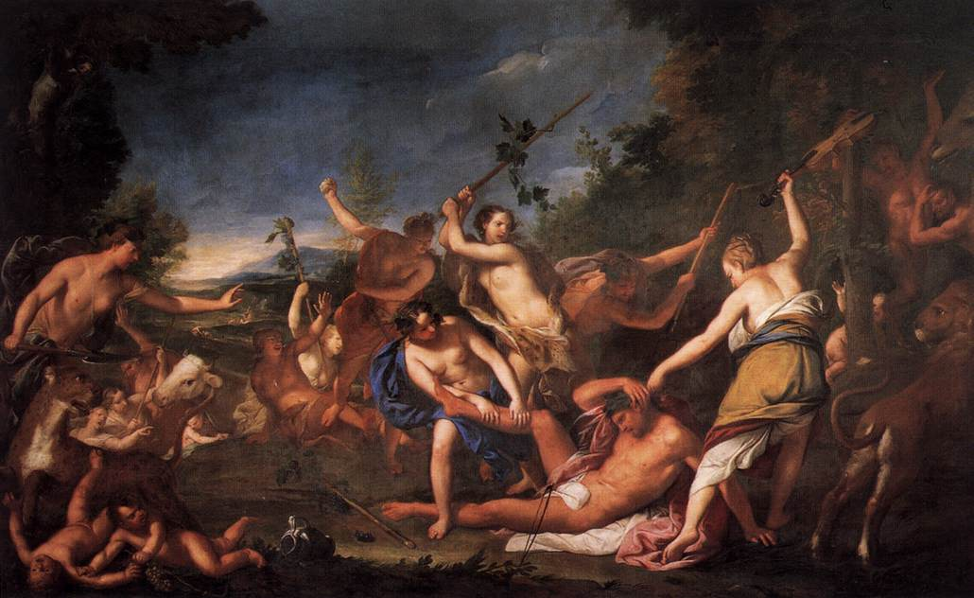
Who were the Orphics?
‘[Onomacritus was] Banished from Athens by Hipparchus...caught... In the act of interpolating into the writings of Musaeus [son of Orpheus] an oracle showing the islands off Lemnos would disappear into the sea’. Herodotus 7.4
‘For the doctrines are his (Orpheus’) but they say Onomacritus put them into verse’ Philoponos Commentary on Aristotle’s De Anima 186.24
‘Because he regulated the mysterious devoutly, and worthily of Dionysos Kathegemon’ Inscription from Pergamon, 3rd-2nd century.
‘No one may be buried here who has not been made Bakhos’. Inscription from Cumae.

Slide 6
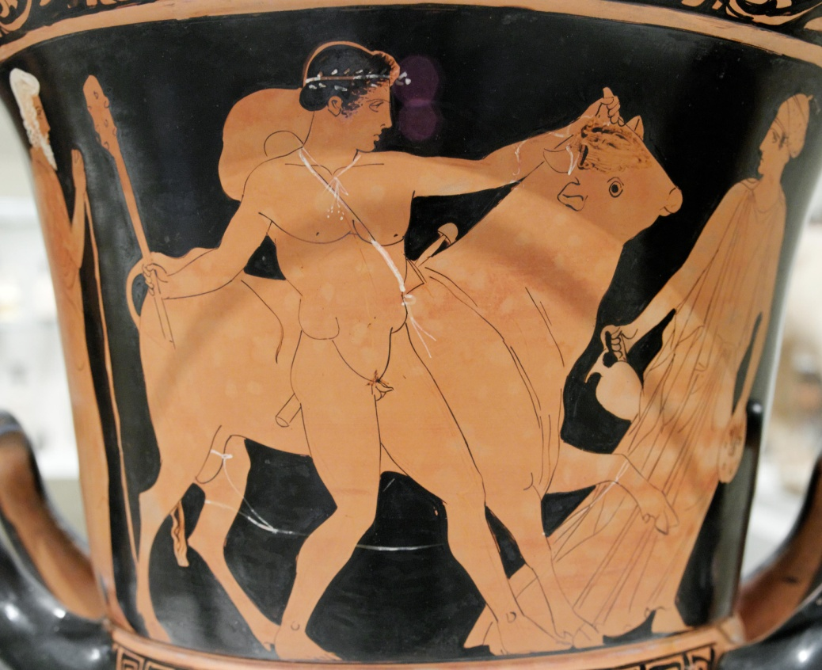
Orphism vs. Greek religion
‘For Athena Nike a priestess who from all the Athenian women shall be appointed’ Fornara 93.
‘Move on up, move on, move on, to get within the consecrated area.’ Aristophanes Acharnians 43
‘Meat distributed in strict order: 5 portions to the Prytaneis...’ IG II2 334

Slide 7
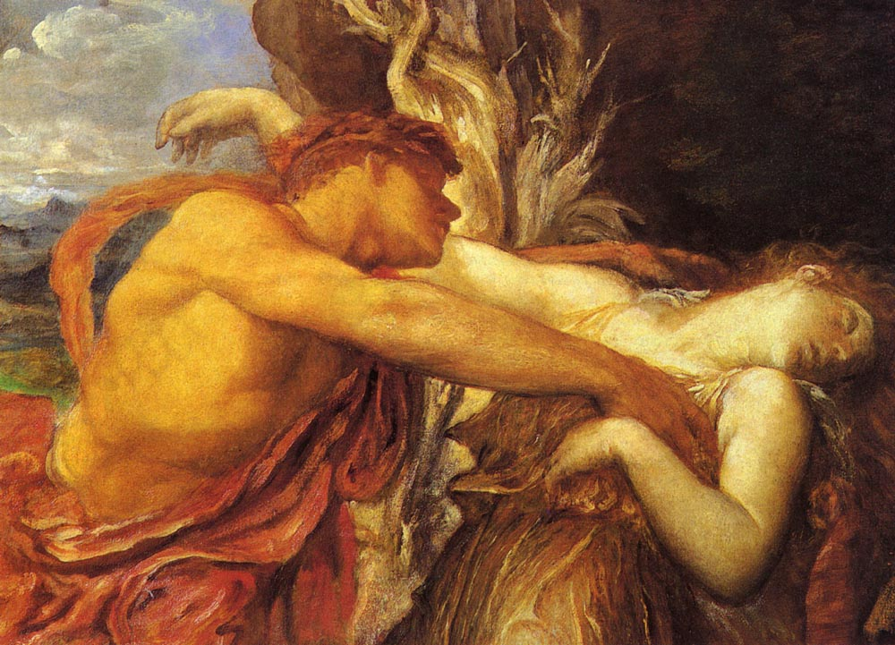
What does this mean?
An organised religion.
Afterlife
Orphic communities?
Disengaged with public cult
Disengaged with political life?
One of many alternative communities?

