Slide 1
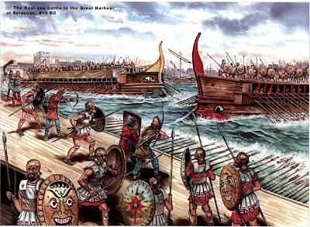
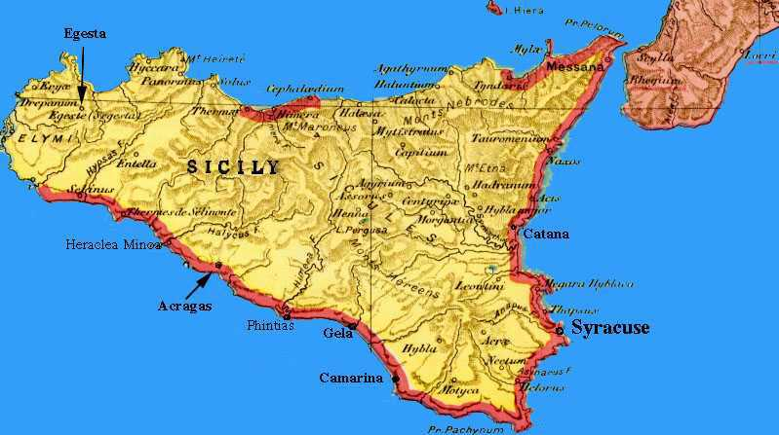
THE SICILIAN EXPEDITION

Slide 2
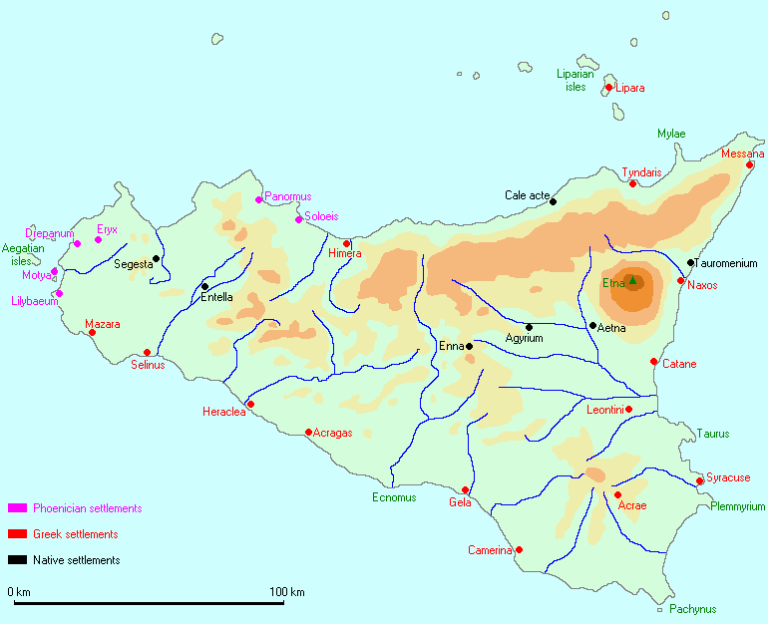
BACKGROUND
423 BC- Peace of Nicias with Sparta established
Athens was still trying to further its empire
Sicily and Greek colonies in Italy divided already by Peloponnesian war
Syracuse supports Sparta
Rhegium and Segasta side with Athens

Slide 3
SEGASTA ASKS FOR HELP
415 BC- Segasta was a long standing enemy of Silenus and Syracus
Sends delegation to Athens to encourage the Athenians to intervene
Offers 60 talents to Athens in payment
Athenians fear Syracuse growing too powerful and siding with Sparta
Sicily is a rich land with plentiful grain
With affairs in Greece relatively peaceful, Athens debates an expedition

Slide 4
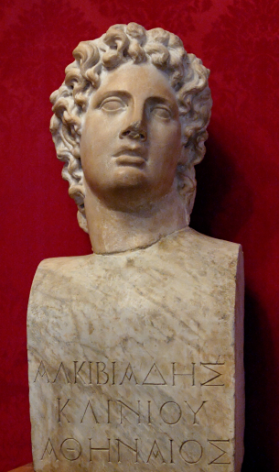
THE DEBATE
Older general Nicias opposes an invasion
Alcibiades is the main supporter
Nicias argues that Sicily is too large and hostile for Athens to fight effectively with the planned force
The assembly agrees, but decides to send a larger army instead of cancelling the invasion
Athens begins to prepare for war and orders her subjects to do the same

Slide 5
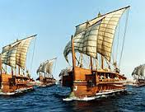
THE EXPEDITION SETS OFF
Alcibiades, Lamachus and Nicias are elected to lead the invasion force
Thucydides reports a fleet of 100 Athenian ships, 50 from Chios and Lesbos and more from other allies
4000 Athenian hoplites and 300 cavalry
Syracusans are sceptical about Athenian threat but make preparations anyway

Slide 6
EARLY PROBLEMS
The Western Greek cities prove unresponsive to Athens’s appeals for help on the voyage
Segasta lied about the amount of silver it could pay
The three commanders disagree on how to conduct the campaign from the start, with Nicias still insisting that the expedition was a bad idea
Alcibiades’s plan for aggressive diplomacy is ultimately chosen
Things are further complicated when Alcibiades is recalled to Athens to be put on trial by his political enemies

Slide 7
A VICTORY FOR ATHENS
With Alcibiades gone, Nicias and Lamachus decide to confront Syracuse in open battle
The Athenians win the battle but cannot destroy the Syracusan army outright
Winter prevents any more campaigning and the Athenians prepares for a siege
Athens sends more ships, cavalry and money
Syracuse takes stock and appeals to Sicilian cities and mainland Greece for help, Sparta sends the general Glyippus with a token force

Slide 8
NEMESIS
Athens wins a string of minor victories in 414 but is unable to take the city
Nicias falls ill and Lamachus is mortally wounded in battle
Gylippus gather allies against Athenians and comes to the aid of the besieged Syracusans
The Athenian triremes fall into disrepair and the army grows increasingly tired of campaigning
Plutarch asks ‘was it Nemesis who halted the Athenians on their march to the pinnacle of power and greatness?’

Slide 9
413 BC
Another winter passes with no decisive victories
Nicias, still ill, writes to Athens urging them to call off the expedition
The assembly responds by sending more reinforcements and two new commanders, Eurymedon and Demosthenes
The new soldiers and ships do not turn the tide of battle and the emboldened Sicilians challenge Athens on land and at sea
The Athenians ultimately decided to retreat rather than suffer a total defeat

Slide 10
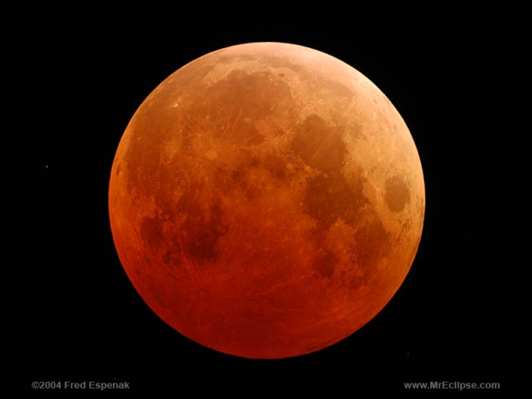
THE END
A lunar eclipse was interpreted as sign for the Athenians to stay in Sicily for another 27 days
Decisive battle in Syracuse’s harbour results in Athens’s fleet being utterly destroyed
Demoralised Athenian army attempts to flee on foot
Army disintegrates under pursuit from Syracusan army
Entire expedition was killed or captured, with Demosthenes and Nicias among the captives

Slide 11
AFTERMATH
7000 taken prisoner and forced to work in Sicilian stone quarries, practically a death sentence
Nicias and Demosthenes die in Syrcause
Entire generation of Athenian men lost, along with hundreds of ships
Athens’s morale and reputation are damaged irreparably
Sicilian Greeks unite to fight Carthaginian invasion
War with Sparta resumes shortly afterwards and a beleaguered Athens manages to fight on until 404 BC

