Slide 1
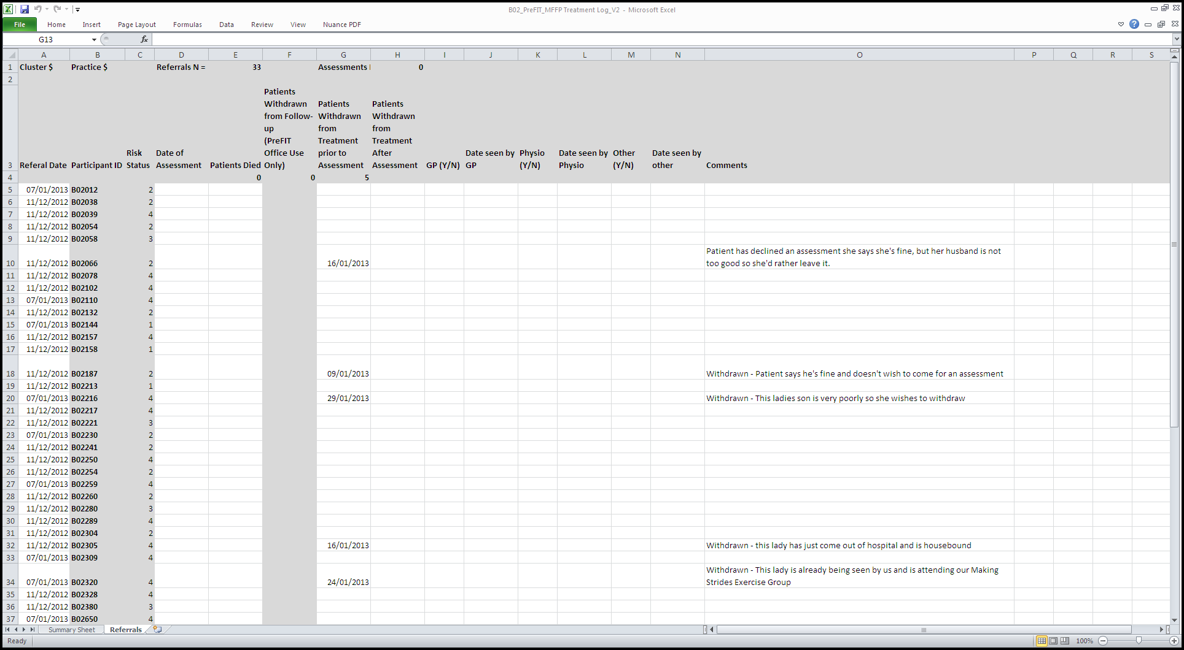
Will indicate if the participant has been referred have referred on
Date the MFFP team assess the patient
Add any additional comments
Date you assessed the participant
Participant ID
Patient has withdrawn before MFFP assessment
Risk Status

