Slide 1
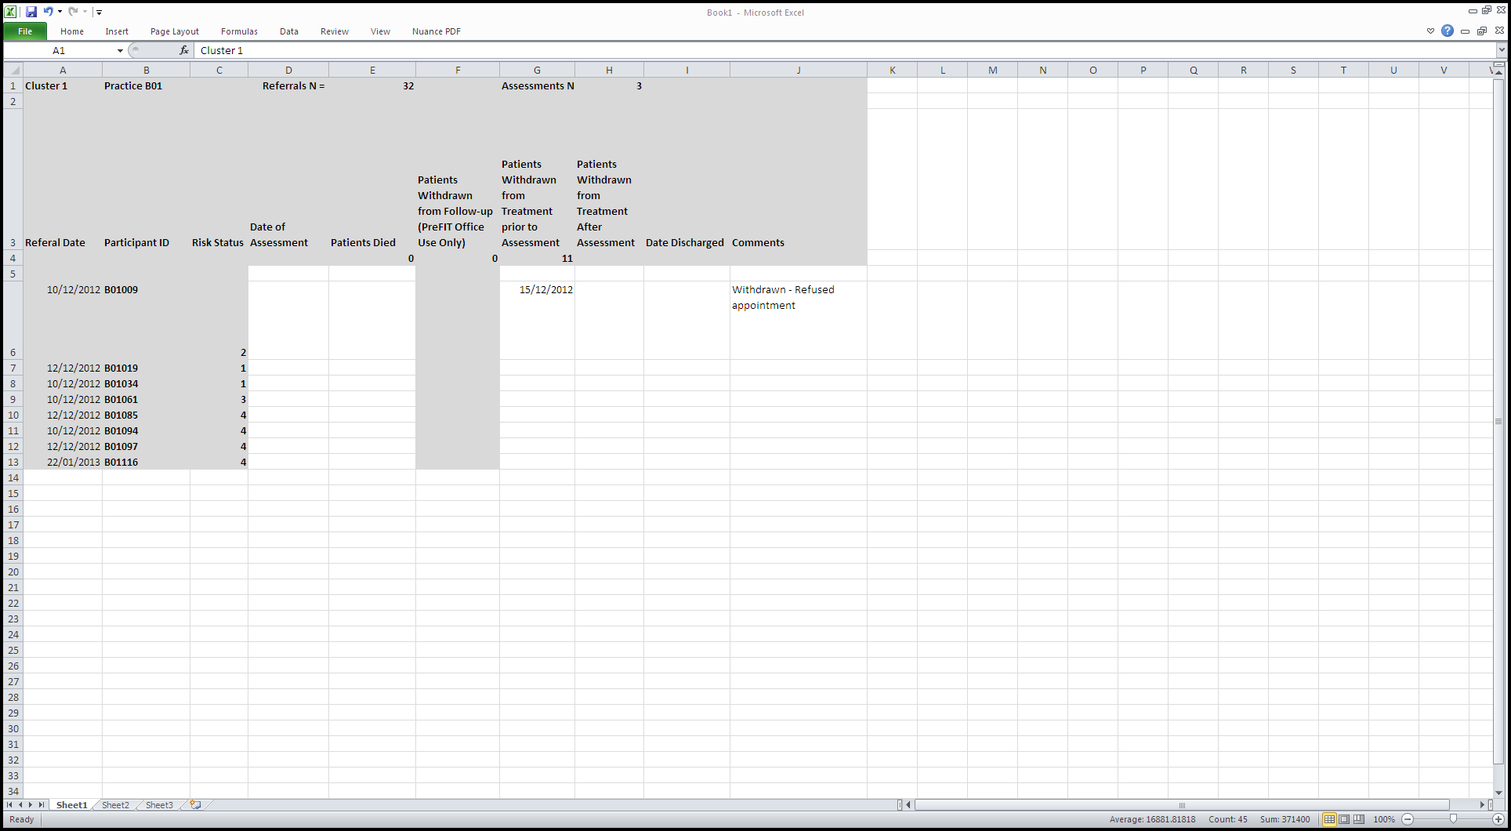
Date you assess the participant
Any additional comments
Participant has withdrawn before assessment
Risk status
Participant ID

