Slide 1
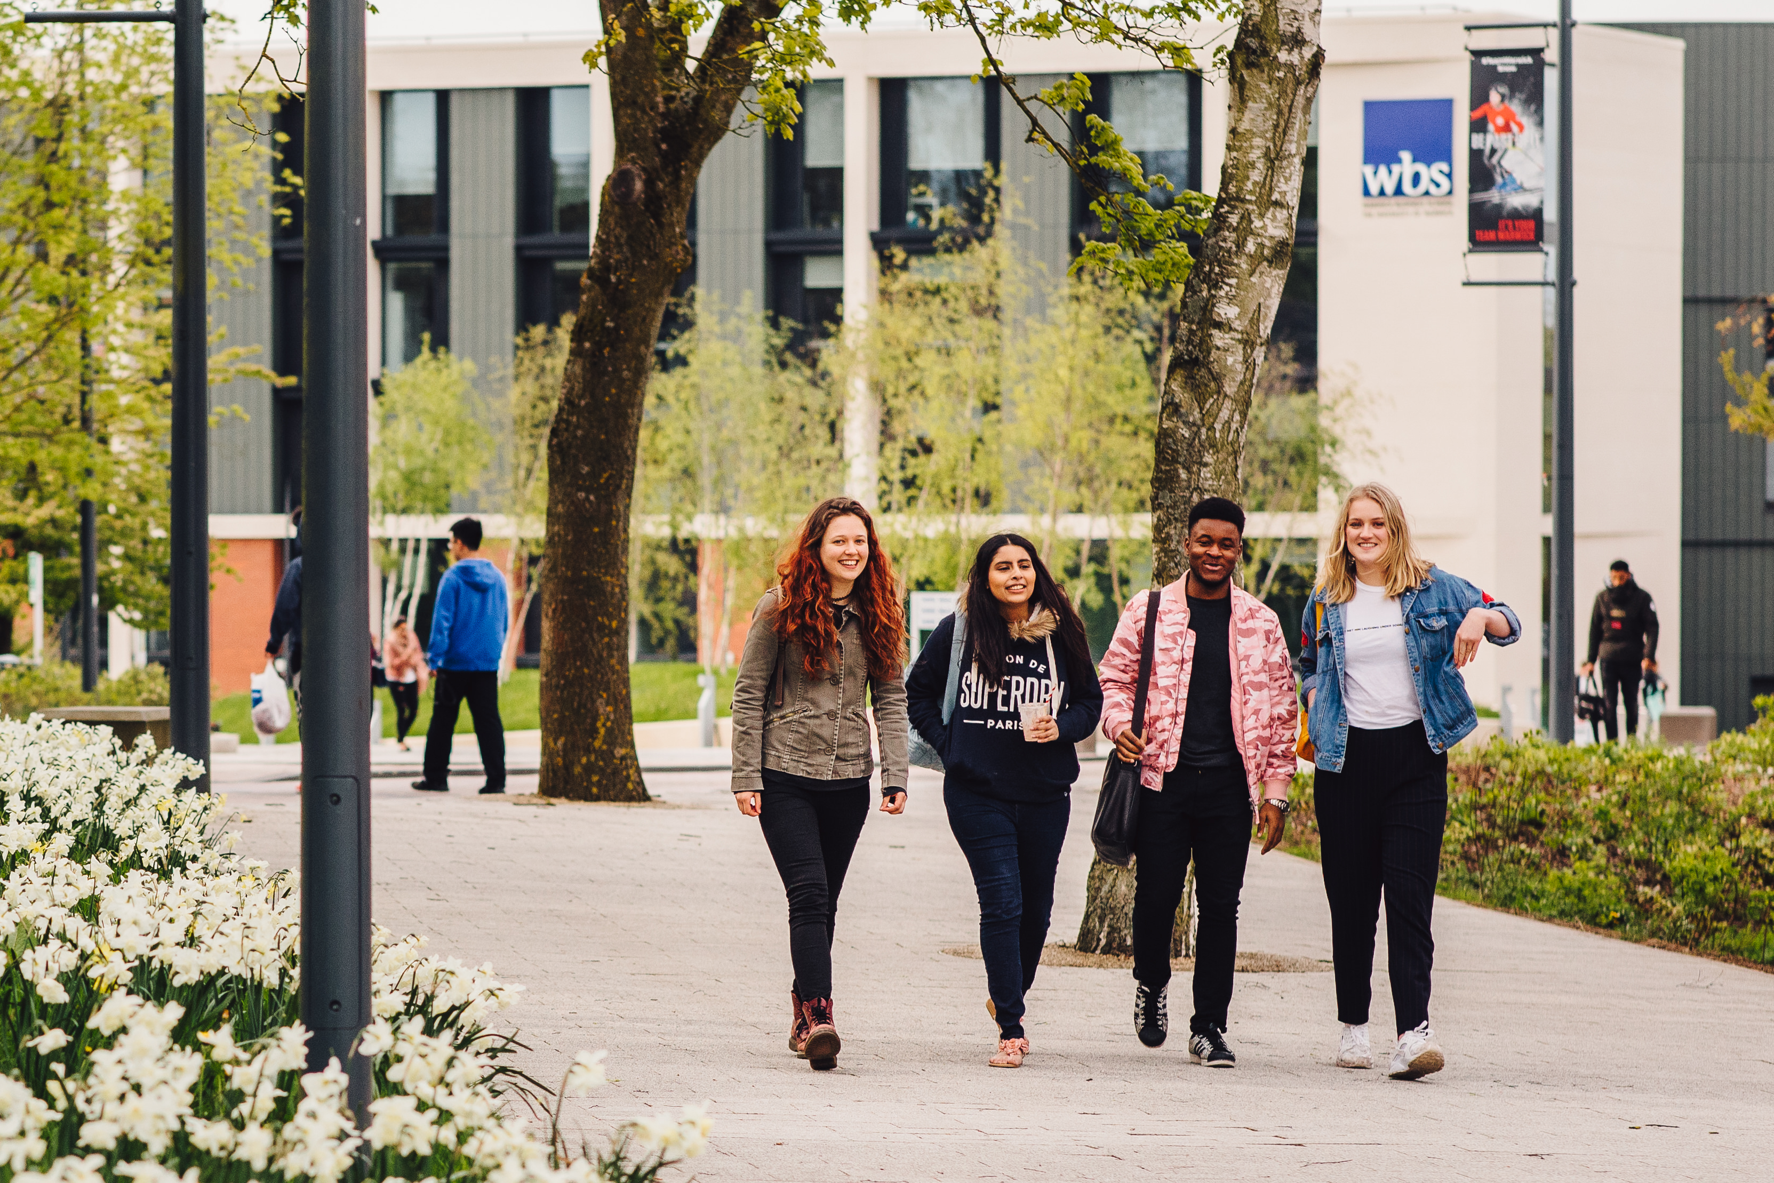

Student Surveys
in 2018-19
Staff Briefing
October 2018

Slide 2
Surveys at Warwick
“We will rationalise and steer the use of student surveys to focus on the enhancement of the student experience”
IMPROVING HOW WE RUN CORE SURVEYS
REDUCING SURVEY FATIGUE
RAISING AWARENESS OF EXISTING DATA
TAKING A JOINED-UP APPROACH
ACTION AND IMPACT FOCUSED
Education Strategy, 3.2.2 Student Surveys Strategy
Notes:
Surveys form an important strand of how we engage students to assure and enhance their experience
They are used frequently at Warwick but are not always used well;
Students are like anybody else – they suffer survey fatigue when they are asked to complete too many or where they can’t see the impact;
Major review in 2016-17 to understand current practices and recommend principles to underpin our approach – agreed by SLEEC and Education Committee in autumn term 2017-18.
SLEEC established the Surveys Strategy Steering Group as a sub-group in early 2018, which is initially focused on:
Improving how we run a core group of major surveys (from design, to response rate %, to how we use the data to enhance student learning);
Being more selective in the other surveys we run, supporting departments to draw on existing data or alternative forms of engagement;
Building buy-in and engagement from academic and professional services departments so that we take a joined-up approach.
This is alongside work to more effectively draw on survey results in ongoing quality assurance and enhancement work

Slide 3

At Warwick, we all contribute to the conversation. In a world of brilliant minds, cultures and ambitions, that conversation helps us learn a lot from each other – an ongoing discussion between student and student, student and academic, and student and University administration.
It’s why we need students to have a say in how things are done at Warwick: it’s the best way for us to move things forward here. It’s your worldview, and your experiences, that will improve how we operate.
Notes:
Successes so far:
Established a ‘dialogue pillar’ of the Student Communications Strategy which sets a tone for our relationship with students
Established the Surveys Group as a filter and approval point (with several requests not approved)
National Student Survey campaign launched the first campaign within this framework, and the PTES campaign continued this
Rallied the University’s marketing resources resources and senior staff behand PTES more so than before (39% response rate)
Evolved the way survey results data is analysed, disseminated and reported for NSS

Slide 4




Major surveys in 2018-19
13%
78%
45%
39%
40%
75%
50%
45%
Fnd, UG & PGT, on-campus
UG finalists
PGR
PGT
5th Nov – 7th Dec
4th Feb – 31st Apr
1st Apr – 17th May
24th Apr – 17 June
Notes:
These are the ‘major’ surveys running this academic year. Others are running alongside these too, but only where they don’t detract from these four, and they will typically be promoted centrally.
Response rate from the last time the survey was run (2017 for SB, NSS and PTES; 2016 for PRES) above.
Target response rate for this year in bold below.
Open and close dates detailed below in the purple bar.
The next slide introduces the name change on the Barometer. The use of the logo here is intentional.

Slide 5
Student Barometer
Warwick Student Experience Survey
Scope
Arrival experience (e.g. finance, meeting staff, registration, opening bank account);
Learning experience (e.g. teaching, lecturers, assessment & feedback, library);
Living experience (e.g. accommodation, sports, safety, transport, living cost);
Support experience (e.g. accommodation, catering, Health Centre, SU, Careers);
Overall satisfaction;
Propensity to recommend Warwick to others thinking of applying here.

Slide 6
Warwick Student Experience Survey
Eligible students
Value added from the survey
Foundation
Undergraduate
Postgraduate Taught
Not including:
Postgraduate Research
Distance Learners
Awards <60 credits
Studying via partners
Studying in London
Rich insight into the wider student experience
Timely evaluation of arrivals and welcome
The only survey across levels and cohorts
Benchmarking to RG, nationally and globally
Counter-metrics and evidence for TEF
Covers ALL Home/EU and Non-EU Students

Slide 7


Slide 8


Slide 9


Warwick Student Experience Survey
Our campus conversation launches November 5th for five weeks
Setting a tone for the year: dialogue and community
Mixture of Warwick-wide and departmental promo
Fifty prizes worth £100 (10 drawn each week)

Slide 10
University-wide campaign
Week 1 w/c 05/11/18 | Week 2 w/c 12/11/18 | Week 3 w/c 19/11/18 | Week 4 w/c 26/11/18 | Week 5 w/c 03/12/18
Vinyl displays on large windows Digital screens (content may change to celebrate incentive winners) Screensavers on PCs in study spaces Presence on MyWarwick website Visuals on till and reception points in Retail, Sport and Accommodation outlets
Launch email App notification | Video content on social media from key figures First reminder email that celebrates the first incentive winners | Video content on social media from incentive winners On-campus student ambassador pop-up (Library/Rootes) | Second reminder email that celebrates the second and third week incentive winners | App notification
 | Draw 10 winners of £100 packages at the start | Draw 10 winners of £100 packages at the start | Draw 10 winners of £100 packages at the start | Draw 20 winners of £100 packages at the end
 | Response rate update to departments | Response rate update to departments | Response rate update to departments | Response rate update to departments

Slide 11
NSS 2019
Launches w/c 4th February
Front-loaded to reach 50% in the first three weeks
Shorter campaign overall: just targeted engagement after six weeks
Likely to repeat £5 Eat at Warwick incentive but open to better ideas
PRIORITY: CLOSING THE LOOP IN TERM ONE

Slide 12
Both surveys will run this year.
Combination of ‘big bang’ campaign during overlap (just after Easter) and targeted messaging either side.
Using last year’s PTES feedback over the next two terms and closing the loop is essential to sustain student engagement
1st April
24th April
17th May
14th June
PRES
PTES

Slide 13
Student Module Feedback
New online Student Module Feedback Service can be used online and in teaching sessions for maximum response rates;
HoDs are currently being asked to confirm either:
Use new SMF Service including recommended questions
Continue with paper service for final year, but with recommended questions
My department will be using a different solution, but with recommended questions
None of the above [please describe]
Please name the one thing in the module which has had the most impact on your learning (open question)
Module content is delivered in an engaging way (strongly disagree to strongly agree)
Feedback (on work, in class, or other forms) received on the module enhances my learning (strongly disagree to strongly agree)
The module is well organised (strongly disagree to strongly agree)
Appropriate support is available to me throughout the module (strongly disagree to strongly agree)
The module offers an appropriate level of intellectual challenge (strongly disagree to strongly agree)

Slide 14
Recap: Major surveys in 2018-19
13%
78%
45%
39%
40%
75%
50%
45%
Fnd, UG & PGT, on-campus
UG finalists
PGR
PGT
5th Nov – 7th Dec
4th Feb – 31st Apr
1st Apr – 17th May
24th Apr – 17 June
+ Student Module Feedback +
+ Student Module Feedback +
Notes:
Response rate from the last time the survey was run (2017 for SB, NSS and PTES; 2016 for PRES)

Slide 15


Overarching narrative and visual identity
We will:
Continue to evolve the ‘dialogue’ narrative
Give clearer examples of how student feedback has had an impact (closing the loop)
Develop a stronger message around the reasons why students should engage with surveys

Slide 16
Discussion
How can we raise awareness of the surveys with the staff community?
How can central teams better support departments with promoting surveys to students? What works?

