Slide 1


WORK DURING AND
AFTER STUDIES
Your Visa Options
Jacky Bibb
International Student Adviser
Student Visa Advice Service
Student Experience

Slide 2

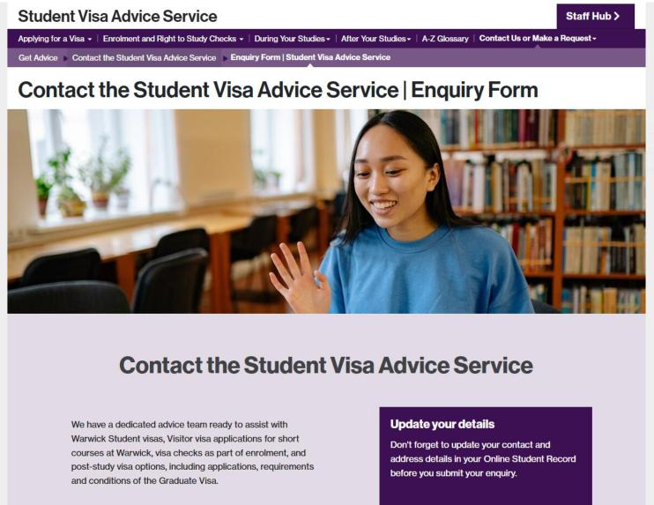
Who are we?
Student Visa Advice Service
International Student Advisers:
Regulated by the Immigration Advice Authority (IAA)
Can give specialist advice about Student Visas
Can provide basic information and help you find information about work visas
(but cannot give 1:1 advice about work visas or check forms)
https://warwick.ac.uk/study/international/visa/
We recommend you seek individual advice from regulated immigration advisers or the employer’s HR team
All information accurate as of July 2026 and provided in good faith.

Slide 3

Today’s Topics
1
Working on your Student Visa What you can do with your current visa
2
Graduate Visa
Unsponsored visa with straightforward requirements
3
Skilled Worker Visa Sponsored work visa
4
For entrepreneurs / special talents
Innovator Founder, Global Talent, Scale Up, High Potential Individual
5
Temporary Work Visas
Youth Mobility, Government Authorised Exchange, Temporary Worker
6
Other Visas
Dependent Visas, Family Visas
All information accurate as of July 2026 and provided in good faith.

Slide 4




Working on your Student Visa Your Student Visa is mainly for.... study But you can also work – just be careful to stay within the restrictions | warwick.ac.uk/visa/during-your-studies/workwarwick.ac.uk/visa/after-your-studies/work
Maximum Working Hours
You can work up to 20 hours per week (Monday-Sunday) in any job for an employer
Before the course start date, and after your course end date on your CAS, you can work more than 20 hours, as long as it’s not a permanent job (no end date)
Undergraduate students only can also work full-time during published university vacations
Can I start working full-time before my course end date?
This is sometimes possible, up to a maximum of 4 weeks for postgraduate students, or 3 weeks for undergraduate students. You need to request a letter.
If you are a PhD student, it is possible to work full-time at certain points during your examination process
Types of Work Not Allowed
You must not be self-employed or engage in Business Activity
You must not work as a professional sportsperson or entertainer
You cannot work in a full-time, permanent job unless you have already made a valid application for a Skilled Worker or Graduate Route visa (no earlier than 3 months before the end of your course, also depends when you applied for current visa)
Volunteering is permitted (different from Voluntary Work)
All information accurate as of July 2026 and provided in good faith.

Slide 5

GRADUATE VISA

Slide 6

Graduate Visa
You don’t need visa sponsorship or a job offer. You can live and work in the UK at any skill level.
The Application Fee is 937 GBP. The Immigration Health Surcharge is 1035 GBP per year of visa (same for dependents).
If you’re a taught Masters student, you can normally apply at the beginning of December in the year you complete your course Different timelines apply for other types of course.
The length of visa will be:
2 years for Bachelors and Masters students who apply on or before 31 December 2026 (most current students)
18 months for Bachelors and Masters students who apply on or after 1 January 2027 (recently announced by the government)
3 years for PhD students
Who can Apply?
Any student who:
successfully completes an eligible qualification (Degree or PGCE)
is still in the UK with their valid Student Visa when it is awarded
had a student visa for at least 12 months during their course
has not previously held a Graduate Visa
or a visa under the former “Doctorate Extension Scheme” (DES – before 2021)
Your dependent (partner or child) can only apply if they are already in the UK as your Student Visa Dependents
It might not be suitable for you if:
• | you want to do further study with a provider that could sponsor a Student Visa | All information accurate as of
• | you don’t want to live in the UK right now (you can only be granted 1 Graduate Visa) | October 2025 and provided in good faith. | 6

Slide 7

Graduate Visa
When to apply?
You must wait for an email notification from the University
saying that your award has been reported to UKVI
otherwise, your visa application will be refused
For undergraduate students: this is normally around mid-July
For postgraduate (Masters) students: this is normally around early December
Timeline:
Step 1
Step 2
Step 3
Step 4
Complete your Course
Wait for your Award to be Conferred
Wait for Graduate Visa UKVI Notification Email
Submit your Visa Application
Complete all of your exams and assignments
You will need to wait some time for your exam board to assess your work.
Make sure you meet all the application requirements.
You must wait to receive an email notification from the Immigration Team. This will happen after your award is conferred
Apply before your current student visa expires.
Your degree must then be officially awarded by the University Senate
All information accurate as of July 2026 and provided in good faith.
7

Slide 8




Graduate Visa
 |  | If you had Official Financial Sponsorship for your course from a Government or International Scholarship Agency, you’ll need a consent letter from them to submit with your application.
Top Tips
Do you have an Official Financial Sponsor?
Thinking about further study?
The Graduate Visa is unlikely to be right for you – it does not allow study in most circumstances. Look at your Student Visa options instead.
Consider what you want to do with your time
Look into Graduate Schemes ahead of time. The Careers Team offer useful information here: What are graduate schemes? | Warwick Careers Blog
Been travelling outside of the UK?
Absences from the UK during your course and after your course end date should not affect your application, but it is not possible for us to tell you how long you can be away because this is not specified by the immigration rules.
All information accurate as of
July 2026 and provided in good faith.
8

Slide 9
SKILLED WORKER VISA

Slide 10

Skilled Worker Visa
Who is it for?
This is a sponsored work visa to allow you to work in a qualifying job. It is tied to the employer and job.
It is possible to have dependent partners and children join you in the UK.
The Skilled Worker Visa is a route to settlement (permanent residence in the UK) after 5 years.
What are the requirements?
The job:
must be shown on the list of eligible occupations as “higher skilled”, and be at skill level RQF6 or above (unless it is on the immigration salary list or temporary shortage list)
must be for an employer that has been approved by the Home Office and has issued you with a Certificate of Sponsorship (CoS) for your application
Salary
You’ll usually need to be paid at least 41700 GBP unless the going rate for your job is higher than this
When can you be paid less (Tradeable points)?
PhD in a subject relevant to the job
£37,500 per year or 90% of the going rate whichever higher.
PhD in a STEM subject relevant to the job,
£33,400 per year or 80% of the going rate whichever higher.
Job is on theImmigration Salary List
£33,400 per year or 100% of the going rate whichever higher.
New entrant (Under 26/studying/recent graduate/or in professional training)*
£33,400 per year or 70% of the going rate whichever higher.
*New entrant rate can be paid for maximum of 4 years - includes proposed leave to be granted and any leave already granted under Graduate Route.
All information is accurate as of
July 2026 and provided in good faith.

Slide 11

Skilled Worker Visa
Making an Application
The application fee can range from 819 GBP to 1,865 GBP depending on how long the visa will be and where you are applying The Immigration Health Surcharge is payable at 1035 GBP per year of visa. If you are switching whilst you still have more than 6 months left on your student visa, you may be entitled to a partial refund, you can check the guidance.
When and where?
If switching inside of the UK from a Student Visa, the start date of the job shown on your CoS must be after your CAS expected course end date.
You cannot apply more than 3 months before the start date of the job.
Other Requirements
You must meet the minimum English Language Requirements – your degree-level studies will be sufficient
You must show you have held funds of 1270 GBP (285 GBP for a dependent partner, 315 GBP for a first dependent child, 200 GBP for any other dependent child) in your bank account for 28 days, unless you are applying within the UK and have lived in the UK for the last 12 months
If your job requires it, you must provide a criminal record certificate from any country you have been in for more than 12
months in the last 10 years
If your job requires it, you must provide a valid ATAS (Academic Technology Approval Scheme) certificate
You must provide a TB certificate if applying outside of the UK and have been living in a relevant country
All information accurate as of July 2026 and provided in good faith.
11

Slide 12
Skilled Worker Visa
What can you do with a Skilled Worker Visa?
You cannot
Change jobs or employer unless you update your visa
Apply for most benefits (public funds) or the state pension
You can
Work in an eligible job
Study
Bring your partner and children as dependents (not possible if you are social care worker)
• Take on supplementary work in certain,
limited, circumstances: Must remain working for your sponsor in your sponsored role. Supplementary employment is outside of your contracted hours. Supplementary employment is for no more than 20 hours per week.
Do voluntary work
Travel in and out of the UK
Apply for Settlement after 5 years (subject to meeting other requirements)
If your application is
successful, you will get a full
list of what you can and
cannot do
SW TOOLKIT & VIDEO HIGHLIGHTS – helpful toolkit to navigate SW visa, all of the information and links in one place!
All information is accurate as of
July 2026 and provided in good faith

Slide 13
SO HOW DO I CHOOSE?

Slide 14
Graduate Visa vs Skilled Worker Visa
Graduate Visa
Unsponsored
Straightforward requirements
successful award and UK study
Flexibility to change jobs
ideal for exploring various careers
Visa duration
2 years (Bachelors/Masters – 18 months for applications after 1 January 2027), 3 years (PhD)
No study allowed
(with a student visa sponsor)
Not a direct route to settlement
Can only be granted once
(apply before your student visa expires)
Skilled Worker Visa
Sponsored
More application requirements
job type, your situation, and salary
Limited flexibility to change job
will need a new visa
More stability
up to 5 years (depends on the job contract)
You can study
(as long as it doesn’t affect the job)
Leads to settlement after 5 years
All information is accurate as of
July 2026 and provided in good faith

Slide 15



Are you an Entrepreneur, or a Global Leader? Consider one of the below visa types, or the High Potential Individual Visa if you’ve got a degree from one of these Universities
Innovator Founder Visa
Global Talent Visa
Scale Up Visa
Must have been recruited by a Scale-Up Sponsor
Need an innovative, viable, and scalable business
No minimum investment
Endorsed by an endorsing body
Meet the other eligibility requirements
Can bring dependents
Must have an award from the Home Office Prize list or endorsement in academic/ research, arts and culture or digital technology
You must have the skills to help the scale-up business grow
Can bring dependents
Settlement after 3 years subject to other eligibility criteria
Salary requirement 39100 GBP and above the going rate
Sponsored initially, then unsponsored
Dependents can join
All information is accurate as of
July 2026 and provided in good faith

Slide 16




Innovator Founder Visa
Top Tips
Endorsement
Before you apply you need to have your business or business idea assessed by an endorsing body.It must be a new idea, and they must agree it is viable, with potential for growth
Warwick Enterprise
Get help with developing your business idea!
Visit the Warwick Enterprise Website for really useful resources and support.
Warwick Enterprise Start-Up Programme
A 12-month programme of 1:1 coaching, expert mentorship and skill-building to equip you to build an investment-ready, trading business. See more information.
All information is accurate as of
July 2026 and provided in good faith.
16

Slide 17

Long-term Relationships or Family Visas
If you are:
Married
In a civil partnership
In a relationship which has existed for more than 2 years and is like a marriage or civil partnership with someone in the UK
Remember that you may have immigration options linked to your partner.
If your partner has another type of time-limited visa in the UK
You may be able to apply for a visa as their dependent
If your partner is a British citizen or is settled in the UK
You may be able to apply for a visa under the “Family Route” of the immigration rules
All information is accurate as of
July 2026 and provided in good faith

Slide 18

Next Steps
Think about what you want to do and start preparing
Get work experience where you can use your Student Visa
Make sure you are aware of the timing for making an application
Ensure you refer to the relevant Policy Guidance published by UKVI when making any application
Get professional help with your application from your employer or an immigration specialist when you feel you might need it
All information is accurate as of
July 2026 and provided in good faith
20

Slide 19

Resources
UKVI
https://www.gov.uk/government/organisations/uk-visas-and-immigration
Policy Guidance
https://www.gov.uk/browse/visas-immigration/work-visas
UKCISA
https://www.ukcisa.org.uk/Information--Advice/Working/Working-after-studies#RL
Warwick Student Visa Advice Service
https://warwick.ac.uk/study/international/visa
Student Opportunity: Careers (Essential Information for working in the UK, including how to answer visa-related questions on application forms)
https://warwick.ac.uk/services/careers/international/students/essential_information/
All information is accurate as of
July 2026 and provided in good faith

Slide 20



More events today
Alumni Panel with Networking social
All information is accurate as of
July 2026 and provided in good faith

Slide 21

THANK YOU FOR LISTENING

