Slide 1
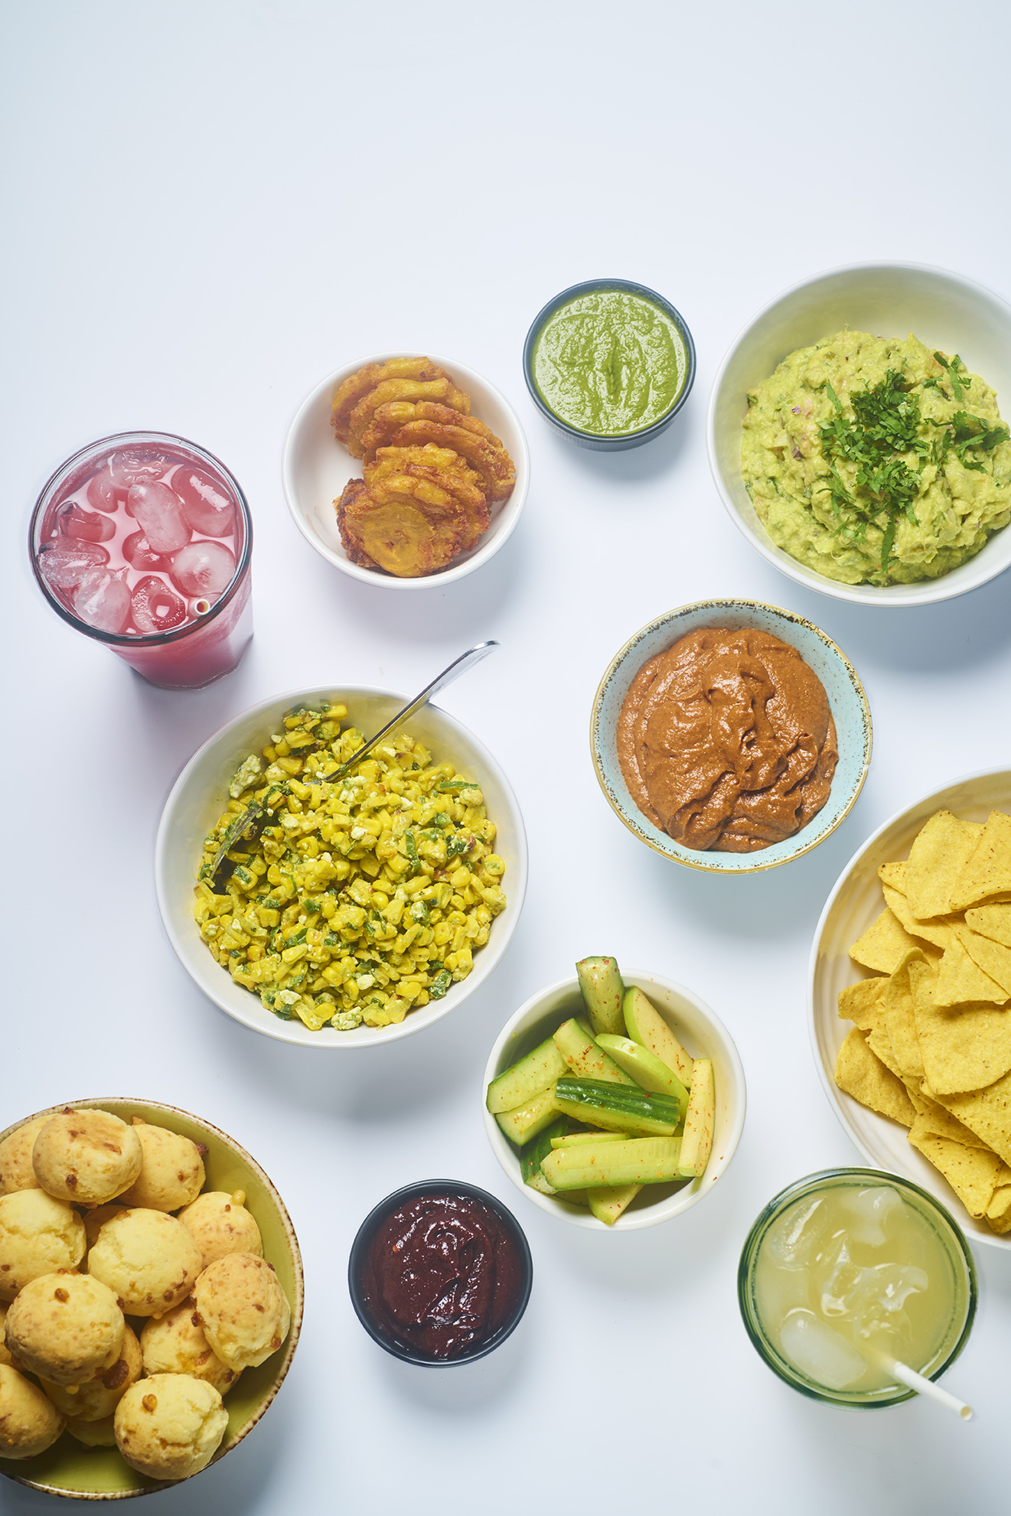
Student Cultural Events: collaborating with Eatwise
Jane Noblet
Head of Food & Beverage Experience, Warwick Food Group

Slide 2
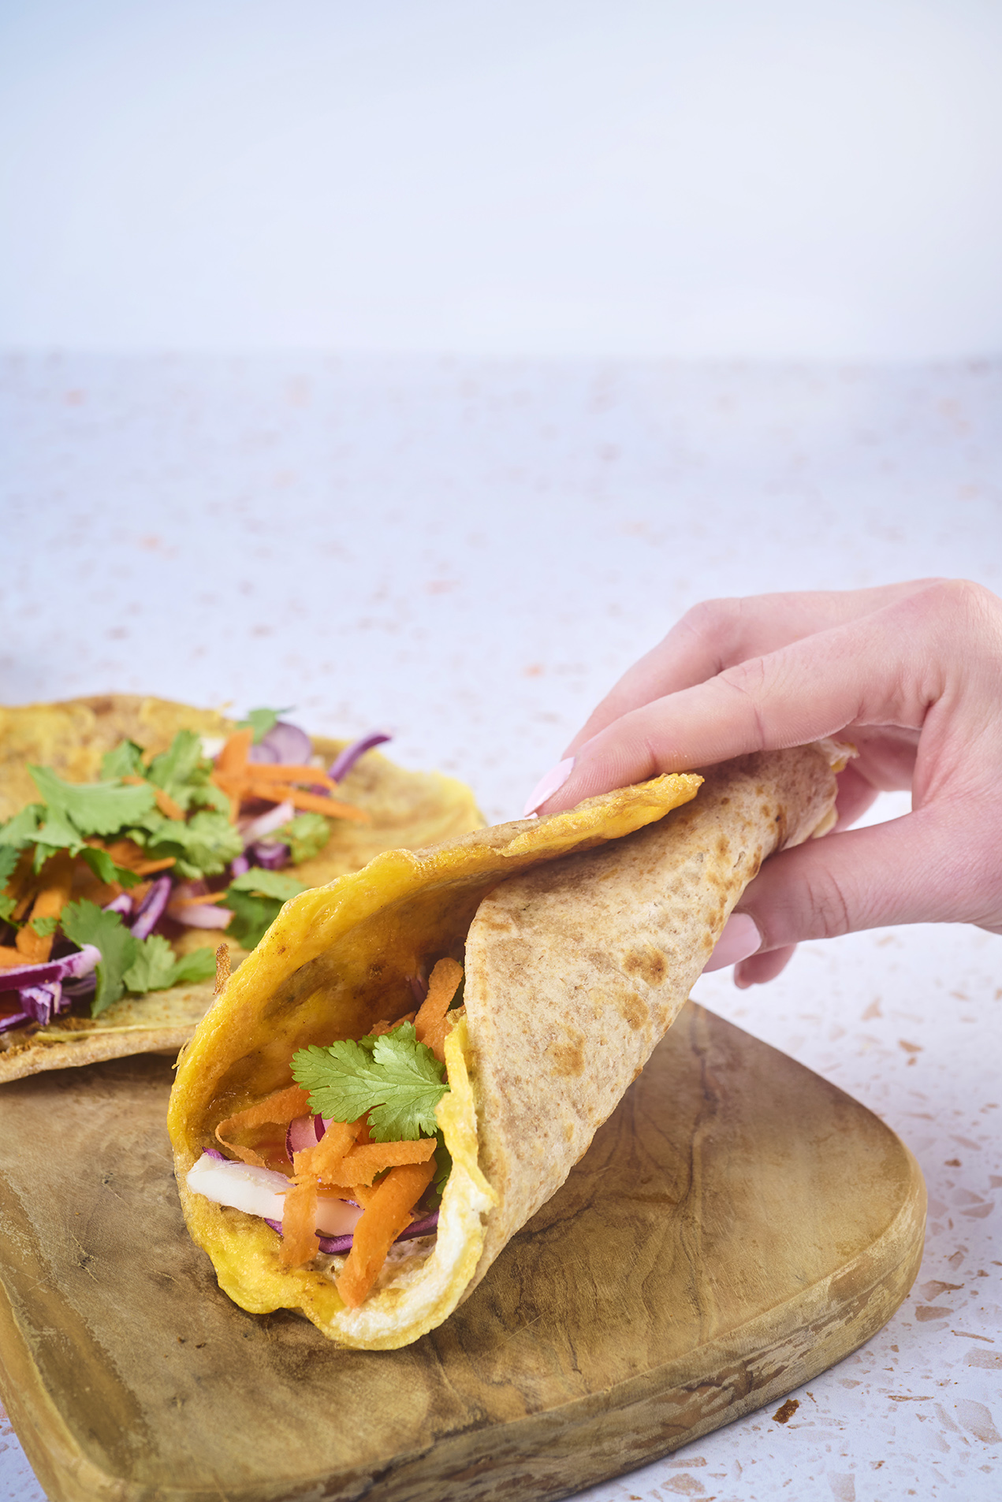
How we might be able to help
Do you have a cultural event in the next 3+ months for students that needs bespoke refreshments that feel authentic to the occasion? Depending on a number of factors, the Eatwise team might be able to help.
Through a collaborative approach of workshops and tasting sessions, the Eatwise team can develop authentic food and drink to serve at your event, with the aim also being that these dishes can be served on Eatwise menus on campus too.
This means we can support important cultural moments on campus whilst also gaining authentic dishes to feature on our menus.
See the next slide for an example.
Please note: if you’re looking for non-bespoke catering for something that isn’t a student cultural event, please visit Warwick Food & Drink to explore what they have to offer.

Slide 3
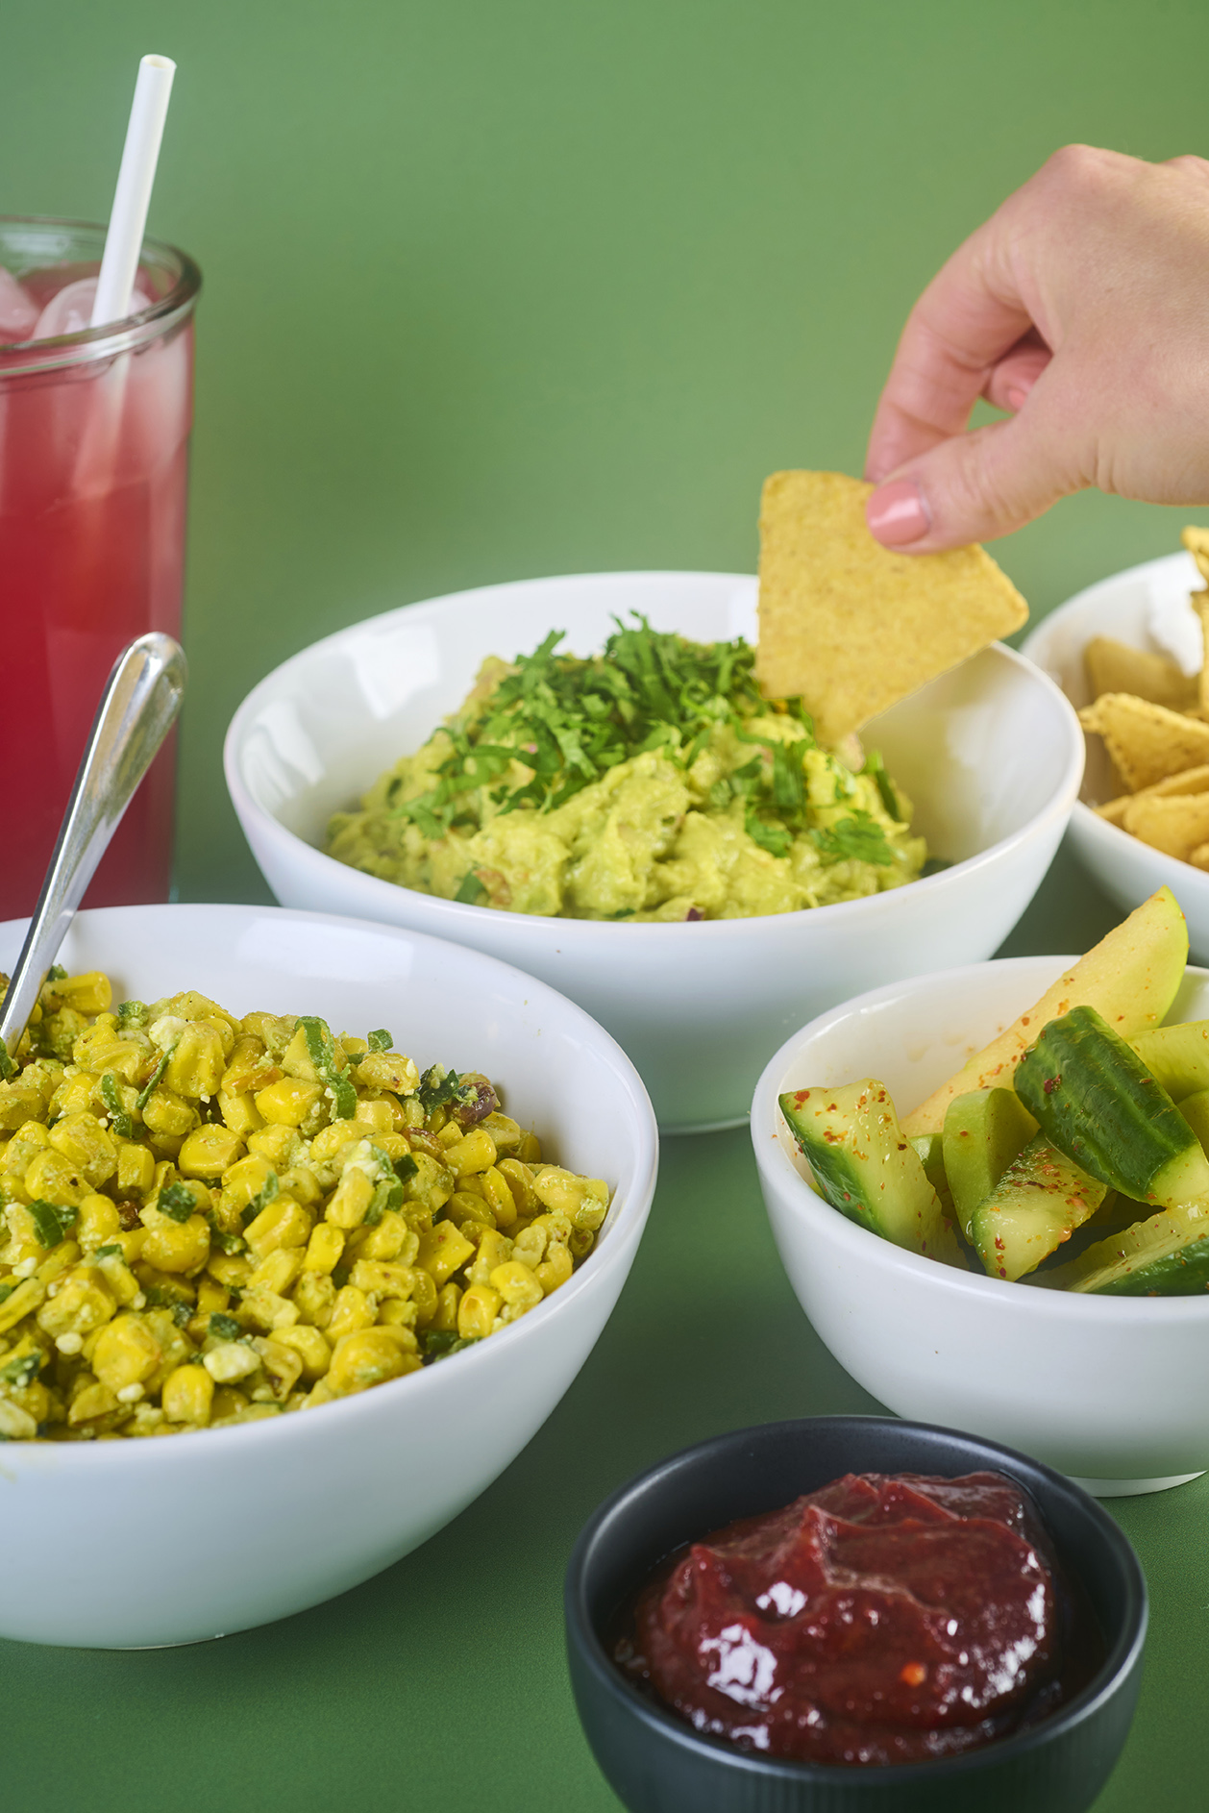
Case study: Latin American Society
The Latin American Society bid for funds from Together at Warwick for their events Carnaval and Cinco de Mayo. The Eatwise team worked with the society to workshop the foods that they traditionally enjoy at these events, after which our development chef went away and developed some products based on this session. We then reconvened for a tasting, with excellent feedback (and a few tweaks to make!).
We are proud to have supplied both events with authentic, delicious food and drink that we can also serve on menus in our cafes. We’re also working with them on a traditional bread for them to serve as their Day of the Dead event later this year.
See the next slides for their feedback on the collaboration.

Slide 4
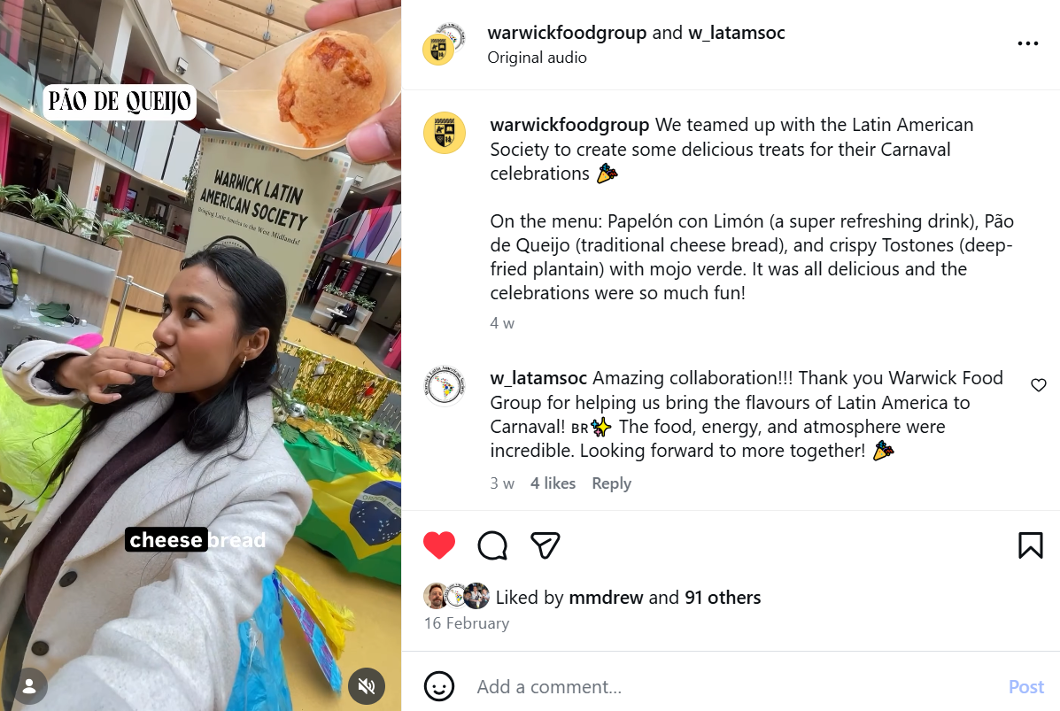
“I wanted to sincerely thank all of you for your work and support with the Brazilian Carnaval food. It was a huge success, and none of it would have been possible without your efforts. The feedback was overwhelmingly positive, everything was eaten, and many students commented on how much they enjoyed it. Several Brazilian students also shared how meaningful it was to experience a taste of Carnaval and feel at home despite being far away. Thank you on behalf of the entire Society.”
Latin American Society
Rodrigo Besoy Trigueros, President, Latin American Society
Click to watch

Slide 5
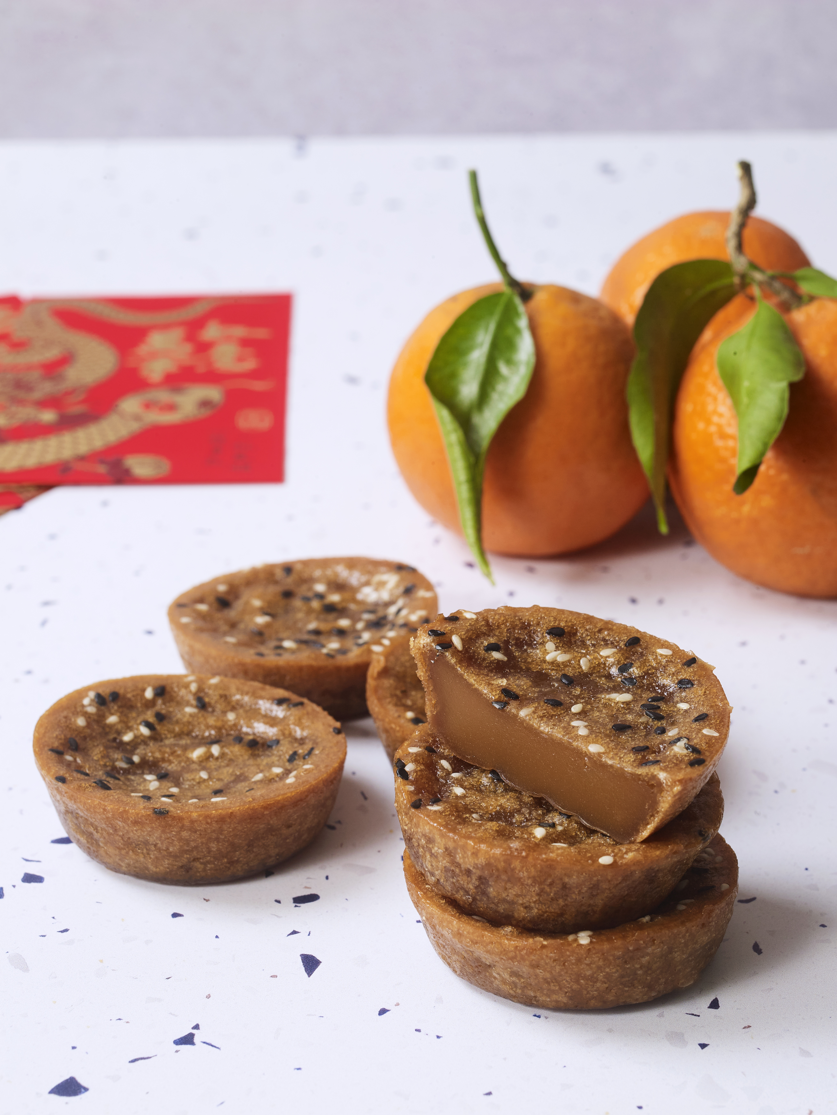
Case study: Good Food Society
We approached the Good Food Society to support us with developing a product for Lunar New Year, bringing together students from the society that celebrate the event, and looking for some common themes in what’s enjoyed to eat as part of the celebrations. This led to the development of our Nian Gao, sticky rice cakes with ginger and sesame.
These now feature on our menus in the week of Lunar New Year and were also served by Together at Warwick at their Lunar New Year 2026 celebrations.

Slide 6
How does it work?
Food needs to be considered early in the event planning stages. In order for this to work, the Eatwise team need a minimum of 3 months to work through the development process end to end.
What happens
1.) Event organiser(s) contact us at warwickfoodgroup@warwick.ac.uk with a summary of what they are looking for, this needs to include:
Overview and background of the event
Details of the event, including date, time, location, expected student numbers
Available budget (if known)
Suggestions on how we can access the relevant event audience to collaborate with on the menu development (e.g. a student society) and contact details for them
2.) The Eatwise team will review all factors of the request to assess for feasibility and capacity within the team, the timeframes we would be working to, logistics of the event and the budget available (remember, we need at least 3 months to complete the process end to end).
We will respond to the request to confirm whether we are in a position to collaborate at this time. If we are, we will work on organising the first collaboration session, where we start to develop ideas with the relevant audience members, this is usually held in one of our Eatwise outlets on campus. This first meeting will be followed by a tasting session during which our audience has a chance to give their feedback.

Slide 7
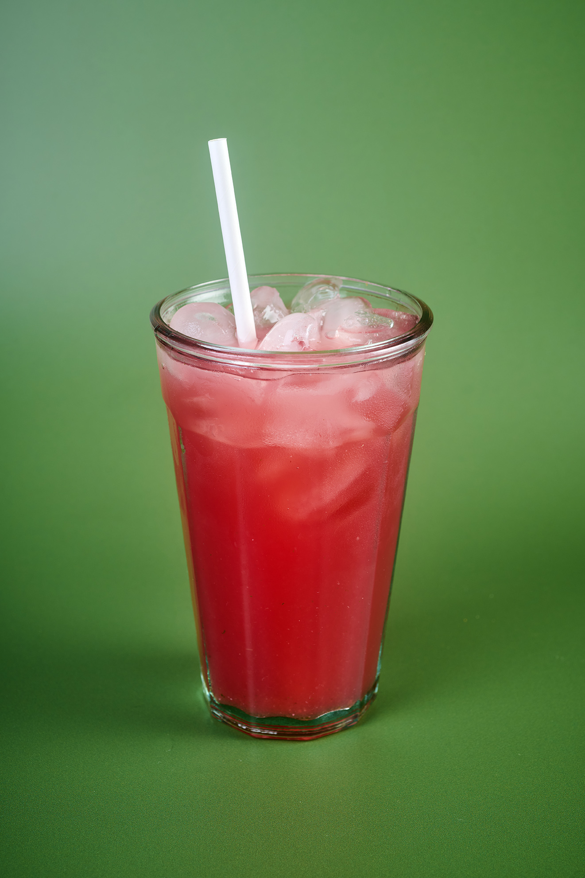
If you have any questions, please don’t hesitate to get in touch: warwickfoodgroup@warwick.ac.uk

