Slide 1

Warwick International Foundation Programme
Pre-Departure Briefing
August 2025 / Alison Durham

Slide 2
Today’s Session
01
Introduction to Warwick
02
Your Next Steps
03
Your Course
04
Questions

Slide 3

Introduction to warwick
01

Slide 4
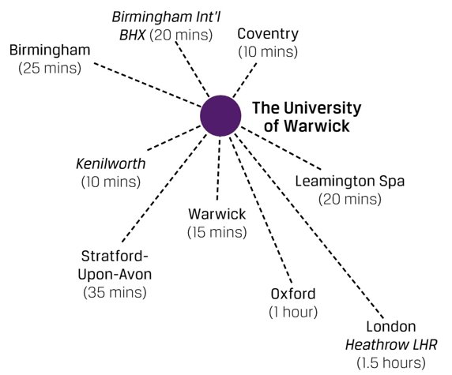
About Warwick
Hopefully, you should already know…
Located in central England – 1hr to the North of London, 25minutes to Birmingham
28,143 students
10,000+ international students (from approx. 150 nationalities)
More than 7,500 staff

Slide 5
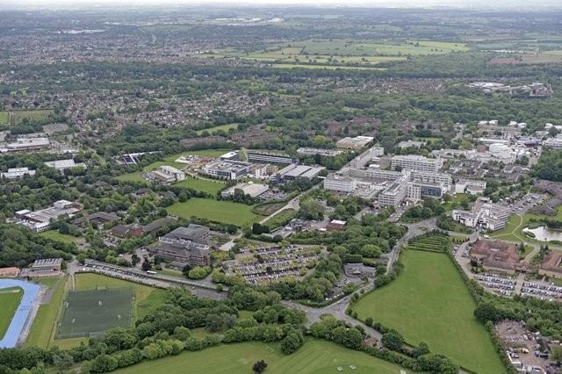
About Warwick
We’re a campus university
Everything you need located close by
Sports Facilities, Library, Grocery stores, Heath Centre, Pharmacy, Post Office, Bank, Restaurants, all available on campus
Accommodation available all around campus​
(but you can choose to live off-campus too)
An aerial shot of campus – there have been lots of new buildings added since this was taken!

Slide 6
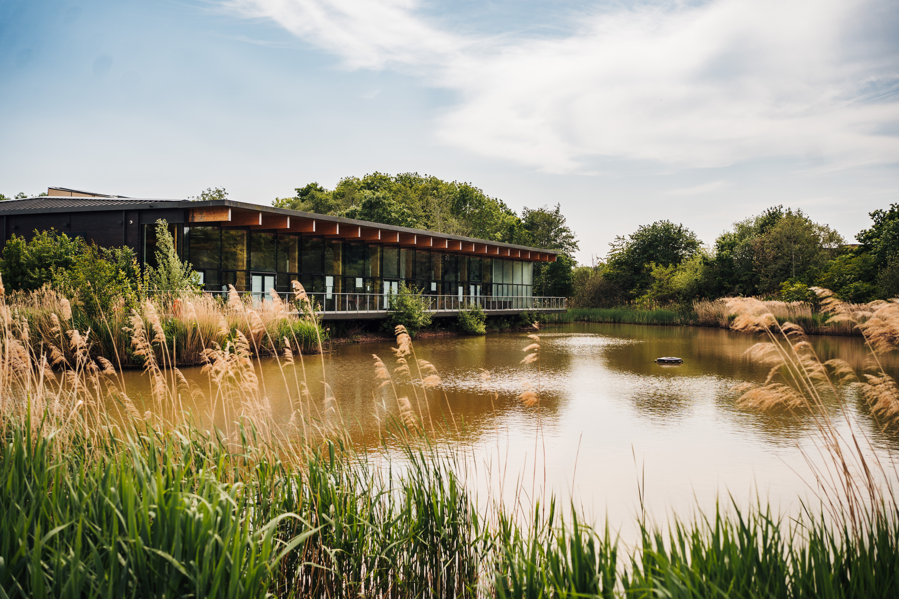


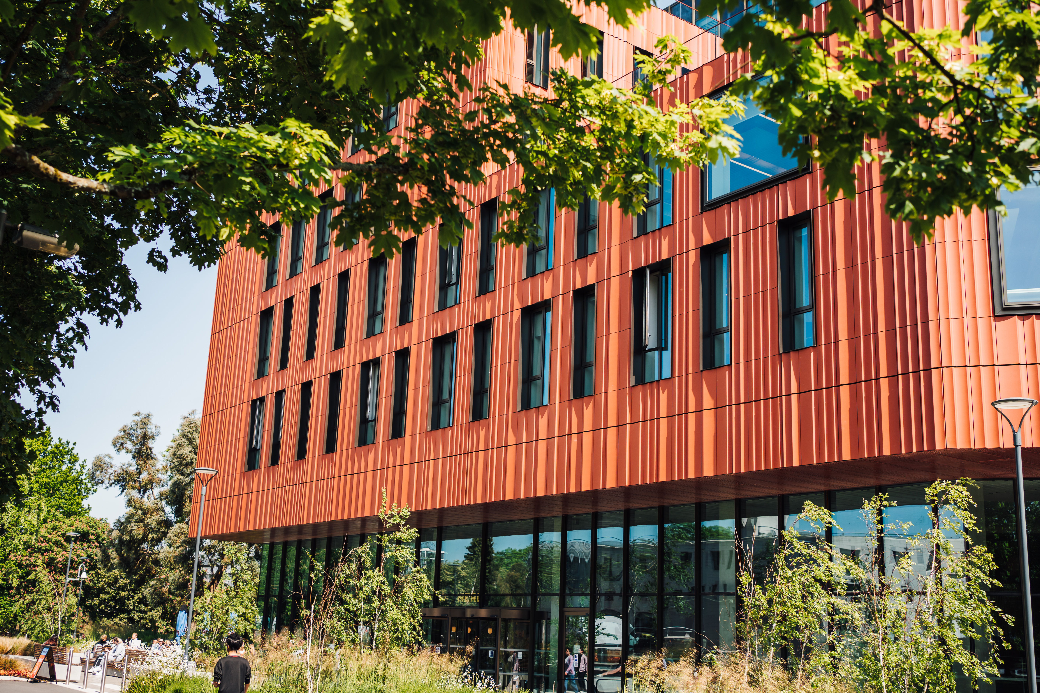

Slide 7
Outside of study
What’s happening on campus?
The Student Union is run by students, for students​. It is located in the heart campus, and is the central hub for students to meet and socialise. The SU uses the revenue from food and drink outlets to fund other activities including:​
  Academic representation​
  Student Advice Centre​
  Job opportunities and volunteering​
  Nearly 300 clubs and societies!​
  Sports and Wellness – an excellent facility on campus with climbing walls, swimming pool and fitness centre. There are also more than 65 different sports clubs to join.
  International Community – advice from our Immigration team, access to intercultural training as well as global celebrations throughout the year.
  Warwick Arts Centre – includes a theatre, cinema, music centre and art galley, and is located in the centre of campus.

Slide 8

Wellbeing and Support
We’re here every step of the way
Residential Community
Chaplaincy
Personal Tutor
Senior Tutor
Counselling
Disability Services
Warwick SU
Student Opportunity

Slide 9

Your next steps
02

Slide 10
Your Offer
Your offer will either be conditional or unconditional
If it’s conditional, then you need to meet these conditions before you can confirm your place at the University
If it’s unconditional, then usually you will be ready to apply for your visa and enroll online
IFP students need to pay an academic deposit, as well as receive an unconditional offer, before the visa process can begin

Slide 11
Confirmation of Acceptance for Studies (CAS)
How does this work?
A virtual document including a unique reference number that you’ll need for your visa application
Before a CAS is issued, you’ll be asked to confirm that all the details that the University holds are correct – you’ll receive an email asking you to do this once you have an unconditional offer
When your CAS is issued, it will be in an email – check this email carefully and let us know if there are any errors
A CAS is a ‘live’ document which can be updated when you pay fees – you should always wait for email confirmation from Student Finance
The University’s Immigration website has lots of materials to help you as you apply for your visa and prepare your supporting documents

Slide 12
Immigration Health Surcharge (IHS)
How does this work?
Most people applying for a UK visa for more than 6 months must pay an additional fee to access free healthcare during their stay
An IHS Reference number will be required on your visa application and your visa will not be considered until the IHS has been paid
The current fees for students (and their dependants) is £776 per person per twelve months of leave granted (or £338 per 6 months of leave)
You can find out exactly what you need to pay on the UK Government website –
www.immigration-health-surcharge.service.gov.uk/checker/type

Slide 13
Applying for your visa
How does this work?
The visa application form can be found online via Student visa : Apply - GOV.UK (www.gov.uk)
You should have all your supporting documents ready when you apply online – the ‘Date of Application’ is the date you apply and make payment online
You will need to register your email address so that you can log back into your application form at a later stage
Full step-by-step guidance is available on the University’s Immigration webpages
https://warwick.ac.uk/study/international/immigration/tier4/applying/entryclearance
You can also download guidance here.

Slide 14
Supporting Documents
The documents you submit to support your visa application must be original
If self-funded, funds must have been held for 28 consecutive days before the ‘Date of Application’
Always check currency conversion on the ‘Date of Application’ and ‘Date of closing balance’ if funds to evidence course fees and/or maintenance are not held in Pound Sterling (£)
If using a parent’s bank account, also include an original birth certificate and letter of consent
Scholarship letters should meet specific formatting requirements
Include official translations for any document not in English
Remember to check your CAS for…
  Evidence of qualifications used for admission
  Confirmation of how English Language has been assessed
  Any fees already paid to the University are properly recorded

Slide 15

Financial Documents
REMEMBER: Funds must have been held for a consecutive 28-day period ending no more than 31 days before the date of your application.

Slide 16
eVisa and Right to Study
Visa approval and arrival to the UK
If your application for a student visa is approved, you may receive:​
  A 90-day travel vignette in your passport​ (these are being phased out from 15 July 2025)
  A decision letter confirming the full grant of leave​
  An eVisa
If you were issued a vignette, on arrival at the airport in the UK you must ensure that your Visa Vignette or Temporary Travel Vignette is stamped with your entry date at the Immigration Desk
An eVisa is proof of the holder’s right to stay, work or study in the UK​ (replaced the previous BRP cards – no longer a physical card)
If you have an eVisa, you will need to generate a Share Code as part of your enrolment – all students with visa requirements will need to attend a Right to Study check, and you can book appointments online
16

Slide 17
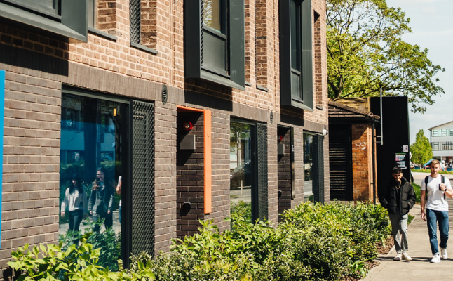
Accommodation
Options
You can choose to live on or off campus for the duration of your studies - on-campus you have the same options as undergraduate students
The deadline has now passed – but you can still apply and the team will support you in finding accommodation
You will receive your accommodation offer and contract in late August/early September – look out for this on your email
Your contract will confirm your move-in date

Slide 18
Insurance
Cover and Options
Travel | Medical | Accommodation | Accommodation: What’s not covered
Purchase travel insurance before you travel to the UK. Most policies cover delays, emergency medical treatment and lost or stolen luggage | Are you studying for more than six months? Yes: IHS payment prior to obtaining your visa | All University managed accommodation is covered by Endsleigh Insurance. It is well covered, but be sure to check it covers your needs adequately | Bikes Laptops, mobiles, musical instruments taken or damaged outside of the room Additional cover can be purchased.

Slide 19
Enrolment
Online Enrolment Process
You will be invited to enrol 6 weeks prior to your course start date (around 12 August)
The enrolment process involves:
  Registering for an IT account
  Uploading a photograph for your student ID card
  Course registration
Once completed, you can access the enrolment dashboard to complete all tasks (pay tuition fees, health centre registration)
Payment can be made in full or instalments (50% required at start of course)
There is lots of information on the Welcome webpages – www.warwick.ac.uk/welcome

Slide 20

Travelling to the UK
Airports and Travel
The closest airport to the University is Birmingham International (BHX) – lots of airlines fly to Birmingham (you may have to take a non-direct flight via Europe)​
There are rail and coach links from all major airports to Coventry (taxis from Birmingham airport to the University are also reasonably priced).
You can find guidance about getting to campus on the University website – www.warwick.ac.uk/about/campus-journey/mode-of-travel/

Slide 21
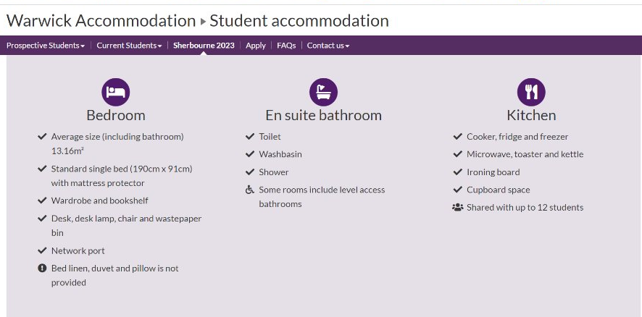
What to bring?
Items to bring, items to buy
Bring
Personal belongings​
Any medication you require​
Adaptors for UK plugs​
Some warm clothes
Can buy on arrival
​​Electrical goods​
Bedding​
Kitchen equipment​
The Accommodation website advises what comes in your flat on arrival​
​
​

Slide 22
What to bring?
Keep in hand luggage
Your passport​
Your UKVI decision letter​
Your CAS email printed out​
Evidence of finances​
Evidence of accommodation (if available)​
Evidence of TB certificate (if required)​
Written confirmation from University of latest start date (if travelling to UK after course start date on CAS)​
Expect to be asked the purpose of your visit and possibly a question about your course
​
​

Slide 23

Your course
03

Slide 24
Academic Programme
Starts 6 October 2025
Split into 3 terms:
Please note that Warwick IFP term dates are different to the University's main term dates.
Term 1 - Autumn Term - Monday 29 September 2025 - Saturday 13 December 2025
Term 2 - Spring Term - Monday 12 January 2026 – Thursday 2 April 2026
Term 3 - Summer Term - Monday 27 April 2026 - Saturday 4 July 2026
Up-to four hours per week of taught time, per academic module
25 Teaching weeks

Slide 25
Course Structure
Academic Content
Inquiry and Research Skills
Academic English Skills

Slide 26
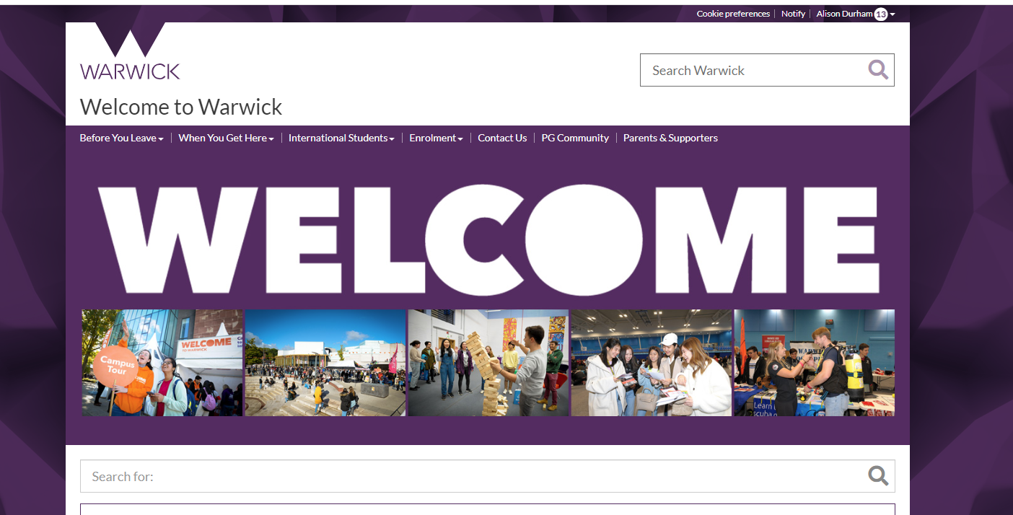
Welcome Week
Before you arrive and when you get here
You will start to arrive messages about Welcome Week shortly
The Welcome pages have lots of resources and checklists for before you arrive and once you get to campus – there's specific guidance for international students

Slide 27
Welcome Week
Welcome Week is designed to give you time to settle in before your IFP main course studies start
You’ll receive a schedule of activities, including the chance to join clubs and societies, as well an induction into the academic department
  Some of these are pre-arranged and compulsory
  The remaining sessions are free for you to arrange

Slide 28

Thank you for joining

