Slide 1

INCLSUIVE RECRUITMENT OF STUDENTS

Slide 2
INCLSUIVE RECRUITMENT OF STUDENTS
Sutton Trust Poll: 49% of undergraduate students missed University activity due to paid work
HEPI and Advance HE:
55% students in paid work
Average 13.5hrs p/w
76% responses indicating negative impact on study due to cost of living
https://www.bbc.co.uk/news/newsbeat-64816948
https://www.bbc.co.uk/news/education-65964375
Notes:
Slide 1: An online poll commissioned by the Sutton Trust suggests that under half (49%) of undergraduate students who responded has missed a lecture. Seminar or workshop since September to do paid work
HEPI and co-authored by Advance HE survey suggested:
More students in paid work (55%) than not (45%)
Students in paid employment working an average of 13.5 hours per week
76% of all respondents reporting a negative impact on study due to the cost of living

Slide 3
INCLSUIVE RECRUITMENT OF STUDENTS
What groups make up Widening Participation students?
Eligible/received free school meals whilst at secondary school
Low socio-economic background: household income < £35,001
Come from an area with low progression rates
Disabled students (both seen and unseen):
specific learning differences
mental health difficulties
autistic spectrum disorder
any other disabling condition
Mature student (over the age of 21)
Spent time in local authority care
Estranged (not supported by parents)
Caring responsibilities (physical/practical/emotional)
Neither of your parents attended university/gained a degree
Granted refugee status
https://warwick.ac.uk/study/outreach/currentstudents/wpstudentnetwork/

Slide 4
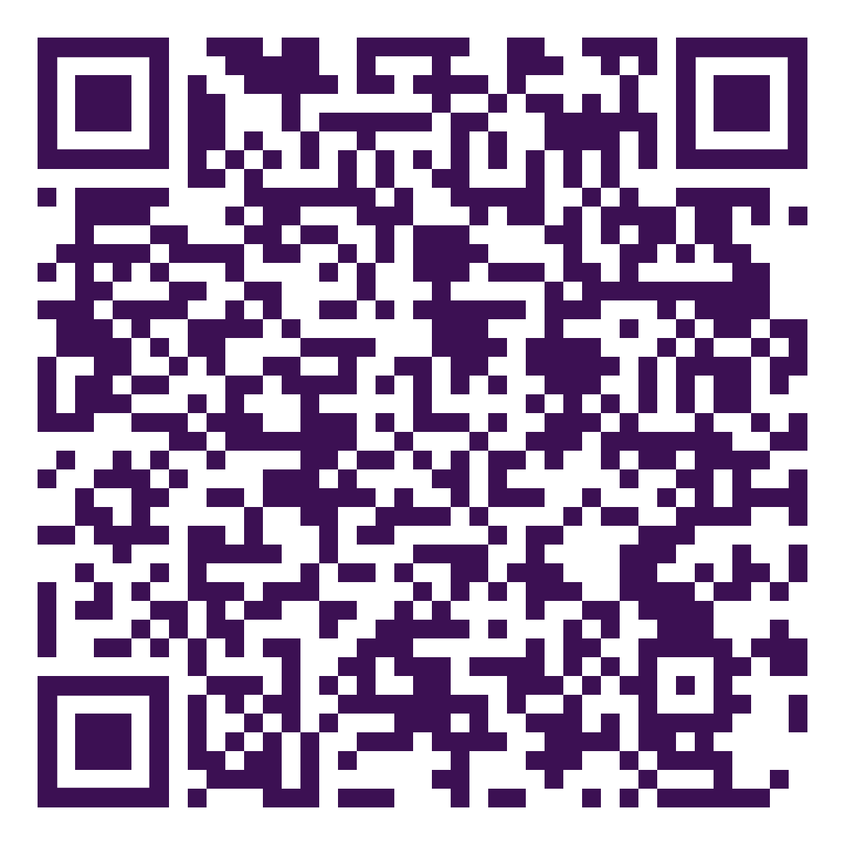
Notes:
Open up google jamboard for people: https://jamboard.google.com/d/1ofciaeYZ_Heu0lmCp98hsxNUdJqC6-KobfwR2T_4gUY/edit?usp=sharing

Slide 5
INCLSUIVE RECRUITMENT Tools
The co-creation toolkit for professional services , is in it’s beginning stages but has some beginning guidance on recruitment (can be a place to start)- this is actively being worked on so please send us any feedback!
Google ‘strengths and value-based interview’ this gives candidates the change to showcase potential rather than experience
Look at the prompt list, on next slide (this is not exhaustive but a good place to start) to prompt yourself/anyone you know on different students' circumstances and how you might overcome those
Ban the box campaign- to help make it easier for those with criminal convictions
Google ‘neurodivergent recruitment techniques’ there are a lot of resources out there that can help, some might be more relevant than others depending on your field, but most accommodations for those with neurodiverse requirements will help others as well!
Shared after the meeting by an attendee is the gender decoder which looks at how an ad might use gendered language/skew towards certain genders.
I will try to type and share the outcomes of today's breakout discussions, and will share when possible

Slide 6
INCLSUIVE RECRUITMENT Prompt List
How will someone who is autistic or neurodivergent be affected by this?
Think sensory (material of chairs, office lighting, surrounding noise levels)
Think stimulation (some ned over some need under)
Think breaks
Eye contact- some people are uncomfortable/struggle with eye contact
Online can give people the option here to keep camera off so feel less required to socially conform
How is someone whose first language isn’t English find this?
Complicated language (are we using Acronyms and colloquialisms)
Are we speaking too fast
Are we using unnecessary jargon
Short, sweet, concise
Infrastructure question and support?
Are we considering people restricted by travel (international students etc)Have we considered people who don’t have access to laptops/phones
What about people with long distances to travel, are we accommodating breaks (esp. for people who may get overstimulated easily and need rests in-between tasks/activities)
Have we accommodated tech issues?
Have we accounted for physical disabilities?
Blind
Deaf
Accessibility (both wheelchair and others)- wheelchair access/step-free access could be a long journey, not appropriate to someone who can walk short distances
Will people of other cultures/religions be affected by this?
Are we accounting for cultural and religious holidays- Make sure we’re not planning anything on major holidays or cultural festivities or other yearly events such as fasting, and if we are how can we help/support
Are we looking for, or discriminating, against certain cultural norms/behaviours and how can we remove this (unconscious bias)
What assumptions are being made in this scenario
Are we assuming everyone coming can afford to attend (in particular for events)
Are we assuming students have flexibility (think about mature students, or students with care responsibilities such as parents or children)

